Slide 1
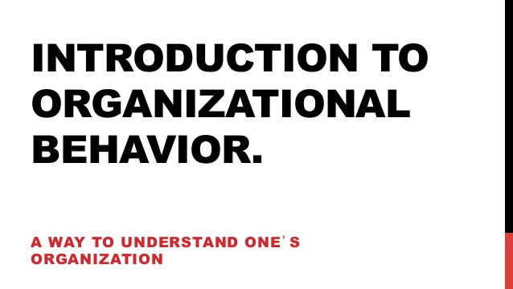

Slide 2
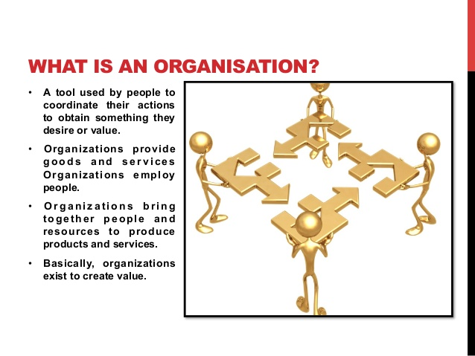

Slide 3
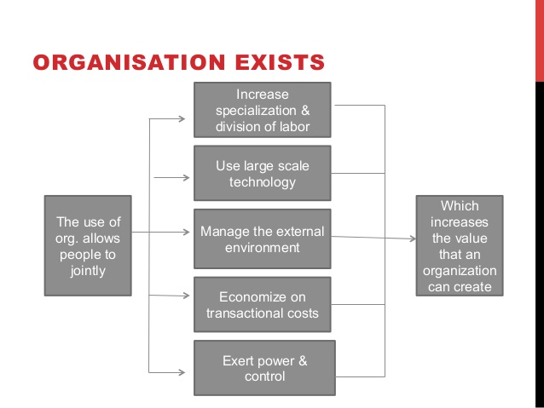

Slide 4
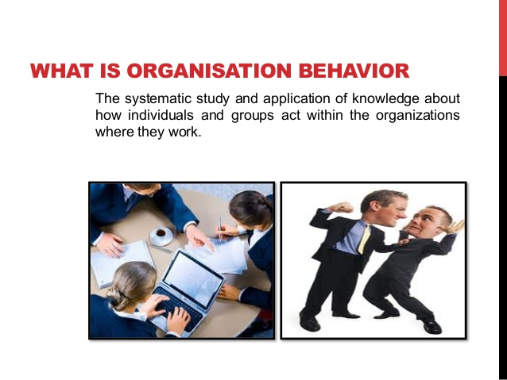

Slide 5
Importance of OB:
OB provides a roadmap tour lives in organisations
OB provides scientific research to help understand and predict organisations life.
OB helps us influence organisational events.
OB helps understand himself and others better
OB is useful for maintaining cordial industrial relations.
OB is useful in field of marketing

Slide 6
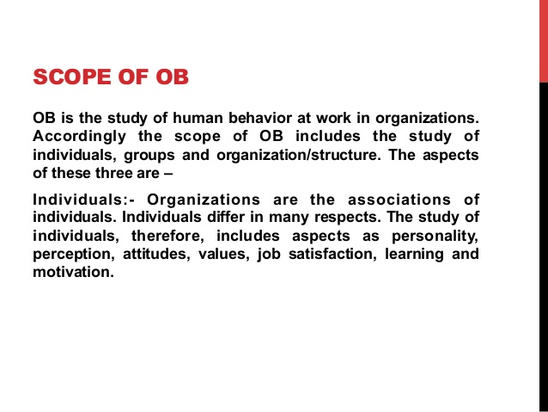

Slide 7
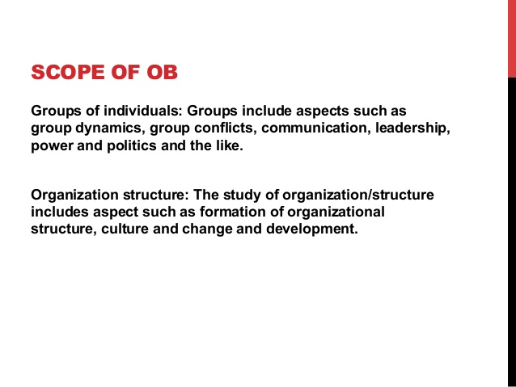

Slide 8
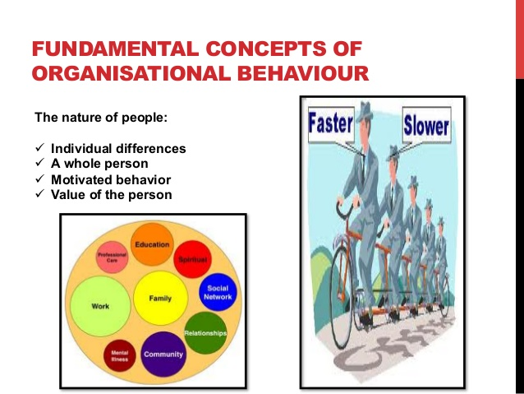

Slide 9
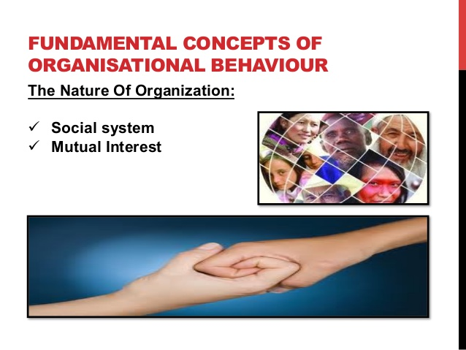

Slide 10
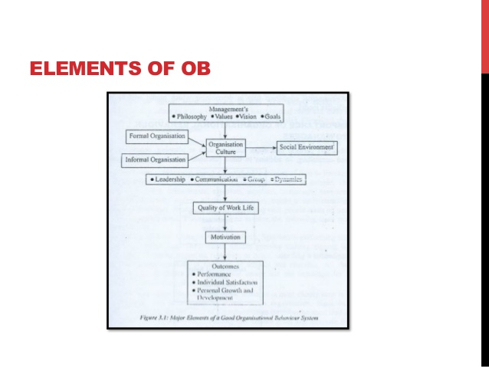

Slide 11
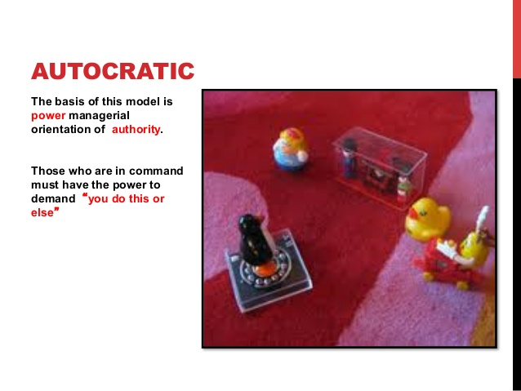

Slide 12
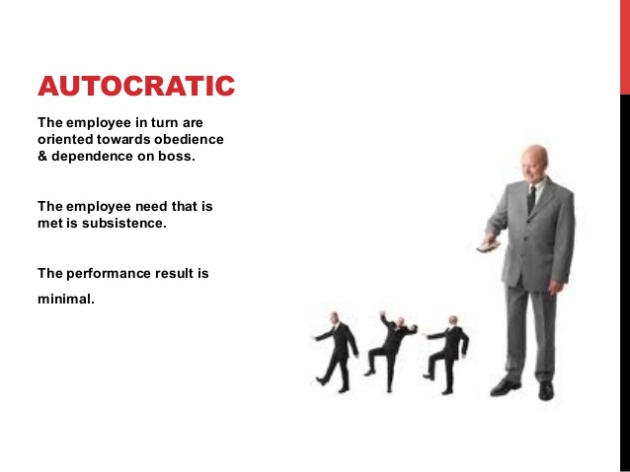

Slide 13
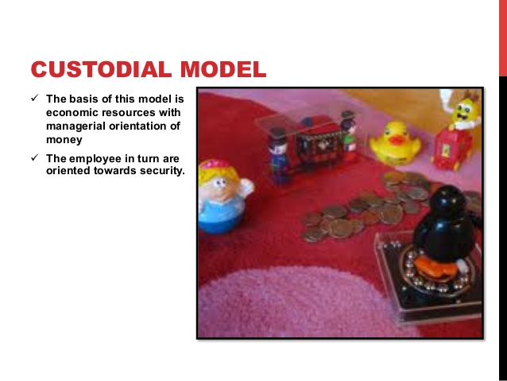

Slide 14
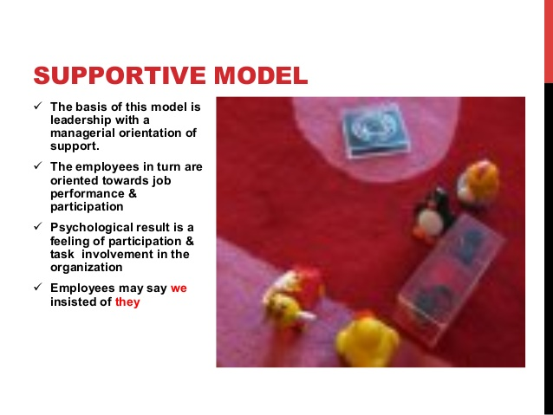

Slide 15


Slide 16
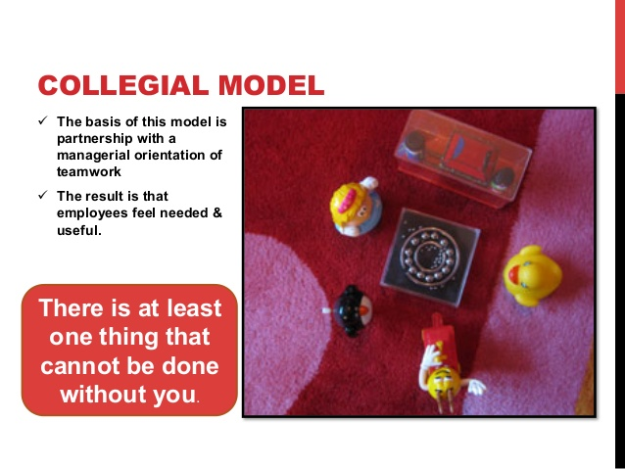

Slide 17
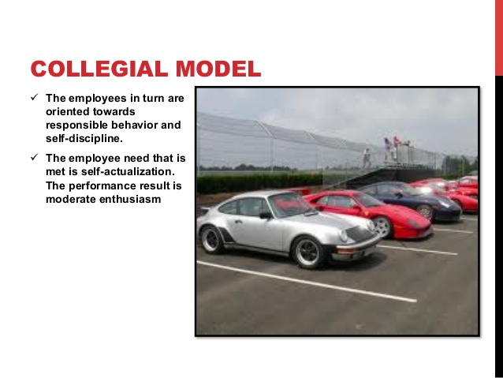

Slide 18
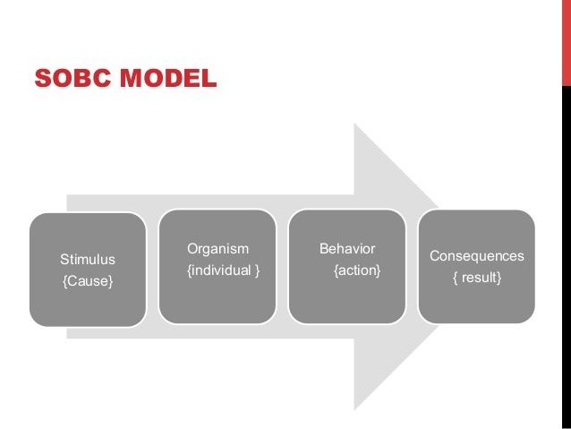
SOBC Model (STIMULUS ORGANISM BEHAVIOUR CONSEQUENCES)

Slide 19
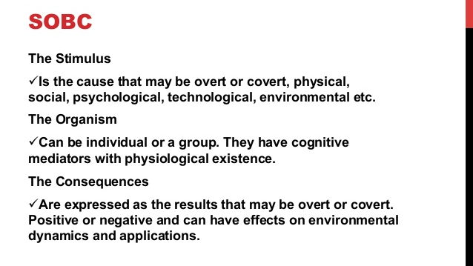

Slide 20
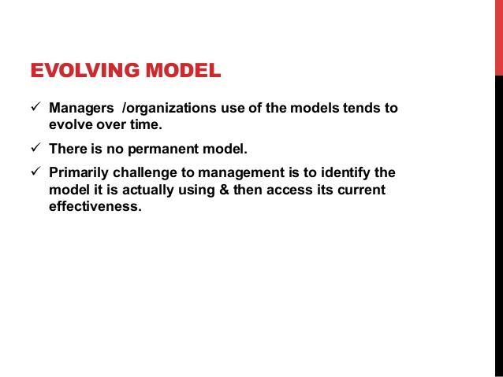

Slide 21

Thanks you!

