Slide 1

Evolution of management thoughts

Slide 2
INTRODUCTION
The driving force behind this is the search better ways for organization resources.
Consist of planning, organizing, staffing etc.
Leadership management .
Evolution of management began in the late 19th century after industrial revolution.
Development of systematic management in 20th century .

Slide 3

EVOLUTION OF MANAGEMENT THOUGHTS
Classical Theory
Neo Classical Theory
Modern Theory

Slide 4
CLASSICAL THEORY
Scientific Management
Administrative Management
Bureaucratic Management

Slide 5
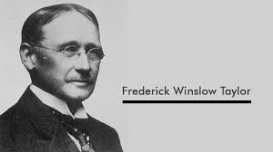
SCIENTIFIC MANAGEMENT
F.W Taylor’s contribution
Scientific management focus on workers and machine relationship.
Organizational productivity can be increased by increasing the efficiency of production processes
F.W Taylor defined Scientific Management as substitution of exact scientific investigation for old individual judgment or opinion, either of workman or the boss, in all matters relating work done in an establishment
Objective of Management should be to maximum prosperity of all the stake holder of the business

Slide 6
ELEMENTS OF SCIENTIFIC METHOD
Separation of Planning from Executing
Scientific task setting
Functional foremanship
Work study
Method study
Motion study
Time Study
Fatigue Study
Rate setting

Slide 7
ELEMENTS OF SCIENTIFIC METHOD
Standardization
Scientific selection and training
Financial Incentive
Mental revolution
Economy

Slide 8
ADMINISTRATIVE MANAGEMENT
Administrative management focuses on the managers and the use or principles and functions for improving organizational functioning.
The administrative management school treated as management as a process get work done though and with people.
Henry Fayol is the pioneer contributor to the administrative management thought.

Slide 9
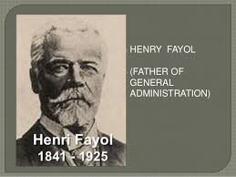
HENRY FAYOL
Fayol’s administrative management focuses on managers and basic management functions.
1.Classification of business activities
2.Basic functions of a manager.
3.Qualities and skills of a manager.
4.Principles of management

Slide 10
THE 14 MANAGEMENT PRINCIPLES FROM HENRI FAYOL (1841-1925) ARE:
Division of Work
Authority
Discipline
Unity of Command
Unity of Direction.
Subordination of individual interest
Remuneration

Slide 11
THE 14 MANAGEMENT PRINCIPLES FROM HENRI FAYOL (1841-1925) ARE:
Centralization.
Scalar chain
Order..
Equity.
Stability of Tenure of Personnel.
Initiative.
Esprit de Corps.

Slide 12
FAYOL'S DEFINITION OF MANAGEMENT ROLES AND ACTIONS DISTINGUISHES BETWEEN FIVE ELEMENTS:
Purveyance. (Forecast & Plan). Examining the future and drawing up a plan of action. The elements of strategy.
To organize. Build up the structure, both material and human, of the undertaking.
To command. Maintain the activity among the personnel.
To coordinate. Binding together, unifying and harmonizing all activity and effort.
To control. Seeing that everything occurs in conformity with established rule and expressed command.

Slide 13
USAGE OF THE 14 MANAGEMENT PRINCIPLES. APPLICATIONS
Change and Organization.
Decision-making.
Skills can be used to improve the basic effectiveness of a manager.
Understand that management can be seen as a variety of activities, which can be listed and grouped.

Slide 14
MAX WEBER’s BUREAUCRATIC MANAGEMENT THEORY
Max Weber’s theory emphasizes the strict adherence to rules and regulations in an organization. These would form an efficient form of organization. This Type of Mgt can be termed as Bureaucracy . This is the oldest form of organization. It is based on the principles of logic, order and ultimate authority.

Slide 15
CHARACTERISTICS OF BUREAUCRACY
Functional specialization
Hierarchy of Authority
Rules and regulations
Rights & duties
Technical competence
Fixation of procedure
Record Keeping
Impersonal relations

Slide 16
ADVANTAGES
Specialization
Employee Behavior
Structures
No conflict
Advance Decisions
Optimum utilization of human resources
Democracy
Perpetual Succession

Slide 17
DISADVANTAGES
Rigidity
red tapism
Displacement of goals
Impersonal nature of work
Failure of Cooperation and Coordination
No Mutual Understanding
Mechanical Treatment
Empire Building

Slide 18
NEO CLASSICAL THEORY
Also known as “behavioral science approach to modifying and improving the classical theory.
Neoclassical theory gives importance to human and social aspects of the water and its relation in the organization. It includes
Hawthorne experiment
Human relation management
Behavioral science approach

Slide 19

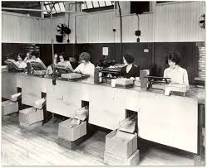
HAWTHORNE EXPERIMENT
Conducted by Alton Mayo at Hawthorne plant and general electronic company.
Objective of the experiment was to find out the behavior and attitude of workers.
4 phases of experiment
Illumination experiment
Relay assembly room experiment
Mass interviewing program
Bank wiring room study

Slide 20
HUMAN RELATION MANAGEMENT
Positive work environment.
Focus in on people
Sound human relation

Slide 21
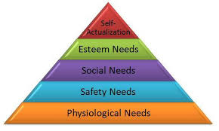
BEHAVIORAL SCIENCE APPROACH
Maslow's Hierarchy Of Needs

Slide 22
MODERN THEORY
Quantitative Management Approach
Systematic Approach
Contingency Management Approach

Slide 23

QUANTITATIVE APPROACH
Quantitative approach also called operation research.
Scientific method
Decision making

Slide 24
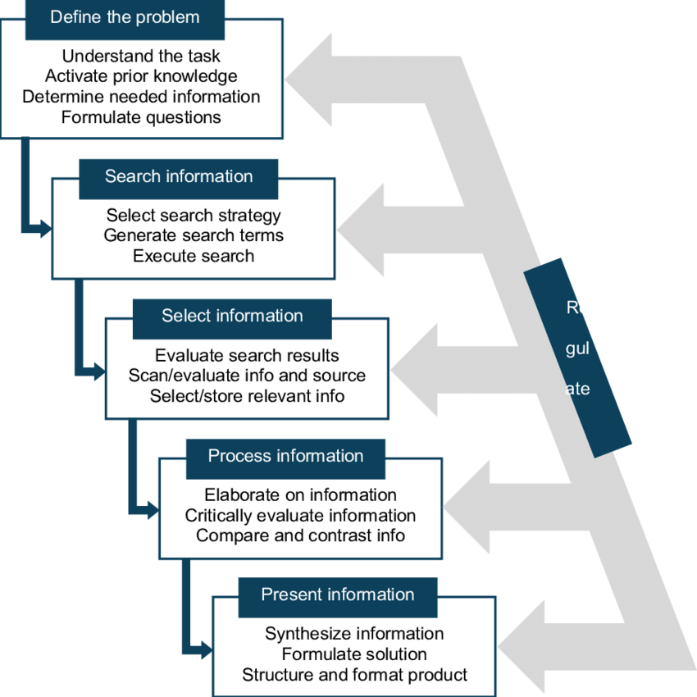
SYSTEMATIC APPROACH
The system approach to management is essentially a way of thinking about organizations and management problems.
From system perspective management should focus on efficiency and effectiveness in each part of the organization affect other parts of organization .

Slide 25
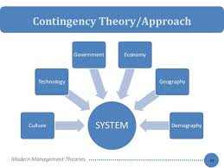
CONTINGENCY MANAGEMENT APPROACH
There can not be a particular management action which will be suitable for all situations
The only action is designed on the basis of external environment , internal basis and needs

Slide 26

RECENT DEVELOPMENT IN MANAGEMENT THOUGHTS
Total Quality Management (TQM)
Search for excellence

Slide 27
Thank you!!!

