Slide 1
Latest trends in marketing

Slide 2
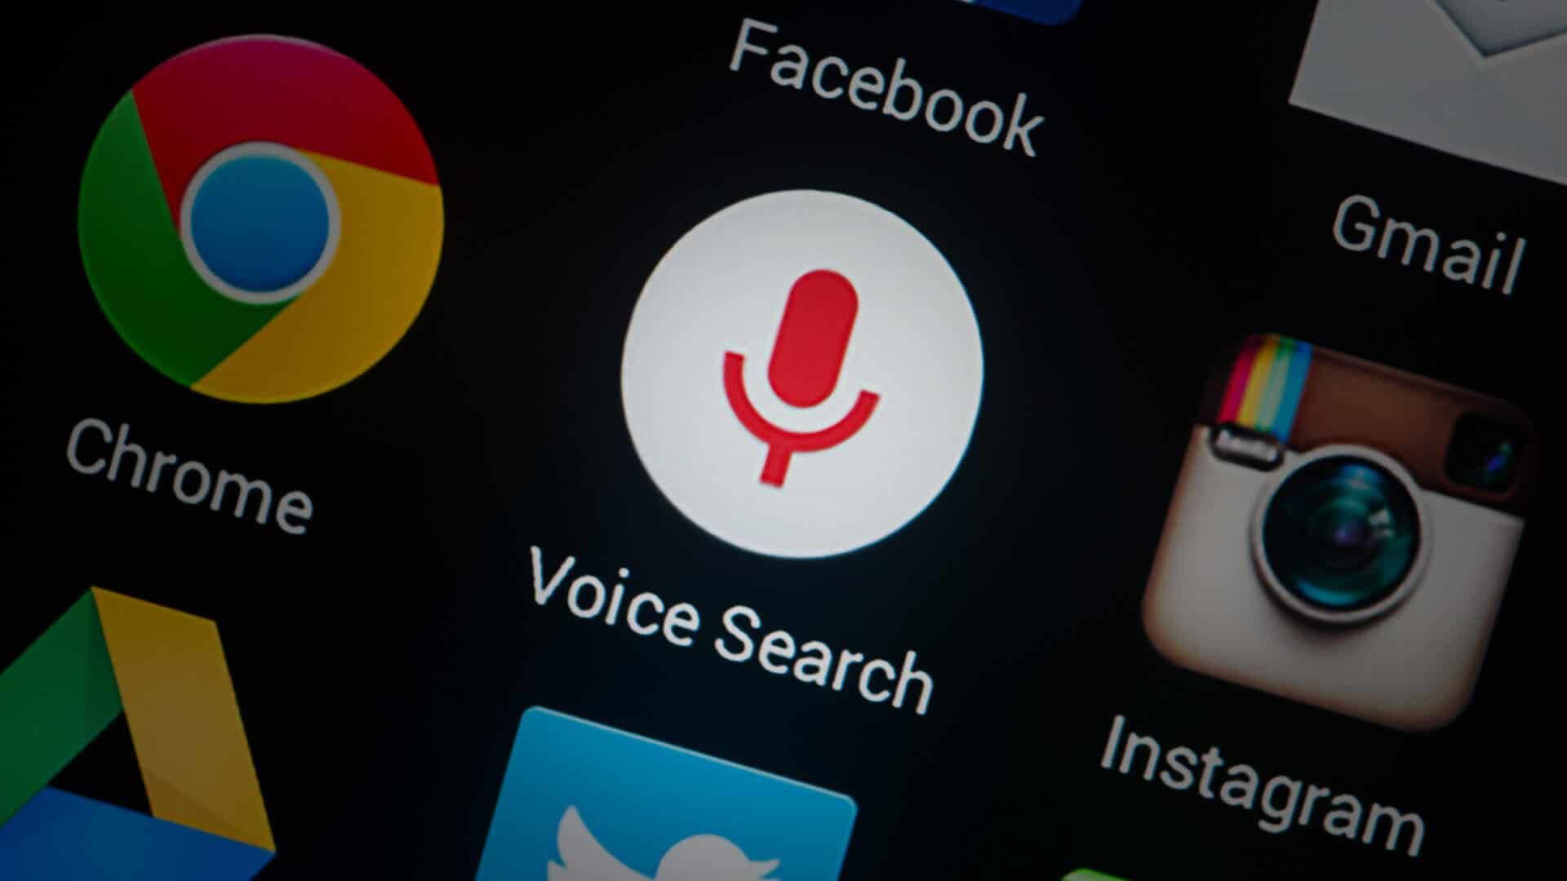

Slide 3
Voice search
Voice technology refers to the means by which a consumer can interact with a device using their voice as the input mechanism
Voice is fast becoming a mainstream interface, and brands are integrating the technology in a variety of ways
Smart assistants like Siri, Amazon’s Alexa, and Google Assistant used in smartphones or smart speakers for home are booming due to advancements in voice recognition, natural language processing, and AI.
Of the estimated 20 million US consumers that currently own a smart speaker, according to data from national public media and Edison research, over 80% are addressing Amazon Echo and Alexa.
Smart voice devices like Amazon Echo and Google Home will be installed in 55 percent of U.S. households by 2022, according to Juniper Research. Amazon's Alexa platform could generate $10 billion in revenues by 2020
It is swiftly becoming a crowded space, as manufacturers and technology companies vie for consumers' attention.

Slide 4


Slide 5
Visual search
Visual search can be defined as anything using an image, rather than text, as the search input
With advances in artificial intelligence and machine learning, visual search has become a more mainstream proposition and has the potential to add enormous value in sectors such as home décor, fashion, FMCG and food and drink.
Pinterest has found itself at the vanguard of progress: Pinterest Lens launched in 2017 and has garnered 600 million searches within 12 months.
Younger consumers are increasingly drawn to visual search: from a sample of 6,000 UK consumers, Mindshare found that over half (51%) of those aged between 18 and 34 have carried out a visual search, compared to 30% of 35- to 54-year-olds and only 10% of over 55.

Slide 6
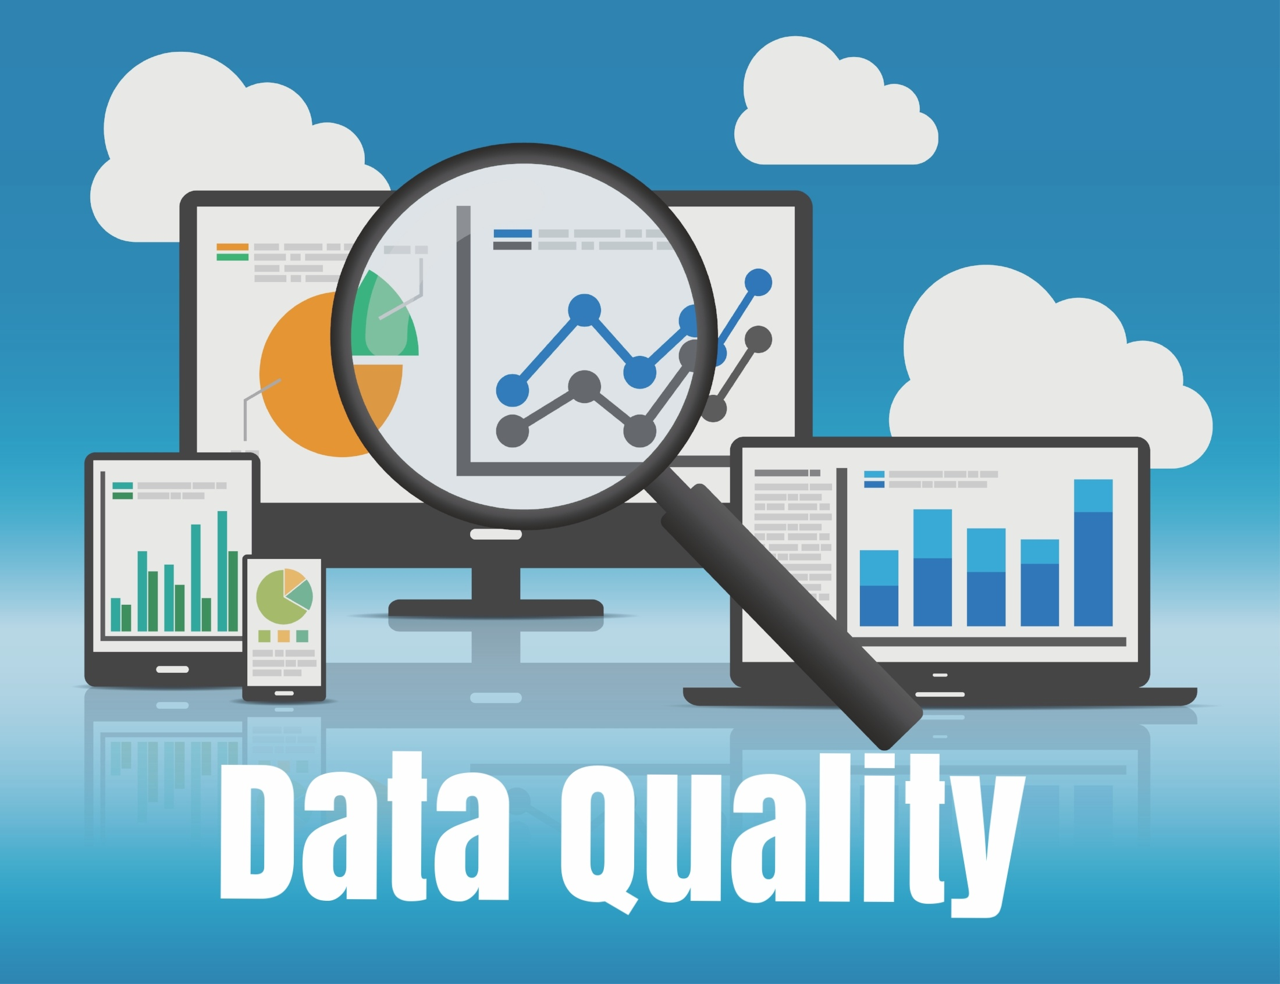

Slide 7
Data Quality
Despite surround-sound rhetoric that the marketing industry is entering a new era of data-driven communications, concerns are rising that the information underpinning this person-level targeting may not be nearly as reliable as brands have been led to believe.
In July 2017, the new York times ran an article, reporting that Procter & Gamble had posted complimentary Gillette razors – complete with “happy 18th birthday” messaging – to a 50 year-old female academic in Alabama. It was one of many cases of mistaken identity apparently undermining Gillette’s long-running direct marketing campaign.
Such mishaps represent a blow for a company that has been vocal in predicting an upcoming shift to mass one-to-one marketing.
According to a recent study by experian, an average of 30% of data being used to inform campaigns across organisations is suspected to be inaccurate.

Slide 8
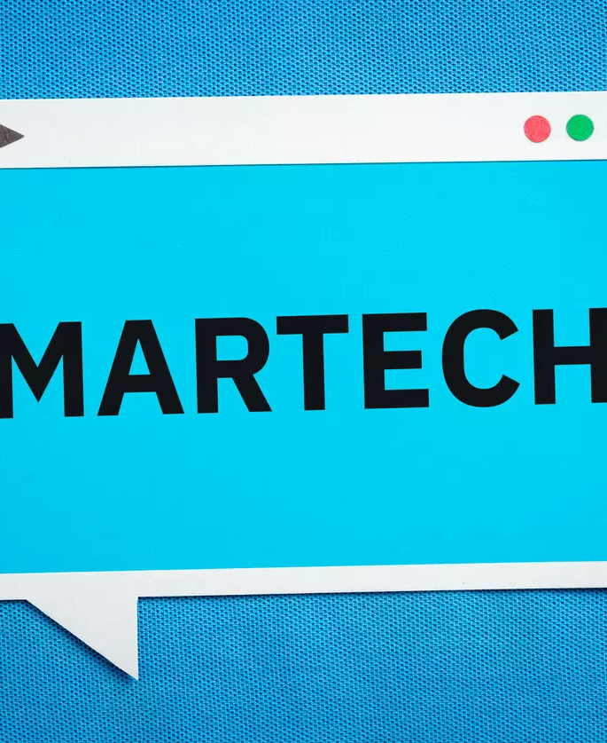

Slide 9
Technology in Marketing
Marketing is quickly moving away from being just a great creative idea, riding on top of a media vehicle to reach the consumer. Technology now enables targeting purposeful communication, at an appropriate time, over a specific channel, to the end consumer…making the communication relevant to the consumer, as also resulting in better ROI on the marketing spends for the brand.
We can engage with “known” users using email / SMS / Mobile push / Web push etc. However, there are a whole bunch of people who visit our website and leave their footprints behind. They appear just as a statistic in our Google Analytics. How do we engage with these unknown users and reach out to them with relevant messaging?

Slide 10
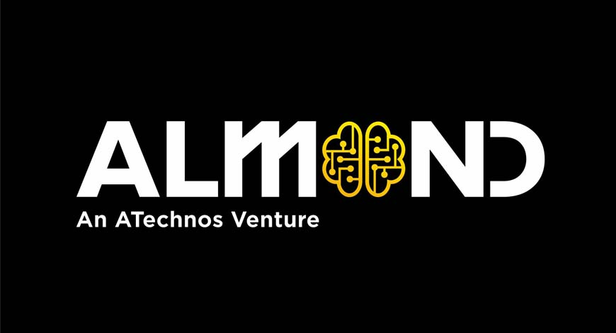
Mar-tech, consulting, and content platform, ATechnos has unveiled its marketing-tech vertical, Almond. The vertical specialises in building simplistic mobile and technology solutions for precision engagement with urban, rural and rurban India, irrespective of the internet.
The solutions are designed to drive action, decode data, and deliver a measurable return on experience and uplifted revenues.

Slide 11
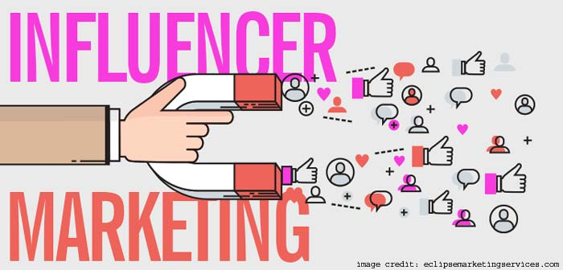

Slide 12
Influencer marketing
Influencers are defined as everyday consumers who are substantially more likely than the average to seek out information and to share ideas, information, and recommendations with other people
The surge in influencer marketing is being fuelled by several factors, primarily the explosive use of social media channels, enabling brands to meet people where they interact online.
By deploying influencer marketing campaigns, brands can spread their messages without having to worry about ad-blocking technologies and it provides an avenue for more authentic brand messaging, versus traditional online ads.
What marketers get from influencers is inspirational, aspirational, and a valid point of view
influencer marketing is becoming A highly effective tool for brands. a source of income for influencers

Slide 13
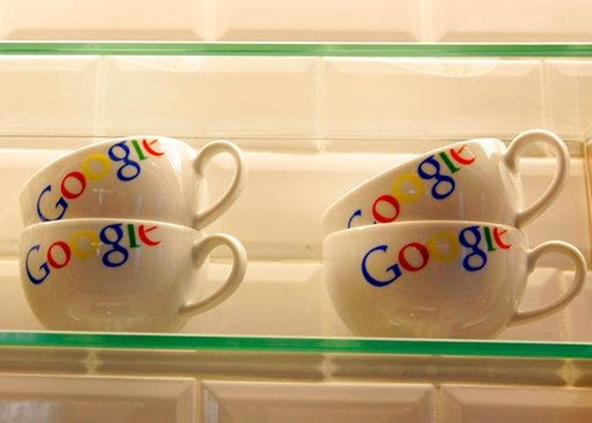
Google as influencer
Alphabet Inc's Google routinely fields product queries from millions of shoppers. Now it wants to take a cut of their purchases, too.
The U.S. technology company is teaming up with retailers including Target Corp, Walmart Inc, Home Depot Inc, Costco Wholesale Corp and Ulta Beauty Inc .

Slide 14
Google as influencer
Under a new program, retailers can list their products on Google Search, as well as on the Google Express shopping service, and Google Assistant on mobile phones and voice devices.
In exchange for Google listings and linking to retailer loyalty programs, the retailers pay Google a piece of each purchase, which is different from payments that retailers make to place ads on Google platforms.
Google's pitch to retailers is a better chance to influence shoppers' purchasing decisions, a move that is likely to help them compete with rival Amazon.com Inc.
this initiative sprang from Google's observation that tens of millions of consumers were sending image searches of products, asking "Where can I buy this?" "Where can I find it?" "How can I buy it?" "How do I transact?" Daniel Alegre, Google's president for retail and shopping, told Reuters exclusively.

Slide 15


Slide 16
emerging viewership trends in India on Youtube
With almost 400 hours of content uploaded on youtube every minute, over 400 million plus monthly active Indian youtube viewers have a never ending supply of fresh and varied content to watch on Youtube.
Entertainment videos are undoubtedly the most popular amongst viewers. A single video in the entertainment category gets 10,000 views on an average while a video in the style category gets about 8,000 views and pets/animals follows third with 7,000 views.

Slide 17
New Influencers in town
Micro influencers are the new breed of influencers swelling on social media today. Neither movie stars nor sports celebrities, these are just regular consumers who after being active on different social media platforms could see the potential of these and get experimental on harnessing content to influence other fellow consumers
global brand L'Oreal works with about 200 key Instagram influencers
YouTube is the new TV
Since 2005, YouTube has become the de facto launchpad for the next generation of celebrities.
Stars like PewDiePie, Jenna Marbles, and Yuya have racked up millions of subscribers over the years through a direct relationship with their fans.

Slide 18
Livestreaming Commerce
Livestreaming achieved mass popularity in China a number of years ago, both as an entertainment format and a commerce channel.
A report by Gartner claimed that livestreaming has become “the de facto online sales and engagement channel” in China during the COVID crisis, and is expected to become a “permanent priority sales channel” when the country returns to normality.
Tens of millions of users even watched a livestream of the construction of new emergency hospitals in Hubei Province.
The greatest opportunities exist within categories such as fashion and beauty, which already dominate the landscape in China. These products have a short decision cycle, and can be purchased and shipped quickly and easily. Brands able to offer a utility – such as sportswear firms helping consumers to keep fit indoors – are also presented with potent content possibilities. “Clearly you are not going to see anyone buying a car via a livestream video any time soon.”

Slide 19

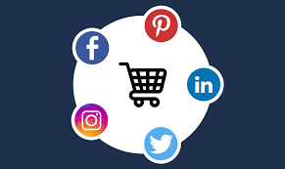

Slide 20
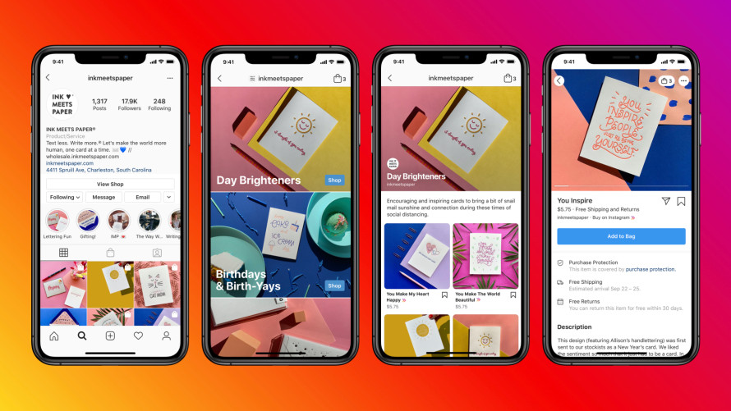
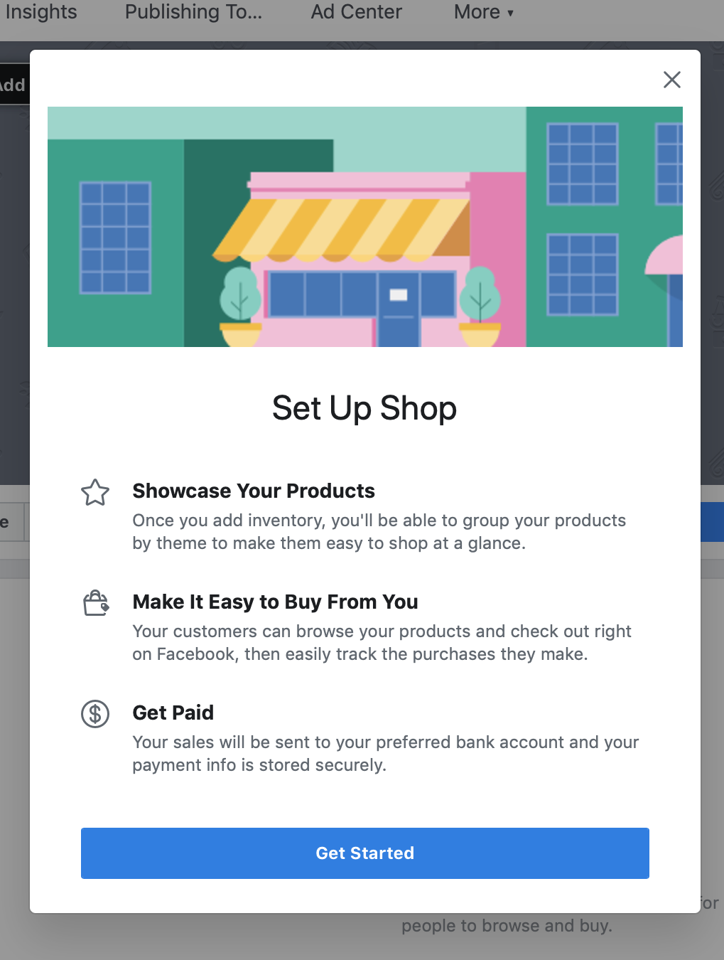
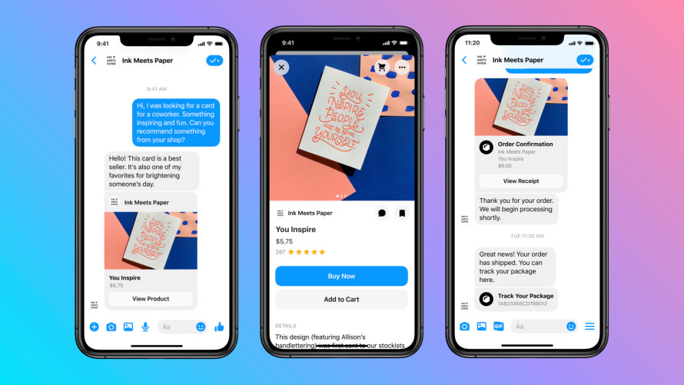
Facebook and Instagram roll out shops
Helping small businesses sell online
China’s social media giant Weibo has launched its first foray into China’s frenetic e-commerce sector with Xiaodian (small shop in Mandarin), a tool that allows users to promote products being sold on other platforms.

Slide 21
Chatbots ai
Chatbots are at the talking point of the business world now. The arrival of chatbots have opened up new realms of the customer engagement and new ways of doing business in the form of conversational commerce. It is one of the most useful technologies that businesses can rely on, possibly replacing the traditional models and making apps and websites redundant.

Slide 22
Omnichannel
Omnichannel refers to retailing by leveraging online and offline channels. For example, a customer may buy online but takes delivery from a preferred retail store or vice-versa he selects a merchandise offline but asks store to deliver

Slide 23
A business model transformation
at India’s leading online marketplaces, led by fashion
Flipkart and its fashion units Myntra and Jabong, Amazon India and Paytm Mall are adopting a hyperlocal strategy to allow customers access to the latest fashion products that can be picked up and delivered from local stores within hours.
This model, routed via technology partners, can be replicated in categories such as mobile phones, electronics, and home furnishings, transforming how marketplaces operate and bringing substantial savings in inventory, warehousing and delivery costs.

