Slide 1
Creating Customer Value
Notes:
‹#›

Slide 2
Creating customer value
Customers are very important
to an organization.
The primary focus of organization is to satisfy customers.
Value is the worth that customers sees in the product.
Notes:
‹#›

Slide 3
Perceived Value
How do the customers perceive value
In a product/Service?
Notes:
‹#›

Slide 4
Customer Perceived value
Step 1.
Customer evaluates all the benefits a product/service offers.
Step 2.
The customer then evaluates the costs he will incurr in obtaining it.
Step 3
Value= Benefit/Costs
Notes:
‹#›

Slide 5
Defining value
.Total Customer benefit- is the perceived monetary value of the bundle of economic, functional and psychological benefits customers expect from a given market offering because of the product, service , people and image.
Total Customer Cost
is the perceived bundle of costs customers expect to incur in evaluating, obtaining, using, and disposing of the given market offering, including monetary, time, energy and psychological costs..

Slide 6
Determinants of
Customer Perceived Value
Total customer benefit
Total customer cost
Product benefit
Monetary cost
Services benefit
Time cost
Personal benefit
Energy cost
Image benefit
Psychological cost
Notes:
‹#›
Figure 4.2 illustrates the relationships between and components of total customer benefit and total customer cost.

Slide 7
CustomerPerceived Value
Customer perceived value is the difference between the prospective customer’s evaluation of all the benefits and all the costs of an offering
Notes:
‹#›
Consumers are better educated and informed than ever, and they have the tools to verify companies’ claims and seek out superior alternatives. Here’s an example:
Dell rode to success by offering low-priced computers, logistical efficiency, and after-sales service. The firm’s maniacal focus on low costs has been a key ingredient in its success. When the company shifted its customer service call centers to India and the Philippines to cut costs, however, understaffing frequently led to 30-minute waits for customers. Almost half the calls required at least one transfer. To discourage customer calls, Dell even removed its toll-free service number from its Web site. With customer satisfaction slipping, and competitors matching its product quality and prices and offering improved service, Dell’s market share and stock price both declined sharply. Dell ended up hiring more North American call center employees.
Customer-perceived value (CPV) is the difference between the prospective customer’s evaluation of all the benefits and all the costs of an offering and the perceived alternatives. Total customer benefit is the perceived monetary value of the bundle of economic, functional, and psychological benefits customers expect from a given market offering because of the product, service, people, and image. Total customer cost is the perceived bundle of costs customers expect to incur in evaluating, obtaining, using, and disposing of the given market offering, including monetary, time, energy, and psychological costs. Customer-perceived value is thus based on the difference between benefits the customer gets and costs he or she assumes for different choices. The marketer can increase the value of the customer offering by raising economic, functional, or emotional benefits and/or reducing one or more costs.

Slide 8
Components of customer value
Tangible Values
Functional Value, eg car
Economic value,eg price
Convenience value eg online
Sensory & Aesthetic value eg design
Service value eg CRM
Intangible values
Social Value eg social acceptance
Prestige Value eg status/ego
Sentiment Value eg memories/past association
Experience value eg the service experience

Slide 9
What is Value Proposition?
Value Proposition - It consists of the whole cluster of benefits the company promises to deliver. Now a days offer is termed as value proposition.
Notes:
‹#›

Slide 10
Value
Air Deccan
  Offering lowest fares
  Special offers like offering tickets between 9-11pm at throwaway prices
  Multiple routes and multiple price options
  Value- Price by offering simple economic value to target customers
Notes:
‹#›

Slide 11
Value
Virgin Atlantic
  They focused on cutomer experience
  Removed all pain points of the traveller
  New services were added which would make the customer comfortable
  Price was added
  Value- Comfortable travel
Notes:
‹#›

Slide 12
Value
FedEx
  Allowed customers to track packages through the company's website
  These services were free of charge
  Enhanced value by adding these services
McDonald's
  Adapting menu acording to the taste & culture of the country.
Notes:
‹#›

Slide 13
eBay
Ebay- founded by Piere Omidyar in 1995
ebay's Model- Low cost
Investment modest
Customer arrive by WOM- little mkt expenses
No costs of goods sold
Sellers pay for listing in advance, no inventory
Notes:
‹#›

Slide 14
eBay
Insertion fees
Sellers paid $5.30 per pd listed on the site
Additional fee for 10 day auction site
Additional fees for promotion of auction
Business customers- $9.95 per mnth
Commision charged for each sale (items less than $25- 5.25%, Between $25.01 - $1000- 2.75%, over $1000, 1.50%)
1998- 600,000 items for sale, $6 m in revenue
2003- 2 m items for sale, $ 47.1m revenue
Notes:
‹#›

Slide 15
Increase Value
How does a firm increase value?
Notes:
‹#›

Slide 16
A firm can improve its offers in these ways
Changing product form- liquid soap
Service- Maruti- max Service centres
Customization & personalisation- Levi’s
Experience- Airlines, Starbucks
Time & Speed- Banks open for long hrs.
Notes:
‹#›
The point is clear: Buyers operate under various constraints and occasionally make choices that give more weight to their personal benefit than to the company’s benefit. Customer-perceived value is a useful framework that applies to many situations and yields rich insights. It suggests that the seller must assess the total customer benefit and total customer cost associated with each competitor’s offer in order to know how his or her offer rates in the buyer’s mind. It also implies that the seller at a disadvantage has two alternatives: increase total customer benefit or decrease total customer cost.
The choice process to buy a tractor for a large construction company from either Mahindra or John Deere can be used to describe the value concepts.

Slide 17
Fair Value by Treacy & Wiersema

Slide 18
Assumptions: Market Driven Principles
Know your markets
Customers have the final say
Commit to being first in the market you serve

Slide 19
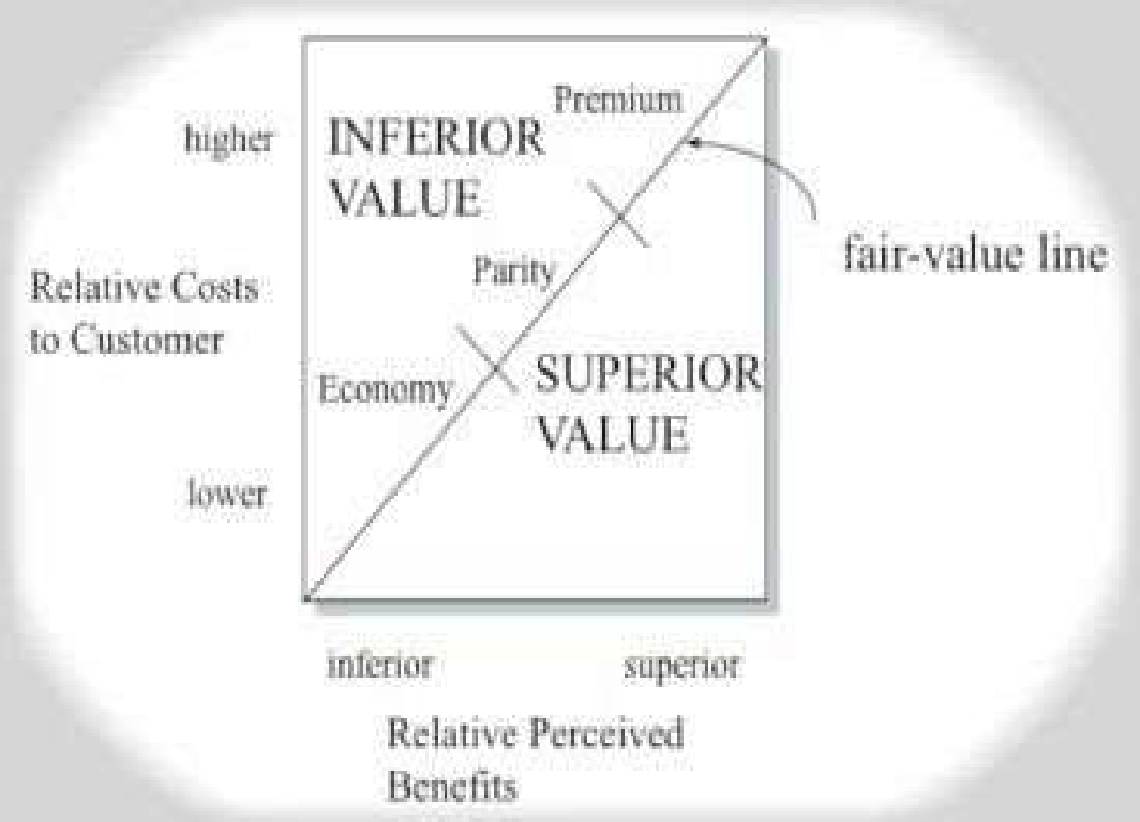

Slide 20
operations factors price, cost, delivery, service, reliability
product features or designs attributes, style, innovation, technology
does this meet my needs? is it customized for me?

Slide 21


Slide 22
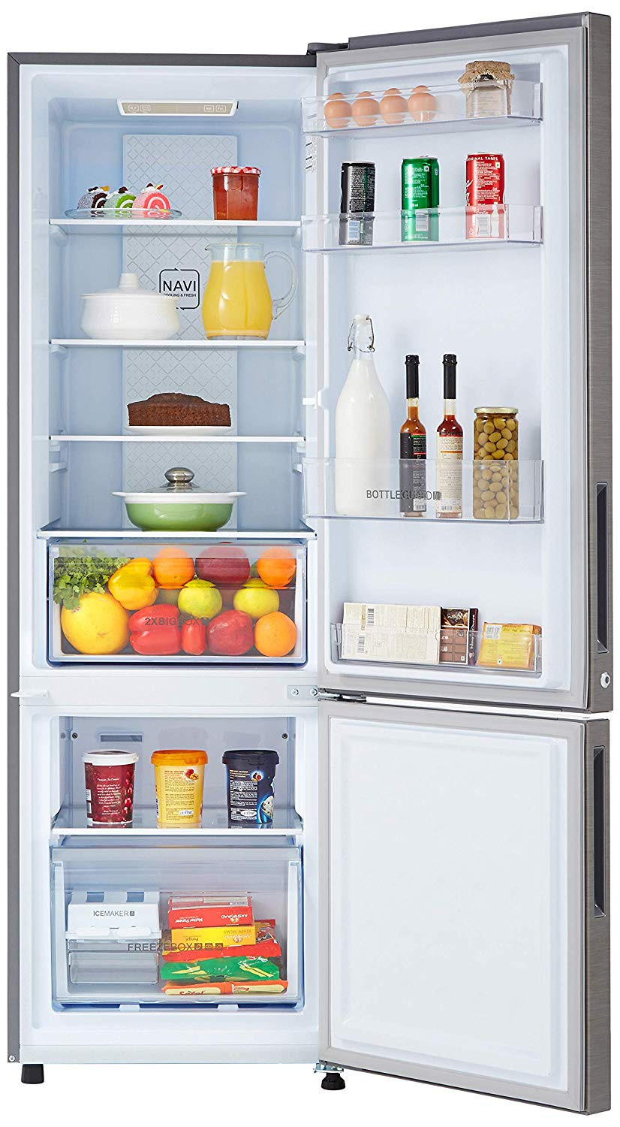

Slide 23



Slide 24
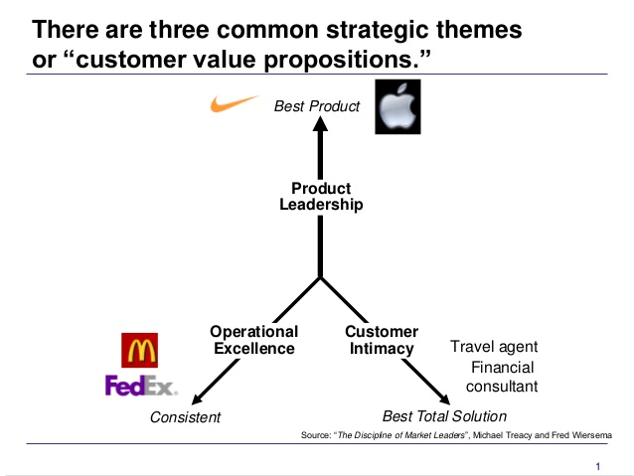

Slide 25
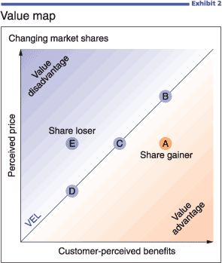
Notes:
Value equivalence Line
Economy, Parity, Premium
‹#›

Slide 26
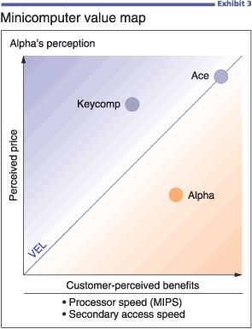

Slide 27
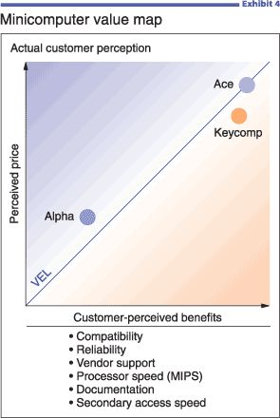

Slide 28
The Alpha Computer case illustrates several important points about value management:
• The key to success often resides in gaining a clear understanding of the real attributes driving customer choice and their relative importance.
• "Softer," nontechnical attributes (perceived reliability, quality of vendor support, ease of doing business) are often as important as or more important than precisely measurable technical features.
• Trusting internal perceptions of which attributes drive customer choice can be a fatal mistake; rely on customers for this critical information.

Slide 29
Value Delivery Process

Slide 30
Value Delivery Framework- Steps
Selecting the value
Creating the value
Communicating the value
Delivering the value
Capturing the value back from the market
Enhancing the value
Notes:
‹#›

Slide 31
Value Selection & Creation by Mahindra & Mahindra
Wanted to launch a vehicle to compete with Ford Ikon, Hyundai Accent, Toyota Qualis,Tata Safari, Sumo...
SCORPIO was born
Value Selection
Market research was conducted
  Latest technology
  Big Size for status
  Thrill in driving SUV
  Aspirations – Land Cruiser
  Had to be affordable
Notes:
‹#›

Slide 32
Value Selection & Creation by Mahindra & Mahindra
Outcome-
  SUV in smaller budget was the Gap identified.
  Consumers wanted a Pajero that would suit their pocket
Value Creation
  M&M entered into alliance wth the best in car manufacturing
  Fuji, Japan for dies
  Wooshin, Korea for body shop
  Durr, germany for paint shop
  Lear, USA for seats and interiors
  BEHR, Germany for AC
  Renault, France for petrol engine
  Alliances were created and they set up facilities in and around M&M.
Notes:
‹#›

Slide 33
Value Proposition
SCORPIO- Superior technology, dynamic looks, pricing was at Rs.5-7 lakhs (penetration pricing)
Notes:
‹#›

Slide 34
Value Communication
M&M developed a compelling Value Proposition: Scorpio, “Carplus. Luxury of a car, Thrill of a SUV.”
Notes:
‹#›

Slide 35
Communicating the Value
Various means are there
  Advertising ( print, TV, Radio, Internet)
  Promotions
  Events
  PR
Notes:
‹#›

Slide 36
Delivering Value
Two levels of value delivery
Level 1- entire value delivery process
Level 2- physical delivery of the product
Notes:
‹#›

Slide 37
Deliver value
Make the product available to the customers.
  Both online and physical store can add value delivery- HP
Enrich the overall experience- CRM
Every contact point is an opportunity for enhnacing value of delivery.
Notes:
‹#›

Slide 38
Value Capturing
Capture back the value through price mechanisms
Offer Value and capture value
1. Bharati Telecom (Airtel)
  Good value to customers by providing cellular telephone services at low prices
  It sponsors cricket matches and captures the value back It created contests related to the match through text messages (SMS) over the cell phone. Bets on outcome through SMS.
  The text message traffic alone created a lot of revenue.
  2. Sachets..
Notes:
‹#›

Slide 39
Enhancing Value
The firm keeps enhancing value continuously.
M&M by Mars Inc.
Mars allowed its online store customers to customize their own M&M with personalised messages.
Instead of the signature M, the personalised candy features the customer's own message.
Mars also offers customised messages for special events
Notes:
‹#›

Slide 40
Customers Value & Sellers value
P&G- 1970's recognised two problems in the potato chip business
  Product damaged during transit
  Low shelf life
Product improvement – launced Pringles
  New packaging ensured no breakages & more shelf life. Premium was charged
15% market share achieved initially but sales fell.
Notes:
‹#›

Slide 41
Customers Value & Sellers value
Consumers felt that the chips tasted artificial
Uniform in shape and texture
Not broken, burnt or greasy.
What went wrong?
  Assumed that customers would pay a more for the attributes added
  These attribtes were solving company's problems and not customers
Notes:
‹#›

Slide 42
Co-creating Value
Propounded y C.K.Prahalad and Venkat Ramaswamy, in their book “The future of competition-Co-creating Unique Value with Customers”
Value creation is at it's best when it is co-created with individual customer.
Notes:
‹#›

Slide 43
Example of Tanishq- Mia
Participants are invited to submit an idea for Mia – the new Working Women’s line from Tanishq, of which the winner will get to collaborate with designers at Tanishq to design the latest collection. Also, top 10 finalist entries stand to win INR 1,00,000 each.
Notes:
‹#›

Slide 44
Customer Satisfaction
Satisfaction is a person's feelings of pleasure or disappointement that result from comparing a product's perceived performance to their expectations.
eg- Dominos
Notes:
‹#›

Slide 45
Total Customer Benefits & Total Customer Costs
TCB-Perceived monetary value of the bundle of economic, functional abd psychological benefits customer's expect from a given market offering.
TCC- Perceived bundle of costs customer's expect to incur in evaluating, obtaining, using and disposing of the given market offering including monetary, time, energy and psychological costs.
Notes:
‹#›

Slide 46
Customer Perceived Value
CPV- is the difference between the prospective customer's evaluation of the benefits and all the costs of an offering and it's perceived alternatives
.
Notes:
‹#›

Slide 47
Customer Profitability analysis
A profitable customer is a person that yields a revenue stream that exceeds the cost stream of attracting, selling and serving that customer.
The emphasis is on the life-stream of revenue and costs and not on the profit from a particular transaction.
Notes:
‹#›

Slide 48
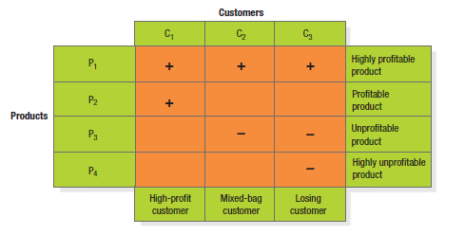
Customer-Product Profitability Analysis
Notes:
‹#›
A useful type of profitability analysis is shown in Figure 4.3. Customers are arrayed along the columns and products along the rows. Each cell contains a symbol representing the profitability of selling that product to that customer. Customer 1 is very profitable; he buys two profit-making products (P1 and P2). Customer 2 yields mixed profitability; he buys one profitable product (P1) and one unprofitable product (P3). Customer 3 is a losing customer because he buys one profitable product (P1) and two unprofitable products (P3 and P4). What can the company do about customers 2 and 3? (1) It can raise the price of its less profitable products or eliminate them, or (2) it can try to sell customers 2 and 3 its profit-making products. Unprofitable customers who defect should not concern the company. In fact, the company should encourage them to switch to competitors.

Slide 49
Customer Lifetime Value
CLV describes the net present value of the stream of future profits expected over the customer's lifetime purchases.
It is the crucial link between the value the firm delivers to customers and the value customer's deliver to the firm.
Notes:
‹#›

Slide 50
What Is
Customer Relationship Management?
CRM is the process of carefully managing detailed information about individual customers and all customer touch points to maximize customer loyalty.
Customer Value Management -describes the company’s optimization of the value of it’s customer base.
Customer Touch Points: any occasion in which the customer encounters the brand or product.
Notes:
‹#›
Customer relationship management (CRM) is the process of carefully managing detailed information about individual customers and all customer “touch points” to maximize loyalty. A customer touch point is any occasion on which a customer encounters the brand and product— from actual experience to personal or mass communications to casual observation.

Slide 51
What Is Loyalty?
Loyalty is a deeply held commitment to re-buy or re-patronize a preferred product or service in the future despite situational influences and marketing efforts having the potential to cause switching behaviour.
Notes:
‹#›
Consumers have varying degrees of loyalty to specific brands, stores, and companies. Oliver defines loyalty as “a deeply held commitment to rebuy or repatronize a preferred product or service in the future despite situational influences and marketing efforts having the potential to cause switching behavior.

Slide 52
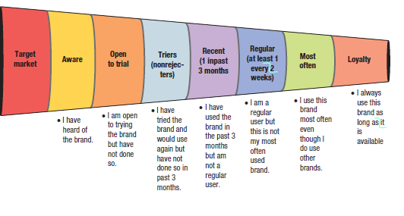
The Marketing Funnel
Notes:
‹#›
Figure 4.4 shows the main steps in attracting and retaining customers in terms of a funnel. The marketing funnel identifies the percentage of the potential target market at each stage in the decision process, from merely aware to highly loyal. Consumers must move through each stage before becoming loyal customers. Some marketers extend the funnel to include loyal customers who are brand advocates or even partners with the firm.

Slide 53
Building Loyalty
Interact closely with customers
Develop loyalty programs
-club membership programs
Create institutional ties
Brand Communities

Slide 54
Customer Database
Organised collection of comprehensive information about individual customers or prospects that is current, accessible and actionable for lead generation, sale or maintanance of CRM
Notes:
‹#›

Slide 55
Using the Database
To identify prospects
To target offers
To deepen loyalty
To reactivate customers
To avoid mistakes
Notes:
‹#›
There are many reasons for firms to use databases.

Slide 56
Don’t Build a Database When
The product is a once-in-a-lifetime purchase
Customers do not show loyalty
The unit sale is very small
The cost of gathering information is too high
Notes:
‹#›
Some situations like those named in the slide are cases for which companies would not benefit from building a database.

