Slide 1
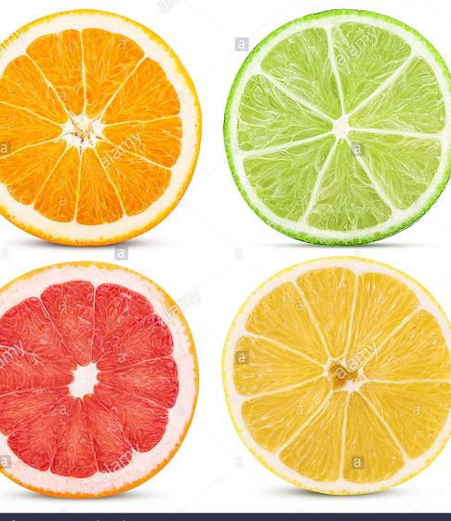
Market Segmentation,
Targeting, and Positioning
for Competitive Advantage

Slide 2
Steps in Segmentation,
Targeting, and Positioning
6. Develop Marketing
Mix for Each Target Segment
Market
Positioning
5. Develop Positioning
for Each Target Segment
4. Select Target
Segment(s)
Market
Targeting
3. Develop Measures
of Segment Attractiveness
2. Develop Profiles
of Resulting Segments
1. Identify Bases
for Segmenting the Market
Market Segmentation
Notes:
Steps in Segmentation, Targeting, and Positioning
Market Segmentation. Market segmentation is the process of dividing a market into distinct groups of buyers who might require separate products or marketing mixes. All buyers have unique needs and wants. Still it is usually possible in consumer markets to identify relatively homogeneous portions or segments of the total market according to shared preferences, attitudes, or behaviors that distinguish them from the rest of the market. These segments may require different products and/or separate mixes.
Market Targeting. Market targeting is the process of evaluating each market segment's attractiveness and selecting one or more segments to enter. Given effective market segmentation, the firm must choose which markets to serve and how to serve them.
Discussion Note: In targeting markets to serve the firm must consider its resources and objectives in setting strategy.
Market Positioning. Market positioning is the process of formulating competitive positioning for a product and a detailed marketing mix. Marketers must plan how to present the product to the consumer.
Discussion Note: The product's position is defined by how consumers view it on important attributes.
Steps in Segmentation, Targeting, and Positioning
This CTR corresponds to Figure 7-1 on p. 196 and relates to the material on pp. 196.

Slide 3
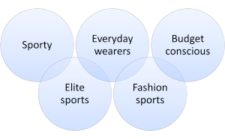
Segmentation
Groups the heterogenous consumers into homogenous subunits
After segmentation, consumers will vary ‘Across segments, but be homogenous within
It is the consumers who are segmented not the product or price.
Shoes market seg.

Slide 4
Why segment the market?
Facilitates right choice of target market
Facilitates effective tapping of the chosen market
Makes marketing effort more efficient and economic
Helps identify less satisfied segments & concentrate on them
Benefits the consumer as well

Slide 5
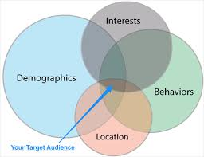
Geographic
Nations, states,
regions or cities,urban rural
Demographic
Social class, Age,Income, Gender,Occupation, Ed,
Behavioral
Occasions, benefits, uses, or responses, loyalty
Psychographic
Psychological,personality, lifestyle, values

Slide 6

PRIZM:Potential Rating Index by Zip markets
Potential Rating Index for Zip Markets
Neilson Claritas
14 distinct groups 66 distinct lifestyle segments
Group 01: Upper Crust - Wealthy, mature without kids
Group 22: Middleburg Managers - Upscale middle age family mix
Group 48: Generation Web - Low income younger family mix
Group 68: Bedrock America - Low income middle age, mostly without kids
Notes:
39 factors in 5 broad categories 1)education&affluence 2)family life cycle 3) urbanization 4) race and ethnicity
5) mobility

Slide 7

Demographic Segmentation
Age and Life Cycle
Life Stage
Gender
Income
Social Class
Notes:
PC’s at low price- Below 12,990 Rs. : budget PC segment, captures 14.5% market share
Pierre cardin misconstrued the so called middle class Indians and the rich, brand image is exclusive apparel, neither the super affluent nor the well to do among the middle class patronized it/ reebok

Slide 8

Generational Segmentation
Baby Boomers: Baby boomers were born between 1944 and 1964. They're current between 56-76 years old
Gen X: Gen X was born between 1965 - 1979 and are currently between 41-55 years old
Gen Y: Gen Y, or Millennials, were born between 1980 and 1994. They are currently between 26-40 years old.
  Gen Y.1 = 25-29 years old
  Gen Y.2 = 29-39
Gen Z: Gen Z is the newest generation to be named and were born between 1995 and 2015. They are currently between 5-25 years old
  The term “Millennial” has become the popular way to reference both segments of Gen Y (more on Y.1 and Y.2 below).

Slide 9
Earlier SEC by Market Res. Soc. Of India
Urban SEC based upon occupation and Education of the head
Urban SEC has a grid matrix of 10 categories across occupation and 10 categories across education.
Urban SEC- A to E{with ABE divided into A1(highest purchase pot.),A2,B1, B2,E1, E2}
Rural based on the education and the type of house he lives in.
Rural has 8 categories across education and three categories across types of house.
Rural {R1(highest purchase potential)}

Slide 10
Old SEC
Based on occupation and education for urban
Rural: education and type of House occupied
(market research society of India)

Slide 11
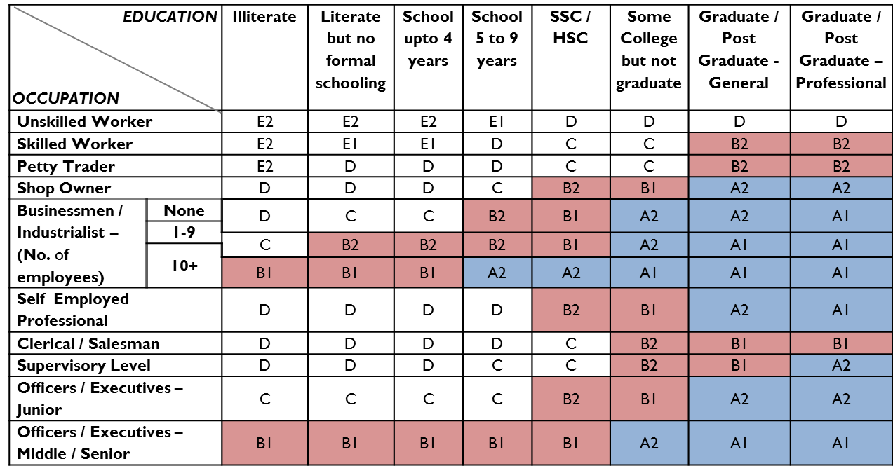

Slide 12
Revised System
Combines Urban and Rural
Classifies households on two parameters of educational Qualifications and assets owned (11 assets)
12 SEC’s: A1,A2, A3, B1, B2, C1,C2,D1, D2, E1 , E2, E3.

Slide 13
The 11 assets
Electricity connection
Ceiling Fan
LPG Stove
2 Wheelers
Colour TV
Refrigerators
Washing Machines
PC/Laptop
Car/Jeep/Van
AC
Agricultural Land

Slide 14
McKinsey Global Institute
(Based on real annual disposable Income)
The Global Indians( Rs. 10 lakh+)
The Strivers (Rs.5 lakh-10 lakh)
The Seekers (2-5lakh)
The Aspirers (90,000-2 lakh)
The Deprived (less than 90,000)

Slide 15
Psychographic Segmentation
Strategic Business Insight’s VALS
Classifies U.S adults into 8 primary groups
Vertical Dimension: innovative and have resources such as income, education, self-confidence, intelligence, leadership skills, and energy.

Slide 16
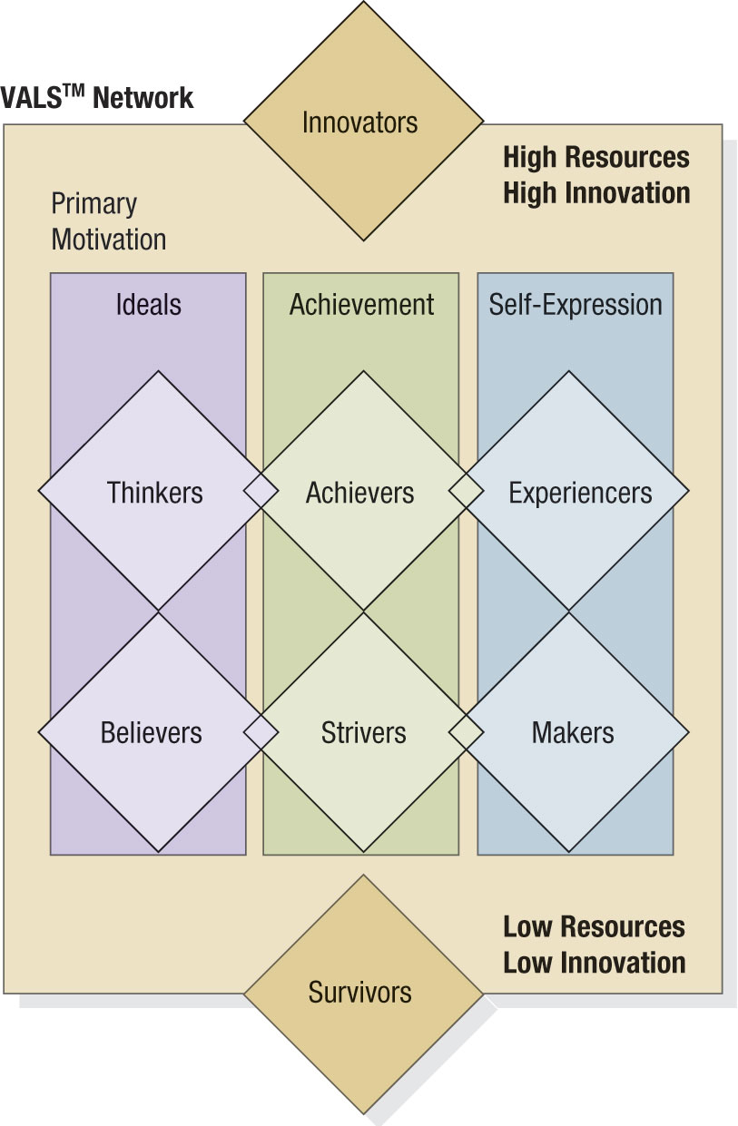

Slide 17
Innovator.
These consumers are on the leading edge of change,
Have the highest incomes
High self-esteem
abundant resources that they can indulge in any or all self-orientations.
Image is important to them as an expression of taste, independence, and character.
Their consumer choices are directed toward the "finer things in life."

Slide 18
Thinkers.
These consumers are the high-resource group of those who are motivated by ideals.
They are mature, responsible, well-educated professionals.
Their leisure activities center on their homes
they are well informed about what goes on in the world and are open to new ideas and social change.
They have high incomes but are practical consumers and rational decision makers.

Slide 19
Achievers.
These consumers are the high-resource group of those who are motivated by achievement.
They are successful work-oriented people who get their satisfaction from their jobs and families.
They are politically conservative and respect authority and the status quo.
They favor established products and services that show off their success to their peers.

Slide 20
Experiencers
These consumers are the high-resource group of those who are motivated by self-expression.
They are the youngest of all the segments, with a median age of 25.
They have a lot of energy, which they pour into physical exercise and social activities.
They are avid consumers, spending heavily on clothing, fast-foods, music, and other youthful favorites, with particular emphasis on new products and services.

Slide 21
Believers.
These consumers are the low-resource group of those who are motivated by ideals.
They are conservative and predictable consumers who favor local products and established brands.
Their lives are centered on family, community, and the nation.
They have modest incomes.

Slide 22
Strivers.
These consumers are the low-resource group of those who are motivated by achievements.
They have values very similar to achievers but have fewer economic, social, and psychological resources.
Style is extremely important to them as they strive to emulate people they admire.

Slide 23
Makers.
These consumers are the low-resource group of those who are motivated by self-expression.
They are practical people who value self-sufficiency.
They are focused on the familiar-family, work, and physical recreation-and have little interest in the broader world.
As consumers, they appreciate practical and functional products.

Slide 24
Survivors.
These consumers have the lowest incomes.
They have too few resources to be included in any consumer self-orientation and are thus located below the rectangle.
They are the oldest of all the segments, with a median age of 61.
Within their limited means, they tend to be brand-loyal consumers.

Slide 25
Needs & Benefits: Constellation Brands study on US Premium Wine market
Enthusiasts
Image Seekers
Savvy Shoppers
Tradationalists
Satisfied Shoppers
Overwhelmed
Notes:
Constellation Brands did a study on wine tasters
Luxury enthusiasts

Slide 26
Behavioral Segmentation: Decision Roles
Initiator
Influencer
Decider
Buyer
User
Notes:
People play five roles in a buying decision: Initiator, Influencer, Decider, Buyer, and User. For example, assume a wife initiates a purchase by requesting a new treadmill for her birthday. The husband may then seek information from many sources, including his best friend who has a treadmill and is a key influencer in what models to consider. After presenting the alternative choices to his wife, he purchases her preferred model, which ends up being used by the entire family.

Slide 27
Behavioral Segmentation
Behavioral Variables
Occasions
Benefits
User Status
Usage Rate
Buyer-Readiness
Loyalty Status
Attitude

Slide 28
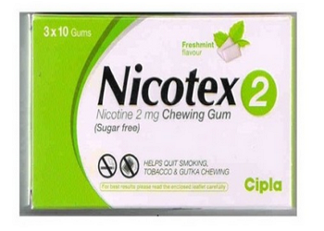

Slide 29
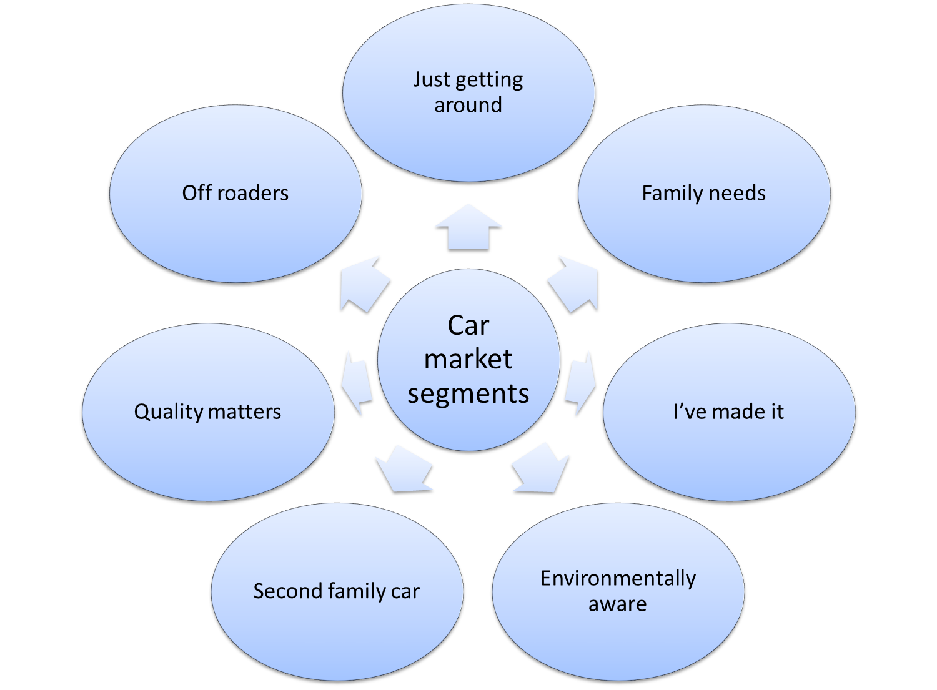

Slide 30
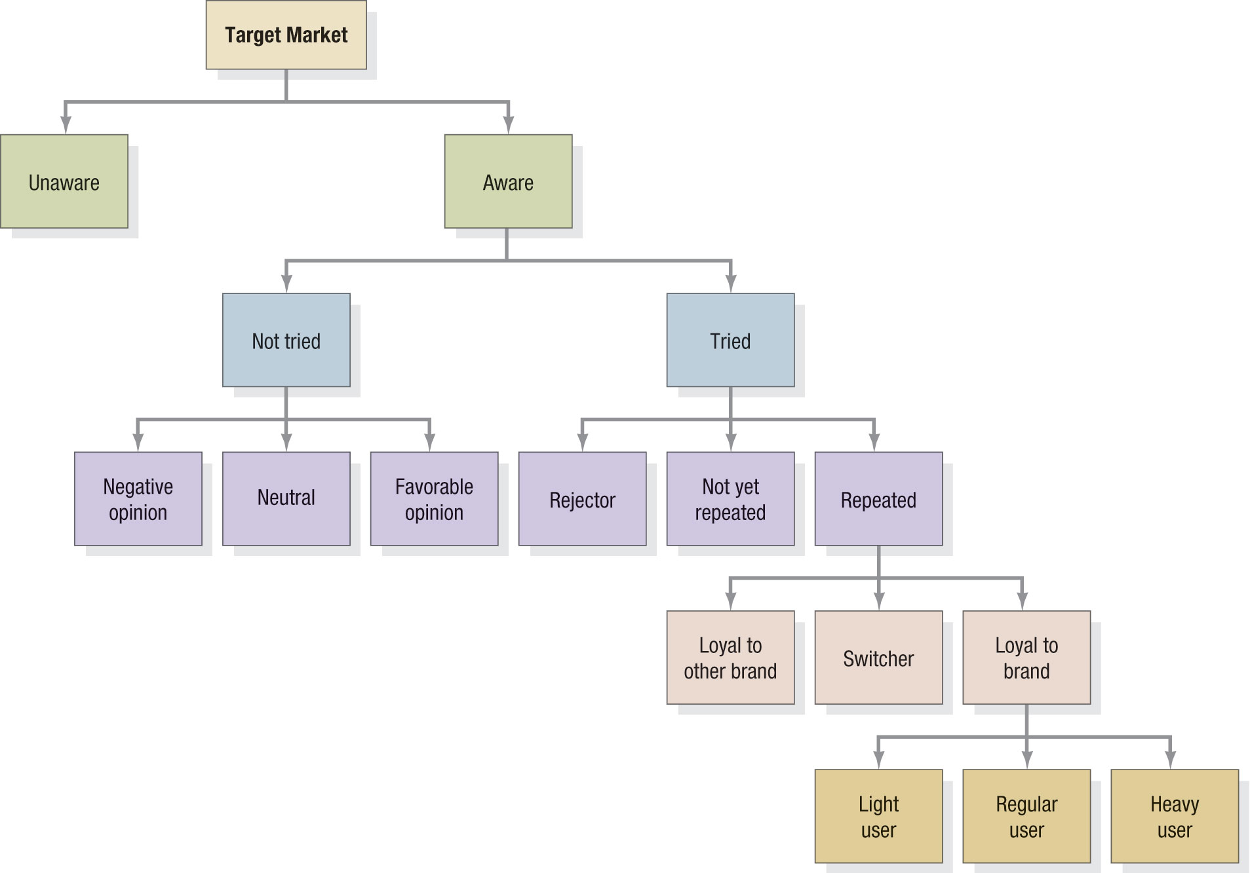
Behavioral Segmentation Breakdown

Slide 31
Using Multiple Segmentation
Bases: Geodemographics

Slide 32
Possible Levels of Segmentation
Full Market Coverage
Multiple Segments
Single Segments
Individuals as segments

Slide 33
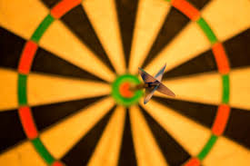
Targeting

Slide 34
Step 2. Market Targeting
Evaluating Market Segments
Segment Size and Growth
  Analyze sales, growth rates and expected profitability.
Segment Structural Attractiveness
  Consider effects of: Competitors, Availability of Substitute Products and, the Power of Buyers & Suppliers.
Company Objectives and Resources
  Company skills & resources relative to the segment(s).
  Look for Competitive Advantages.
Notes:
Evaluating Market Segments
Segment Size and Growth. The company must collect and analyze data on current dollar sales, projected sales-growth, and expected profit margins for each market segment.
Segment Structural Attractiveness. Long run attractiveness includes an assessment of current and potential competitors, the threats of substitutes, and the power of buyers and suppliers.
Company Objectives and Resources. The company’s resources and core business strengths should also fit well with the market segment opportunities.
Evaluating Market Segments
This CTR relates to the material on pp. 215-216.

Slide 35
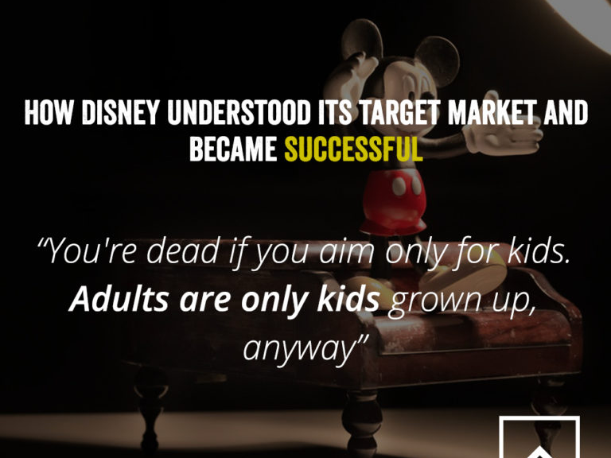

Slide 36
David Ogilvy
'The results of a campaign depends less
upon how we create the ad than on how we
position the product’

Slide 37
Typology of Strategic Positioning
Top of the range – Upper class – Rolls Royce
Service – Impressive service – Pizza hut – 30 mins
Value for money – Affordability –Megamart,D mart
Reliability – Durability – Kenstar mixer- 10yrs warranty
Attractive – Cool, Elegant – Mercedes, Bournville
Country of Origin – Patriotism- Amul- The Taste of India
The Brand Name – Leaders in the market – Apple, Sony

Slide 38
Positioning
It is the art of designing a company's offering and image to occupy a distinctive place in the minds of the target market.
Deciding the locus : in consumer's mind where to lodge the product.
A foot in the present and another in the future

Slide 39
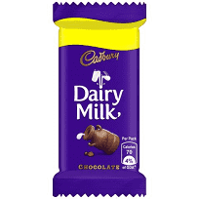
1994 - Cadbury Dairy Milk’s The Real Taste of Life. Popularly known as ‘Shimona’ after the girl who ran out on the cricket field.
For the kid in you
1998- khaane waalon ko khaane ki bahane chahiye
2004- kuch meetha chahiye
2010 - Cadbury Dairy Milk’s Shubh Aarambh takes the story forward to capture a new generation.

Slide 40
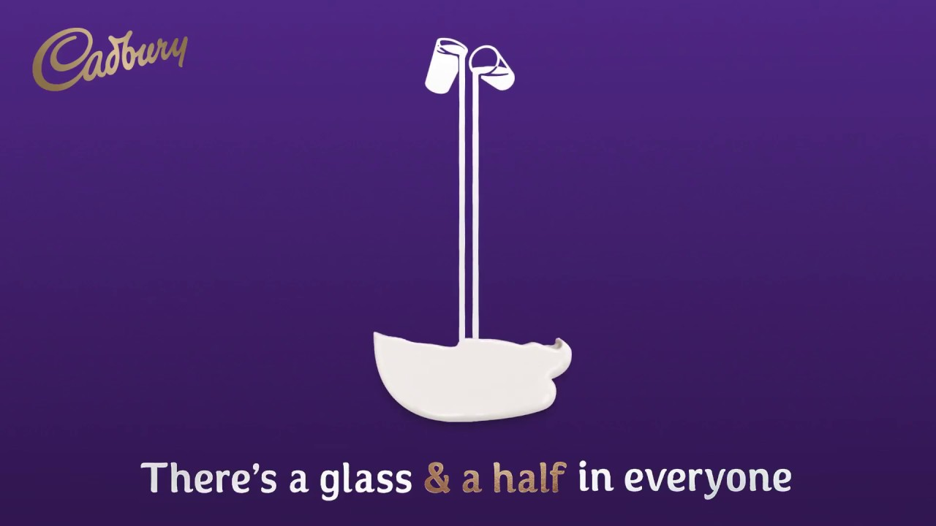
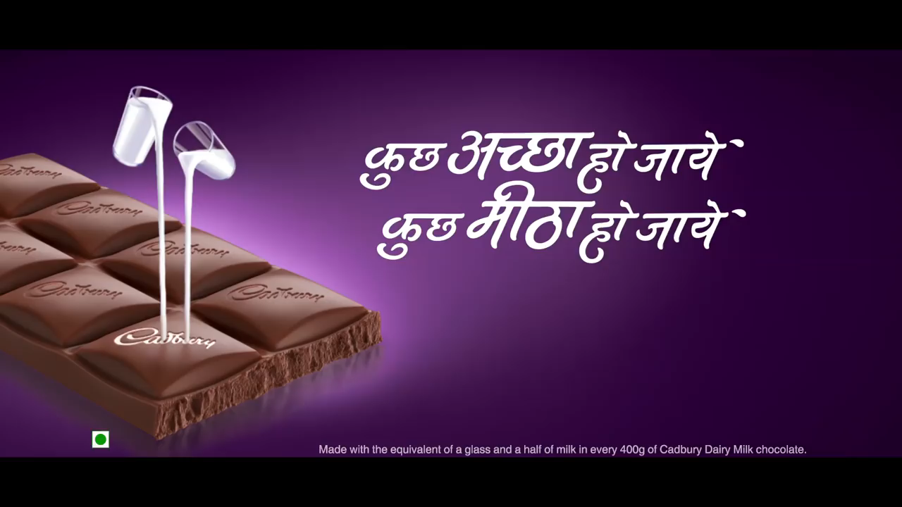

Slide 41
Step 3. Positioning for Competitive Advantage
Product’s Position - the place the product occupies in consumers’ minds relative to competing products- competitive frame of reference; i.e. Volvo positions on “safety”.
Marketers must:
  Plan positions to give products the greatest advantage
  Develop marketing mixes to create planned positions

Slide 42
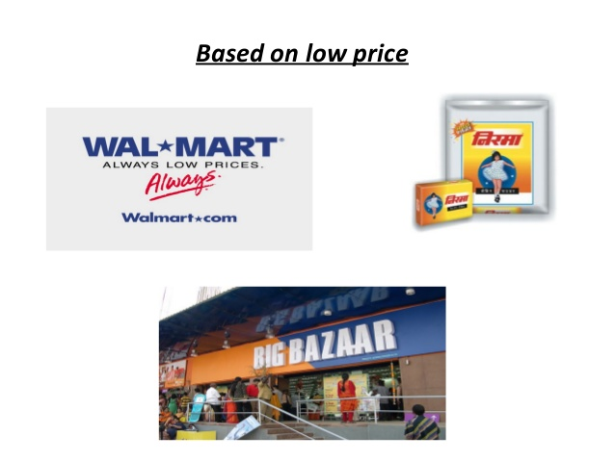

Slide 43
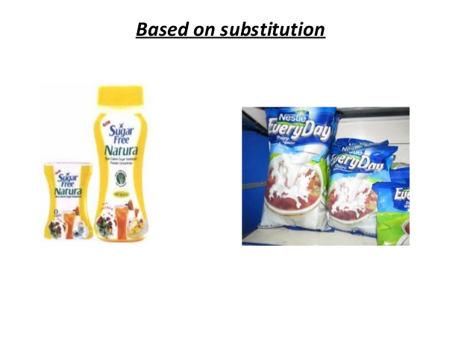

Slide 44
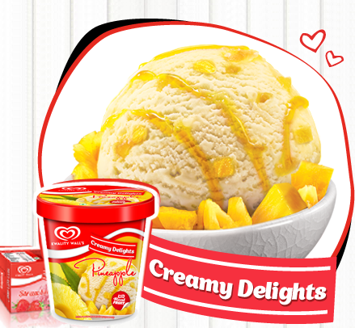
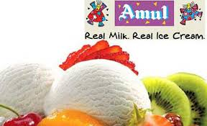
Notes:
Frozen desserts

Slide 45


Slide 46
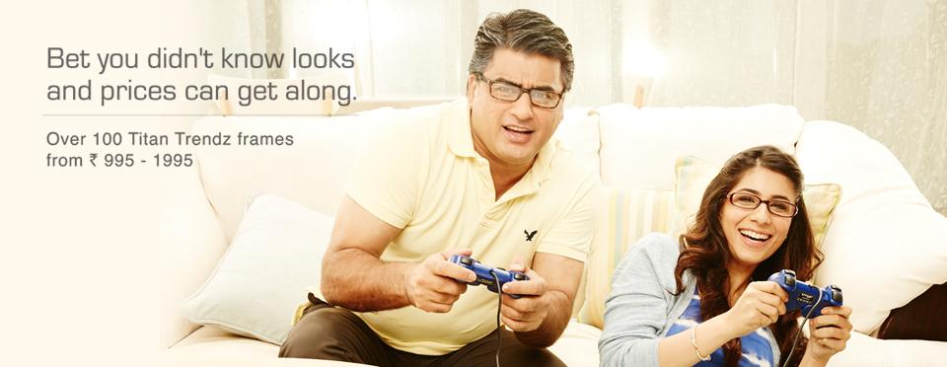

Slide 47
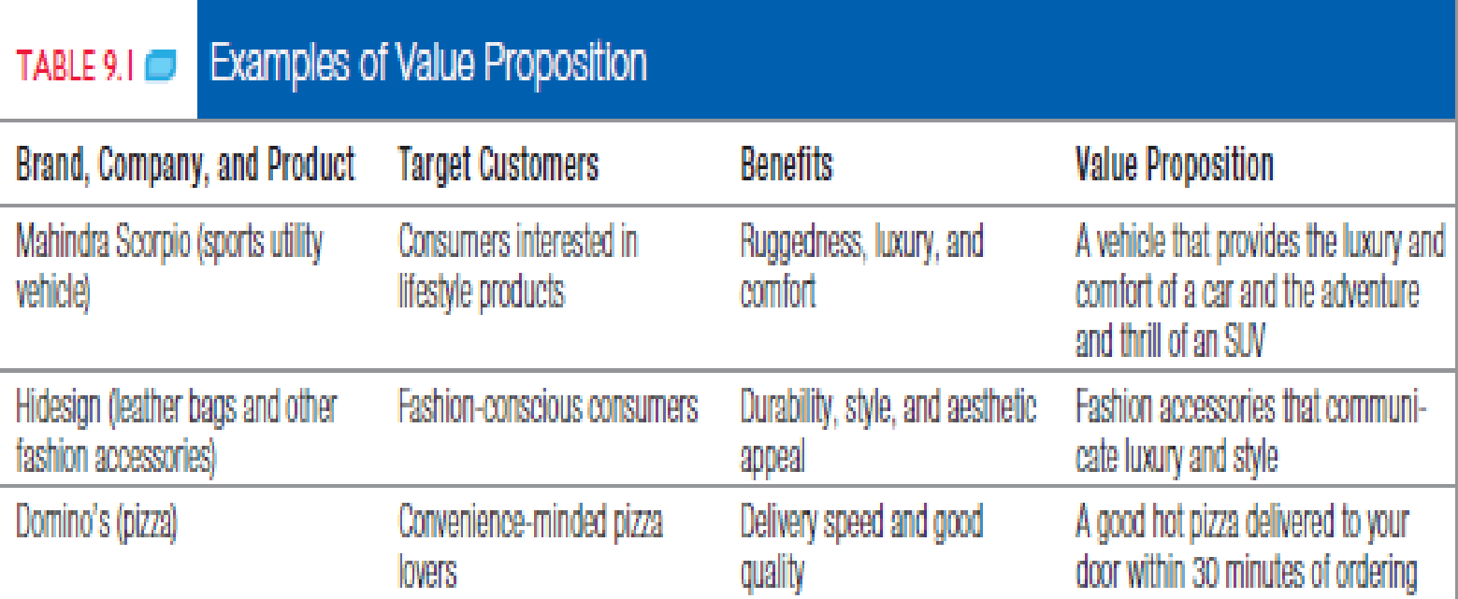

Slide 48
Steps to Choosing and Implementing a Positioning Strategy
Step 1. Identifying a set of possible competitive advantages: Competitive Differentiation.
Step 2. Selecting the right competitive advantage.
Step 3. Effectively communicating and delivering the chosen position to the market.

Slide 49
Positioning requires
To decide
Who the target consumer is?
Who the main competitors are?
How the brand is similar to these competitors?
How the brand is different from these competitors?

Slide 50
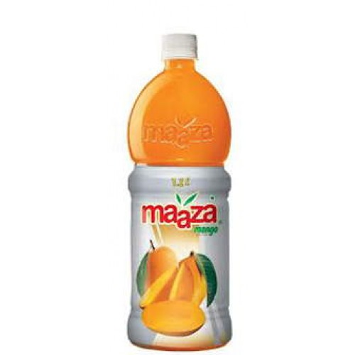
Bina Gutli Wala Aam : Coca Cola

Slide 51


Slide 52
Points of Parity
Those associations that are not necessarily unique to the brand but may in fact be shared with other brands.

Slide 53
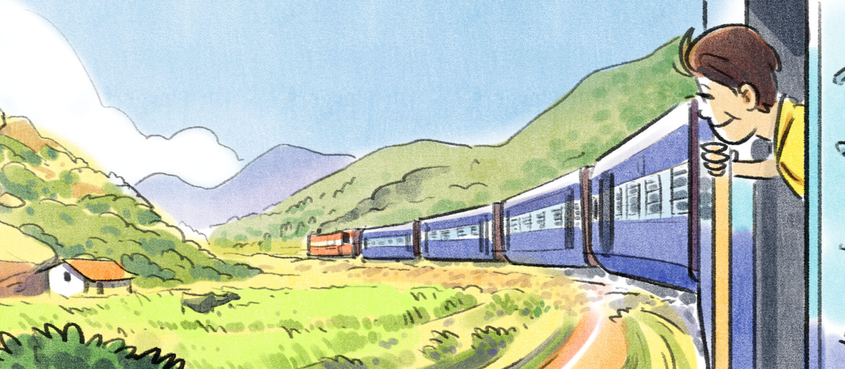

Slide 54
L
life is still beautiful
We all are very fond of our most innocent memories. Our childhood, our years of growing up. Those were simpler times, completely unadulterated. A memory here, and a memory there, still gets a smile on our lips.
nutritious benefits
Natural Ingredients & functional
Indian traditional ingredients
Great packaging & hygienic
Panakkam, Chilli guava, neer more, anar, jaljeera, jamun , kokum, aam panna, rose tamarind
Hector Bevrages- Neeraj Kakkar /Neeraj biyani
Frooti: Parle agro/
Slice and Tropicana: pepsicio/
Maaza: Coca Cola

Slide 55
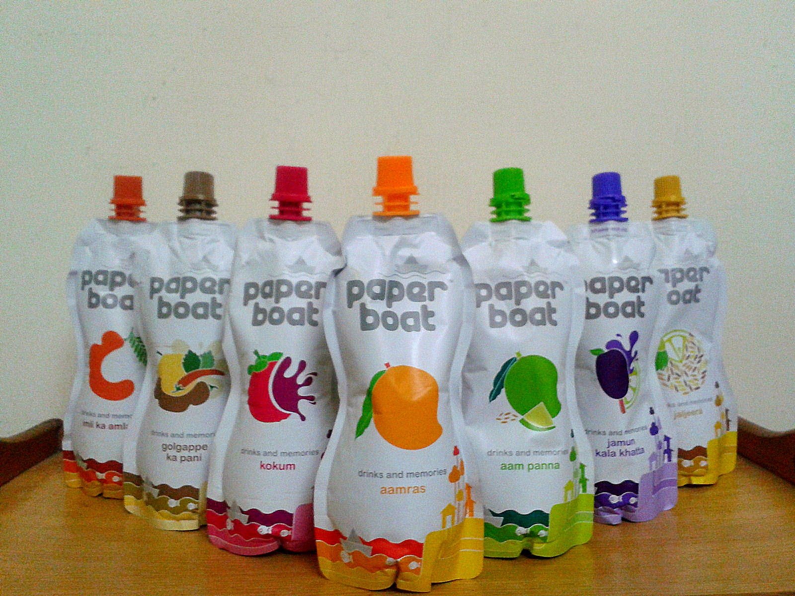

Slide 56
Points of Difference
These are attributes or benefits that consumers strongly associate with a brand, positively evaluate and believe that they cannot find these to the same extent with a competitive brand i.e. strong, favourable & unique associations.
These are of different types:
Brand performance associations (ujala)
Brand imagery associations
Emotional Branding

Slide 57
Criteria for POD
-Desirability.
-Deliverability.

Slide 58
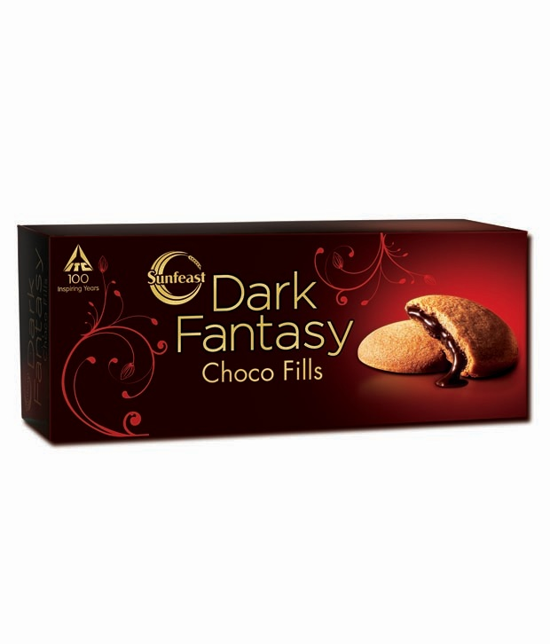
Package Aesthetics as differentiator

Slide 59
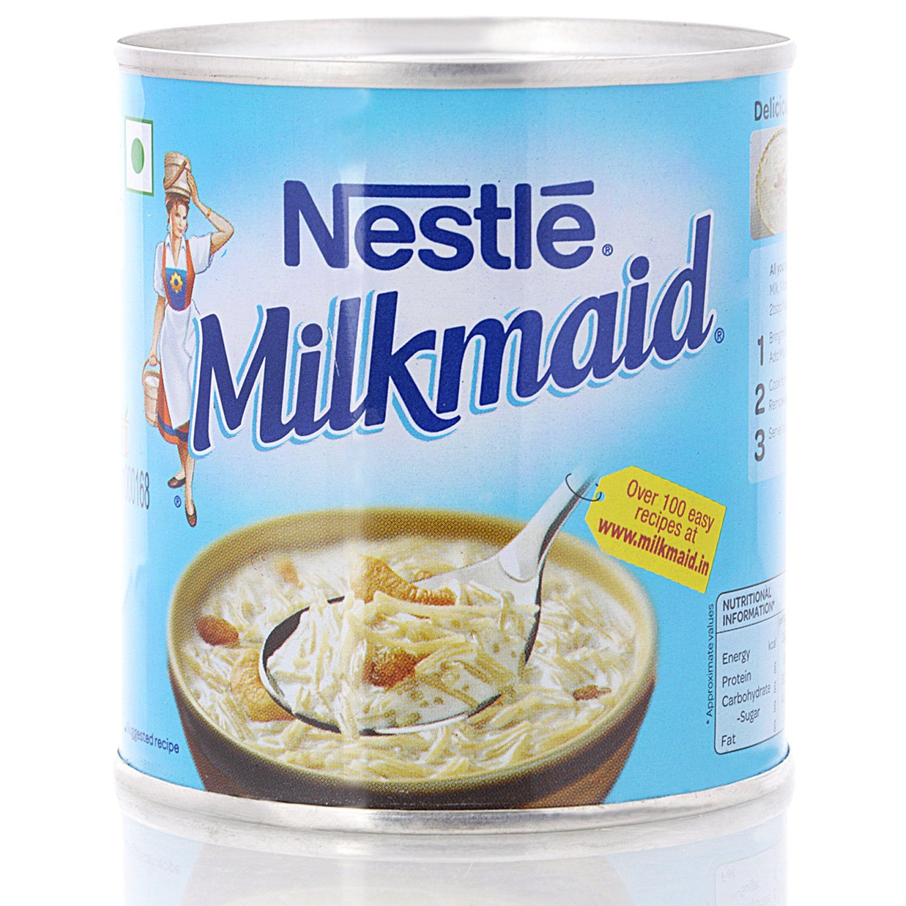
Notes:
Hul s fair and lovely

