Slide 1

DESIGNING AND MANAGING INTEGRATED MARKETING COMMUNICATIONS
MM

Slide 2

Learning Objectives
What is the role of marketing communications?
What is the marketing communications mix?
How do marketing communications work?
What are the major steps in developing effective communications?
How should the communications mix be set and evaluated?
What is an integrated marketing communications program?

Slide 3
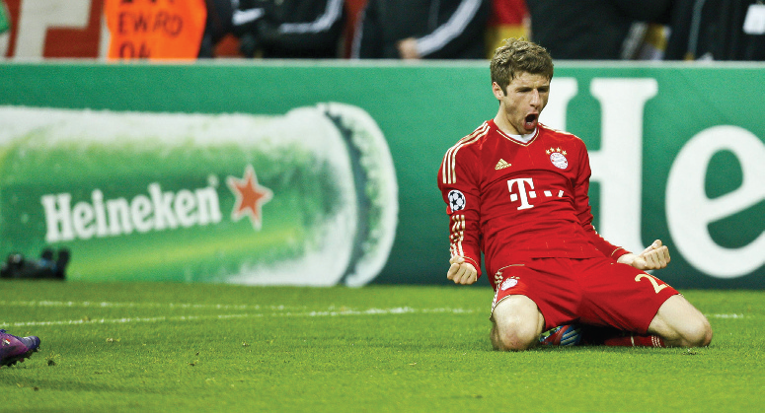
The Role of Marketing Communications
Marketing communications
  The means by which firms attempt to inform, persuade, and remind consumers about the products and brands they sell
Notes:
In a sense, they represent the voice of the company and its brands; they are a means by which the firm can establish a dialogue and build relationships with consumers. By strengthening customer loyalty, they can contribute to customer equity. Marketing communications also work by showing consumers how and why a product is used, by whom, where, and when. Consumers can learn who makes the product and what the company and brand stand for, and they can become motivated to try or use it. Marketing communications allow companies to link their brands to other people, places, events, brands, experiences, feelings, and things.
‹#›

Slide 4
Marketing Communications Mix
Advertising
Sales promotion
Events and experiences
Public relations and publicity
Online and social media marketing
Mobile marketing
Direct and database marketing
Personal selling
Notes:
The marketing communications mix consists of eight major modes of communication:
1. Advertising—Any paid form of nonpersonal presentation and promotion of ideas, goods, or services by an identified sponsor via print media (newspapers and magazines), broadcast media (radio and television), network media (telephone, cable, satellite, wireless), electronic media (audiotape, videotape, videodisk, CD-ROM, Web page), and display media (billboards, signs, posters).
2. Sales promotion—A variety of short-term incentives to encourage trial or purchase of a product or service including consumer promotions (such as samples, coupons, and premiums), trade promotions (such as advertising and display allowances), and business and sales force promotions (contests for sales reps).
3. Events and experiences—Company-sponsored activities and programs designed to create daily or special brand-related interactions with consumers, including sports, arts, entertainment, and cause events as well as less formal activities.
4. Public relations and publicity—A variety of programs directed internally to employees of the company or externally to consumers, other firms, the government, and media to promote or protect a company’s image or its individual product communications.
5. Online and social media marketing—Online activities and programs designed to engage customers or prospects and directly or indirectly raise awareness, improve image, or elicit sales of products and services.
6. Mobile marketing—A special form of online marketing that places communications on consumer’s cell phones, smart phones, or tablets.
7. Direct and database marketing—Use of mail, telephone, fax, e-mail, or Internet to communicate directly with or solicit response or dialogue from specific customers and prospects.
8. Personal selling—Face-to-face interaction with one or more prospective purchasers for the purpose of making presentations, answering questions, and procuring orders.
‹#›

Slide 5
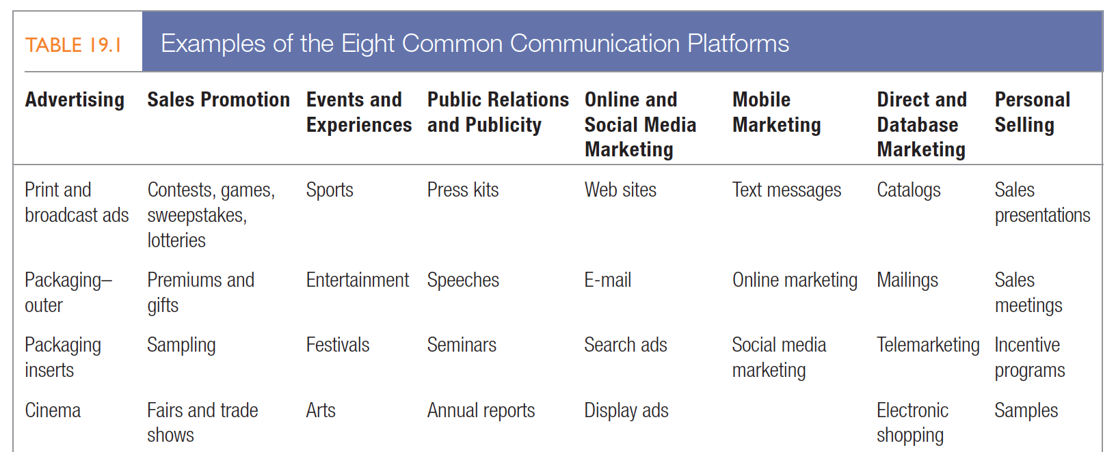
Common Communication Platforms
Notes:
Table 19.1 lists examples of these platforms, but company communication goes beyond these. The product’s styling and price, the shape and color of the package, the salesperson’s manner and dress, the store decor, and the company’s stationery all communicate something to buyers. Every brand contact delivers an impression that can strengthen or weaken a customer’s view of a company.
‹#›

Slide 6

How Does Marketing Communications Work?
The communications process models
  Macromodel of the communications process
  Micromodel of consumer responses
Notes:
Marketers should understand the fundamental elements of effective communications. Two models are useful: a macromodel and a micromodel.
‹#›

Slide 7
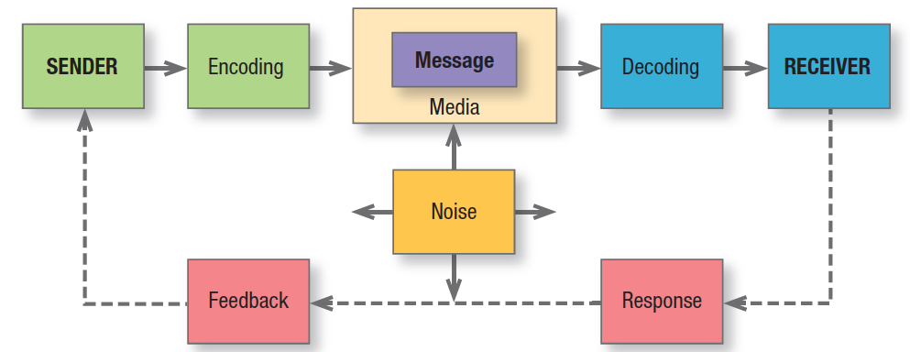
Figure 19.1
Elements in Communications Process
Notes:
Figure 19.1 shows a macromodel with nine key factors in effective communication. Two represent the major parties—sender and receiver. Two represent the major tools—message and media. Four represent major communication functions—encoding, decoding, response, and feedback. The last element in the system is noise, random and competing messages that may interfere with the intended communication.
Senders must know what audiences they want to reach and what responses they want to get. They must encode their messages so the target audience can successfully decode them. They must transmit the message through media that reach the target audience and develop feedback channels to monitor the responses. The more the sender’s field of experience overlaps that of the receiver, the more effective the message is likely to be. Note that selective attention, distortion, and retention processes—first introduced in Chapter 6—may be operating.
‹#›

Slide 8
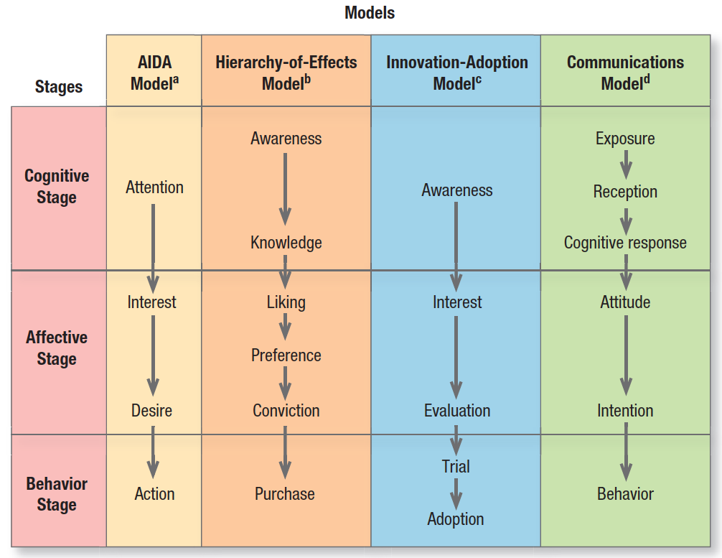
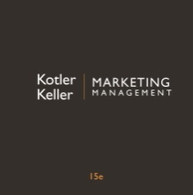
Figure 19.2
Response Hierarchy Models
Notes:
Micromodels of marketing communications concentrate on consumers’ specific responses to communications. Figure 19.2 summarizes four classic response hierarchy models. All these models assume the buyer passes through cognitive, affective, and behavioral stages in that order. This “learn-feel-do” sequence is appropriate when the audience has high involvement with a product category perceived to have high differentiation, such as an automobile or house. An alternative sequence, “do-feel-learn,” is relevant when the audience has high involvement but perceives little or no differentiation within the product category, such as airline tickets or personal computers. A third sequence, “learn-do-feel,” is relevant when the audience has low involvement and perceives little differentiation, such as with salt or batteries. By choosing the right sequence, the marketer can do a better job of planning communications.
‹#›

Slide 9
The ideal ad campaign
With an ideal ad campaign:
  The right consumer is exposed to the message at the right place and time
  The ad causes the consumer to pay attention
  The ad reflects consumer’s level of understanding of brand
  The ad positions points-of-difference and points-of-parity
  The ad motivates consumers to consider purchase
  The ad creates strong brand associations
Notes:
To increase the odds of success for a communications campaign, marketers must attempt to increase the likelihood that each step occurs. The challenges in achieving success with communications necessitate careful planning.
‹#›

Slide 10
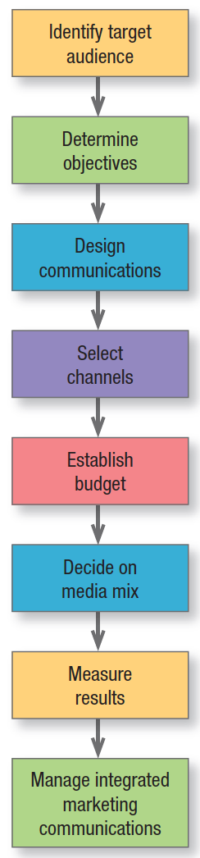
Developing Effective Communications
Notes:
Figure 19.3 shows the eight steps in developing effective communications.
‹#›

Slide 11
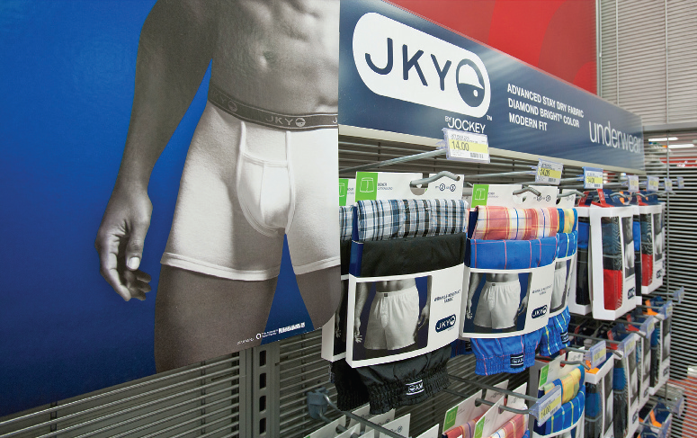
Developing Effective Communications
Identify the target audience
Set the communications objectives
  Establish need for category
  Build brand awareness
  Build brand attitude
  Influence brand purchase intention
Notes:
The process must start with a clear target audience in mind: potential buyers of the company’s products, current users, deciders, or influencers, as well as individuals, groups, particular publics, or the general public. The target audience is a critical influence on the communicator’s decisions about what to say, how, when, where, and to whom.
Set the Communications Objectives
Establish need for category—Establishing a product or service category as necessary for removing or satisfying a perceived discrepancy between a current motivational state and a desired motivational state.
2. Build brand awareness—Fostering the consumer’s ability to recognize or recall the brand in sufficient detail to make a purchase.
3. Build brand attitude—Helping consumers evaluate the brand’s perceived ability to meet a currently relevant need.
4. Influence brand purchase intention—Moving consumers to decide to purchase the brand or take purchase-related action.
‹#›

Slide 12
Developing Effective Communications
Design the Communications
Message strategy
Creative strategy
Message source
Notes:
Formulating the communications to achieve the desired response requires answering three questions: what to say (message strategy), how to say it (creative strategy), and who should say it (message source).
Message Strategy In selecting message strategy, management searches for appeals, themes, or ideas that will tie in to the brand positioning and help establish points-of-parity or points-of-difference. Some of these appeals or ideas may relate directly to product or service performance (the quality, economy, or value of the brand); others may relate to more extrinsic considerations (the brand as being contemporary, popular, or traditional).
Creative Strategy Communications effectiveness depends on how well a message is expressed as well as on its content. If a communication is ineffective, it may mean the wrong message was used or the right one was poorly expressed. Creative strategies are the way marketers translate their messages into a specific communication. We can broadly classify them as either informational or transformational appeals. An informational appeal elaborates on product or service attributes or benefits. A transformational appeal elaborates on a nonproduct-related benefit or image.
Message Source Research has shown that the source’s credibility is crucial to a message’s acceptance. The three most often identified sources of credibility are expertise, trustworthiness, and likability. Expertise is the specialized knowledge the communicator possesses to back the claim. Trustworthiness describes how objective and honest the source is perceived to be. Friends are trusted more than strangers or salespeople, and people who are not paid to endorse a product are viewed as more trustworthy than people who are paid. Likability describes the source’s attractiveness, measured in terms of candor, humor, and naturalness.
‹#›

Slide 13
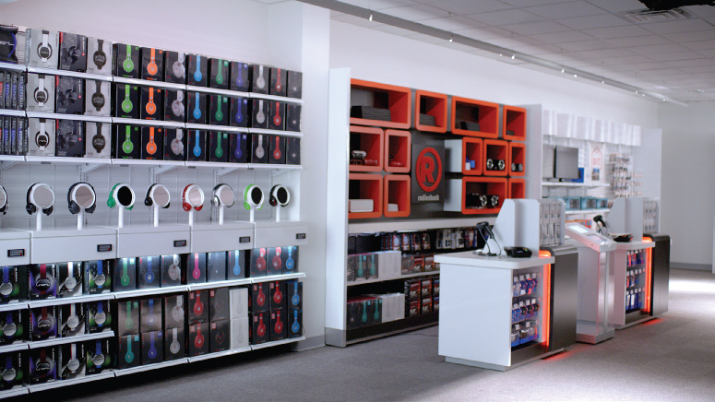
Creative Strategy
Informational appeals
  One-sided vs. two-sided arguments
Transformational appeals
  Negative/fear vs. positive appeals
Notes:
You might expect one-sided presentations that praise a product to be more effective than two-sided arguments that also mention shortcomings. Yet two-sided messages may be more appropriate, especially when negative associations must be overcome. Two-sided messages are more effective with more educated audiences and those who are initially opposed. The order in which arguments are presented is important. In a one-sided message, presenting the strongest argument first arouses attention and interest, important in media where the audience often does not attend to the whole message. With a captive audience, a climactic presentation might be more effective. For a two-sided message, if the audience is initially opposed, start with the other side’s argument and conclude with your strongest argument.
Communicators use negative appeals such as fear, guilt, and shame to get people to do things (brush their teeth, have an annual health checkup) or stop doing things (smoking, abusing alcohol, overeating). Fear appeals work best when they are not too strong, when source credibility is high, and when the communication promises, in a believable and efficient way, that the product or service will relieve the fear it arouses. Messages are most persuasive when they moderately disagree with audience beliefs. Stating only what the audience already believes at best just reinforces beliefs, while messages too much at variance with those beliefs will be rejected. Communicators also use positive emotional appeals such as humor, love, pride, and joy. Motivational or “borrowed interest” devices—such as cute babies, frisky puppies, popular music, and provocative sex appeals—are often employed to attract attention and raise involvement with an ad.
‹#›

Slide 14

Message source
Messages delivered by attractive or popular sources can achieve higher attention and recall
Notes:
The most credible source will score high on all three dimensions—expertise, trustworthiness, and likability. If a person has a positive attitude toward a source and a message or a negative attitude toward both, a state of congruity is said to exist. But what happens if a consumer hears a likable celebrity praise a brand she dislikes? Charles Osgood and Percy Tannenbaum believe attitude change will take place that increases the amount of congruity between the two evaluations. The consumer will end up respecting the celebrity somewhat less or the brand somewhat more. If she encounters the same celebrity praising other disliked brands, she will eventually develop a negative view of the celebrity and maintain negative attitudes toward the brands. The principle of congruity implies that communicators can use their good image to reduce some negative feelings toward a brand but in the process might lose some esteem with the audience.
‹#›

Slide 15

Developing Effective Communications
Select the communications channels
  Personal communications
  Nonpersonal channels
Notes:
Personal communications channels let two or more persons communicate face to face or person to audience through a phone, surface mail, or e-mail. They derive their effectiveness from individualized presentation and feedback and include direct marketing, personal selling, and word of mouth. We can draw a further distinction between advocate, expert, and social communications channels. Advocate channels consist of company salespeople contacting buyers in the target market. Expert channels consist of independent experts making statements to target buyers. Social channels consist of neighbors, friends, family members, and associates talking to target buyers.
Nonpersonal channels are communications directed to more than one person and include advertising, sales promotions, events and experiences, and public relations.
Integration of Communications Channels Although personal communication is often more effective than mass communication, mass media might be the major means of stimulating it. Mass communications affect personal attitudes and behavior through a two-step process. Ideas often first flow from radio, television, and print to opinion leaders or consumers highly engaged with media and then from these influencers to less media-involved population groups.
‹#›

Slide 16

Establish the Marketing Communications Budget
Affordable method
Percentage-of-sales method
Competitive-parity method
Objective-and-task method
Notes:
How do companies set their communications budgets? We will describe four common methods: the affordable method, the percentage-of-sales method, the competitive-parity method, and the objective-and-task method.
Affordable Method Some companies set the communications budget at what they think they can afford.
Percentage-of-Sales Method Some companies set communication expenditures at a specified percentage of current or anticipated sales or of the sales price.
Competitive-Parity Method Some companies set their communications budgets to achieve share-of-voice parity with competitors.
Objective-and-Task Method The most defensible approach, the objective-and-task method, calls upon marketers to develop communications budgets by defining specific objectives, identifying the tasks that must be performed to achieve these objectives, and estimating the costs of performing them. The sum of these costs is the proposed communications budget.
‹#›

Slide 17
Objective-and-Task Method
  Establish market share goal
  Select % of market reached by advertising
Estimate % of prospects who should try brand
Calculate ad impressions per 1% trial rate
Find gross rating points to be purchased
Calculate budget for cost of gross rating point
Notes:
1. Establish the market share goal. The company estimates 50 million potential users and sets a target of attracting 8 percent of the market—that is, 4 million users.
2. Select the percentage of the market that should be reached by advertising. The advertiser hopes to reach 80 percent of the market (40 million prospects) with its advertising message.
3. Estimate the percentage of aware prospects who should be persuaded to try the brand. The advertiser would be pleased if 25 percent of aware prospects (10 million) tried Sunburst. It estimates that 40 percent of all triers, or 4 million people, will become loyal users. This is the market share goal.
4. Calculate the number of advertising impressions per 1 percent trial rate. The advertiser estimates that 40 advertising impressions (exposures) for every 1 percent of the population will bring about a 25 percent trial rate.
5. Find the number of gross rating points to be purchased. A gross rating point is one exposure to 1 percent of the target population. Because the company wants to achieve 40 exposures to 80 percent of the population, it will want to buy 3,200 gross rating points.
6. Calculate the necessary advertising budget on the basis of the average cost of buying a gross rating point. Suppose it costs an average of $3,277 to expose 1 percent of the target population to one impression. Then 3,200 gross rating points will cost $10,486,400 (= $3,277 X 3,200) in the introductory year.
The objective-and-task method has the advantage of requiring management to spell out its assumptions about the relationship among dollars spent, exposure levels, trial rates, and regular usage.
‹#›

Slide 18
Selecting the Marketing Communications Mix
Advertising
Sales promotion
Events and experiences
Public relations and publicity
Online and social media marketing
Mobile marketing
Direct and database marketing
Sales force
Notes:
Companies must allocate their marketing communications budget over the eight major modes of communication— advertising, sales promotion, events and experiences, public relations and publicity, online and social media marketing, mobile marketing, direct and database marketing, and the sales force. Within the same industry, companies can differ considerably in their media and channel choices.
‹#›

Slide 19

Marketing Communications Mix Characteristics
Advertising
  Pervasiveness
  Amplified expressiveness
  Control
Sales Promotion
  Ability to be attention-getting
  Incentive
  Invitation
Notes:
Advertising Advertising reaches geographically dispersed buyers. It can build up a long-term image for a product (Coca-Cola ads) or trigger quick sales (a Macy’s ad for a weekend sale).
1. Pervasiveness—Advertising permits the seller to repeat a message many times. It also allows the buyer to receive and compare the messages of various competitors. Large-scale advertising says something positive about the seller’s size, power, and success.
2. Amplified expressiveness—Advertising provides opportunities for dramatizing the company and its brands and products through the artful use of print, sound, and color.
3. Control—The advertiser can choose the aspects of the brand and product on which to focus communications.
Sales Promotion Companies use sales promotion tools—coupons, contests, premiums, and the like—to draw a stronger and quicker buyer response, including short-run effects such as highlighting product offers and boosting sagging sales. Sales promotion tools offer three distinctive benefits:
1. Ability to be attention-getting—They draw attention and may lead the consumer to the product.
2. Incentive—They incorporate some concession, inducement, or contribution that gives value to the consumer.
3. Invitation—They include a distinct invitation to engage in the transaction now.
‹#›

Slide 20
Marketing Communications Mix Characteristics
Events and experiences
  Relevant
  Engaging
  Implicit
Public relations and publicity
  High credibility
  Ability to reach hard-to-find buyers
  Dramatization
Notes:
Events and Experiences Events and experiences offer many advantages as long as they have the following characteristics:
1. Relevant—A well-chosen event or experience can be seen as highly relevant because the consumer is often personally invested in the outcome.
2. Engaging—Given their live, real-time quality, events and experiences are more actively engaging for consumers.
3. Implicit—Events are typically an indirect soft sell.
Public Relations and Publicity Marketers tend to underuse public relations, yet a well-thought-out program coordinated with the other communications-mix elements can be extremely effective, especially if a company needs to challenge consumers’ misconceptions. The appeal of public relations and publicity is based on three distinctive qualities:
1. High credibility—News stories and features are more authentic and credible to readers than ads.
2. Ability to reach hard-to-find buyers—Public relations can reach prospects who prefer to avoid mass media and targeted promotions.
3. Dramatization—Public relations can tell the story behind a company, brand, or product.
‹#›

Slide 21
Marketing Communications Mix Characteristics
Online and social media marketing
  Rich
  Interactive
  Up to date
Mobile marketing
  Timely
  Influential
  Pervasive
Notes:
Online and Social Media Marketing Online marketing and messages can take many forms to interact with consumers when they are in active search mode or just browsing and surfing online for something to do. They share three characteristics:
1. Rich—Much information or entertainment can be provided—as much or as little as a consumer might want.
2. Interactive—Information can be changed or updated depending on the person’s response.
3. Up to date—A message can be prepared very quickly and diffused through social media channels.
Mobile Marketing Increasingly, online marketing and social media rely on mobile forms of communication and smart phones or tablets. Three distinguishing characteristics of mobile marketing are:
1. Timely—Mobile communications can be very time-sensitive and reflect when and where a consumer is.
2. Influential—Information received or obtained via a smart phone can reach and influence consumers as they are making a purchase decision.
3. Pervasive—Consumers typically carry their smart phones everywhere, so mobile communications are at their fingertips.
‹#›

Slide 22
Marketing Communications Mix Characteristics
Direct and database marketing
  Personal
  Proactive
  Complementary
Personal selling
  Customized
  Relationship-oriented
  Response-oriented
Notes:
Direct and Database Marketing The advent of “Big Data” has given marketers the opportunity to learn even more about consumers and develop more personal and relevant marketing communications. Three noteworthy characteristics of direct and database marketing are:
1. Personal—Personal facts, opinions, and experiences can be stored in massive databases and incorporated into personal messages.
2. Proactive—A direct marketing piece can create attention, inform consumers, and include a call to action.
3. Complementary—Product information can be provided that helps other marketing communications, especially in terms of e-commerce. A good catalog might spur online shopping.
Personal Selling Personal selling is the most effective tool at later stages of the buying process, particularly in building up buyer preference, conviction, and action. It has three notable qualities:
1. Customized—The message can be designed to appeal to any individual.
2. Relationship-oriented—Personal selling relationships can range from a matter-of-fact selling relationship to a deep personal friendship.
3. Response-oriented—The buyer is often given personal choices and encouraged to directly respond.
‹#›

Slide 23

Setting the Marketing Communications Mix
Type of product market
  Consumer vs. business marketers
  Advertising/sales promotion vs. personal selling
Product life-cycle stage
Notes:
Consumer marketers tend to spend comparatively more on sales promotion and advertising; business marketers tend to spend comparatively more on personal selling. In general, personal selling is used more with complex, expensive, and risky goods and in markets with fewer and larger sellers (hence, business markets).
Advertising combined with personal selling can increase sales over personal selling alone. Corporate advertising can improve a company’s reputation and improve the sales force’s chances of getting a favorable first hearing and early adoption of the product.
An effectively trained company sales force can make four important contributions:
1. Increase stock position—Sales reps can persuade dealers to take more stock and devote more shelf space to the company’s
brand.
2. Build enthusiasm—Sales reps can build dealer enthusiasm by dramatizing planned advertising and communications support for the company’s brand.
3. Conduct missionary selling—Sales reps can sign up more dealers.
4. Manage key accounts—Sales reps can take responsibility for growing business with the most important accounts.
Product Life-Cycle Stage In the introduction stage of the product life cycle, advertising, events and experiences, and publicity have the highest cost-effectiveness, followed by personal selling to gain distribution coverage and sales promotion and direct marketing to induce trial. In the growth stage, demand has its own momentum through word of mouth and interactive marketing. Advertising, events and experiences, and personal selling all become more important in the maturity stage. In the decline stage, sales promotion continues strong, other communication tools are reduced, and salespeople give the product only minimal attention.
‹#›

Slide 24
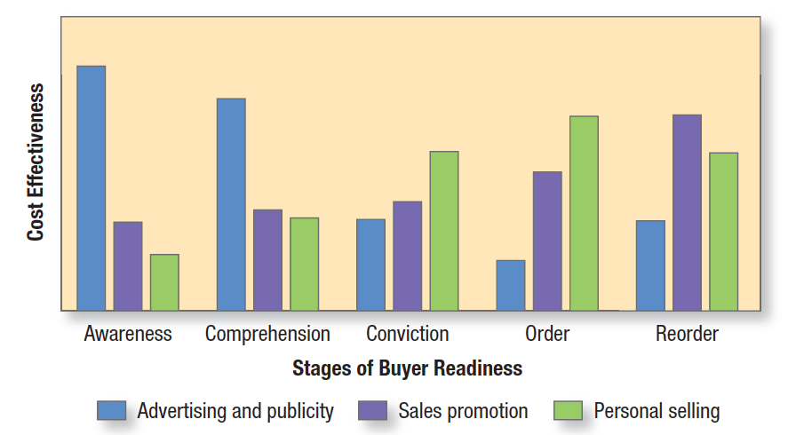
Setting the Marketing Communications Mix
Buyer-readiness stage
Notes:
Communication tools vary in cost-effectiveness at different stages of buyer readiness. Figure 19.4 shows the relative cost-effectiveness of three communication tools. Advertising and publicity play the most important roles in the awareness-building stage. Customer comprehension is primarily affected by advertising and personal selling. Customer conviction is influenced mostly by personal selling. Personal selling and sales promotion are most helpful in closing the sale. Reordering is also affected mostly by personal selling and sales promotion and somewhat by reminder advertising. Note too that online activities can affect virtually any stage.
‹#›

Slide 25
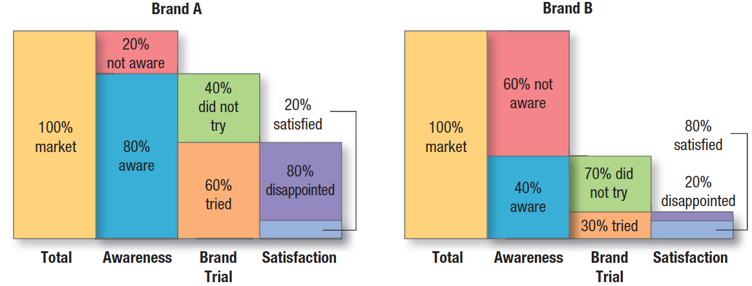
Measuring Communication Results
Notes:
After implementing the communications plan, the communications director must measure its impact. Members of the target audience are asked whether they recognize or recall the message, how many times they saw it, what points they recall, how they felt about the message, and what are their previous and current attitudes toward the product and the company. The communicator should also collect behavioral measures of audience response, such as how many people bought the product, liked it, and talked to others about it.
Figure 19.5 provides an example of good feedback measurement. We find 80 percent of the consumers in the total market are aware of brand A, 60 percent have tried it, and only 20 percent who tried it are satisfied. This indicates that the communications program is effective in creating awareness, but the product fails to meet consumer expectations. In contrast, 40 percent of the consumers in the total market are aware of brand B and only 30 percent have tried it, but 80 percent of them are satisfied. In this case, the communications program needs to be strengthened to take advantage of the brand’s potential power.
‹#›

Slide 26
Managing Integrated Marketing Communications
Integrated marketing communications (IMC)
  “A planning process designed to assure that all brand contacts received by a customer or prospect for a product, service, or organization are relevant to that person and consistent over time”
Notes:
When done well, this planning process evaluates the strategic roles of a variety of communications disciplines and combines them seamlessly to provide clarity, consistency, and maximum impact of messages. The wide range of communication tools, messages, and audiences available to marketers makes it imperative that companies move toward integrated marketing communications. They must adopt a 360-degree view of consumers to fully understand all the different ways communications can affect behavior.
‹#›

Slide 27
Managing Integrated Marketing Communications
Coordinating media & implementing IMC
Coverage
Contribution
Cost
Commonality
Conformability
Complementarity
Notes:
Media coordination can occur across and within media types, but marketers should combine personal and nonpersonal communications channels through multiple-vehicle, multiple-stage campaigns to achieve maximum impact and increase message reach and impact.
Integrated marketing communications can produce stronger message consistency and help build brand equity and create greater sales impact. In assessing the collective impact of an IMC program, the marketer’s overriding goal is to create the most effective and efficient communications program possible. The following “six Cs” criteria can help determine whether communications are truly integrated.
Coverage. Coverage is the proportion of the audience reached by each communication option employed as well as the amount of overlap among those options.
Contribution. Contribution is the inherent ability of a marketing communication to create the desired response and communication effects from consumers in the absence of exposure to any other communication option.
Commonality. Commonality is the extent to which common associations are reinforced across communication options; that is, the extent to which different communication options share the same meaning.
Complementarity. Communication options are often more effective when used in tandem. Complementarity relates to the extent to which different associations and linkages are emphasized across communication options.
Conformability. In any integrated communication program, the message will be new to some consumers and not to others. Conformability refers to the extent to which a marketing communication option works for such different groups of consumers.
Cost. Marketers must evaluate marketing communications on all these criteria against their cost to arrive at the most effective and most efficient communications program.
‹#›

Slide 28
ANY Q’S?
GOOD LUCK!

