Slide 1

Free Speech

Slide 2
Duration
Timing : 1-2 minutes each student

Slide 3
Parameters
Content
Articulation
Body Language

Slide 4
Topics Examples

Slide 5
Higher education is a basic need for succeeding in life today.

Slide 6
Students that study online cheat more.

Slide 7
Smoking in all public places should be illegal worldwide

Slide 8
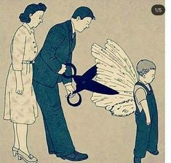

Slide 9


Slide 10
Fashion Reveals Your True Identity.

