Slide 1


Notes:
Discuss the learning from the movie.
We have a social media problem. ...
Social media really is designed to be addictive. ...
It is more destructive than being creative if not used wisely
You can (and must) make the changes on your own.
If you can control it, you can use it to your benefit. That’s what we are here for.

Slide 2

Social Media Management
Notes:
Ask what can we do effectively with Social Media. We can manage is productively. Why is it so important for you all to manage your social media media account?

Slide 3
Learning Outcomes
Understand the importance of social media
Understand the importance of personal branding
Practice the optimum use of social media in daily life
Apply its different uses in professional life

Slide 4


Slide 5

Conscious and Intentional effort to create and influence public perception
Elevates your credibility
Differentiates you from the competition
Ultimately advances your career

Slide 6
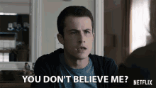
FIRING employees is SIMPLE these days.
All they have to do is POST IRRESPONSIBLY on SOCIAL MEDIA. Period.

Slide 7

During a baseball match in Canada, someone from the audience tossed a beer can at Orioles outfielder, Hyun Soo Kim.
It wasn’t long before social media lit up and a city-wide search began for the alleged ‘beer-tosser’.
While ‘the doer’ didn’t post anything himself on social media, it wasn’t long before the Twitterverse outed Ken, a sports journalist.
Ken’s current employer was quick to respond, noting the seriousness of the situation.
Not only was Ken charged by the Toronto Police for mischief, he is no longer employed with PostMedia.

Slide 8
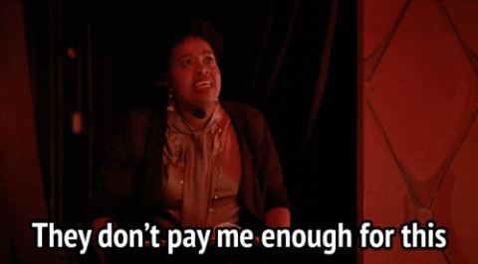
Earlier in 2016, a disgruntled employee, Talia Jane, posted about her low pay on Medium.
It was a very public open letter to the CEO of Yelp. As a customer service rep living in San Francisco, she claimed her pay was so low that she couldn’t afford to pay for groceries, had stopped using her heater, was balancing all sorts of debt, and spent 80% of her income to pay for rent in San Francisco.
In his reply back, Jeremy Stoppelmann, the CEO of Yep at the time, acknowledged the truthful statements about San Francisco being an expensive city to live in.
The personal attack towards him, however, didn’t bode well for Jane, who was let go not long after.

Slide 9

This isn't the first time Facebook has gotten someone fired.
A situation occurred in June after a Bank of America employee unleashed a racist rant on Facebook.
The post featured derogatory language directed towards African Americans. The woman also called for people to "go back to Africa."
Bank of America reportedly received thousands of complaints regarding the comments, and the employee was terminated.

Slide 10

Curt Schilling, a baseball analyst with ESPN, shared a Facebook post directed towards the transgender community.
Schilling added, "A man is a man no matter what they call themselves... Now you need laws telling us differently? Pathetic."
ESPN subsequently fired Schilling, noting that ESPN is an "inclusive company."

Slide 11
Do you think EVERYTHING you post on social media
impacts your PERSONAL BRAND?
Yes/No?
Notes:
Now that I have your attention

Slide 12
How do you want to be known?
Notes:
Ask the participants to put their words on the social media

Slide 13
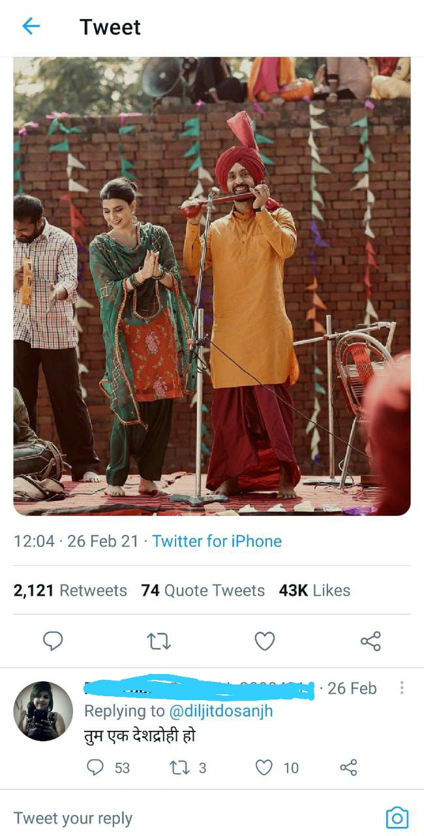
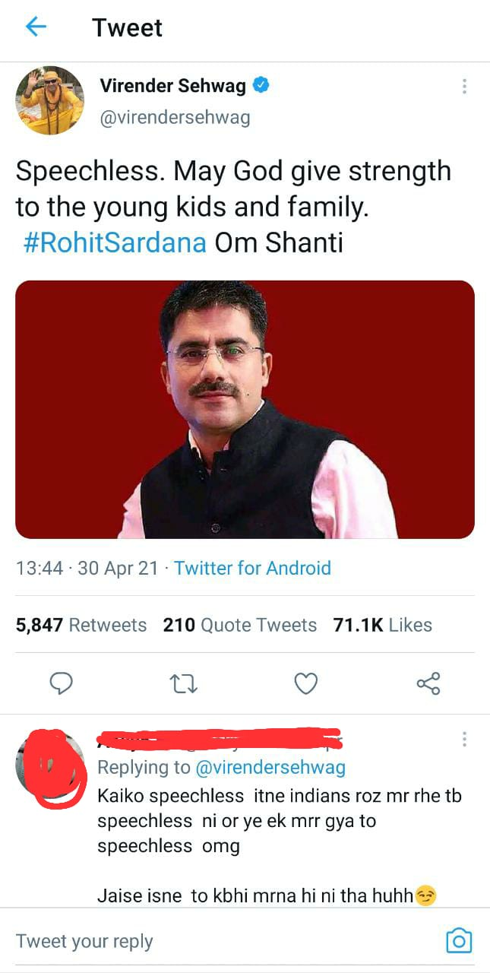



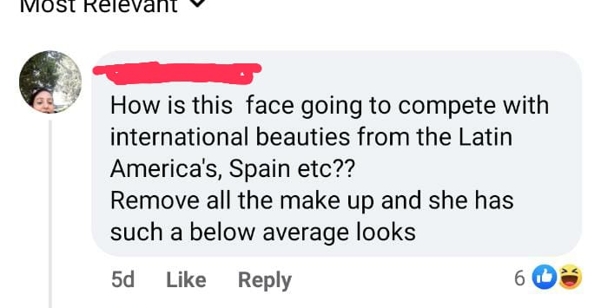

Notes:
Before the students give an answer to the slide the trainer shows this slide and then asks the questions again. (Highlighting the 3 words on the slide)
Trainer must make a comparison of the words mentioned in the chat box for last slide.

Slide 14

CLARITY
CONSISTENCY
CONSTANCY

Slide 15

Be clear about who you are and who is your target audience
Know your competitors
Distinguish your brand

Slide 16

Platforms to build personal branding!
LinkedIn
Naukri
Facebook
Monster
Instagram
Twitter
WhatsApp
Medium

Slide 17

Same brand message across all communication channels
If your personal brand varies then your audience will be confused

Slide 18

Strong brands are always visible to their TG
Monitor your brand through Social media

Slide 19
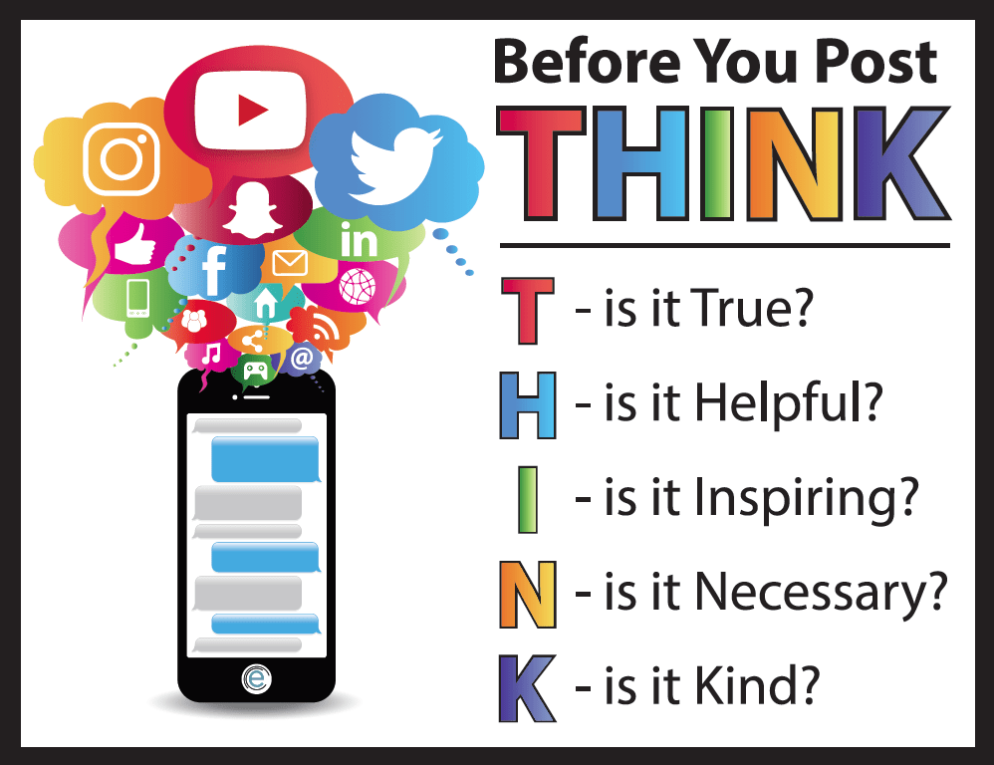

Slide 20
FIRING employees is SIMPLE these days.
All they have to do is POST IRRESPONSIBLY on SOCIAL MEDIA. Period.

Slide 21


