Slide 1

How much value do you give to words?

Slide 2
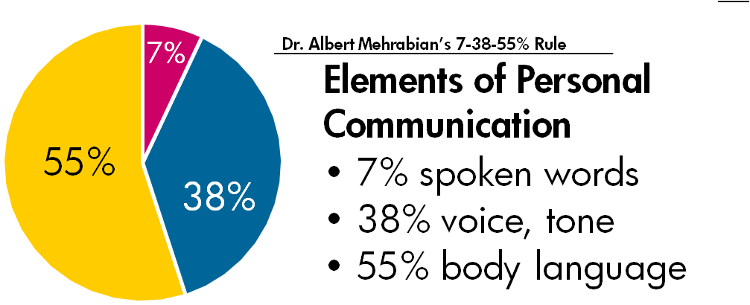
Albert Mehrabian Principle
2

Slide 3
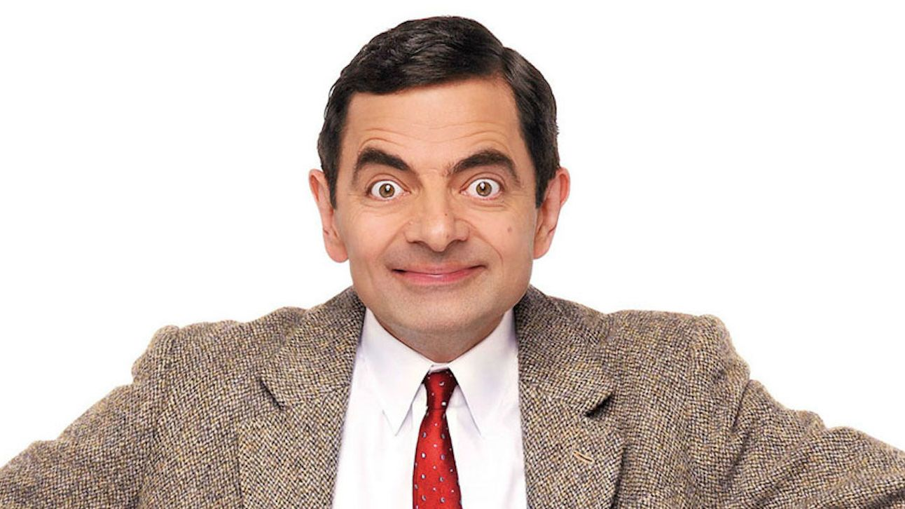
05th October 2020 Non- Verbal Communication 1

Slide 4
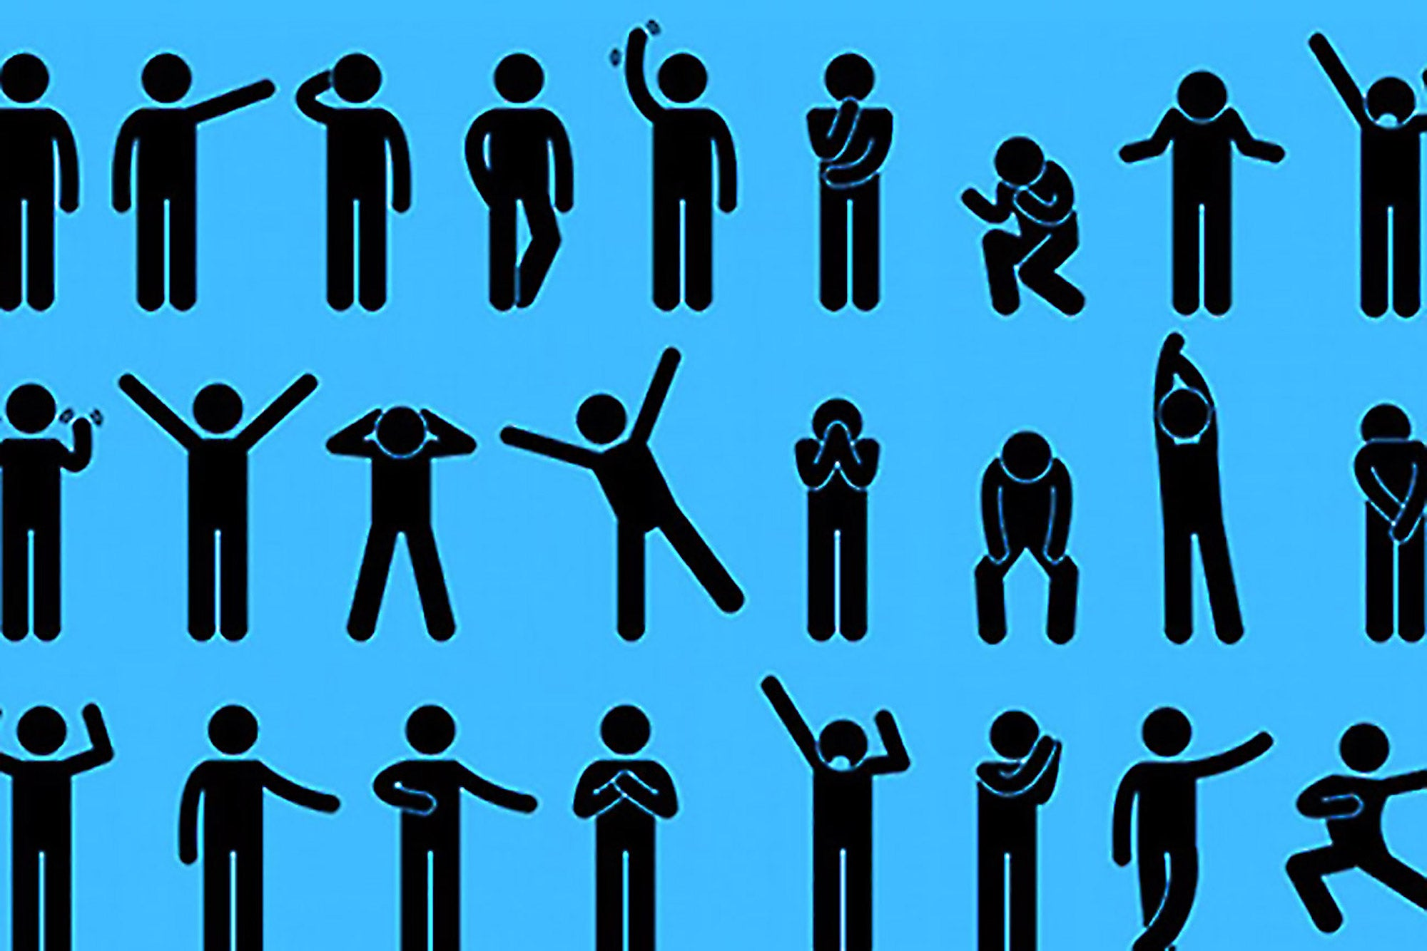
Nonverbal Communication
05th October 2020 Non- Verbal Communication
4

Slide 5
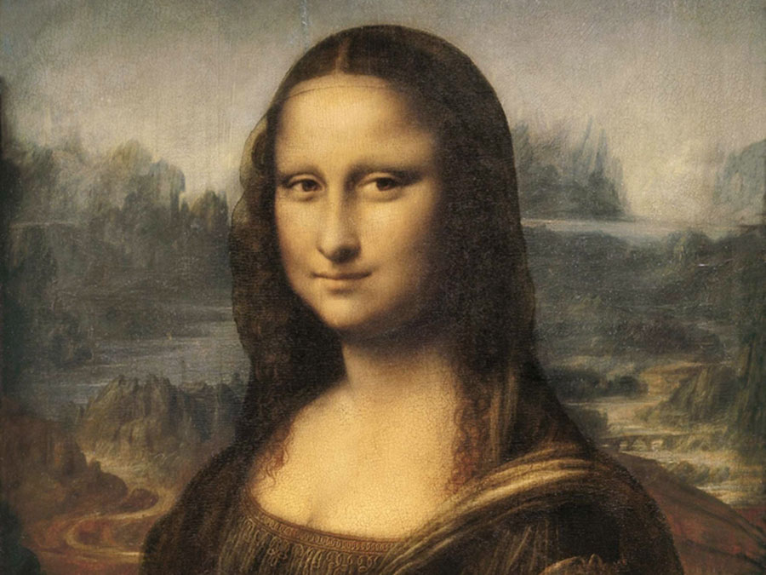
Notes:
https://www.bodylanguagesuccess.com/2011/09/negotiation-secret-312-mona-lisa-isnt.html

Slide 6
Types of nonverbal communication
Kinesics
Proxemics
Haptics
Oculesics
Chronemics
Vocalics
Chromatics
Olfactics

Slide 7
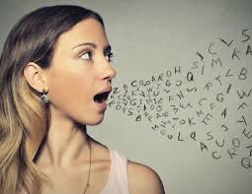
Vocalics
The volume, intonation, tone of voice and pitch used by the sender for communicating
7

Slide 8
I never said she stole my money
I never said she stole my money
I never said she stole my money
I never said she stole my money

Slide 9
I never said she stole my money
I never said she stole my money
I never said she stole my money

Slide 10
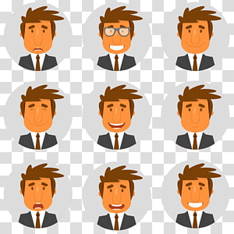
Kinesics
It is the study of the body language of a person, i.e., gestures, postures, facial expressions, eye contact, etc.
10

Slide 11

Haptics
The use of touch
11

Slide 12
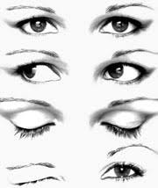
Oculesics
The study of eye movement
12

Slide 13
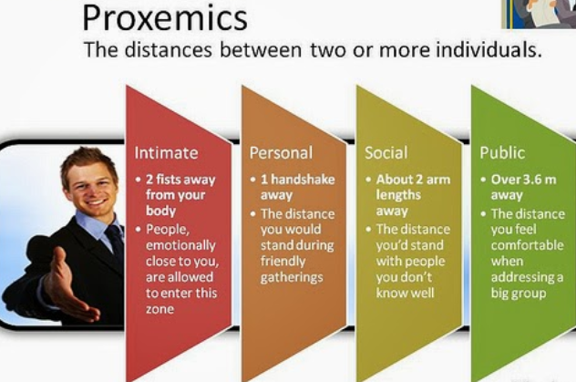
Proxemics
The distance maintained by a person while communicating with others.
13

Slide 14

Chronemics
The study of how time is used in communication
Indicator of status
Running late for a meeting means differently for different people
The way people use time reflects their personality
14

Slide 15
Importance of nonverbal communication
It plays a role in face-to-face situation
It expresses nonverbal paralinguistic messages
Convey information about emotional state
Reinforce or modify what is said
15

Slide 16
Characteristics of Nonverbal communication
Subconscious- we are often not aware of the message we send nonverbally
Contextual- it depends on the situation on which it occurs
Ambiguous- nonverbal messages are open to interpretation and are often confusing
Cultural- a nonverbal message commonly used in one culture may send a completely different message in another culture
16
Notes:
Subconscious- we are often not aware of the message we send nonverbally
Contextual- it depends on the situation on which it occurs
Ambiguous- nonverbal messages are open to interpretation and are often confusing
Cultural- a nonverbal message commonly used in one culture may send a completely different message in another culture

Slide 17
How to Improve Non-verbal communication
Avoid giving conflicting signals
Try to be as honest as possible in communicating your emotions
Smile genuinely
Maintain eye-contact
Beware of your posture and gesture
Minimize unintentional messages
17

Slide 18
Thank You
18

