Slide 1




Slide 2


Slide 3

How would you showcase these skills?
Resume
Interview

Slide 4


Slide 5
Learning Outcomes
Understand the types and flow of communication
Apply the effectiveness of communication by 7 Cs
Analyze the modes of communication

Slide 6
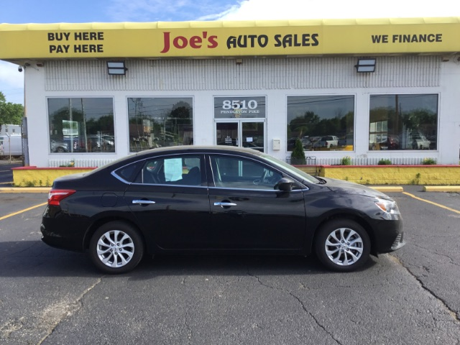
Notes:
Let us take an example.
Here is an example of Joe’s auto sales services (company operating in Vereniging, South Africa).

Slide 7
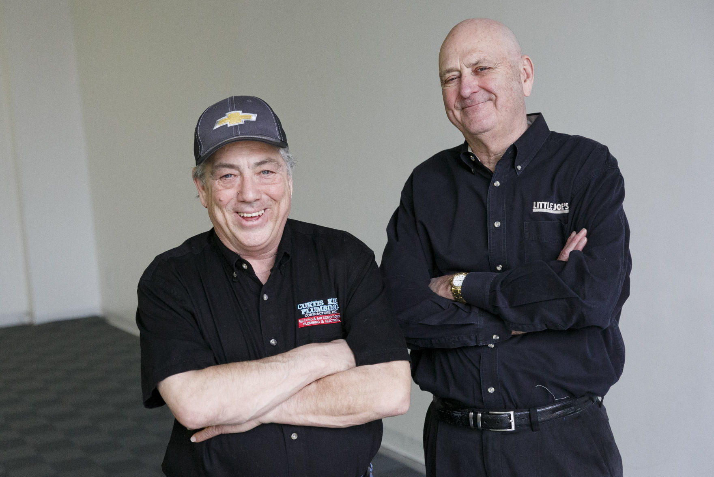
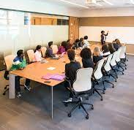
New Cars on the lot
Current interest rates available to customers
Monthly sales goals proximity
Mr. Joe
Hot Sheet
Notes:
Little Joe holds a meeting every morning with his entire sales staff. In this meeting he gives them information on new cars on the lot, current interest rates available to customers, and how close they are to meeting the company’s monthly sales goals.
The most important information shared is a “hot sheet” that lists the cars that need to be sold ASAP because they have been on the lot for more than forty-five days.

Slide 8



Notes:
As Little Joe goes through his morning briefing, the sales staff listen, take notes, and sometimes ask a few clarifying questions, but clearly the purpose of this daily pow-wow is for Little Joe to convey the information his staff need to perform their jobs and meet the expectations of management.

Slide 9

Notes:
Every car sold from the hot sheet earns the salesperson a $500 bonus, adding more than a little motivation to the mix

Slide 10

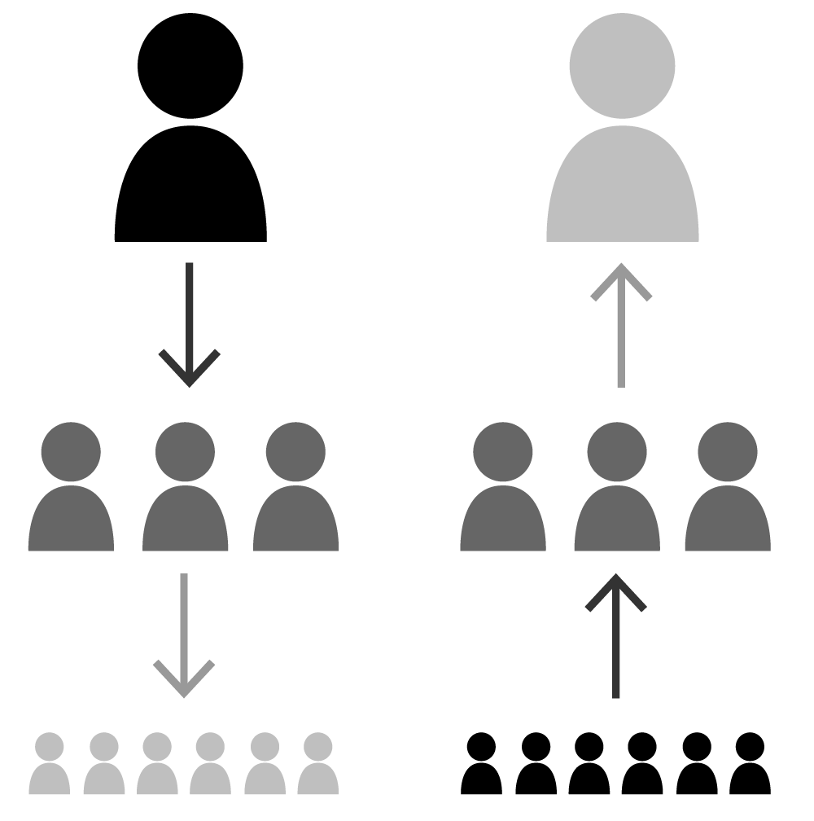
Downward Communication
  Information
  Policies
  Motivation
  Clarification of doubts
Upward Communication
  Reports

Slide 11
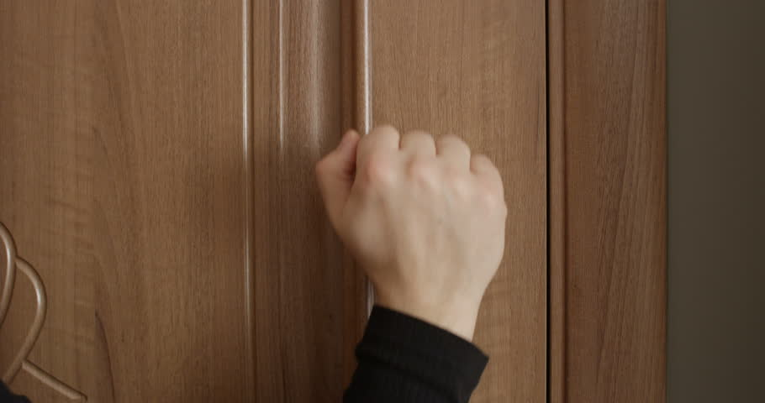
Communication ???
Notes:
One afternoon, Frances, the sales manager, knocks at Little Joe’s office door, which is always open.

Slide 12

Notes:
The availability of communication channels affects employees’ overall satisfaction with upward communication. For example, an open-door policy sends the signal to employees that the manager welcomes impromptu conversations and other communication. This is likely to make employees feel satisfied with their level of access to channels of upward communication and less apprehensive about communicating with their superiors. For management, upward communication is an important source of information that can inform business decisions. It helps to alert management of new developments, levels of performance, and other issues that may require their attention.

Slide 13
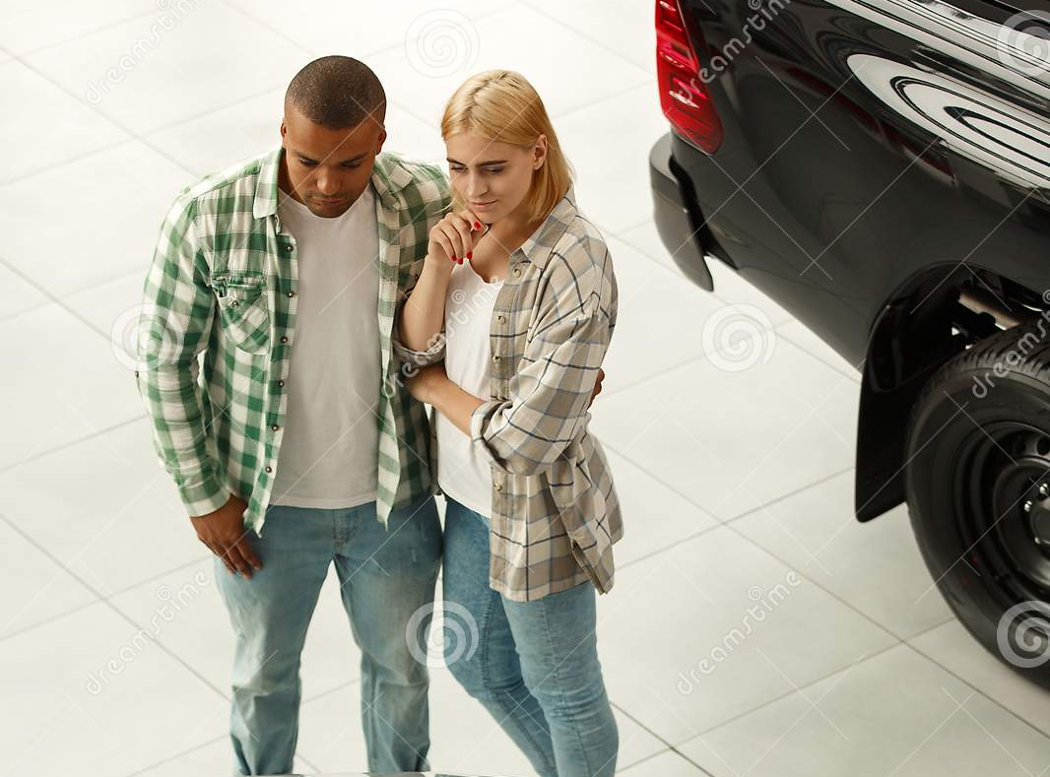
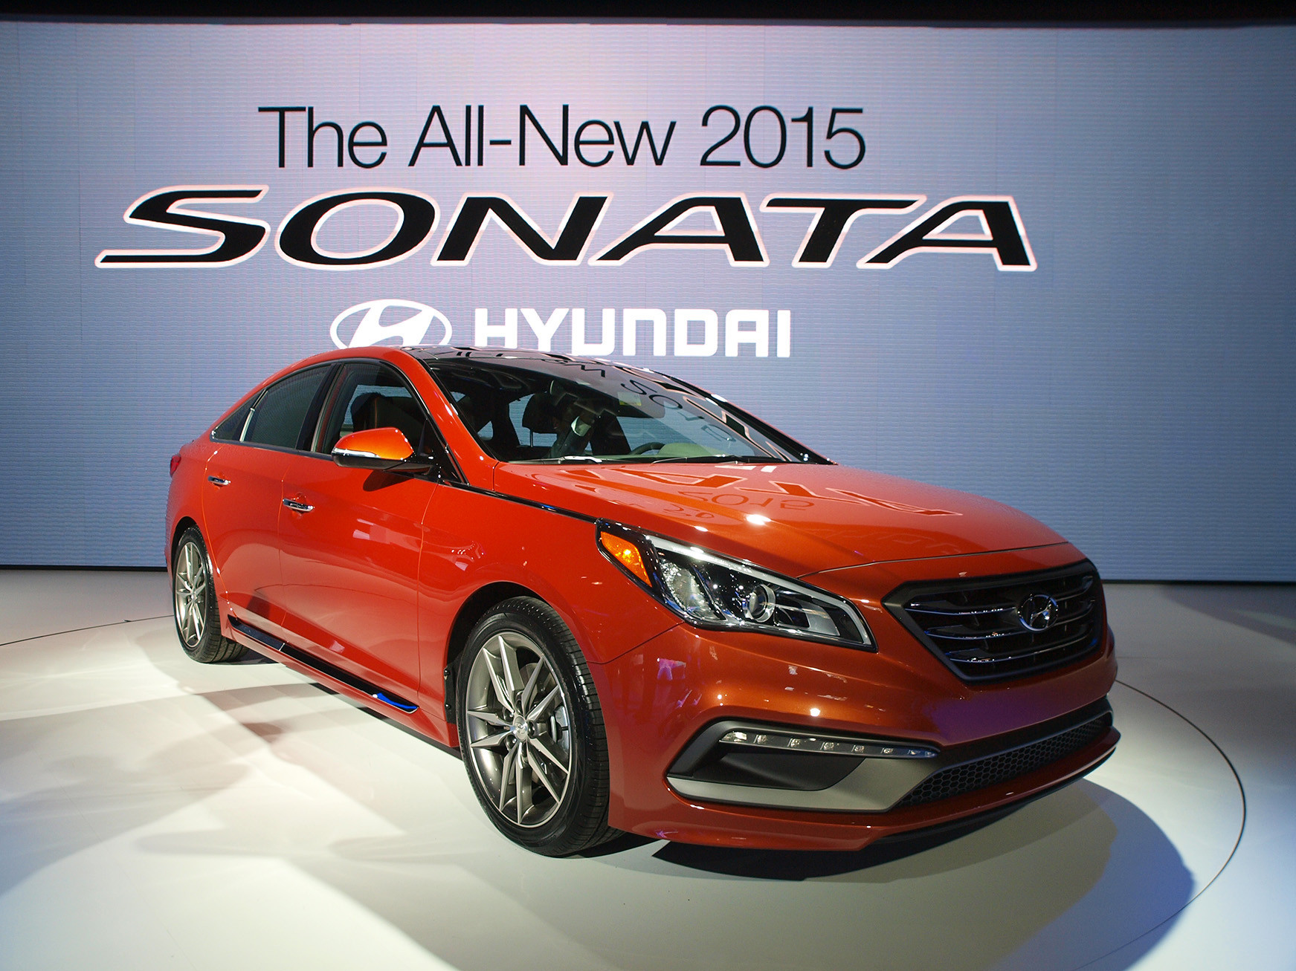
Notes:
Frances, the sales manager, wants Little Joe to know that he has a couple interested in one of the new cars on the hot sheet, a 2015 Sonata, but the car is out of their price range by just a hair.

Slide 14
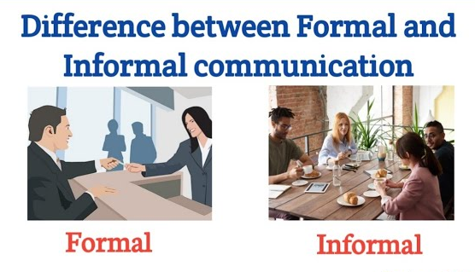
Notes:
Frances knows the couple from his church and really wants to help them get reliable transportation,

Slide 15
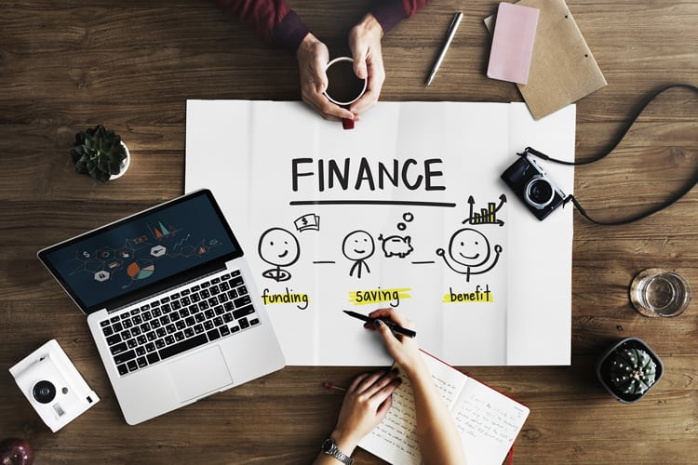

Notes:
Frances also knows he needs to get the deal past the finance manager.
Cross functional communication

Slide 16
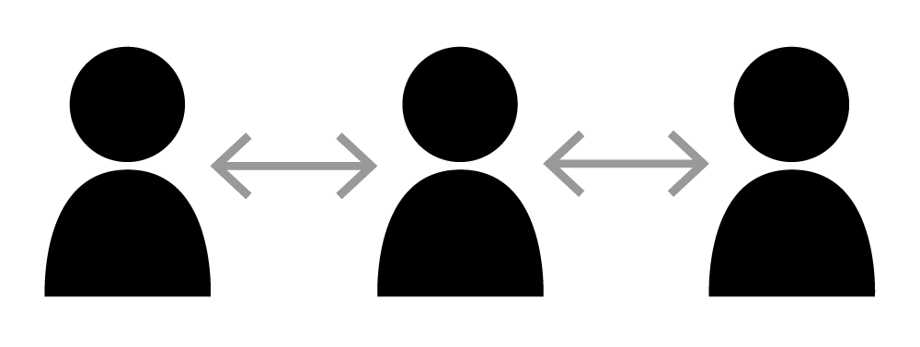
HORIZONTAL/LATERAL COMMUNICATION

Slide 17
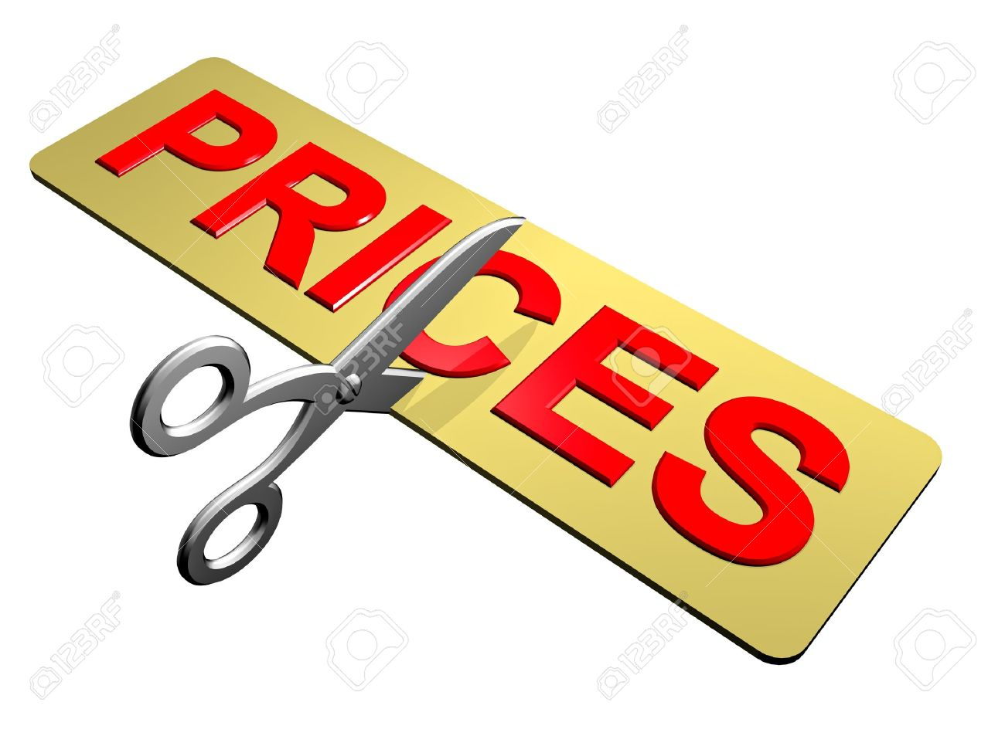





Notes:
Frances wants to know if it’s possible for Joe to cut the price to his customers and give up his $500 bonus for selling the car. Little Joe agrees, since it really makes no difference who gets the $500—Frances or the customer.

Slide 18
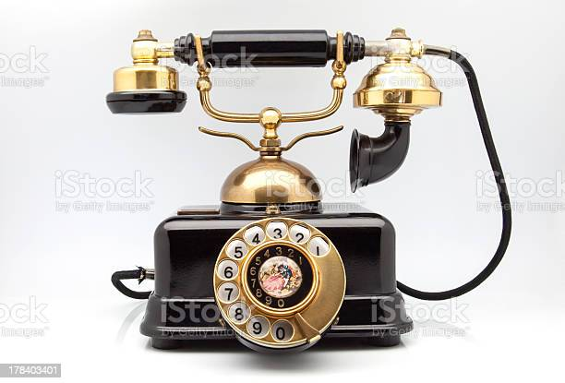
Channel
Brian
Instruction
Order
Command
Notes:
Little Joe picks up his phone and calls Brian, the finance manager. He explains that Frances is going to send a deal through on a hot-sheet car that is $500 less than the bottom line, but if the rest of the deal is solid, Brian should approve it. Brian immediately begins to object, when Little Joe cuts him off and says that Frances is waiving his hot-sheet bonus. When Little Joe hangs up with Brian, he tells Frances he’s set—now go sell that car!

Slide 19
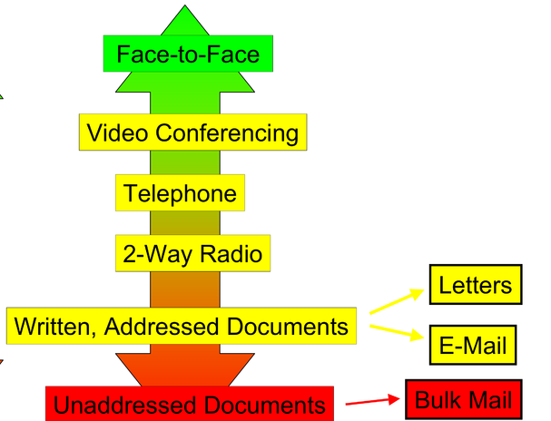
Communication Channels

Slide 20
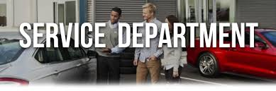
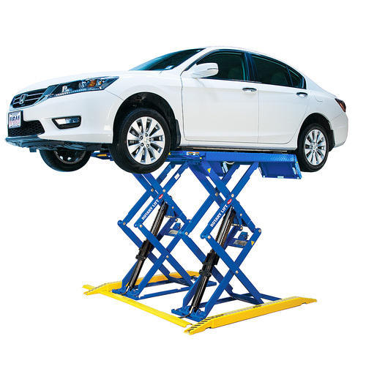


Marcie
Notes:
Frances returns to his customers and tells him he thinks he’s got a way to make the deal work. Brian, the finance manager, approves the deal per his conversation with Little Joe, so all that’s left is the final inspection in the service department.
The customers have told Frances they need to be home by 3 pm, but when Frances sees the time and looks over at the line of cars waiting for final inspection, his stomach drops. There’s no way he is going to get them out of the dealership by three, and he’s afraid he’ll lose the sale. He heads over to the service department to find Marcie, the service manager. He finds her in one of the service bays and explains his situation, asking if there’s any way his customer can be moved ahead in the line. Marcie checks her clipboard, does some quick calculations, and calls over one of the service techs. She tells him to locate the 2015 Sonata and get it up on the lift next. Smiling, she turns to Frances and says, “Mission accomplished.”

Slide 21


Slide 22
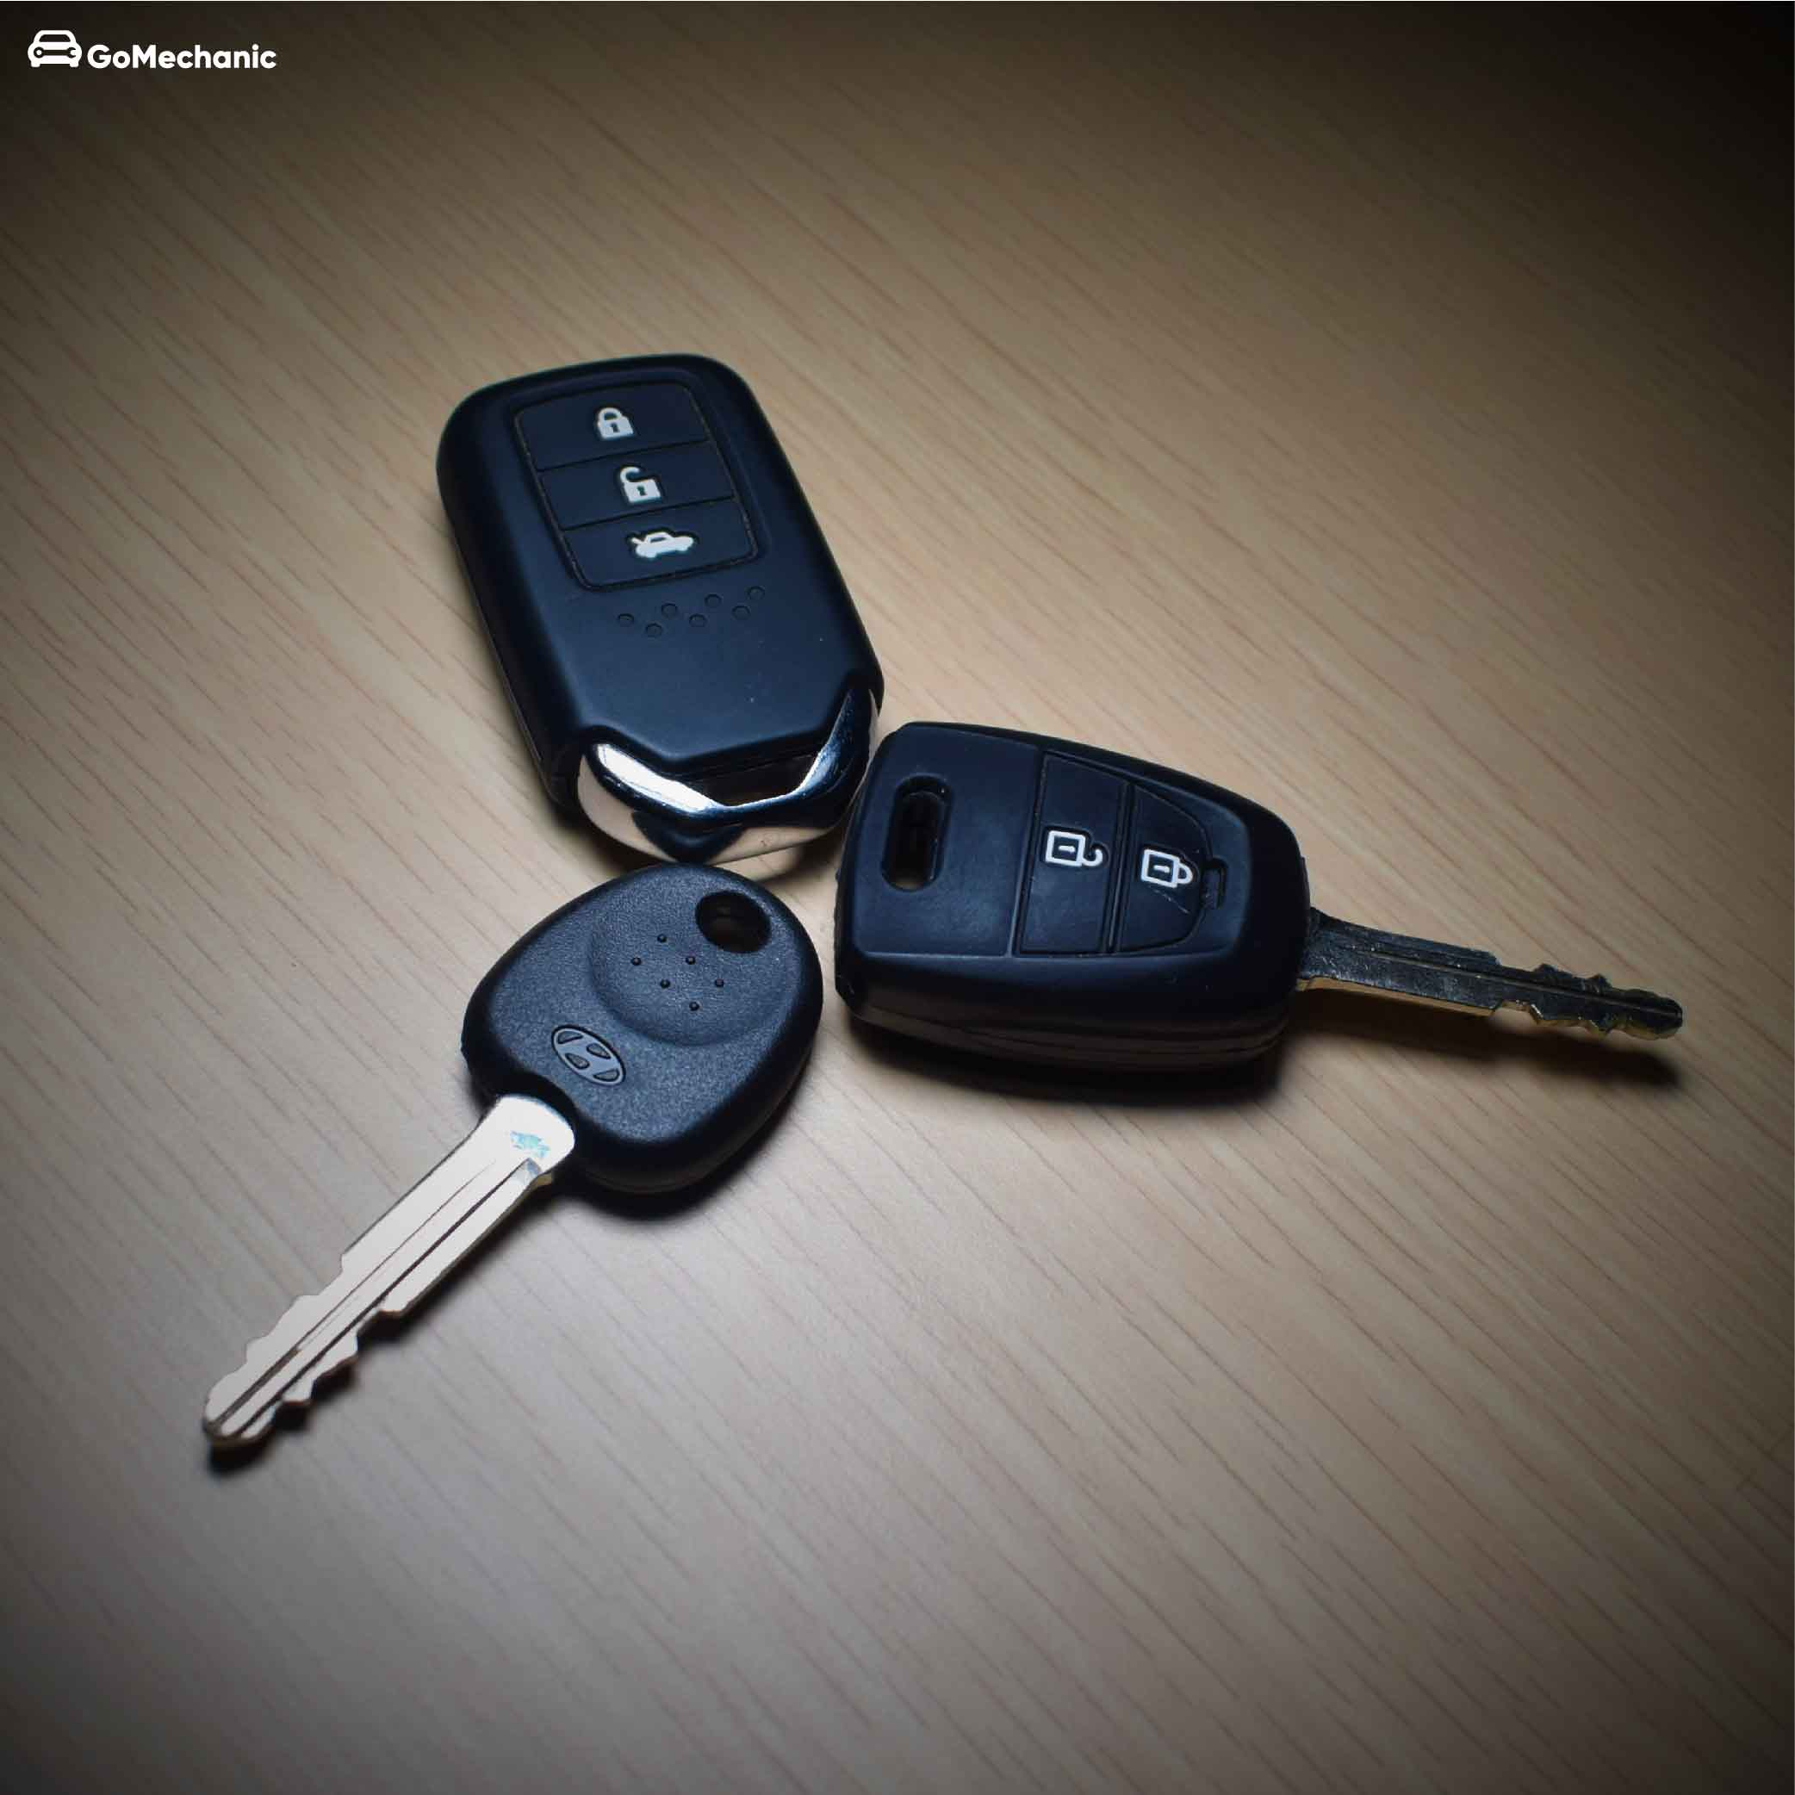


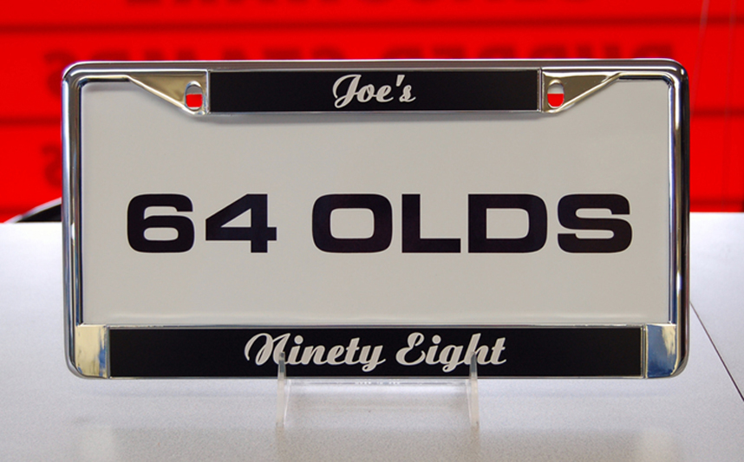
Notes:
The last thing Frances does before he hands the keys to his customers is to affix a Little Joe’s Auto license plate frame to the front and back of the Sonata. Now everyone who sees his customers driving their new car will know where they bought it. He hopes this sale will generate more business for himself and the dealership, so along with the keys to the car, he gives them several business cards and a coupon for a free oil change. At 2:30, Frances waves good-bye to his customers as they drive their new Sonata off the lot.

Slide 23

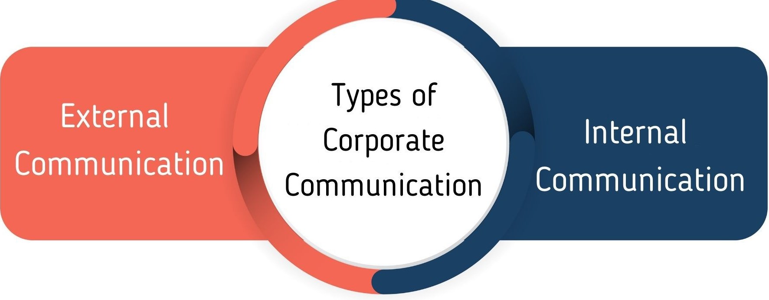

Slide 24

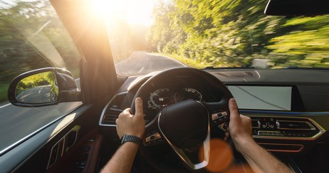
Notes:
https://courses.lumenlearning.com/wmintrobusiness/chapter/reading-communication-flows/

Slide 25
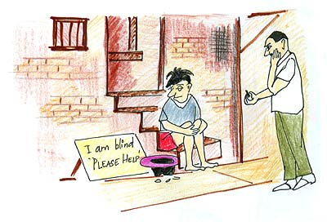

Slide 26
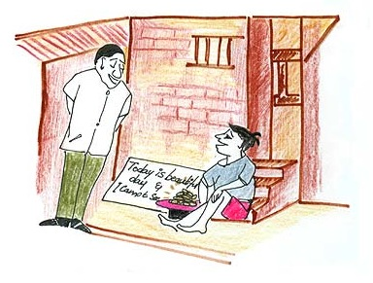

Slide 27


Slide 28
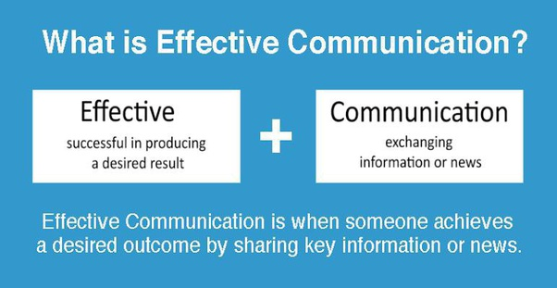

Slide 29
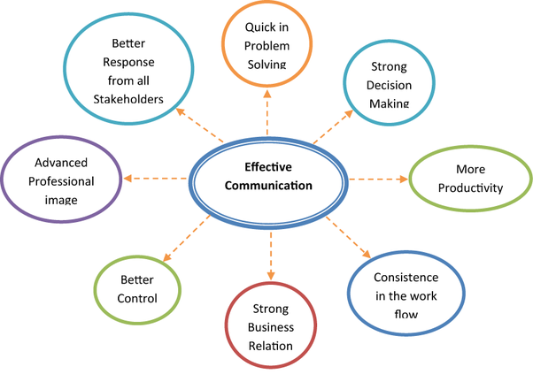

Slide 30
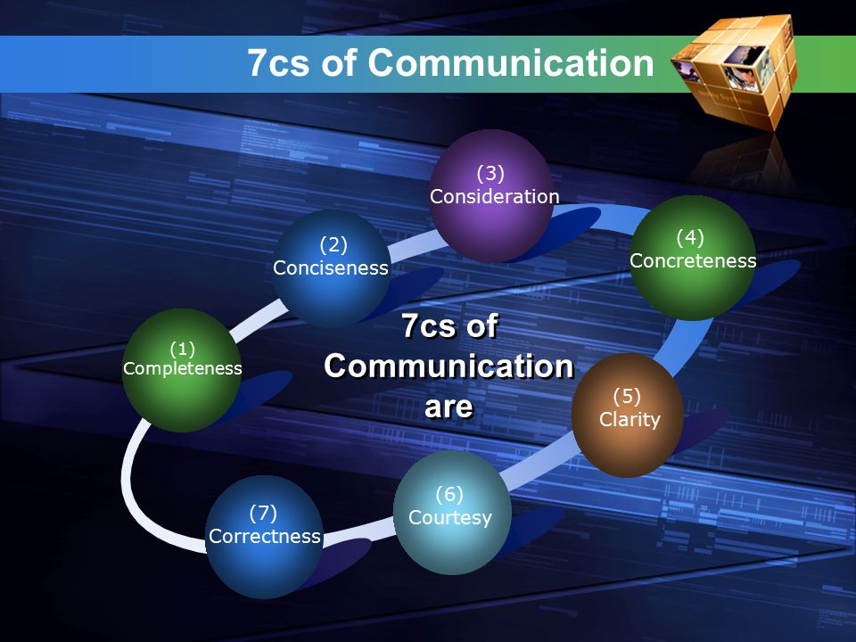
Coherence
Notes:
https://www.invensislearning.com/blog/7-rules-of-effective-communication-with-examples/

Slide 31


Slide 32

OR
Let us meet tomorrow at 11 am at Conference room 3 to discuss the product launch event. We will have to decide the keynote speakers and complete the event invite draft tomorrow. Please be there on time.
Let us meet tomorrow to discuss the product launch event. Please be there on time.

Slide 33

OR
I need to discuss the quarterly CSR campaign with you. Let us take the kids out this time to a nearby park or zoo instead of just visiting them. This will help enhance our brand image. We’ll talk in detail tomorrow.
I think we need to talk about the CSR campaign, I mean the one which we need to do as a quarterly exercise. I think it is a great way of enhancing our brand image. Basically, it would just be a visit to an orphanage, but we can sort of do other things too. For instance, we could take the kids out for a short trip to a nearby park or zoo. Let us sit and talk tomorrow.

Slide 34

OR
Thanks for submitting the industry report. Finn will give you some feedback on it. Finn also wanted to find out if you will be available for the client meeting tomorrow. We will be discussing the budget for the next phase of the project.
Thanks for submitting the industry report. Finn will give you some feedback on it. You will be receiving an email from him with detailed comments.

Slide 35

OR
Hilltop Resort is the jewel of the western hills. Take a break from your work. Escape from life’s chaos and stress. Relax and rejuvenate yourself at Hilltop. Go back fresh and energized
Hilltop Resort is the best resort. Do come to us on your next holiday

Slide 36

OR
As you may know we have signed up XYZ as our new client. I had a meeting with the engineering team yesterday and had discussed the campaign requirements for this project. John Redden from your team had done a pretty good job last time doing the social media campaign for ABC and so I would like him to work on the XYZ campaign too. Would you be available sometime tomorrow to discuss this further?
I would like to talk to you about the new client’s project which the engineering team had discussed yesterday. I might need the help of John from your team.

Slide 37

OR
I really do not appreciate how your IT team ignores the requests of my team alone. My team is an important function in this organization too and we have our own IT requirement. Can you ensure that your team responds promptly to my team’s requests hereon?
I understand that the IT team is swamped with work and gets requests from every department in the organization. My team, however, is working on a high-priority project and I would greatly appreciate if you could ask your team members to respond to my team’s queries promptly and help us complete this project on time. Please do let me know if you need anything from me.

Slide 38

OR
Further to our conversation today, I am attaching the plan for the first stage of the project. Hope the one-week deadline is okay with you and your team.
Further to our conservation today, I am attaching the plan for the first stage of the project. Hope the one weak deadline is okay with you and your team.
Correctness

Slide 39




Slide 40


