Slide 1
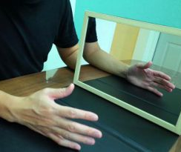
Phantom Limb
Phantom limb pain (PLP)
refers to ongoing painful sensations that seem to be coming from the part of the limb that is no longer there. The limb is gone, but the pain is real. The onset of this pain most often occurs soon after surgery.

Slide 2
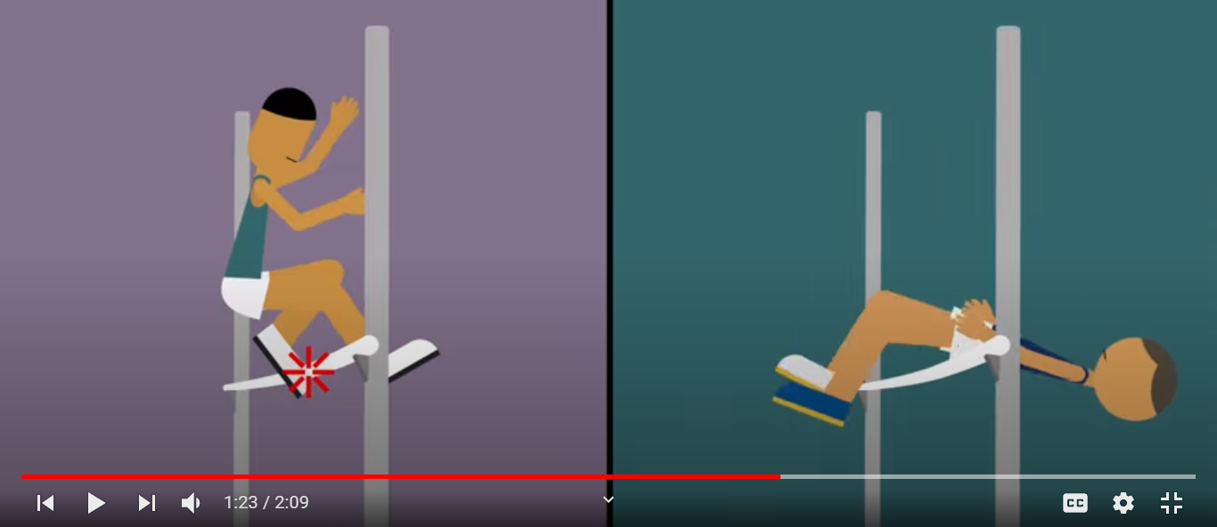
Fosbury Flop

Slide 3

Let me introduce you to the world of

Slide 4
The good news
We all are gifted with it.

Slide 5
Learning Objective
Participants will be able to:
Understand the importance of Critical Thinking
Apply the techniques of Critical Thinking to business situations

Slide 6
WIIFM

Slide 7
One of the most demanded skills by the employers.
2Helpful to solve critical situations in
  Personal life
  Work

Slide 8


The great Performers
Felicity
Vaibhav and Pratika Khandelwal
Jaipur-based Felicity aims to help people get access to mental health therapy through online video counselling at an affordable cost.
Trell
Pulkit Agarwal Trell noted that with over 15 million downloads and five million monthly active users on its app, it has grown 20 times in the last 12 months in India.

Slide 9
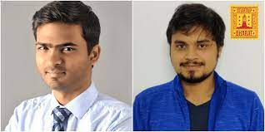

The great Performers
Dishant Gandhi and Alok Kumar
The duo launched Gradeazy in June 2020 to enable educational institutes to conduct online examinations for just Re 1 per exam.
Abhishek Deo and Gaurav Sarangi
Greenhive sells eco-friendly products. Our mission is to offer sustainable and plastic-free alternatives for commonly used items.
Clocked a turnover of Rs 50 lakh

Slide 10
WIIFM
All Entrance exams examine a students’ ability to think critically.
Critical Thinking directly help students do better even at the reasoning tests.
Many of the highest paying jobs require critical thinking skills.
Job interviewers often ask applicants questions that test their ability to think critically.
Critical thinking skills may also be a deciding factor when an employee seeks a promotion.

Slide 11
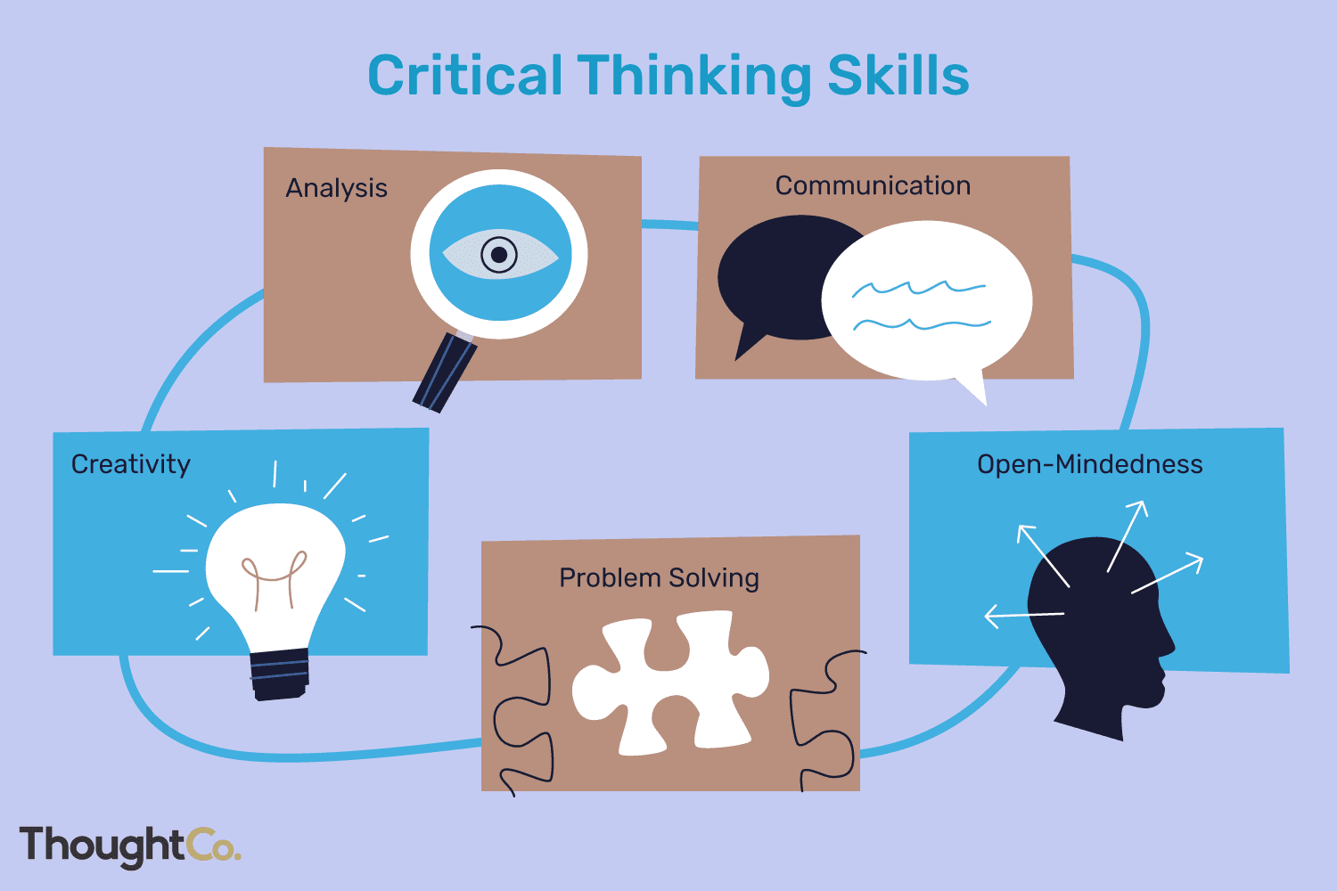

Slide 12
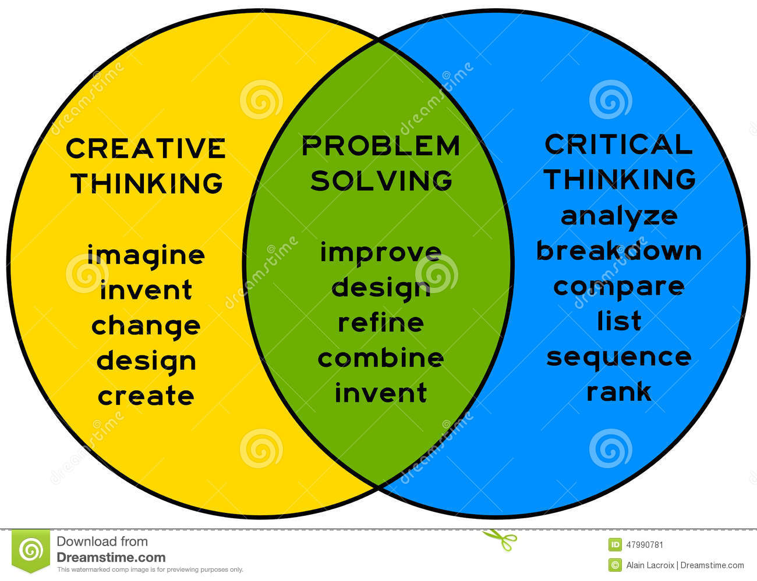
The three-fold process
Successful organizations rely on critical thinking and creative thought leaders who can generate inventive problem solving answers to the organizations issues.

Slide 13
7 Habits of a Critical Thinker
Multiple Affiliations/ Collaborations
Opposable Mind
Take Hobbies Seriously
Creativity V/s Intelligence /Provoke Ideas
Experimental Mindset/Be optimistically Objective
Sense of Humour
Give absurd ideas respect

Slide 14
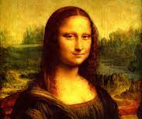
Multiple Affiliations
Da Vinci – Monalisa
Art – Science
Artist/ Physicist/ Biologist
Boundaries
Competition / Collaborations

Slide 15
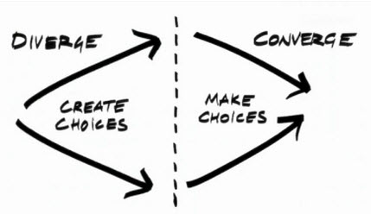
Opposable Mind
Best ideas
Stay with the idea
Decision Making

Slide 16
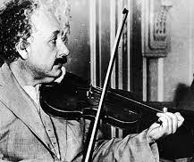
Protect Your Hobbies
Einstein
Spatial Thinking
Hobbies
New People
Confidence
Internal Motivation
Example of an egg

Slide 17
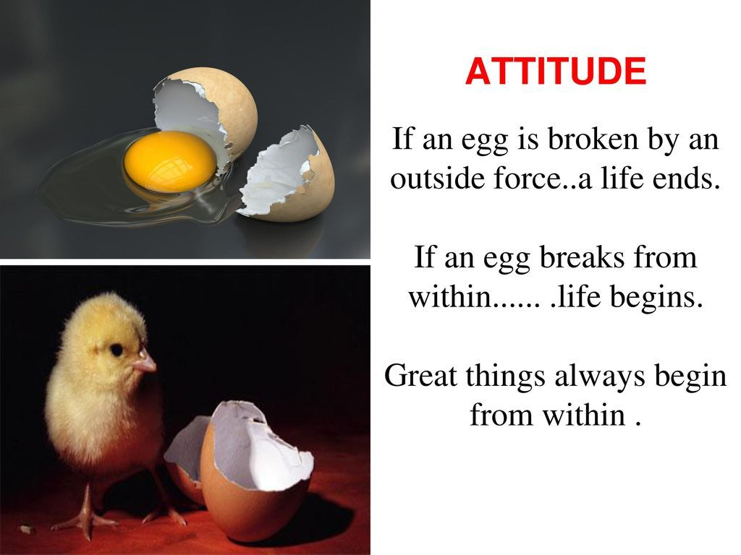

Slide 18
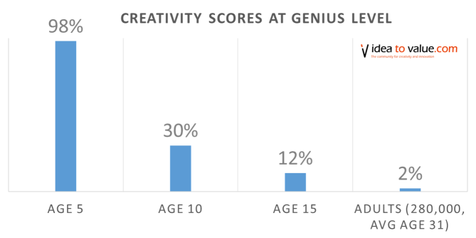
Creativity V/s Intelligence
Provoke Ideas
Art of asking questions
Google Era
Attitude matters
Failure

Slide 19
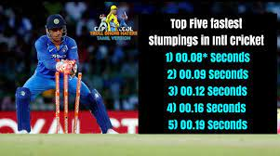
Experimental Mindset
Take chances
Create Opportunities
Importance of experiments

Slide 20

Take it Easy
Seriousness V/s Sincerity
Sense of Humour
New connections
Overcome Failures
Journey

Slide 21

Give Absurd Ideas Respect
Crazy idea - Let it breathe
Do not reject immediately
Let us take an example
  An idea for a restaurant

Slide 22
Critical Thinking
Brainstorm – A new restaurant
Authentic Mexican
Russian
Nepalese
High End burger place
How about a restaurant that doesn’t serve food

Slide 23
Boom

Slide 24
Brainstorm
A restaurant that does not serve food.
Bring the food-we provide place, cutlery, drinks
Sharing table
Provide entertainment
Provide place to share - a stage.

Slide 25
Critical Thinking
Day 2 -

Slide 26
Case Study 1
As employees of the corporate sector we solve various problems for our companies.
Think of a real problem that you see around yourself and come up with an idea to solve the issue by introducing a product or a service.
Explain the problem, solutions and the product/ service and cost -benefit.

Slide 27
Case Study 1
Founder : Ankit Agarwal
Place and year : 2018, Kanpur India
Previous profile : Automation Scientist
Collects flower waste : Separated, dried and converted into powder.
Handmade Products like incense sticks, incense sticks, soaps, colour, bio leather
Generated employment for the local people.
Within 2020 he received funding of 1.4 Million Dollars from San Francisco Foundation.
This start-up has so far secured funding of close to 13 crores .
https://www.entrepreneur.com/article/355405

Slide 28
Case Study -2
The current scenario is such that readymade garments for corporate wear are virtually non existent in India. The concept of Corporate Dressing is mainly restricted to Presidents and CEOs of companies. However, the consumer – is changing; the Western trend of ready-to-wear is gaining popularity.
At all levels in the workplace an increasing need for formal dressing is now being felt. Your company ’Poshak’ was quick to spot this. They are already an iconic name in the Indian firmament apart from being the market leader and the preferred choice of fabric for consumers who need to tailor a suit. They geared to manufacture a range of readymade formal wear and accessories. To their surprise the venture did not do well. A thorough market research was conduced to understand the reason for the failure.
The results
Consumers say : The Indian brand is good for the fabric but for the fit and the style people prefer imported garments. How would you tackle this issue and dispose off the huge merchandise you have produced?

Slide 29
Case Study -2
The results : PARK AVENUE
Consumers say : The Indian brand is good for the fabric but for the fit and the style people preferred imported garments. How would you tackle this issue and dispose off the huge merchandise you have produced?
To answer the concerns of the consumers
Raymond came up with The name "PARK AVENUE" was influenced by an elite, high street in Manhattan
Thus emerged the word ‘Park Avenue’
The same merchandise was launched and it lead to a success.
Park Avenue boasts of a wide distribution network
More than 565 'The Raymond Shops’,
over 50 Exclusive Brand Stores,
more than 656 Multi-Brand Outlets.
https://www.linkedin.com/company/park-avenue-india/about/

Slide 30
Case Study -3
A reputed company that is well known for manufacturing capsules that are extremely effective. The capsules contain paracetamol substitute. The company dominates the market with close to 40% market share.
This empire was soon threatened when approximately10 people died after consuming the product.
The victims ranged from a teenager to a mother of a new born.
Further investigation revealed that an unidentified source had removed the capsules from the store and replaced them with a new set of capsules laced with a poisonous drug that had led to the mishap.
Calling off all of the products from the shelves would cost the company millions of dollars. The management has to explain to the world why its trusted product is suddenly killing people
Your suggested solution?

Slide 31
Case – 3 (Johnson & Johnson)
Case Study: The Johnson & Johnson Tylenol Crisis
Handling Crisis : A seven-member strategy team.
Alerted consumers : not to consume any type of Tylenol product.
Action : Withdrew all Tylenol capsules from the store shelves
J & J established a 1-800 hot line for consumers to call.
New triple safety seal packaging
New tamper resistant packaging
Johnson & Johnson used Remediation and Rectification, both Forgiveness
strategies, in the Tylenol crisis.
https://www.ou.edu/deptcomm/dodjcc/groups/02C2/Johnson%20&%20Johnson.htm

Slide 32
Case Study - 4
The product in this case is an adhesive band-aid/plaster with a sensor which measures the body temperature of the baby. The sensor is connected to a phone through a dedicated app. Parents are notified through the app if and when the temperature of their baby is going up or down. This product was launched with a huge campaign to support it. As expected sales shot up immediately but in a matter of a few days sales began to fall flat. The assumption was that some feature of the launch process had gone wrong or had been poorly communicated.
The key question was : what had gone ‘wrong’ with the launch
What data should be collected and to analysed
It came to light that the product had one big omission. The product would only notify parents in case the temperature of their baby changed, yet it did not tell them if nothing had changed.

Slide 33
Case -4 (First Aid Case)
The product would only notify parents in case of the temperature of their baby changed, yet it did not tell them if nothing had changed. The assumption with product developers was that no news was good news and parents also wanted to be notified when something was not normal.
The parents wanted constant updates even if nothing had happened. So, many reported getting out of bed in the middle of the night to check on the baby themselves in case the product was not functioning and double-check the baby’s temperature themselves anyway. A significant portion of customers assumed the app wasn’t working effectively as they had been told nothing new.
Cause: However, many felt the product was either broken or non-functional in some way. The lack of feedback was perceived as bad news by the parents. Customers consequently
After this issue came to light, the following actions were taken:
A modification on the app: continuous feedback about the baby was added
The communication and packaging information were changed
The company ran an influencer campaign for damage control
https://www.wonderflow.ai/success-stories/case-study-product-launch

Slide 34
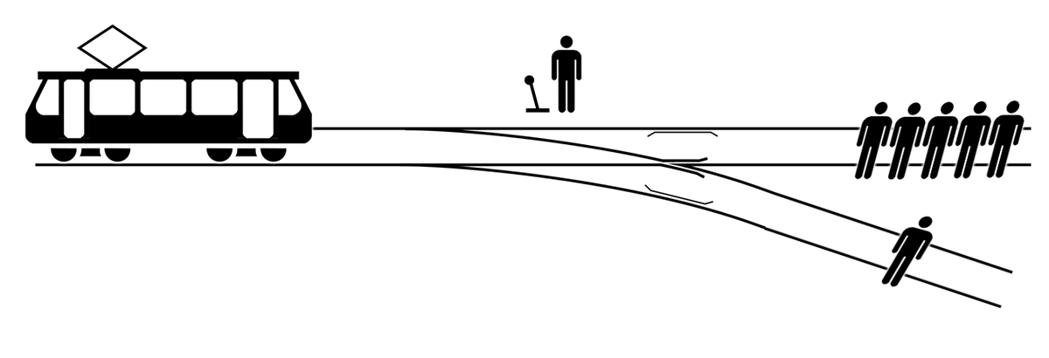
A brain teaser Puzzle!
There is a trolley coming down the tracks and ahead, there are five people tied to the tracks who are unable to move.
Real scenario

Slide 35
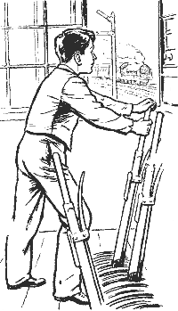
If you pull the lever, the train will be directed to another track, which has only one person tied to it. You have two choices:
Do nothing and the five people will die
Pull the lever and save the five people but let one person die.
What will you do?

Slide 36
WIIFM
Organisations want to hire employees that have critical thinking skill sets. According to the Foundation for Young Australians, demand for critical thinking skills in new graduates has risen 158% in three years. Their report showed that employers are willing to pay high wages for graduates who demonstrate problem-solving and critical thinking skills!

