Slide 1
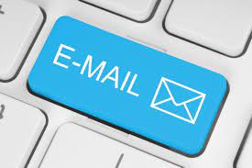

Slide 2
Observe
Subject: Leave
Dear Sir,
I have been tested Covid-19 positive. I will attend the classes after my recuperation.
Xxxxxxxxxx xxxxx
Marketing -2020-2022

Slide 3
Identify the mistakes
(no subject)
Hai Sir,
Gud afternoon
The following are the details of the students and there topics

Slide 4
What is Wrong?
Dear Sir,
I hope you are well and recovering from your medical condition, Iam writing this email in regards to your leaves from 20th April’ 21-27th April’21. We understand that your absence is due to medical conditions but once you recover fully from your medical condition, we will require a medical report from a verified doctor about your fitment to work.
I would like to bring to your notice that as per the company’s policy, in a calender quarter, the employee is allowed to take up to 2 paid medical leaves. Any medical leaves beyond 2 days in a quarter will be unpaid.
Since you have joined on 19th January 2021 you have accrued 2.5 paid leaves.
Wishing you a speedy recovery.
Regards
Tanu Gupta.

Slide 5
Corrected
Dear Sir,
I hope you are recovering well to sound health.
Iam writing this email in regarding your leaves from 20th April’ 21-27th April’21. We understand that your absence is due to medical conditions. Once you are all fit to join us back,Please submit a medical report from a verified doctor about your fitment to work.
I would also like to bring to your notice that as per the company’s policy, in a calender quarter, the employee is allowed to take up to 2 paid medical leaves. Any medical leaves beyond 2 days in a quarter remains unpaid.
Since you have joined on 19th January 2021 you have accrued 2.5 paid leaves.
We hope to see you all healthy soon and we wish you a speedy recovery .
Please take care.
Regards
Tanu Gupta.

Slide 6
Learning Objectives
The participants will be able to:
Define email and email etiquette.
Realise the importance of email etiquette.
Learn the steps in writing an email.
Understand the structure of an email.

Slide 7
Email
Electronic mail is most commonly referred to as email or e-mail.
Email generally refers to a method of exchanging digital messages from a sender to one or more recipients via a network.
Email Etiquette
It refers to the principles of behaviour that one should use when writing or answering E-mails.
E-mail is less personal than a phone or in-person conversation but quicker to send than a letter, It is possible for serious breaches of manners to take place.

Slide 8

Why Email etiquette?
To remain professional in company communications.
Emails that are to the point and easy to read are more efficient.
Employees who understand email etiquettes are less likely to put the company at risk.
People who read an email with grammatical errors thought the writer was :
Less conscientious, less intelligent and less trust worthy.
If you read an email with typos, you probably think of two things:
1. The sender does not know basic spelling and grammar.
2.The sender didn’t care enough about this message to review it before sending.
In a separate experiment, people who applied for funding
Were less likely to be funded and recieved less favorable
terms when their loan requests had spelling mistakes.

Slide 9
Styles of Emails
Formal
Informal

Slide 10
Steps for writing professional emails
1. Identify your goal
2. Consider your audience
3. Keep it concise
4. Proofread your email
5. Use proper etiquette

Slide 11
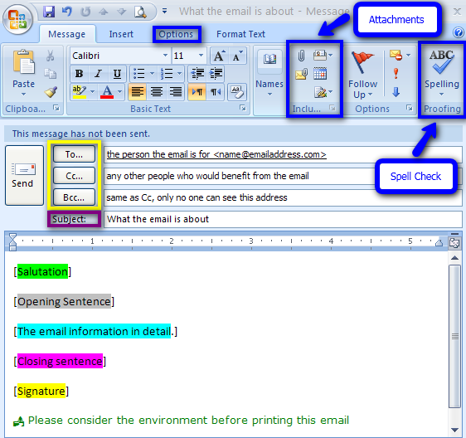

Parts of an Email
Header
Parts of an Email

Slide 12


Slide 13


