Slide 1
Seven Chakras
and
Chakra Meditation with Mudras

Slide 2
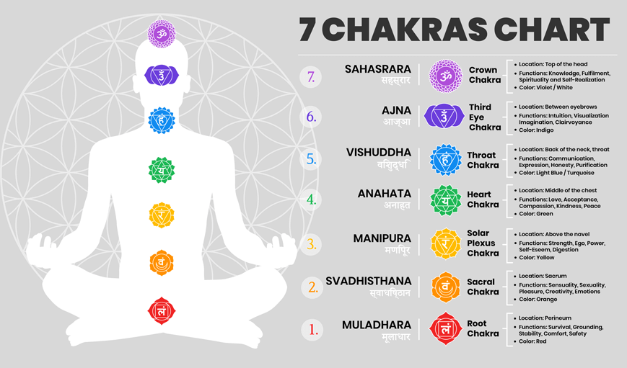

Slide 3
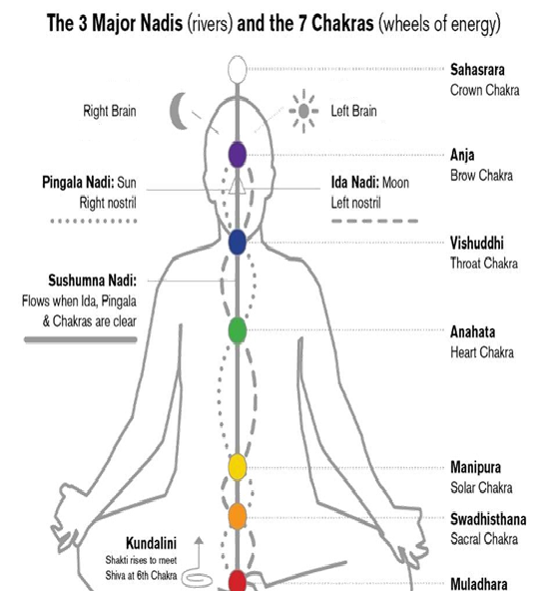
Concept of Chakra
In Sanskrit Chakra means “Wheel” which are rotating centres of energy , symbolized as coloured lotus flowers with different numbers of petals.
Chakras are whirlpools of pranic energy at specific areas in the body which control the circulation of “prana” through the entire human body.
These lotuses represent progressively higher states of awareness & consciousness
The Chakras symbolize varying levels of awareness in man-from the more instinctive realms ( levels ) associated with the “Mooladhara chakra “to the more intuitive levels associated with the “ Ajna Chakra.
The colors of a chakra indicates our current physical , emotional & spiritual state.
The Chakras lie at the intersection – of the 3 main nadis that is - Ida / Pingala/ Sushumna Nadis.
These 7 chakras are – Mooladhara , Swadishtana , Manipur,,Anahata , Vishuddhi , Ajna Chakras & Sahasrar Chakras.
These chakras are aligned in an ascending column from the base of the spine to the top (crown of the head )

Slide 4
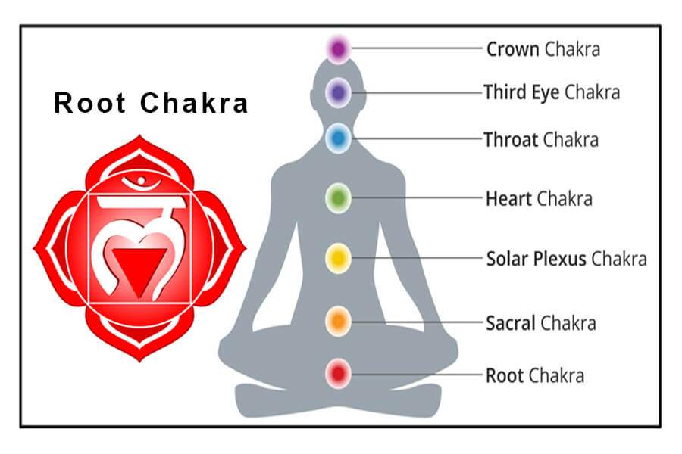
Muladhara Chakra (The Root Chakra)
This chakra is located at the base of the spine
The root chakra is the base chakra. It is represented by a red color.
It is associated with basic survival needs such as food, water, shelter, air, and our physical body.
This chakra is related to the element of earth.
When the root chakra is balanced, we feel a sense of accomplishment, safe, supported, stable and grounded.

Slide 5
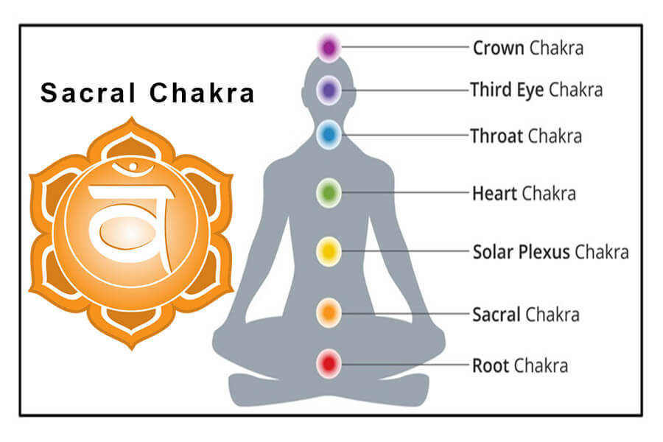
Svadhisthana Chakra (The Sacral Chakra )
This chakra is located below the navel.
It is represented by orange color. This chakra is associated with the lymphatic system and is responsible for expressing emotions.
This chakra is associated with sensuality, and desire for pleasure. The sacral chakra is related to the element of water. When this chakra is balanced, we experience joy, creativity, and a connection of desire.

Slide 6
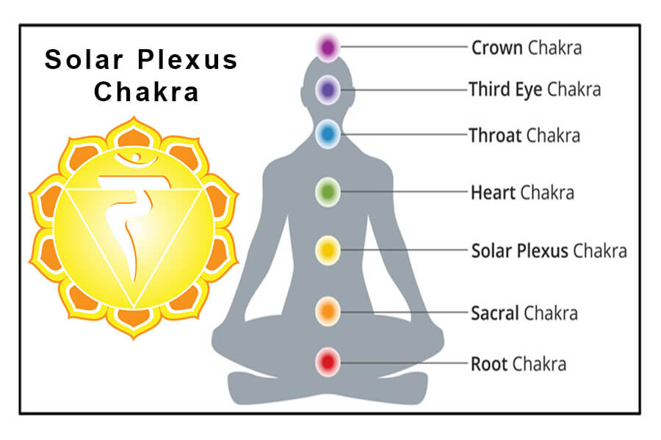
Manipura Chakra (The Solar Plexus Chakra )
Solar Plexus chakra is located at the navel center.
This chakra is represented by yellow color.
This chakra is associated with personal power, self-confidence, self-discipline, and motivation.
Solar Plexus chakra is associated with the element of fire.
A balanced Solar Plexus chakra allows you to feel your power, sense of wisdom and decisiveness.

Slide 7
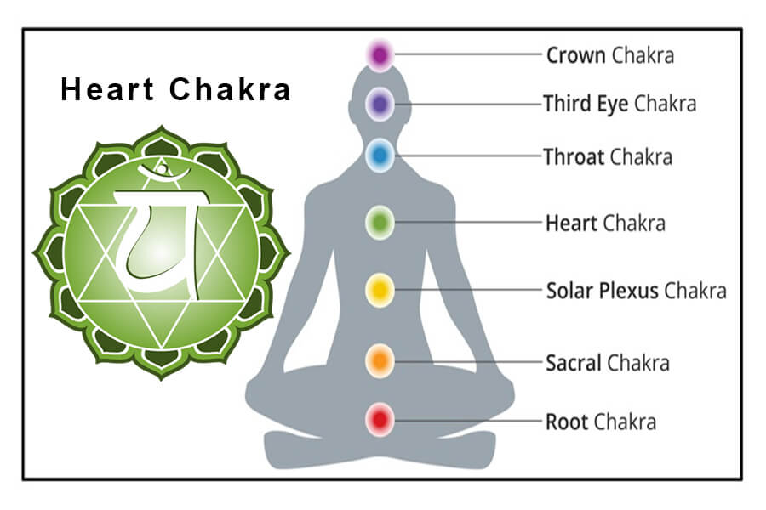
Anahata Chakra (The Heart Chakra )
Heart Chakra is located at the center of your chest.
This chakra is represented by a green color.
This chakra is associated with love, compassion, understanding, forgiveness, and connection.
The heart chakra is associated with the element of air.
The heart chakra is the middle of physical and spiritual chakras.
When this chakra is balanced, we can easily express our love for ourselves and others and experience a healthy relationship with others.

Slide 8
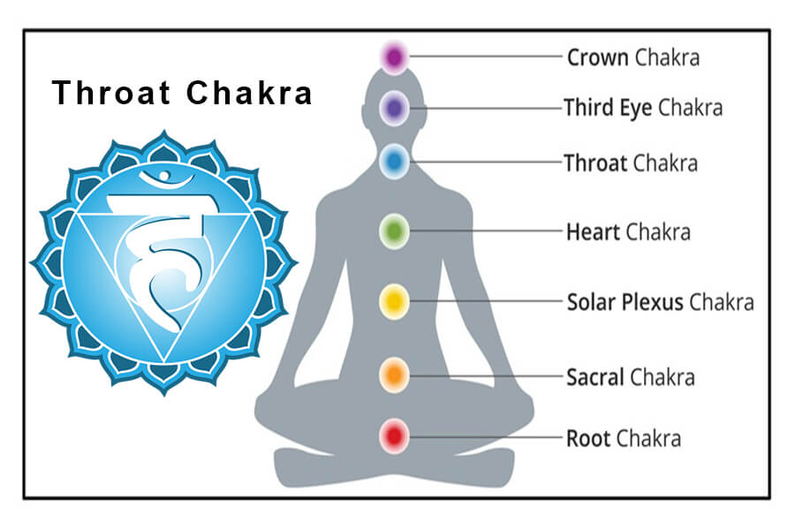
Vishuddha Chakra (The Throat Chakra )
The throat chakra is located at the base of the throat.
It is represented by a blue color. This chakra controls the functions of the thyroid gland.
This chakra is associated with the communication.
The throat chakra is associated with the element of space.
When this chakra is balanced, a person communicates effectively, feels confident and inspires others.

Slide 9
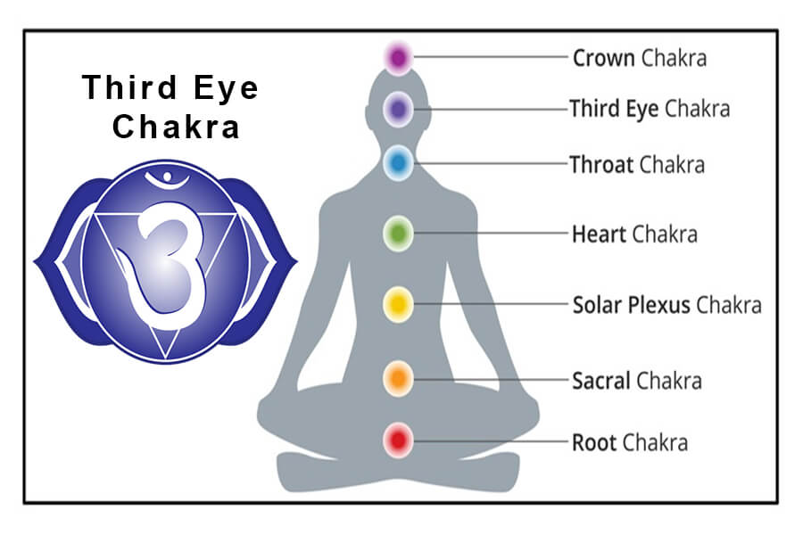
Ajna Chakra ( The Third Eye Chakra )
Third eye chakra is present between the eyebrows.
This is represented by Indigo color.
This chakra controls the functions of the pituitary gland.
This chakra is associated with intellect, wisdom, intuition, understanding, and imagination.
A balanced Third Eye chakra assists you on the right path and helps you to follow your inner guidance.

Slide 10
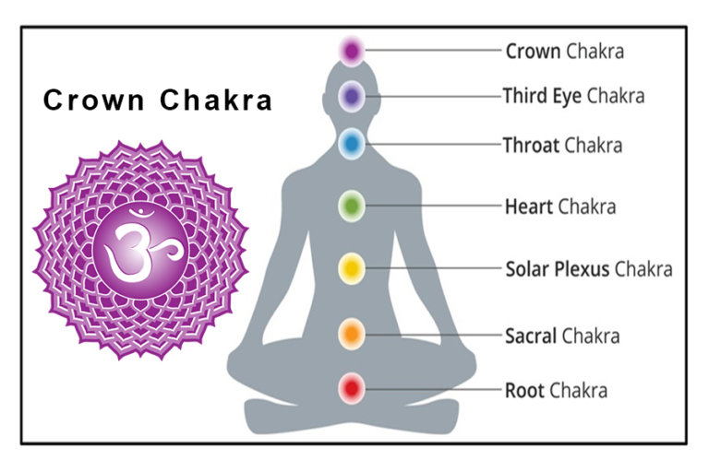
Sahasrara Chakra ( The Crown Chakra )
Crown chakra is present at the top of the head.
This chakra is represented by violet-white color.
Crown chakra is associated with pure consciousness and interconnection.
When this chakra is balanced, we feel a deep spiritual connection with ultimate wisdom.

