Slide 1
Marketing Analytics

Slide 2
Marketing Analytics
Marketing analytics is the practice of measuring, managing and analysing marketing performance to maximize its effectiveness and optimize return on investment (ROI).
Beyond the obvious sales and lead generation applications, marketing analytics can offer profound insights into customer preferences and trends.
According to a survey of senior marketing executives published in the Harvard Business Review, "more than 80% of respondents were dissatisfied with their ability to measure marketing ROI.

Slide 3
The Importance of Marketing Analytics
Marketing analytics, Internet (or Web) marketing analytics in particular, allow you to monitor campaigns and their respective outcomes, enabling you to spend each dollar as effectively as possible.
The importance of marketing analytics is obvious: if something costs more than it returns, it's not a good long-term business strategy.

Slide 4
In search marketing one of the most powerful marketing performance metrics comes in the form of keywords.
Keywords tell you exactly what is on the mind of your current and potential customers.
it's the keyword data contained within each click which can be utilized to inform and optimize other business processes.
    Product Design: Keywords can reveal exactly what features or solutions your customers are looking for.
    Customer Surveys: By examining keyword frequency data you can infer the relative priorities of competing interests.
    Industry Trends: By monitoring the relative change in keyword frequencies you can identify and predict trends in customer behaviour.
    Customer Support: Understand where customers are struggling the most and how support resources should be deployed.

Slide 5
Marketing Process
Marketing process includes ways in which value can be created for the customers to satisfy their requirements.
It is an endless series of actions and reactions between the customers and the companies making attempt to create value for and satisfy the needs of customers.
In marketing process, the situation is examined to identify opportunities, the strategy is formulated for a value proposition, tactical decisions are taken, plan is executed, and results are monitored.
The following four steps are involved in the marketing process −
      Situation Analysis
      Marketing Strategy
      Marketing Mix Decisions
      Implementations & Control

Slide 6
Data To Improved Marketing Strategy
With the rise of Big Data and Artificial Intelligence, marketers have more powerful analytics tools at their disposal than ever before.
Data-backed customer insights can be used to enhance marketing efforts at every stage of the funnel, and one of the most effective tactics is using predictive analytics.
Use Cases for Predictive Marketing Analytics Detailed Lead Scoring
Lead Segmentation for Campaign
Lifetime Value Prediction
Churn Rate Prediction
Upselling and Cross-Selling Readiness
Optimization of Marketing Campaigns

Slide 7
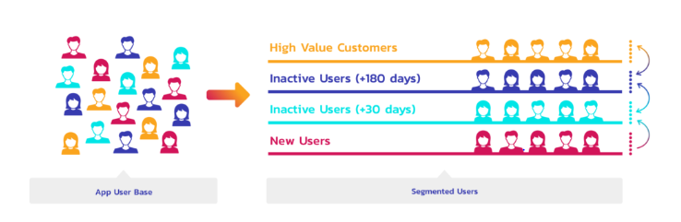
Lead Segmentation
There a lot of lead segmentation possibilities upon which the segmenting of the customers depends on. It should always be kept in the record while going for a segmentation.

Slide 8
Market Segmentation
Market Segmentation is a process of dividing the market of potential customers into
different groups and segments on the basis of certain characteristics.
The member of these groups share similar characteristics and usually
have one or more than one aspect common among them.
Market segmentation is one of the most efficient tools for marketers
to cater to their target group.
It makes it easier for them to personalize their campaigns, focus on what’s necessary,
and to group similar consumers to target a specific audience in a cost-effective manner.
The concept of market segmentation was coined by Wendell R. Smith in 1956

Slide 9
Bases of Market Segmentation
Segmenting is dividing a group into subgroups according to some set ‘basis’.
These bases range from age, gender, etc. to psychographic factors like attitude, interest, values, etc.
Gender
Gender is one of the most simple yet important bases of market segmentation.
The interests, needs and wants of males and females differ at many levels.
Thus, marketers focus on different marketing and communication strategies for both.
This type of segmentation is usually seen in the case of cosmetics, clothing, and jewellery industry, etc

Slide 10
Age group
Segmenting market according to the age group of the audience is a great strategy for personalized marketing.
Most of the products in the market are not universal to be used by all the age groups.
Hence, by segmenting the market according to the target age group, marketers create better marketing and communication strategies and get better conversion rates.
Income
Income decides the purchasing power of the target audience.
It is also one of the key factors to decide whether to market the product as a need, want or a luxury.
Marketers usually segment the market into three different groups considering their income. These are
    High Income Group
    Mid Income Group
    Low Income Group

Slide 11
Place
The place where the target audience lives affect the buying decision the most.
A person living in the mountains will have less or no demand for ice cream than the person living in a desert.
Occupation
Occupation, just like income, influences the purchase decision of the audience.
A need for an entrepreneur might be a luxury for a government sector employee.
There are even many products which cater to an audience engaged in a specific occupation.
Usage
Product usage also acts as a segmenting basis.
A user can be labelled as heavy, medium or light user of a product.
The audience can also be segmented on the basis of their awareness of the product.

Slide 12
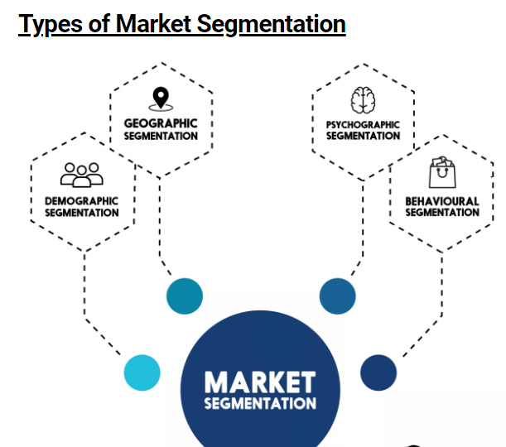

Slide 13
Geographic Segmentation
Geographic segmentation divides the market on the basis of geography.
This type of market segmentation is important for marketers as people belonging to different regions may have different requirements.
For example, water might be scarce in some regions which inflates the demand for bottled water but, at the same time, it might be in abundance in other regions where the demand for the same is very less.
People belonging to different regions may have different reasons to use the same product as well. Geographic segmentation helps marketer draft personalized marketing campaigns for everyone.

Slide 14
Demographic Segmentation
Demographic segmentation divides the market on the basis of demographic variables like age, gender, marital status, family size, income, religion, race, occupation, nationality, etc.
This is one of the most common segmentation practice among marketers.
Demographic segmentation is seen almost in every industry like automobiles, beauty products, mobile phones, apparels, etc.
The customers’ buying behaviour is hugely influenced by their demographics.

Slide 15
Behavioural Segmentation
The market is also segmented based on audience’s behaviour, usage, preference, choices and decision making.
The segments are usually divided based on their knowledge of the product and usage of the product.
It is believed that the knowledge of the product and its use affect the buying decision of an individual.
The audience can be segmented into –
    Those who know about the product,
    Those who don’t know about the product,
    Ex-users,
    Potential users,
    Current Users,
    First time users, etc.

Slide 16
Psychographic Segmentation
Psychographic Segmentation divides the audience on the basis of their personality, lifestyle and attitude.
This segmentation process works on a premise that consumer buying behaviour can be influenced by his personality and lifestyle.
Personality is the combination of characteristics that form an individual’s distinctive character and includes habits, traits, attitude, temperament, etc. Lifestyle is how a person lives his life.
Personality and lifestyle influence the buying decision and habits of a person to a great extent.
A person having a lavish lifestyle may consider having an air conditioner in every room as a need, whereas a person living in the same city but having a conservative lifestyle may consider it as a luxury.

Slide 17
Top 5 Data Analytics Tools
R
R is the leading analytics tool in the industry and widely used for statistics and data modeling. It can easily manipulate your data and present in different ways.
Tableau
Tableau Public is a free software that connects any data source be it corporate Data Warehouse, Microsoft Excel or web-based data, and creates data visualizations, maps, dashboards etc. with real-time updates presenting on web.
If you want to see the power of tableau, then we must have very good data source.
Tableau’s Big Data capabilities makes them important and one can analyse and visualize data better than any other data visualization software in the market.

Slide 18
Python
Python is an object-oriented scripting language which is easy to read, write, maintain and is a free open source tool.
It supports both functional and structured programming methods and Python is easy to learn as it is very similar to JavaScript, Ruby, and PHP. Also, Python has very good machine learning libraries viz. Scikitlearn, Theano, Tensorflow and Keras.
SAS
Sas is a programming environment and language for data manipulation and a leader in analytics and is easily accessible, manageable and can analyse data from any sources.
SAS introduced a large set of products in 2011 for customer intelligence and numerous SAS modules for web, social media and marketing analytics that is widely used for profiling customers and prospects. It can also predict their behaviours, manage, and optimize communications.
Apache Spark
Apache Spark is a fast large-scale data processing engine and executes applications in Hadoop clusters 100 times faster in memory and 10 times faster on disk.
Spark is built on data science and its concept makes data science effortless. Spark is also popular for data pipelines and machine learning models development.

Slide 19
Thanks You

