Slide 1
Session 6
Consumer Attitude Formation and Change

Slide 2
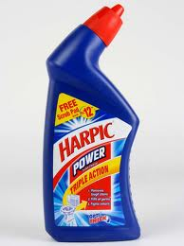


What Is Your Attitude Toward the Product Advertised? What Is Your Attitude Toward the Ad Itself? Are the Two Attitudes Similar or Different?

Slide 3
You May Have Liked the Product but Disliked the Ad or Vice Versa

Slide 4
Attitude
A learned predisposition to behave in a consistently favorable or unfavorable manner with respect to a given object.
(situation – fav or unfav)
Notes:
We have attitudes toward many things – to people, products, advertisements, ideas, and more. For the most part, these attitudes have been learned and guide our behavior toward the object. It is important to understand these four concepts. The first is that we must clearly define the object which we are discussing or measuring the attitude toward. Is it a product category, a specific brand, or a particular model? The second is the agreement among researchers that attitudes are learned, either through direct experience or from others. Attitudes are consistent, they are not necessarily permanent and can change over time. We all know how our attitude can be affected by a situation – think about the times you have to eat foods that are not necessarily your favorite but they are what is available or what you are being served at a friend’s house.

Slide 5
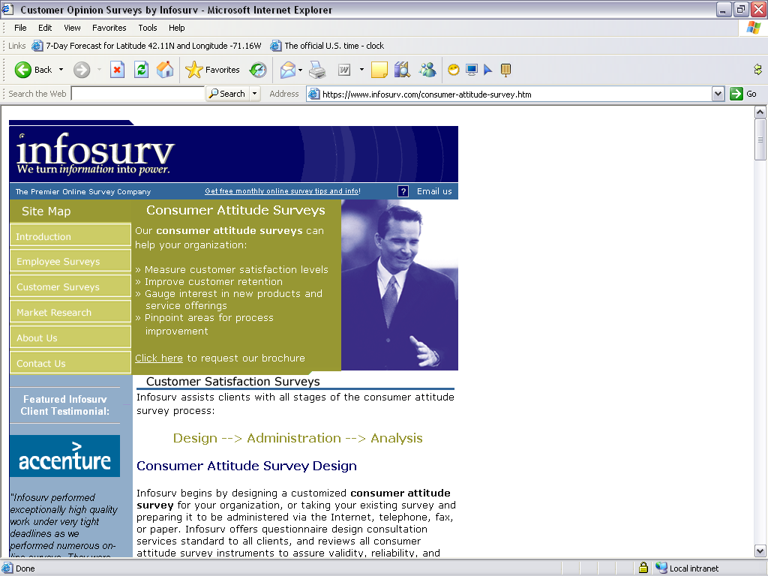
A Company Which Specializes in Attitude Measurement

Slide 6

What Information Does This Ad Provide to Assist
Consumers in Forming Attitudes Toward the Saturn Vue Hybrid?

Slide 7
It is Stylish, Safe, and
Good for the Environment

Slide 8
Structural Models of Attitudes
Tricomponent Attitude Model
Multiattribute Attitude Model
The Trying-to-Consume Model
Attitude-Toward-the-Ad Model
Notes:
These are models that attempt to understand the relationships between attitude and behavior. They will be explained in more detail on the following slides.

Slide 9
A Simple Representation of the Tricomponent Attitude Model
Cognitive
Affective
Conative
Notes:
The tricomponent attitude model has three components, as seen on this figure – the cognitive, affective, and conative components. Each of these will be explained in more detail in the slides that follow.

Slide 10
The Tricomponent Model
Components
It is what you know or think about an object.
This can be formed through direct experience or what you learn from others.
The knowledge you form becomes a belief.
Cognitive
Affective
Conative

Slide 11
The Tricomponent Model
Components
A consumer’s emotions or feelings about a particular product or brand
Cognitive
Affective
Conative
Notes:
How you feel about a brand, the emotions you have toward it, constitutes the affective component of the model. These feelings often tend to be overall good or bad feelings.

Slide 12
The Tricomponent Model
Components
The likelihood or tendency that an individual will undertake a specific action or behave in a particular way with regard to the attitude object
Cognitive
Affective
Conative
Notes:
The conative component describes the likelihood that you will do something in regard to the object. One of the most important is your intention to buy a certain object.

Slide 13
Discussion Questions
Explain your attitude towards “FAST FOOD” based on the tricomponent attribute model.
Or
Explain your attitude toward product of your choice based on the tricomponent attribute model.
Be sure to isolate the cognitive, affective, and conative elements.
Notes:
You probably have an overall positive or negative feeling toward your university. Try to break this affective component down a bit more – what do you like and not like? You can now look to the cognitive to determine what beliefs you have about these different parts of your university. Finally, how does this influence what you do? Will you come back for a graduate degree? Recommend your little brother or sister attend? Send your children here? Donate money as an alumnus?

Slide 14
Multiattribute Attitude Models
Attitude models that examine the composition of consumer attitudes in terms of selected product attributes or beliefs.
Notes:
Just as the name implies, these are models that breakdown overall attitude into the attributes or beliefs which form an overall opinion. There are several of these models, as you will see on the next few slides.

Slide 15
Multiattribute Attitude Models
Types
Attitude is function of the presence of certain beliefs or attributes.
Useful to measure attitudes toward product and service categories or specific brands.
E.g. buying a house –
2 bhk +2 freshrooms + back yard.
The attitude-toward-object model
The attitude-toward-behavior model
Theory-of-reasoned-action model
Notes:
According to the attitude-toward-object model, consumers will like a brand or product that has an adequate level of attributes that the consumer thinks are positive. For example, if you are buying a home, there is a list of attributes that the home must have – 2 bedrooms, 2 bathrooms, air conditioning, and a back yard. With this model, an attitude is positive for the house that has the most of these attributes.

Slide 16

Positive attitudes toward brands help with brand extensions

Slide 17
Multiattribute Attitude Models
Types
Is the attitude toward behaving or acting with respect to an object, rather than the attitude toward the object itself
Corresponds closely to actual behavior
How likely are you to purchase brand X rather than how highly do you rate brand X.
The attitude-toward-object model
The attitude-toward-behavior model
Theory-of-reasoned-action model
Notes:
Instead of asking people what product they like and have positive attitudes toward, the attitude-toward-behavior model is based on how positive someone's attitude is toward acting a certain way, for instance purchasing a certain brand. The question is now how likely are you to purchase brand X rather than how highly do you rate brand X.

Slide 18
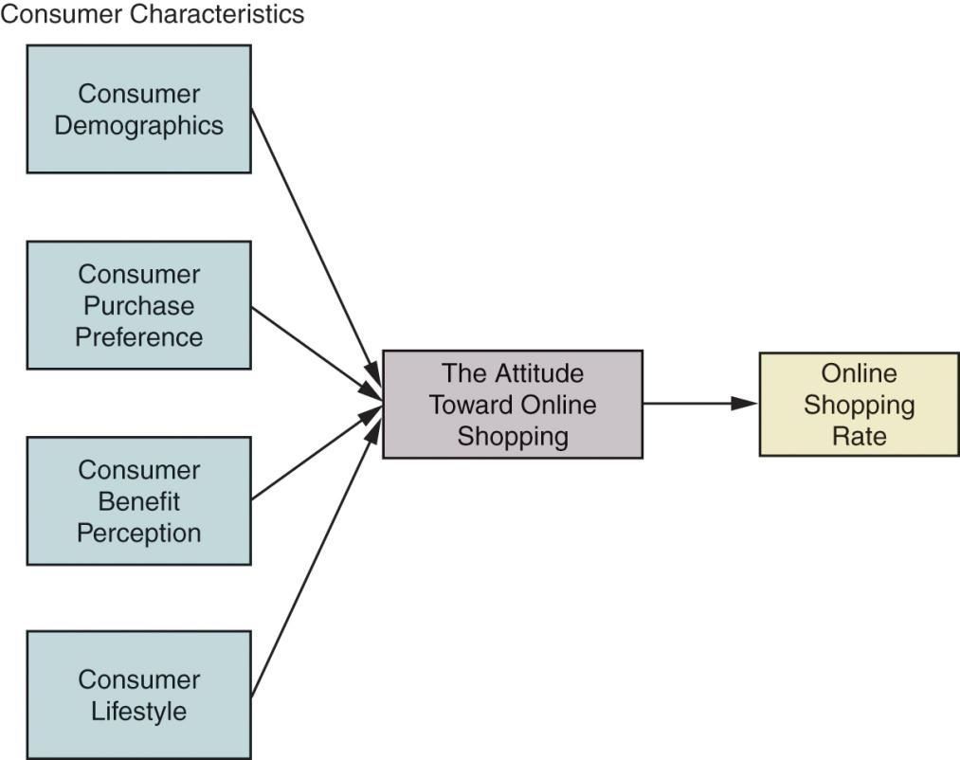
Consumer Characteristics, Attitude, and Online Shopping
Notes:
This is a model that looks at people’s attitudes toward purchasing online. On the lefthand side are the consumer characteristics that tend to impact a person’s attitude toward purchasing online. Their attitude was broken down further by how they view nine benefits of online shopping, including effectiveness, convenience, information, safety, service, delivery speed, web design, selection, and familiarity with company name. In addition, the attitude leads to how a consumer will rate an online shopping experience.

Slide 19
Multiattribute Attitude Models
Types
Includes cognitive, affective, and conative components
Includes subjective norms in addition to attitude
The attitude-toward-object model
The attitude-toward-behavior model
Theory-of-reasoned-action model
Notes:
Like other models, the theory of reasoned action has the three components, cognitive (think), affective (feel), and conative (do). In this model, we also need to understand subjective norms or how a consumer is influenced by others.

Slide 20
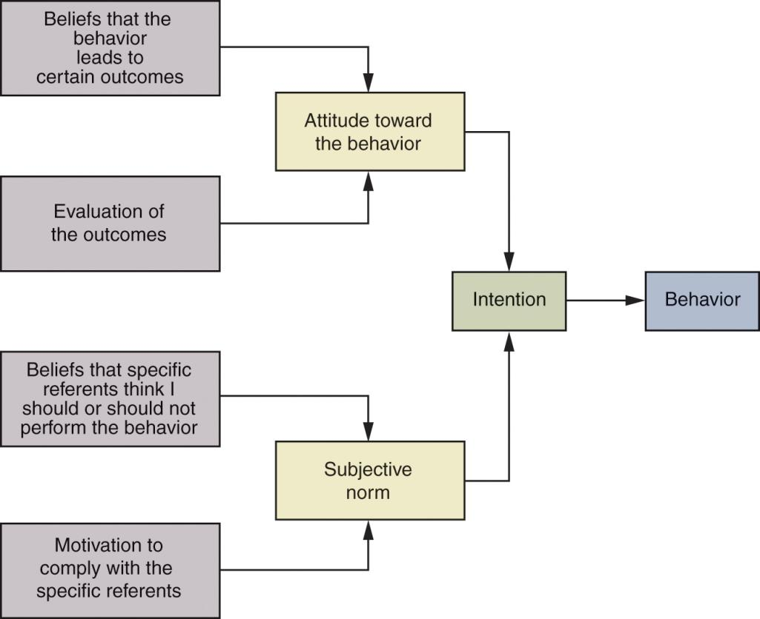
A Simplified Version of the Theory of Reasoned Action
Notes:
This is a figure of the theory of reasoned action. The subjective norms that are distinctive to this model are the two lower blocks on the right. A consumer has beliefs about what others think they should do and also have differing levels of how likely they will follow those beliefs, also known as their motivation to comply with the referents. This subjective norm is now combined with the consumer’s personal attitude toward a behavior to form an intention to perform a behavior. This intention may or may not lead to the actual behavior.
Certain groups are very influenced by the motivation to comply with people in their group. This web link brings you to cosmogirl.com. This site for younger female teens is loaded with information to supply motivation – see if you can identify three on the homepage alone.

Slide 21
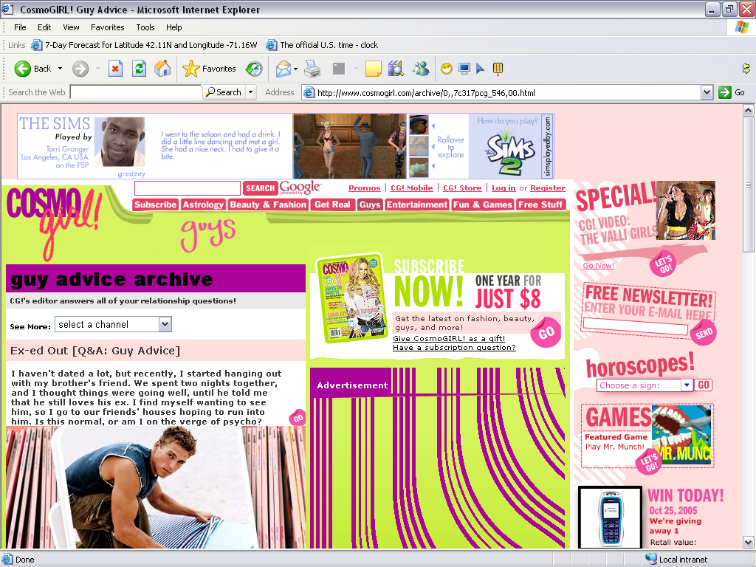
Subjective Norms Are Extremely Important for Teens

Slide 22
Discussion Question
Now use the theory of reasoned action to describe your attitude toward your college/university when deciding on which school to attend.
Notes:
This will lead you to think about the subjective norm and your attitude toward the behavior.

Slide 23
Theory of Trying to Consume
An attitude theory designed to account for the many cases where the action or outcome is not certain but instead reflects the consumer’s attempt to consume (or purchase).
Notes:
The theory of trying to consume addresses the fact that many people may want to purchase but in many cases they cannot. This may occur for personal reasons, such as not having enough money, or environmental reasons, such as not being able to go to a particular store.

Slide 24
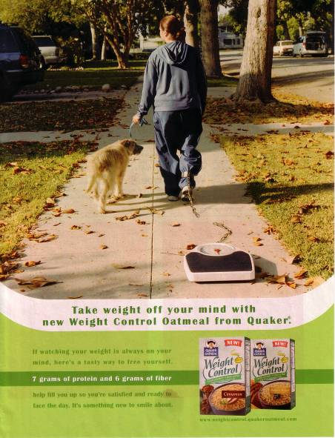
Ad illustrating the theory of trying to consume

Slide 25
Attitude-Toward-the-Ad Model
A model that proposes that a consumer forms various feelings (affects) and judgments (cognitions) as the result of exposure to an advertisement, which, in turn, affect the consumer’s attitude toward the ad and attitude toward the brand.
Notes:
The attitude-toward-the-ad model helps us understand how advertising impacts attitudes. The model is more thoroughly diagramed on the next slide.

Slide 26
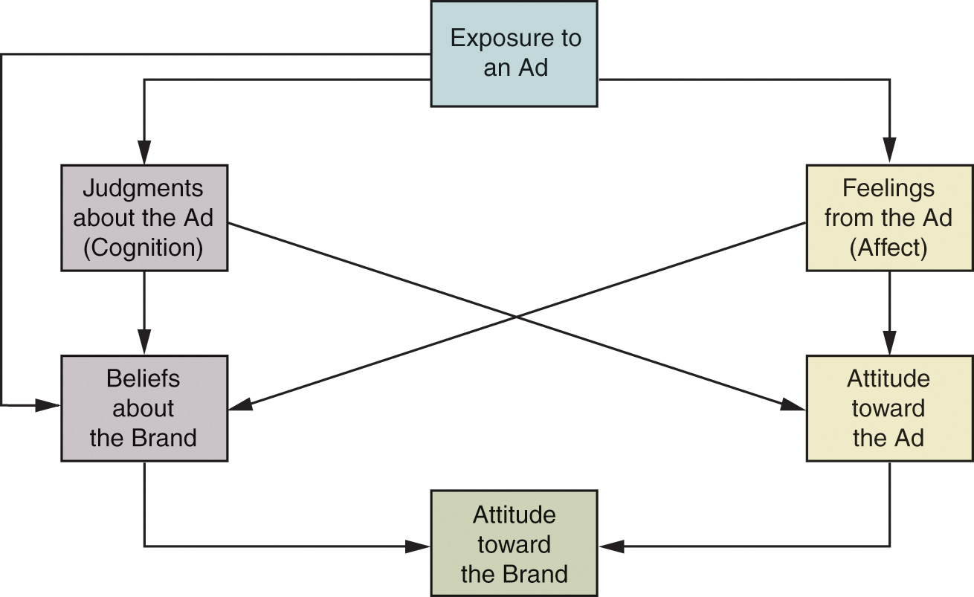
A Conception of the Relationship Among Elements in an Attitude-Toward-the-Ad Model
Notes:
Here we see that everything begins with exposure to the ad. After this exposure, the consumer has feelings (affect) and thoughts (cognition) regarding the ad. This forms an attitude which works with beliefs about the brand to help form an attitude toward the brand.

Slide 27
Issues in Attitude Formation
How attitudes are learned
  Conditioning and experience
  Knowledge and beliefs
Notes:
Attitudes are formed through learning. Recalling the concepts of classical and operant conditioning from earlier chapters, we recall that two stimuli can be paired or linked together to form a learned response. In addition, consumers can learn attitudes from rewards or outcomes from behavior.
If attitudes are learned, then it is through experiences that this learning occurs. This can be from personal experience or from experiences with friends or exposure to marketing influences. Another topic studied in an earlier chapter comes into play with attitude formation. This is the consumer’s need for cognition. People will form attitudes based on the information that best suits them, information for the high need for cognition consumer, and images and spokespeople for the low need for cognition.

Slide 28

How Does a Favorably Known Brand Name Impact the Formation of Consumer Attitudes
Toward a New Product?

Slide 29
There is Stimulus Generalization From the KFC Brand Names to the New Product.

Slide 30
Issues in Attitude Formation
Sources of influence on attitude formation
  Personal experience
  Influence of family
  Direct marketing and mass media
Personality factors

Slide 31

How Does Offers Impact Consumers’ Attitudes?

Slide 32
New Customers Will Try the Product,
Existing Customers will be Rewarded.

Slide 33
Strategies of Attitude Change
Changing the Basic Motivational Function
Associating the Product with an Admired Group or Event
Resolving Two Conflicting Attitudes
Altering Components of the Multi-attribute Model
Changing Beliefs about Competitors’ Brands
Notes:
Here are five strategies for attitude change. If you think about it, attitude change and formation are not all that different. They are both learned, they are both influenced by personal experience, and personality affects both of them.

Slide 34
1. Changing the Basic Motivational Function
Utilitarian
Ego-defensive
Value-expressive
Knowledge
Notes:
Changing the basic motivational function means to change the basic need that a consumer is trying to fulfill. Utilitarian function is how the product is useful to us. A marketer might want to create a more positive attitude toward a brand by showing all it can do. An ego-defensive function would show how the product would make them feel more secure and confident. A value-expressive function would more positively reflect the consumer’s values, lifestyle, and outlook. Finally, the knowledge function would satisfy the consumer’s “need to know” and help them understand more about the world around them.
It is important for marketers to realize that they might have to combine functions because different customers are motivated to purchase their products for different reasons. Someone might buy a product because it tastes good and fills them up (utilitarian), while another thinks it is low fat and will make them healthy and therefore look better (ego-defensive).

Slide 35

Why and How Does This Ad Appeal to the Utilitarian Function?

Slide 36
The Product is Green and Works as Well or Better than Other Products.

Slide 37

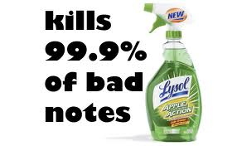

Slide 38
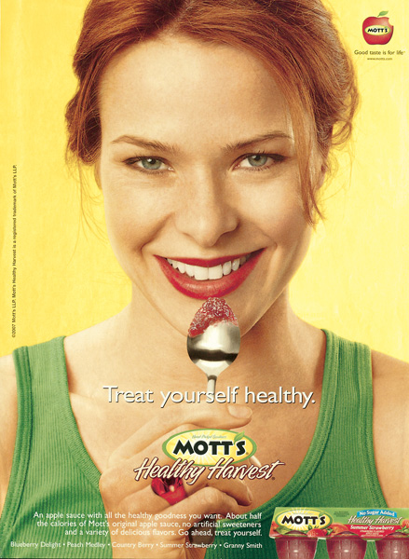
Which Lifestyle- Related Attitudes Are Expressed or Reflected in This Ad?

Slide 39
Healthy Eating and Snacking Lifestyle

Slide 40

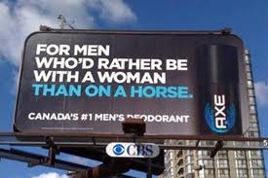
Ego defensive function

Slide 41

How Does This Ad Provide Information to Establish or Reinforce Consumer Attitudes?

Slide 42
It Raises the Question About UVA Rays and then Provides Information on Sun Protection.

Slide 43

Value Expressive Function

Slide 44

Crest uses a knowledge appeal.

Slide 45
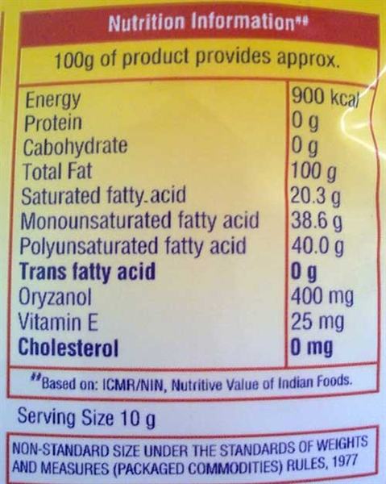
Knowledge Function

Slide 46
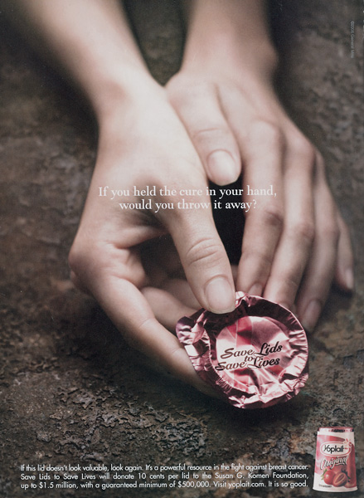
Discussion Questions
What products that you purchase associate themselves with an Admired Group or Event?
When does it personally influence your purchasing?
Notes:
Marketers often associate their products with certain not-for-profit groups. Many of us buy products because of this association. For some products, we are aware of this association but still do not purchase.

Slide 47

How Is Fiji Water’s Link to an Environmental Cause Likely to Impact Consumers’
Attitudes Toward Its Product?

Slide 48
They Might Have a More Favorable Attitude.

Slide 49
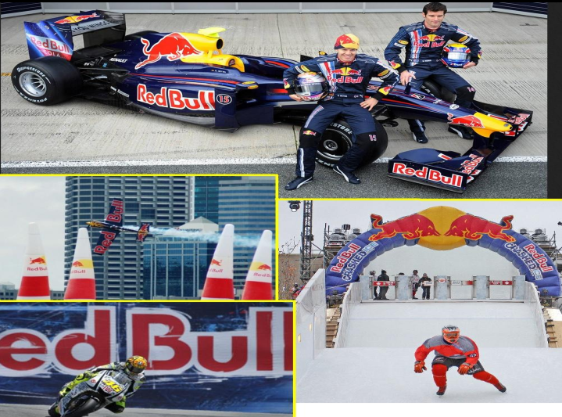

Slide 50

3. Resolving two conflicting attitudes
Moving from negative to positive attitude
Example: Conflicting attitude - Saffola though healthy not tasty.

Slide 51
4. Altering Components of the Multi-attribute Model
Altering Components of the Multi-attribute Model
  Changing relative evaluation of attributes
  Changing brand beliefs
  Adding an attribute
  Changing the overall brand rating
  Changing consumer beliefs about competitors brands
Notes:
If we think analytically about a multiattribute model, we realize there are many different attributes that make up an overall attitude. As marketers, we can change the way the consumer evaluates a certain attribute. Perhaps the consumer thinks inexpensive is fine for a product, but a marketer might be able to point out that it is often worth paying a bit more for better quality. A marketer can also change the way consumers believe a brand rates on a certain attribute. Maybe a consumer thinks a brand is very expensive when in fact it is less expensive then several other brands. There may be an attribute that does not even exist. Who thought chewiness was an attribute that could even exist for a vitamin until Gummy Vites came along? Finally, we can step away from looking individually at the attribute and attempt to change the consumer’s overall assessment of the brand. We can do any of these attitude change strategies by changing beliefs of our own product or our competitor's product.

Slide 52
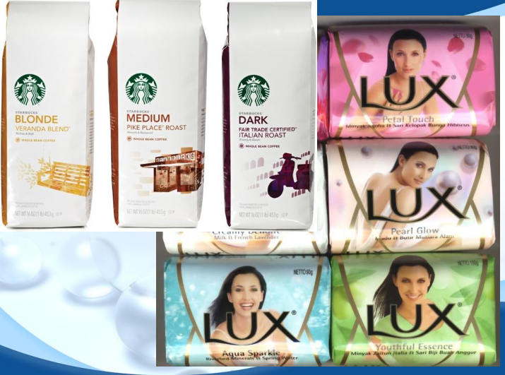

Slide 53
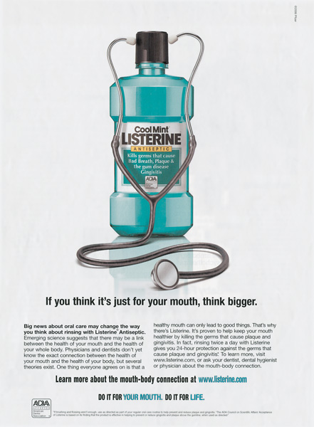
How Is This New Benefit Likely to Impact Consumers’ Attitudes Toward the Product?

Slide 54
The Consumer Will Have a More Positive Attitude Overall from the New Attribute.

Slide 55
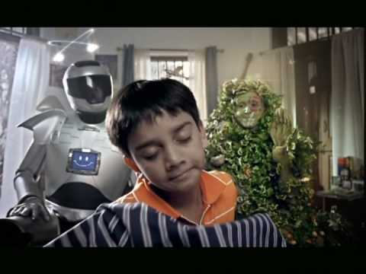
How Is the Absence of an Ingredient Likely to Lead to a Favorable Attitude Toward a Product?

Slide 56


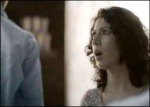
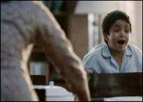




Adding an attribute

Slide 57
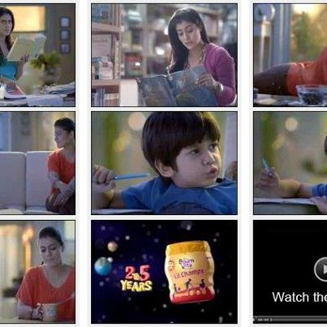
Adding an attribute

Slide 58

Which Attitude Change Strategy Is Depicted in This Ad?

Slide 59
Changing the Overall Brand Rating

Slide 60

Changing the overall brand rating
Company | Punchlines
Amazon.com | Earth’s biggest bookstore | Everything from a to z
HP invent |  | Invent …Everything is possible
BMW | The ultimate driving machine | Designed For Driving Pleasure

Slide 61
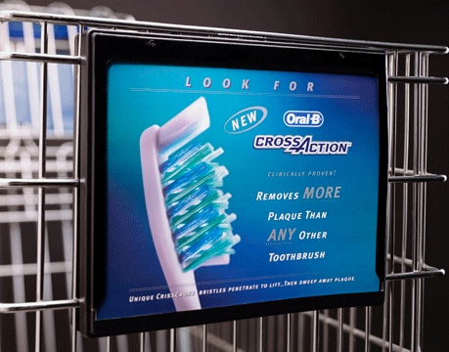
5. Changing consumer beliefs about competitors brands

Slide 62

How Is Valvoline’s Attempt to Change Attitudes Toward a Competing Brand Likely to Impact Attitudes Toward Its Own Brand?

Slide 63
By Showing Better Wear Protection

Slide 64
Discussion Question
A local cake shop / coffee house is having a hard time attracting customers due to a poor image. Explain how they can change people’s attitudes by using three of the following:
  Changing the Basic Motivational Function
  Associating the Product with an Admired Group or Event
  Resolving Two Conflicting Attitudes
  Altering Components of the Multiattribute Model
  Changing Beliefs about Competitors’ Brands

Slide 65
Evaluate the attitude of your friends regarding the use of the vacuum cleaners.
Categorize them in terms of the functions so described.
Suggest at least 3 ways in which the marketers can modify these attitudes.

