Slide 1

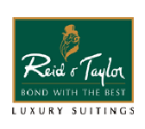

Slide 2
Session 7
Personality and Consumer Behavior

Slide 3
Personality and
The Nature of Personality
The inner psychological characteristics that both determine and reflect how a person responds to his or her environment
The Nature of Personality:
  Personality reflects individual differences
  Personality is consistent and enduring
  Personality can change
Notes:
The study of personality has been approached in many different ways. Heredity, early childhood experiences, and other social influences have a strong effect on who you become. The definition given here is on inner characteristics which distinguish one individual from others. The web link on this page brings you to one of the thousands of personality tests you can find online.
There are some interesting findings regarding the nature of personality. First of all, personality reflects individual differences. Because no two people are exactly the same, marketers can look for certain similar personality traits in different consumers. These consumers can then be grouped together based on this identified personality train. Personality is consistent and enduring. This helps marketers predict consumer behavior over time in terms of personality. Finally, personality can change due to major life events, such as marriage. You may notice personally that your personality has changed somewhat as you have grown – certainly your personality now is somewhat different then from when you were 7 years old.

Slide 4

Discussion Questions
How would you describe your personality?
How does it influence products that you purchase?
Notes:
You will probably describe your personality in terms of qualities, attributes, traits, factors and mannerisms. These personality traits influence products, including food, vacations, education, clothing, and more.

Slide 5
Theories of Personality
Freudian theory
  Unconscious needs or drives are at the heart of human motivation
Neo-Freudian personality theory
  Social relationships are fundamental to the formation and development of personality
Trait theory
  Quantitative approach to personality as a set of psychological traits
Notes:
These are the three major theories of personalities. There are many more but these three have been chosen because they are important to the relationship between personality and consumer behavior. Each will be discussed in detail on the next couple of slides.

Slide 6
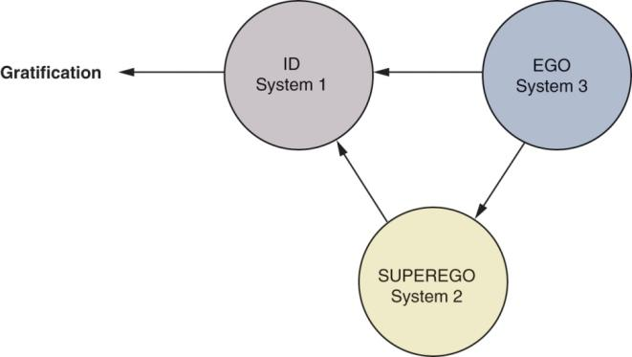
Freudian Theory
Id
  pleasure principle
The Superego:
  social, moral, & ethical inhibitions
The Ego:
  mediator between id’s impulses & superego’s restrictions
Notes:
Sigmund Freud was one of the most important and influential psychiatrists of all time. There are many web sited devoted to him and his theories. The web link on this page will take you to one such site.
Freudian theory itself is based on the existence of unconscious needs or drives as the heart of human motivation and personality. According to Freud, human personality consists of these three systems, the id, super ego and the ego. The Id is the “warehouse” of primitive drives, basic physiological needs such as hunger, thirst, and sex. The superego drives the individual to fulfill their needs in a socially acceptable function. Finally, the ego is the internal monitor that balances the needs of the id and the superego.

Slide 7
Snack Foods and Personality Traits
Snack Foods | Personality Traits
Potato chips | Ambitious, successful, high achiever, impatient with less than the best.
Tortilla chips | Perfectionist, high expectations, punctual, conservative, responsible.
Pretzels | Lively, easily bored with same old routine, flirtatious, intuitive, may over commit to projects.
Snack crackers | Rational, logical, contemplative, shy, prefers time alone.
Cheese curls | Conscientious, principled, proper, fair, may appear rigid but has great integrity, plans ahead, loves order.
Notes:
Can certain foods be a reflection of your personality? This table shows the results of a study of 19,000 consumers which examined the link between snack food perceptions and personality types. The table shows, for example, that nuts are associated with a personality that is take charge, pitches in often, modest, self-confident but not a show-off.

Slide 8

How Does This Marketing Message Apply the Notion of the Id?

Slide 9
It Captures Some of the Mystery and The Excitement Associated With the “Forces” of Primitive Drives.

Slide 10
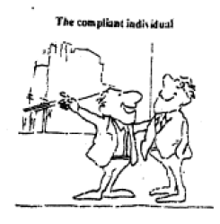
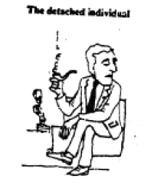
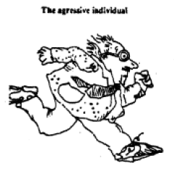
Neo-Freudian Personality Theory
Social relationships are fundamental to personality
  Compliant: move toward others
  Aggressive: move against others
  Detached: move away from others
Notes:
As opposed to Freud’s theories which were based heavily on development, Neo-Freudian’s are concerned with social relationships. These relationships are formed to reduce feelings of inferiority or tension. Furthermore, people can be classified as to how they interact with others – are they compliant, aggressive, or detached. A compliant individual desires attention, an aggressive desires admirations, and a detached person desires independence and freedom from obligation. What is particularly interesting is how research has shown that these different personality groups differ in their brand usage.

Slide 11
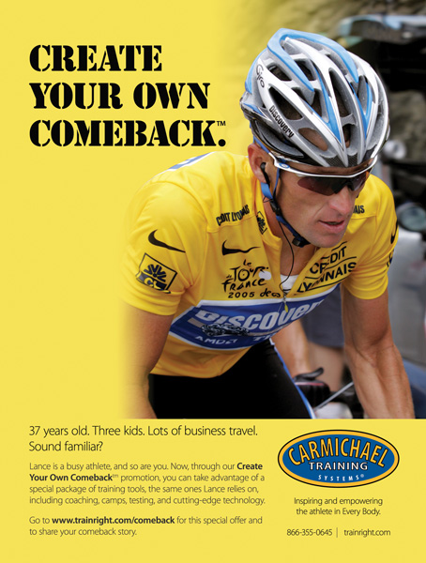
Why Is Appealing to an Aggressive Consumer a Logical Position for This Product?

Slide 12
Because its Consumer Seeks to Excel and Achieve Recognition

Slide 13
Trait Theory
Focus on measurement of personality in terms of traits
Trait - any distinguishing, relatively enduring way in which one individual differs from another
Personality is linked to broad product categories and NOT specific brands
Notes:
Unlike Freudian and Neo-Freudian theories, trait theory is less qualitative and more focused on measurement of personality. Tests can be done to measure single traits in consumers such as how receptive they are to new experiences (innovativeness), their attachment to worldly possessions (materialism), and their likelihood to accept or reject foreign-made products (ethnocentrism).

Slide 14
Soup and Soup Lover’s Traits
Chicken Noodle Soup Lovers
  Watch a lot of TV
  Are family oriented
  Have a great sense of humor
  Are outgoing and loyal
  Like daytime talk shows
  Most likely to go to church
Tomato Soup Lovers
  Passionate about reading
  Love pets
  Like meeting people for coffee
  Aren’t usually the life of the party
Vegetable/Minestrone Soup Lovers
  Enjoy the outdoors
  Usually game for trying new things
  Spend more money than any other group dining in fancy restaurants
  Likely to be physically fit
  Gardening is often a favorite hobby
Notes:
Researchers have found that traits are more tied to general product categories then specific brands. For instance, in this chart we see the type of soup a consumer prefers but not necessarily the brands they would purchase.

Slide 15
Personality and Understanding
Consumer Behavior
Consumer innovativeness
Dogmatism
Social character
Optimum stimulation level
Variety-novelty seeking
Notes:
Marketers are very interested in the link between personality and consumer behavior. These are seven topics which are examined on the following slides.

Slide 16
Consumer Innovativeness
Willingness to innovate
Further broken down for hi-tech products
  Global innovativeness
  Domain-specific innovativeness
  Innovative behavior
Notes:
Consumer innovators are the group of consumers that are very open to new ideas and are usually the first to purchase products. Innovativeness is the underlying trait that describes a consumer’s willingness to try new products. Companies have found this very important when introducing brand extensions because it is a key factor in the consumer’s likelihood to try the new product. For hi-tech products, we see that innovativeness can be explained at three levels. The first, global innovativeness, is the overall innovative level of the consumer. Drilling down further, domain-specific innovativeness has to do with the particular product category, and finally, the innovative behavior is the actual purchase of the new product.

Slide 17
Dogmatism
A personality trait that reflects the degree of rigidity a person displays toward the unfamiliar and toward information that is contrary to his or her own established beliefs
Notes:
Dogmatic is a personality trait that describes how rigid or open a person is to new and unfamiliar ideas and products. A person who is highly dogmatic approaches the unfamiliar defensively and with discomfort. They will rarely consider the unfamiliar and tend to be very close minded. Marketers have realized this type of customer appreciates advertising appeals with celebrities and other experts.

Slide 18
Social Character
Ranges on a continuum for inner-directedness to other-directedness
Inner-directedness
  rely on own values when evaluating products
  Innovators
Other-directedness
  look to others
  less likely to be innovators
Notes:
This personality trait has its origins in sociological research but it is of great interest to marketers because it differentiates the type of advertising that influences these customers. Inner-directed people prefer ads that stress product features. Other-directed individuals gravitate to ads that that show approving social environment rather than product information – they want to look to others to understand how to act or be accepted, and the ads give an example of this.

Slide 19
Optimum Stimulation Level
A personality trait that measures the level or amount of novelty or complexity that individuals seek in their personal experiences
High OSL consumers tend to accept risky and novel products more readily than low OSL consumers.
Notes:
Optimum stimulation levels are related to how a consumer tends to like or dislike novel, complex, and unusual experiences and products. High optimum stimulation levels lead consumers to take risks and try new products. Similar to a person with high innovativeness, these consumers are important to marketers of new products.

Slide 20
Variety-Novelty Seeking
Measures a consumer’s degree of variety seeking
Examples include:
  Exploratory Purchase Behavior
  Use Innovativeness
  Vicarious Exploration
Notes:
Consumers seek variety in many ways. Some exhibit exploratory purchase behavior where they switch brands often to experience new products. Other consumers display variety by use innovativeness, using an existing product in a new way. Finally, vicarious exploration, which often does not involve actual purchase about the product, refers to daydreaming or thinking often about a new product. Ask yourself, for product categories, how do you exhibit variety-novelty seeking?

Slide 21

Cognitive Personality Factors
Need for cognition (NFC)
  A person’s craving for enjoyment of thinking
  Individual with high NFC more likely to respond to ads rich in product information
.
Notes:
Researchers are aware that cognitive personality factors influence consumer behavior. In fact, it has been realized that the level of a consumer’s need for cognition affects how they are likely to respond to certain types of advertisements. Those that are high in need for cognition tend to respond to ads that supply product information as opposed to those who are low in need for cognition who tend to be attracted to the background of the ad, attractive models, and cartoon characters.

Slide 22
Cognitive Personality Factors
Visualizers
Verbalizers
Notes:
Another cognitive personality factor that researchers have isolated is whether a consumer is a visualizer who prefers visual information or a verbalizer who prefers written or verbal information. This difference in cognitive personality factors would affect how they respond to a print ad.

Slide 23

Why Is This Ad Particularly Appealing to Visualizers?

Slide 24
The Ad Stresses Strong
Visual Dimensions

Slide 25

Why Is This Ad Particularly
Appealing to Verbalizers?

Slide 26
It Features a Detailed Description

Slide 27
Brand Personality
Personality created to appeal target customers
Association with brand:
  Character/Personality
  Emotional
Positioning of brand:
  Social
  Values
Benefits provided:
  Attributes
  Quality
Notes:
Brand personality can be tied to many a successful brand. If the personality is favorable and strong, it will strengthen the brand and lead to a more favorable attitude, brand preference, higher purchase intention, and brand loyalty. In addition, in commodity category, detergent for example, it can help differentiate a brand (it’s the one with the Snuggly Teddy Bear).

Slide 28
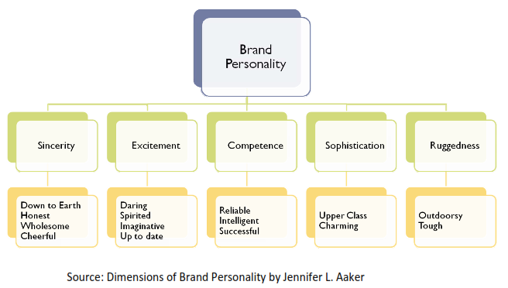
A Brand Personality Framework
Notes:
This is a brand personality framework that shows the five dimensions of a brands personality. Consider one of your favorite brands – how does it map out on this framework?

Slide 29
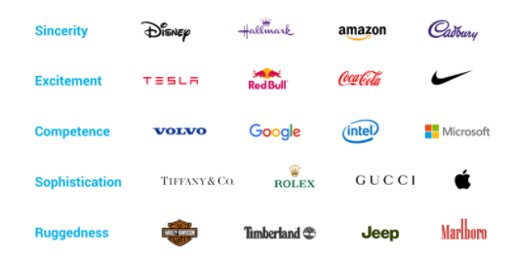
A Brand Personality Framework
Notes:
This is a brand personality framework that shows the five dimensions of a brands personality. Consider one of your favorite brands – how does it map out on this framework?

Slide 30
Components of Brand Personality
Brand Name & Logo
Color & Packaging
Advertisement (including Brand Ambassador)
Price
Performance

Slide 31




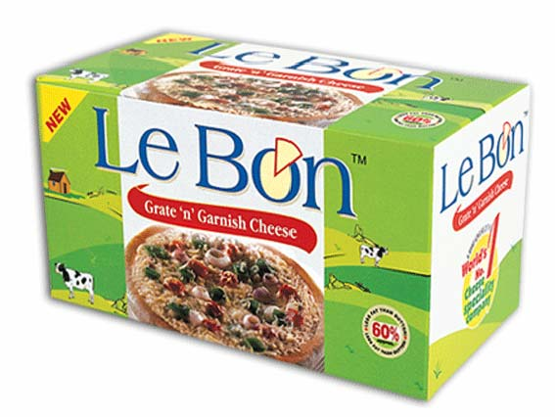
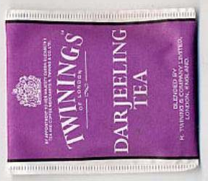
Brand Names
Red Bull, Power Horse –Energy Drinks
Himalayan – Mineral Water
Le Bon –Cheese
Twinings—Darjeeling Tea
Puma –Footwear
Dove – Bathing Soap

Slide 32
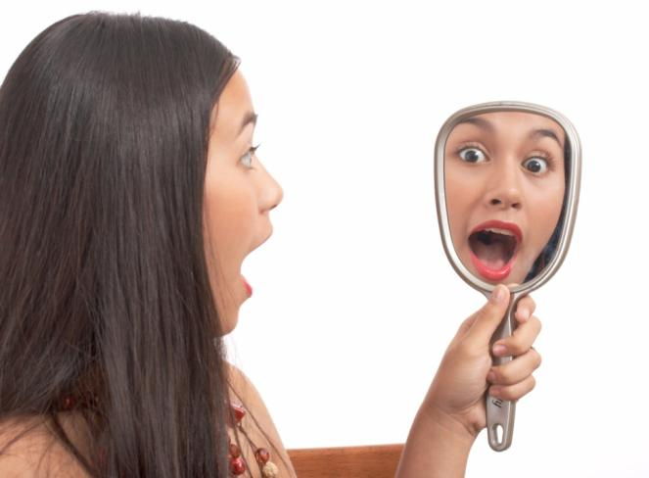
Self & Self Image
Consumers have a variety of enduring images of themselves
These images are associated with personality in that individuals’ consumption relates to self-image

Slide 33
One or Multiple Selves
A single consumer will act differently in different situations or with different people
We have a variety of social roles
Marketers can target products to a particular “self”
Notes:
To understand multiple selves, think of the way you present yourself and think about yourself at a formal university function (career fair perhaps) vs. a party with good friends. Next, think of the clothing you would purchase for these events. It would likely be very different as you are presenting a different “self” at each event.

Slide 34
Dimensions Of Self Image
Actual Self Concept
Ideal Self Concept
Private Self
Actual Self How I actually see myself
Ideal self How I would like to see myself
Social Self
Social Self How others actually see me
Ideal Social Self How I would like others to see me.

Slide 35


Self-Image / Self-concept
Self-Image Congruence
  When self-image matches brand-user image.

Slide 36
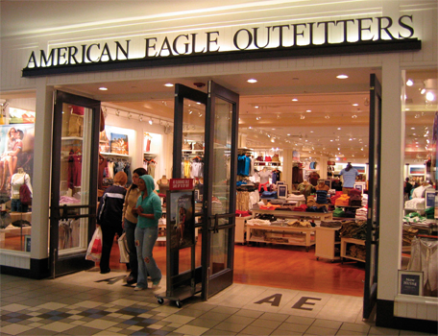
Self-Congruency
Does this store match ur self-concept?

Slide 37
Altering the Self-Image
Consumers use self-altering products to express individualism by:
  Creating new self
  Maintaining the existing self
  Extending the self
  Conforming
Notes:
Often, a consumer wishes to change themselves. Perhaps they want a new look or to appear in a different way. Altering the self-image can tie to personal vanity as it is involved in one’s appearance.

Slide 38

Which Consumer
Self-Image Does This Ad Target, and Why?

Slide 39
Actual self-image because it tells middle-age women who like their hair long to continue doing so.

Slide 40
