Slide 1
MODELS OF CONSUMER BEHAVIOUR
Session 9

Slide 2
Traditional Models
Contemporary Models
The Economic Model
Learning Model
Psychological Model
The Sociological Model
The Howard Sheth Model of buying behaviour
The Nicosia Model
The Engle-Kollat-Blackwell Model
Engle, Blackwell and Miniard (EBM) Model
Webstar and Wind Model of organizational buying behaviour
Notes:
Traditional models:- these models were developed by economists with a view to understand economic systems.
Contemporary models:- these models evolved as newer approaches to understand what are influencing consumer behaviour these models focused on the decision process adopted by consumers and borrowed concepts from behavioural sciences field.

Slide 3
Economic Model:
This model assumes that with limited purchasing power and a set of needs and tastes, a consumer will allocate his/ her expenditure over different products at a given prices so as to maximize utility.
Bases for Economic Model:
  Price Effect
  Substitution Effect
  Income Effect
Criticism:
Fails to explain how does the consumer actually behave.
Incompleteness in the Model.
Lack of broader perspective.

Slide 4
Learning Model:
This model help marketers to promote association of products with strong drivers and cues, which would lead to positive reinforcement from the consumers.
In marketing context, ‘learning’ will help marketers to understand how consumer learn to respond in new marketing situations, or how they have learned and respond in the past in similar situations.
As Consumers also learn to discriminate and this information will be useful in working out different marketing strategies.

Slide 5
Psychological Model:
This model based on the work of psychologists who were concerned with personality. The view was human needs and motives operates on buying.
This theory was developed by Sigmund Frued. Acc. To him human behaviour is the outcome of
  Id – the sources of all psychic energy which drives to act
  Super Ego – the internal representation of what is approved by society
  Ego – the conscious directing ‘id’ impulses to find gratification in socially accepted manner.
This model is concerned with personality and says that human behaviour to a great extent is directed by a complex set of deep seated motives.
Helps the marketer to know how buyers influenced by symbolic factors in buying a product.
Notes:
Id – the sources of all psychic energy which drives to act
Super Ego – the internal representation of what is approved by society
Ego – the conscious directing ‘id’ impulses to find gratification in socially accepted manner.

Slide 6
The Sociological Model:
As per this model, an individual buyer is a part of the institution called society, gets influenced by it and in turn, also influences it in its path of development.
The interactions with all the set of society leave some impressions on him and may play a role in influencing his buying behaviour.
The marketers, through a process of market segmentation can work out on the common behaviour patterns of a specific class and group of buyers and try to influence their buying pattern.

Slide 7
The Howard Sheth Model of buying behaviour
It attempts to throw light on the rational brand behaviour shown by buyers when faced with situations involving incomplete information and limited abilities.
The model refers to three levels of decision making:
Extensive problem solving
Limited problem solving
Routinized response behaviour
The model has borrowed the learning theory concepts to explain brand choice behaviour when learning takes places as the buyer moves from extensive to routinized problem solving behaviour.

Slide 8
Four components involved in the model:
The model makes significant contribution to understand consumer behaviour by identifying the variables which influence consumers.
Input variables
Output variables
Hypothetic constructs
Exogenous variables

Slide 9
Howard Sheth Model - Inputs
Input Variables consist of three distinct stimuli (information sources)
The marketer furnishes
  Physical brand characteristics (significative stimuli) i.e (are those actual elements of brands which the buyer confronts)
  Verbal or visual product characteristics (symbolic stimuli). i.e.(which are used by marketers to represent their products in a symbolic form)
  The third type is generated by the social environment such as family, friends, groups etc.
All three types of stimuli provide inputs concerning the product class or specific brands to the specific consumer.
Significative
Quality
Price
Distinctive
Service
Availability
Symbolic
Quality
Price
Distinctive
Service
Availability
Social
Family
Reference Group
Social Class

Slide 10
Howard Sheth Model - Output
  The outputs are the results of the perceptual and learning variables
  How the consumers will response to these variables
    Purchase
    Attitude
    Intention
    Attention
    Brand Comprehension
Intention
Purchase
Routinized Response Behaviour
Limited Problem Solving
Extensive Problem Solving
Intention
Attitude
Brand Comprehension
Attention

Slide 11
Output variables:
These are which buyer’s observable responses to stimulus inputs. They appear in the sequence as below:
Attention: Based on the importance of the buyer’s information intake.
Comprehension: the store of information the buyer has about the brand.
Attitude: the buyer’s evaluation of the particular brand's potential to satisfy his or her motives.
Intention: the brand which the buyer intends to buy.
Purchase behaviour: the act of actually purchasing, which reflects the buyer’s predisposition to buy as modified by any of the inhibitors.

Slide 12
Howard Sheth Model – Perceptual Construct
  Pertain to the way the individual deals with information
  How the Consumer Receives Information
  How Consumer Understands Information
  Stimulus ambiguity
    When the consumer does not understand the message from the environment
  Perceptual bias
    When the consumer distorts the information received so that it fits his or her established needs or experience
Significative Inputs
Overt Search
Symbolic Inputs
Stimulus Ambiguity
Attention
Perceptual Bias

Slide 13
Howard Sheth Model - Learning Construct
  Learning Construct
    Category
    Consumers’ Goals
    Information about Brands
    Criteria for evaluation
    Alternatives
    Preferences
    Buying Intentions
Intention
Routinized Response Behaviour
Limited Problem Solving
Extensive Problem Solving
Confidence
Attitude
Brand Comprehension
Motive
Choice Criteria
Satisfaction
Perceptual Bias

Slide 14
Exogenous variables:
These are list of a number of external variables (external to the buyer) which can significantly influence buyer decisions.

Slide 15
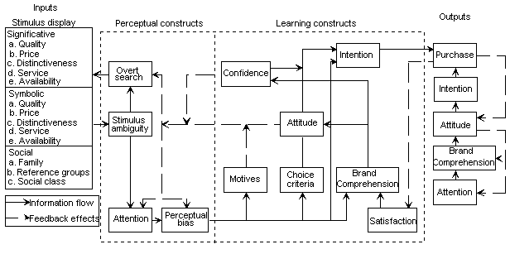
The Howard Sheth Model of buying behaviour

Slide 16


Howard Sheth Model
EXOGENUOUS
VARIABLES
INPUTS
OUTPUTS
PERCEPTUAL & LEARNING CONSTRUCT

Slide 17
Limitations of the model:
There is a absence of sharp distinctions between exogenous variables and other variables.
Some of the variables, which are not well defined, and are difficult to measure too.
The model is quite complex and not very easy to comprehend.

Slide 18
The Nicosia Model
This model attempts to explain buying behaviour by establishing a link between the organisation and its prospective customer. It analyse human being as a system with stimuli as the input to the system and the human behaviour as an output of the system.
The model suggests that message from the first influences the predisposition of the consumer towards the product or services. Based on the situation, the consumer will have a certain attitude towards the product. This may result in a search for the product or an evaluation of the product attributes by the consumer.
If the customer satisfies with above it may result in a positive response, with a decision to buy the product otherwise the reverse may occur.

Slide 19
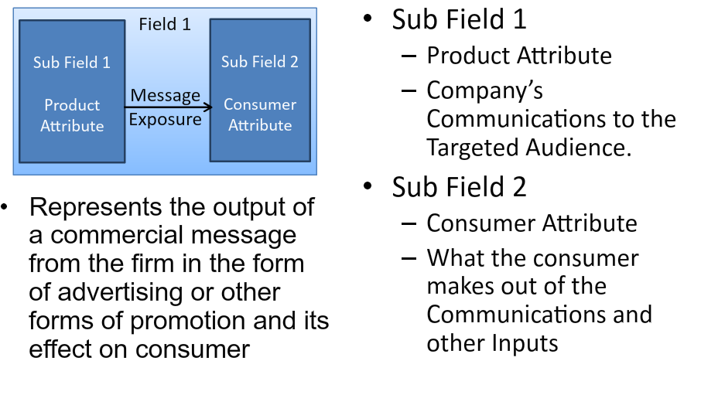
Nicosia Model – Field 1

Slide 20
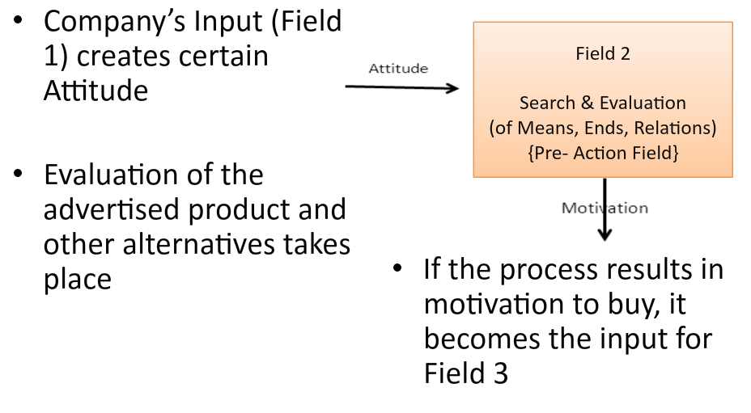
Nicosia Model – Field 2

Slide 21
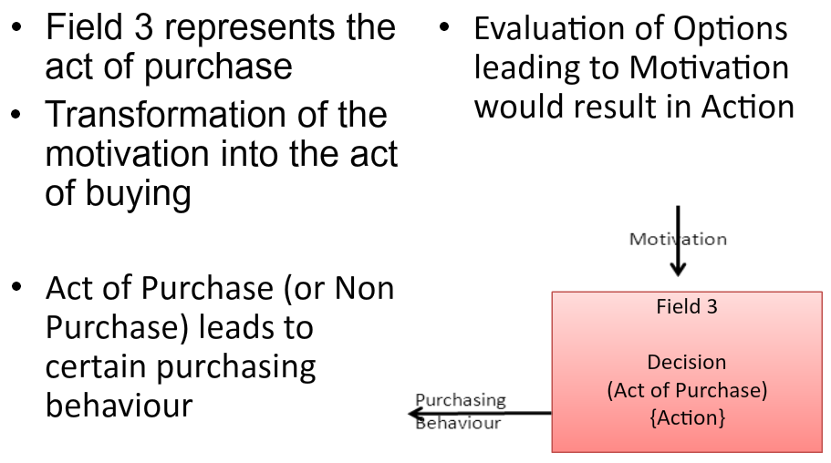
Nicosia Model – Field 3

Slide 22
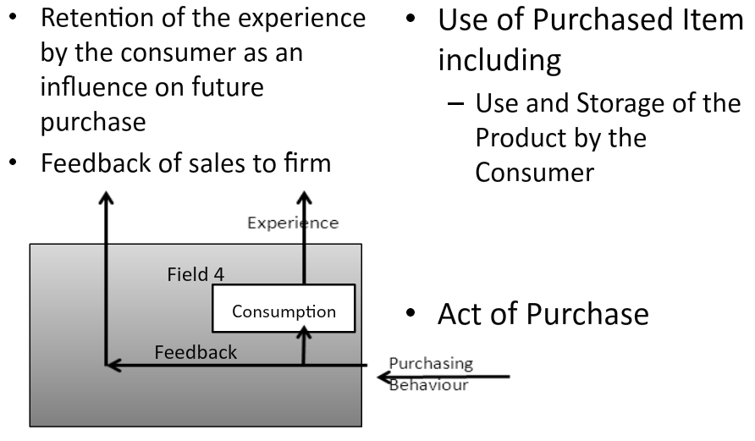
Nicosia Model – Field 4

Slide 23
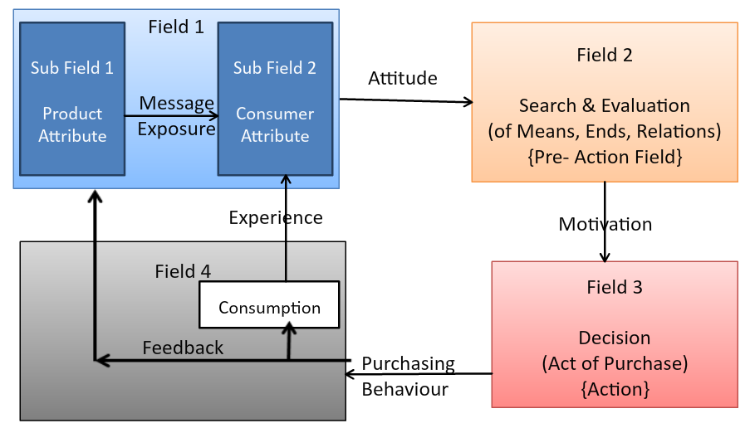
Nicosia Model

Slide 24
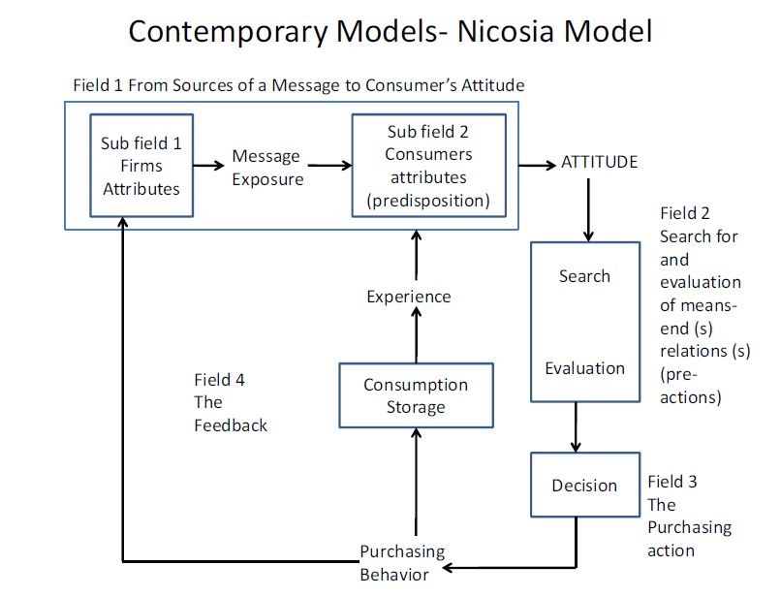

Slide 25
Limitations:
The flow is not completed and does not mention the various factors internal to the consumer.
The assumption about the consumer being involved in the decision process with no predisposition about the various brands is restricting.
Overlapping between firm’s attributes and consumers attributes.

Slide 26
The Engel – Kollat – Blackwell (EKB) Model:
This model talks of consumer behaviour as a decision making process in the form of five steps (activities) and other related variables which occur over a period of time.
5 steps involved in the decision process:
  Problem Recognition
  Information Search
  Alternative Evaluation
  Choice
  Outcome

Slide 27
Other related Variables included in this model:
  Information input
  Information processing
  Product – brand evaluation
  General motivating influences
  Internationalised environment influences

Slide 28
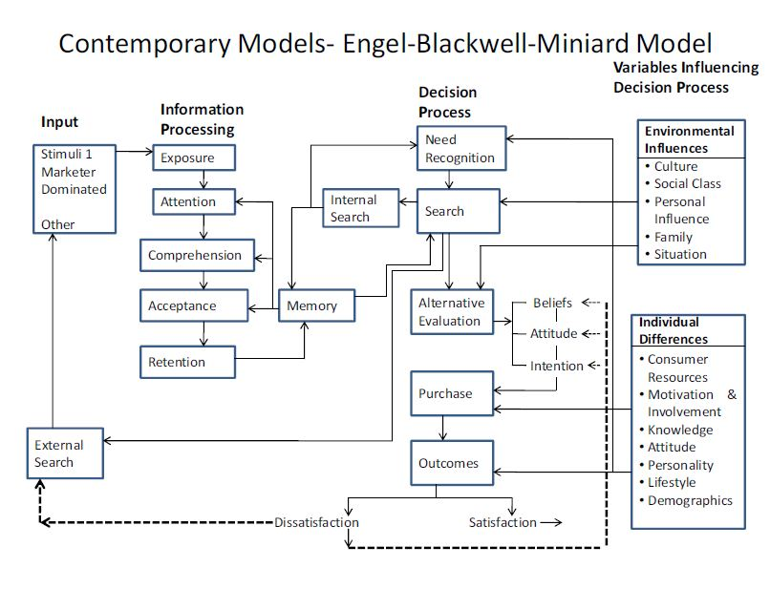

Slide 29
About the model
The model has emphasised on the conscious decision making process adopted by a consumer.
The model is easy to understand and is flexible.
This model recognises that a consumer may not go through all the steps always. This is because in case of repeat purchases the consumer may bypass some of the steps.
One limitation, the inclusion of environmental variables and general motivating influences but not specifying the effect of these on the buyer behaviour.

Slide 30
Engel, Blackwell and Minirad (EBM) Model:
It shares certain things with Howard-Sheth model.
The core of the EBM model is a decision process which is augmented with inputs from information processing and other influencing factors.
Four sections of the Model:
Input
Information Processing
Decision process and
Variables influencing decision process.

Slide 31
The EBM Model when compared to the Howard-seth model is more coherent and flexible than the latter.
This model also includes human processes like memory, information processing and considers both the positive and negative purchase out comes.

Slide 32
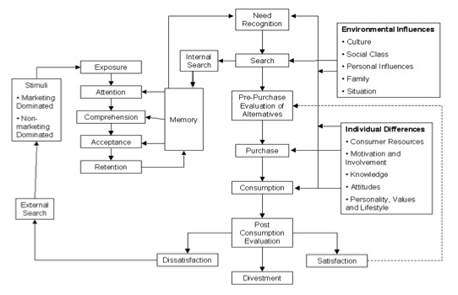

Slide 33
Contd…
The ekb model is a comprehensive and shows the components of decision making and the relationship and interaction among them . The five distinctive parts of consumer decision making are input, information processing, decision process ,decision process variables and external influences.

Slide 34
Webster and Wind
partitiones the buying process into several processes
processes of decision-making are determined by environmental and organizational factors.
Final buying process rendered as the mixture of individual and group decision

Slide 35
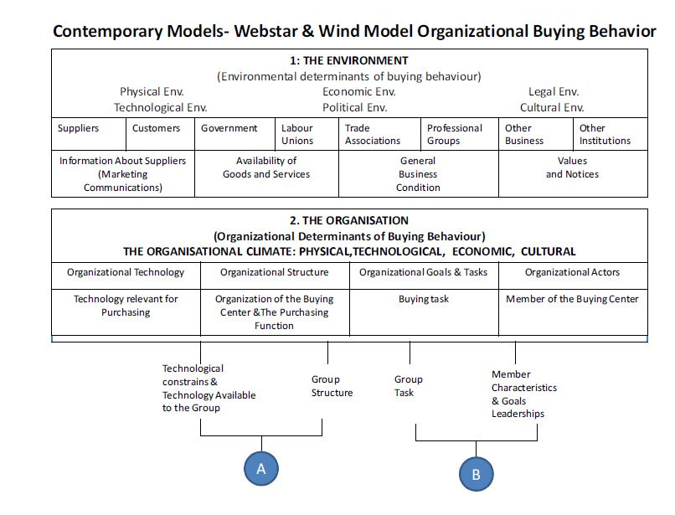

Slide 36
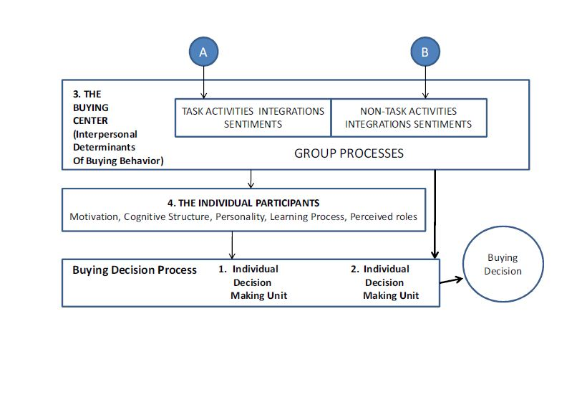

Slide 37
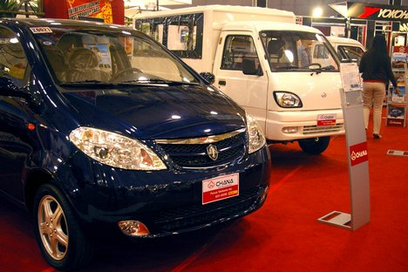
example
Automobile manufacturing
B2B business
Purchasing tires

Slide 38
The Consumer Choice Process
Choice is among alternative brands and services, and among stores
Noncomparable alternatives are two or more choice options in different product categories, such as deciding whether to buy a new stereo or a new television

Slide 39
High- and Low-Involvement Conditions
Compensatory models are used in high-involvement conditions and allow high ratings on one attribute to compensate for low ratings on another.
Noncompensatory models are used in low-involvement situations and emphasize that high ratings on some attributes will not compensate for low ratings on another attribute.

Slide 40
High-Involvement Choice
Multi-attribute models are employed in which information on attributes is combined into an overall judgment, and the brand with the highest overall judgment is chosen.
With compensatory models an alternative is not necessarily rejected because it has low ratings on any particular attribute.

Slide 41
Noncompensatory Decision…
Conjunctive Decision Rule (cutoff criteria)
  Consumer sets a minimum standard for each attribute and if a brand fails to pass any standard, it is dropped from consideration.
  Reduces a large consideration set to a manageable size.
  Often used in conjunction with another decision rule.
Disjunctive Decision Rule (rank by importance)-- sets a minimum acceptable standard as the cutoff point any attribute--any brand that exceeds the cutoff point is accepted.
  Reduces large consideration set to a more manageable number of alternatives.
  Consumer may settle for the first satisfactory brand as final choice or may use another decision rule.

Slide 42
Formal Choice Models
Consumer Decision rules are broadly classified
into two major category:
Compensatory model
Noncompensatory models
  Conjunctive model
  Disjunctive model
  Lexicographic model

Slide 43
Performance Levels on Evaluative Criteria for Six Notebook Computers
Evaluative Criteria | Alternatives
 | WinBook | HP | Compaq | Dell | IBM | Toshiba
Price | 5 | 3 | 3 | 4 | 2 | 1
Weight | 3 | 4 | 5 | 4 | 3 | 4
Processor | 5 | 5 | 5 | 2 | 5 | 5
Battery life | 1 | 3 | 1 | 3 | 1 | 5
After-sale support | 3 | 3 | 4 | 3 | 5 | 3
Display quality | 3 | 3 | 3 | 5 | 3 | 3

Slide 44
Evaluation of Six Notebook Computers
Using a Compensatory Model
Evaluative Criteria | Importance Score | Alternatives
 |  | WinBook | HP | Compaq | Dell | IBM | Toshiba
Price | 30 | 5 | 3 | 3 | 4 | 2 | 1
Weight | 25 | 3 | 4 | 5 | 4 | 3 | 4
Processor | 10 | 5 | 5 | 5 | 2 | 5 | 5
Battery life | 05 | 1 | 3 | 1 | 3 | 1 | 5
After-sale Support | 10 | 3 | 3 | 4 | 3 | 5 | 3
Display Quality | 20 | 3 | 3 | 3 | 5 | 3 | 3
Total | 100 | 370 | 345 | 370 | 385 | 300 | 295

Slide 45
Evaluation of Notebook Computers
Using the Conjunctive Model
Evaluative Criteria | Minimum Standards | Alternatives
 |  | WinBook | HP | Compaq | Dell | IBM | Toshiba
Price | 3 | 5 | 3 | 3 | 4 | 2 | 1
Weight | 4 | 3 | 4 | 5 | 4 | 3 | 4
Processor | 3 | 5 | 5 | 5 | 2 | 5 | 5
Battery life | 1 | 1 | 3 | 1 | 3 | 1 | 5
After-sale Support | 2 | 3 | 3 | 4 | 3 | 5 | 3
Display Quality | 3 | 3 | 3 | 3 | 5 | 3 | 3

Slide 46
Evaluation of Notebook Computers
Using the Disjunctive Model
Evaluative Criteria | Minimum Standards | Alternatives
 |  | WinBook | HP | Compaq | Dell | IBM | Toshiba
Price | 4 | 5 | 3 | 3 | 4 | 2 | 1
Weight | 3 | 3 | 4 | 5 | 4 | 3 | 4
Processor | Not critical | 5 | 5 | 5 | 2 | 5 | 5
Battery life | Not critical | 1 | 3 | 1 | 3 | 1 | 5
After-sale Support | Not critical | 3 | 3 | 4 | 3 | 5 | 3
Display Quality | 3 | 3 | 3 | 3 | 5 | 3 | 3

Slide 47
Evaluation of Notebook Computers
Using the Lexicographic Model
Evaluative Criteria | Rank | Alternatives
 |  | WinBook | HP | Compaq | Dell | IBM | Toshiba
Price | 1 | 5 | 3 | 3 | 4 | 2 | 1
Weight | 2 | 3 | 4 | 5 | 4 | 3 | 4
Processor | 4 | 5 | 5 | 5 | 2 | 5 | 5
Battery life | 6 | 1 | 3 | 1 | 3 | 1 | 5
After-sale Support | 5 | 3 | 3 | 4 | 3 | 5 | 3
Display Quality | 3 | 3 | 3 | 3 | 5 | 3 | 3

Slide 48
Decision Outcomes
Choice Model | Brand Choice
Compensatory | Dell
Conjunctive | HP, Compaq
Disjunctive | Dell, WinBook
Lexicographic | WinBook

Slide 49
Examples of Decision Rules
Decision Rule | Mental Statement
Compensatory Rule | “I selected the computer that came out best when I balanced the good ratings against the bad ratings”
Conjunctive Rule | “I selected the computer that had no bad features.”
Disjunctive Rule | “I picked the computer that excelled in at least one attribute”
Lexicographic Rule | “I looked at the feature that was most important to me and chose the computer that ranked highest on that attributes.”

