Slide 1
Ur latest purchase?
What is the latest consumer durable product you have bought for your house?
Whose idea was to get that product? Why did he/she feel that you needed that product?
Who fixed the budget? What was the procedure for fixing budget? Who paid for the product?
Whom did you consult before deciding?
Why did you select the particular brand and not the other?
Who selected the particular brand?
Where did you buy it and why from there only?
What is your feeling after buying and using that product?
Any other aspects worth mention?**

Slide 2
CONSUMER BEHAVIOR

Slide 3
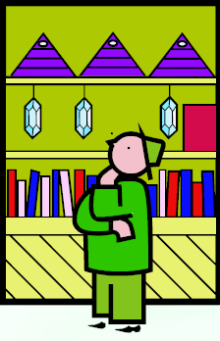
Consumer Behavior
The behavior that consumers display in searching for, purchasing, using, evaluating, and disposing of products and services that they expect will satisfy their needs.

Slide 4
Also …
Consumer behavior is the study of how, why and what people do when they buy products or avail of some services. It attempts to understand the buyer decision making process, both individually and in groups.

Slide 5
Need for understanding CB?
Evolving consumer preferences
  E.g. toothpastes
Changing lifestyles
  Diet coke, Sugar free
Environmental concerns
  E.g. Surf Excel Quick Wash
Shorter PLC
  E.g. mobile phones, cameras, electronic items…
Faster technology adoption
  Online purchases

Slide 6
Quotes for the Day
Anyone can measure the number of seeds in an apple. Who can measure the number of apples in a seed?
  --Anon
  Price is an observable description of a state of the market. Customer value is the hidden source of ideas about what to do to make a market more profitable for the business.

Slide 7
Customer Needs and
Customer Value Measurement
Customer Needs and Buying Process
Behaviors
Ignore
Present
State
Postpone
Functional
and
Economic
Needs
Perceived
and
Psychological
Needs
Engage in
Purchase Process
Desired
State
Search for options
Evaluate options
Choose option
Purchase Option
Use Option
·
Motivation
Customer
Value
Measurement
Approaches
Objective
Measures
of Value
Perceptual
Measures
of Value
Behavioral
Measures
of Value
Notes:
There are three sets of ways to infer customer value….no one is the “best” and they can and should complement each other in use

Slide 8
Changing characteristics of Consumer Worldwide
Collectivism to Individualism
Health & wellness consideration
Online shopping

Slide 9
Two Consumer Entities
Personal Consumer
The individual who buys goods and services for his or her own use, for household use, for the use of a family member, or for a friend.
Organizational Consumer
A business, government agency, or other institution (profit or nonprofit) that buys the goods, services, and/or equipment necessary for the organization to function.
Notes:
The personal consumer is sometimes called the end user or ultimate consumer. This is you when you go to Best Buy to purchase a new television for your home. The organizational consumer is buying for the organization or to re-sell to the personal consumer. Although both types of consumer entities are important, we will be focusing on the personal consumer throughout these presentations.

Slide 10
The personal consumer is sometimes called the end user or ultimate consumer. This is you when you go to Best Buy to purchase a new television for your home.
The organizational consumer is buying for the organization or to re-sell to the personal consumer. Although both types of consumer entities are important, we will be focusing on the personal consumer throughout these presentations.

Slide 11
User
Initiator
Key
Family
Decision
Roles
Buyer
Influencer
Decider

Slide 12
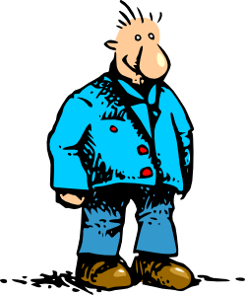

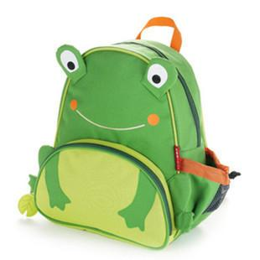

Slide 13
What is Organizational Buying?
Organizational buying refers to the decision-making process by which formal organizations establish the need for purchased products and services, and identify, evaluate, and choose among alternative brands and suppliers.

Slide 14
The Buying Center
Buying Center
Approvers
Influencers
Deciders
Buyers
Gate
keepers
Users
Initiators

Slide 15
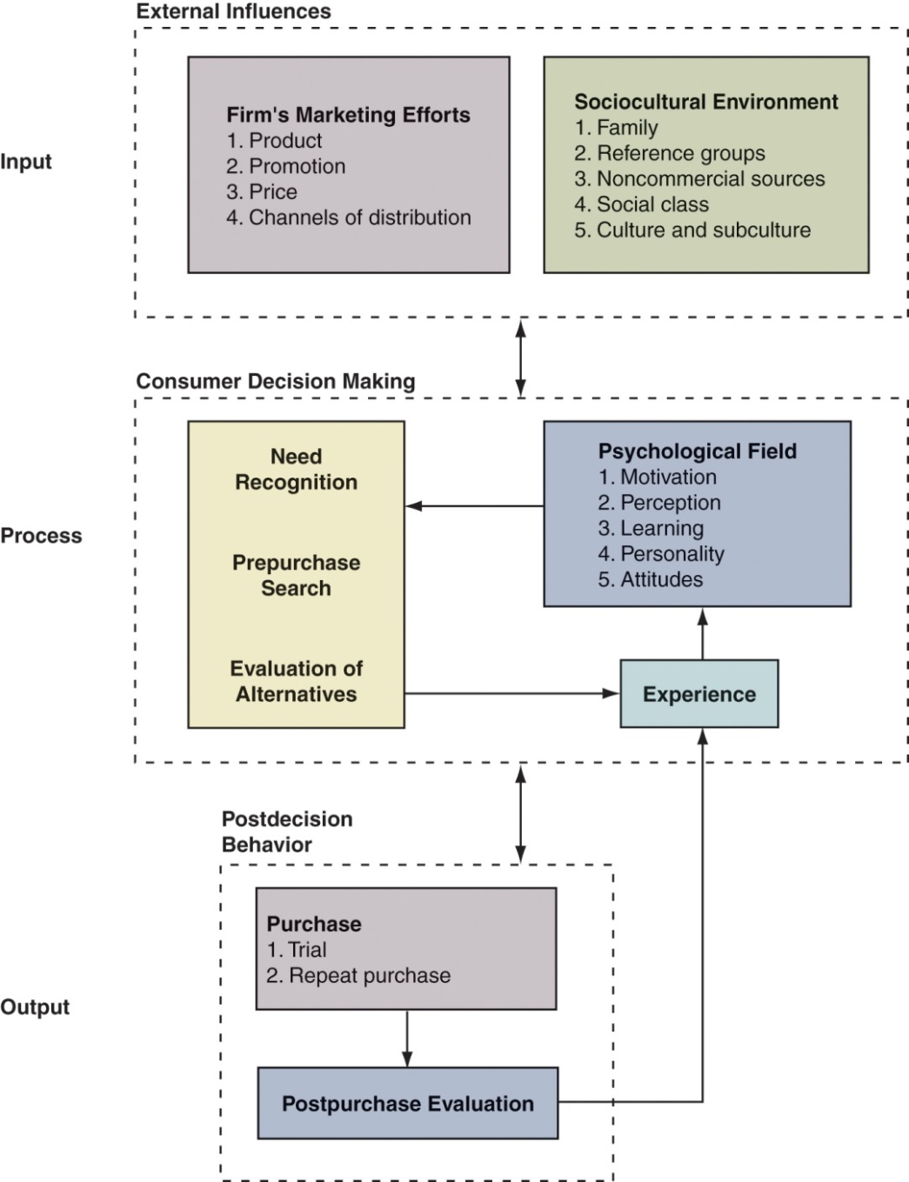
A Simple Model of Consumer Decision Making
Notes:
This model will guide your studies of consumer behavior. The input stage includes sources of information to the consumer – how they learn and are influenced by the marketer and their environment.
The process stage ties to the decision-making process the consumer undergoes when considering a purchase. It moves from the inputs to the psychological factors involved in recognizing a need, searching for information, and evaluating alternatives.
The output stage involves the actual purchase and the post-purchase evaluation. This post-purchase evaluation ties to the satisfaction topics discussed earlier in this presentation and the importance of customer loyalty to marketing’s profitability.

Slide 16
Consumer Decision
Making Process
Problem recognition
Information search
Evaluation
Purchase decision
Post purchase behavior
Notes:
Problem recognition= Need Recognition

Slide 17
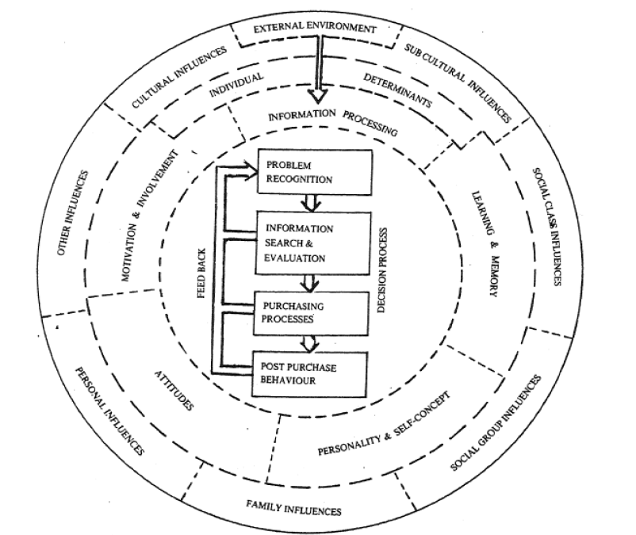

Slide 18
Cultural Factors:
Culture
  Basic cause of person’s wants and behavior.
Sub-culture
  Group of people which share values.
Social class
  It is measured as a combination of occupation, income, education, wealth and other variables.

Slide 19
Social Factors
Reference Groups
Membership groups
Primary groups
Secondary groups
Aspirational groups
Dissociative groups
Family
Family of Orientation
Family of Procreation
Social roles & Status

Slide 20
Personal Factors
Personal Factors
Age & stage in Life cycle
Occupation & Economic
Lifestyle & Values
Personality & Self-concept

Slide 21
Psychological Factors
Motivation
Perception
Learning
Beliefs & Attitude

Slide 22
Situational Influences
Physical surroundings
Psychological Influences
Perception
Social Influences
Roles
Social surroundings
Time
Purchase reason
Buyer’s mood & condition
Motives
Learning
Attitudes
Personality & self concept
Lifestyles
Family
Reference Groups
Opinion leaders
Social Classes
Culture & Subcultures

Slide 23
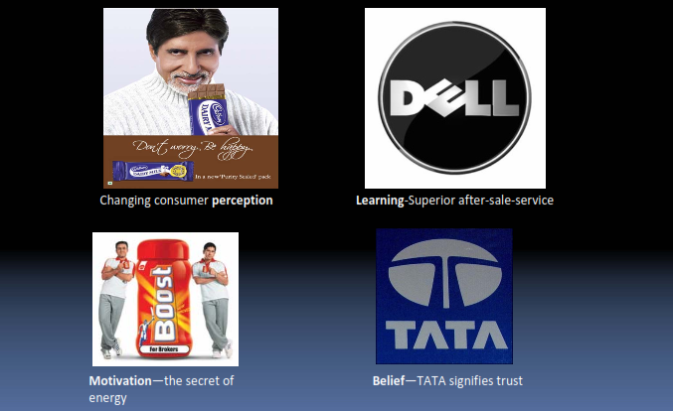
How do psychological factors affect the consumer’s purchase decision?

Slide 24
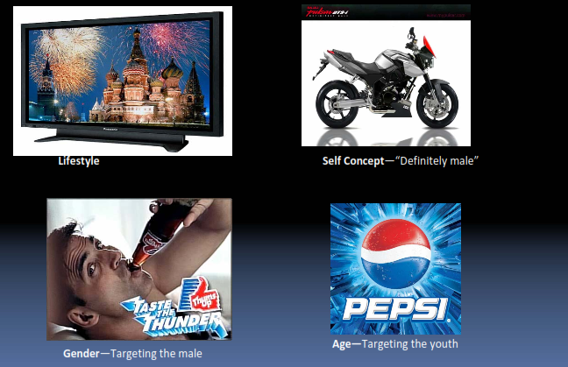
How do personal factors affect the consumer’s purchase decision?

Slide 25
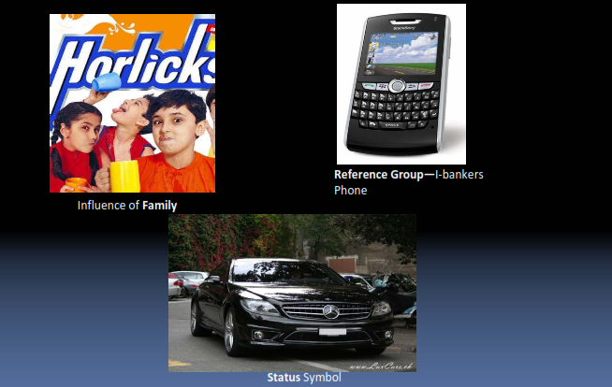
How do social factors affect the consumer’s purchase decision?

Slide 26
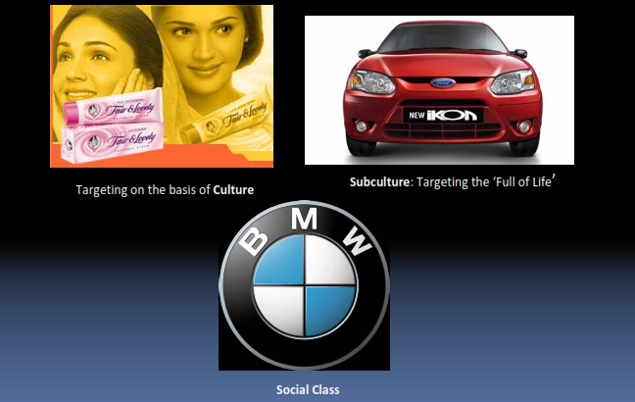
How do cultural factors affect the consumer’s purchase decision?

Slide 27
Level of Involvement & Consumer Problem-Solving Processes
Level of Involvement
  An individual’s degree of interest in a product and the importance of the product for that person
    Enduring involvement is ongoing and long term
    Situational involvement is temporary and dynamic
Routinized Response Behavior
  The process used when buying frequently purchased, low-cost items that require little search and- decision effort

Slide 28
Limited Problem Solving
  The process that buyers use when purchasing products occasionally or when they need information about an unfamiliar brand in a familiar product category
Extended Problem Solving
  The process employed when purchasing unfamiliar, expensive, or infrequently bought products
Impulse Buying
  An unplanned buying behavior resulting from a powerful urge to buy something immediately

Slide 29
High Purchase Involvement
( High level of interest in the purchase)
Extended decision making
High financial & psychological risk
High product involvement
Extensive information search
Post purchase evaluation

Slide 30
Low Purchase Involvement
(low level of interest in the purchase process)
Habitual Decision Making Limited Decision Making
(routine purchases) (variety seeking behavior)
Brand loyal decisions Repeat purchases
(buying out of
commitment to brand) (buying out of habit)

Slide 31
Four Types of Buying Behavior
High
Involvement
Low
Involvement
Complex
Buying
Behavior
Variety-
Seeking
Behavior
Significant
differences
between
brands
Dissonance-
Reducing Buying
Behavior
Habitual
Buying
Behavior
Few
differences
between
brands

Slide 32
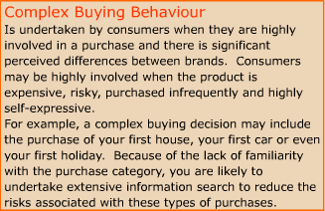

Slide 33
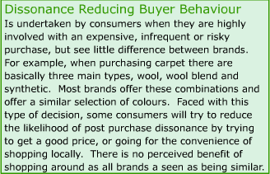

Slide 34
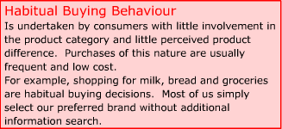

Slide 35
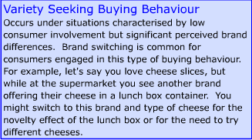

Slide 36
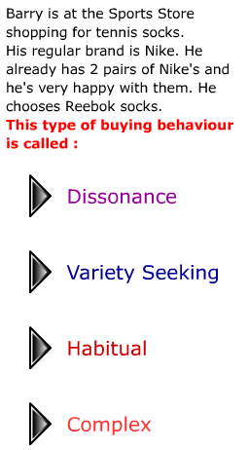

Slide 37
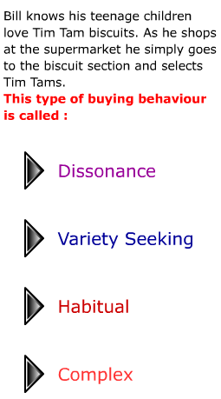

Slide 38
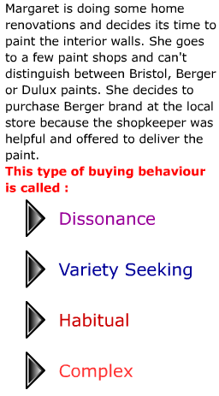

Slide 39
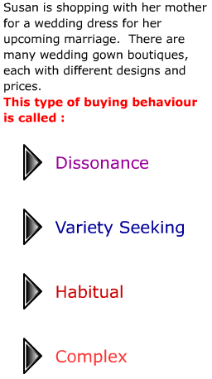

Slide 40
Applications of Consumer Behavior in Marketing
Analyzing Market Opportunity
Selecting the target market
Determining the product mix (4P’s)
Use in non-profit and social marketing

Slide 41
Organizational
Buying Behavior

Slide 42
Characteristics of Business Markets
A multi person buying activity
A formal activity which follows the procedures laid down in an organisation
Longer time lag between efforts and results
Rational but also Emotional activity
Uniqueness of the organization

Slide 43
Characteristics of Business Markets
Market Structure & Demand
Fewer, larger buyers
Nature of the Buying Unit
More buyers
Types of Decision & Decision Processes
More complex decisions
Geographically concentrated
Demand derived from consumers
Inelastic demand
Fluctuating demand
More professional purchasing effort
Process is more formalized
Buyer and seller are more dependent on each other
Build close long-term relationships with customers
Notes:
Characteristics of Organizational Markets
Market Structure and Demand. Business markets have far fewer buyers than consumer markets. Business markets are much more geographically concentrated. Business demand is derived demand coming from the demand for the consumer goods the organization produces. Demand is more inelastic and more fluctuating.
Nature of the Buying Unit. Business markets have more buyers and more professional purchasing procedures. Purchasing agents may be career professionals highly trained in how to buy better. As purchases become more complex, more people are likely to become involved in the purchase decision.
Types of Decisions. Business buying decisions may be more complex due to the large amounts of money involved, technical specification considerations, and the interaction and coordination of more people in the buying process.
Decision Process. Beyond the complexity of the decision business buying is more formalized, often with written procedures. Also, business buying decisions feature buyer-seller relationships that are more dependent upon each other than consumer buying situations. Both buyer and seller have fewer options to do business elsewhere than do consumer buyer and sellers.
Other Characteristics
Direct Purchasing. Business buyers usually buy direct from producers.
Reciprocity. Business buyers often practice reciprocity, selecting suppliers who also buy from them.
Leasing. Many businesses lease rather than buy equipment. Leasing gains a number of advantages over buying such as having more capital, having newer products, and tax incentives.

Slide 44
Stages in the Buying Process: Buy phases
Problem recognition
General need description
Product specification
Supplier search
Proposal solicitation
Supplier selection
Order-routine specification
Performance review

Slide 45
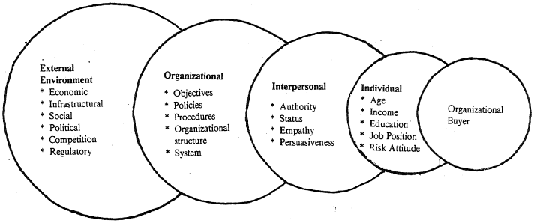
Major Influences on Organizational Buying Behavior

Slide 46
Buying Situations:
New Task Buying
Custom furniture
Installed components
Buildings
Weapon systems
Modified Rebuy
New vehicles
Electrical equipment
Consultants
Computer equipment
Involved Decision Making
Straight Rebuy
Utilities
Office Supplies
Bulk chemicals

