Slide 1
2.
Market Segmentation
Consumer Industrial Buyer Behavior

Slide 2
Marketing: the name of the Game
The days of “one size fits all” are over
No longer can one say “You can have any colour as long as it is black”
Need to follow the “horses for courses” policy - no more mass marketing

Slide 3

Market Segmentation
The process of dividing a potential market into distinct subsets of consumers and selecting one or more segments as a target market to be reached with a distinct marketing mix.

Slide 4
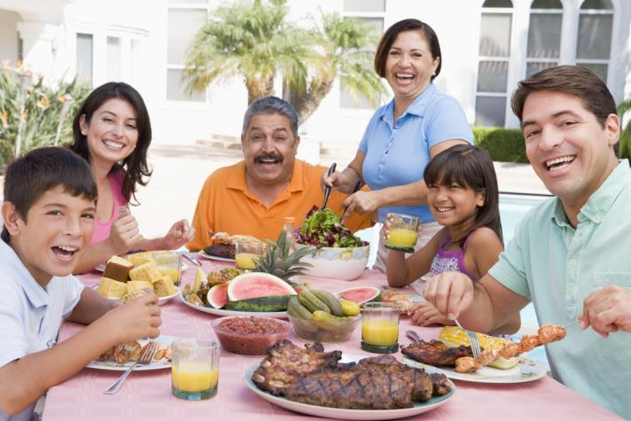
Why Segmentation is Necessary
Consumer needs differs
Differentiation helps products compete
Segmentation helps identify media
To identify the gaps (opportunities) in the market
To help identifying repositioning requirements
Notes:
Not all consumers are alike – different customers have different needs. By segmenting the market and choosing target markets, companies can differentiate their products to provide the benefits that the segments desire. Once a marketer has identified their segment, they can choose media that is targeted to that segment for their advertising.

Slide 5
Segmentation Base
Demographic Segmentation
Benefits-Sought Segmentation
Geographic Segmentation
Situation Segmentation
Psychographic Segmentation
Behavior/Usage Segmentation

Slide 6
Demographic Segmentation
Age
Gender
Occupation
Education
Marital Status
Religion
Family size
Family life cycle
Race
Generation
Income
Nationality
Notes:
Demographics are the core of almost all segmentation because they are easy and logical. In addition, they are a cost-effective way to reach segments and demographic shifts are easier to identify than other types of shifts. When researching segmentation and media exposure, a consumer researcher will learn that media exposure is often directly related to demographics. Age segmentation includes segments such as the baby boomers and generations X and Y. Family life-cycle is based on the premise that many families pass through similar phases in their lives and share major life events such as moving, marriage, birth of a child, and retirement. Income, education, and occupation tend to tie together and lead to segmentation based on social class.

Slide 7




Slide 8
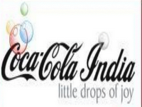

Slide 9
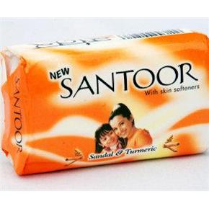
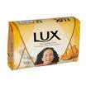



Slide 10
Segmentation Base
Demographic Segmentation
Benefits-Sought Segmentation
Geographic Segmentation
Situation Segmentation
Psychographic Segmentation
Behavior/Usage Segmentation

Slide 11
Geographic Segmentation
“Birds of a feather flock together”
The division of a total potential market into smaller subgroups on the basis of geographic variables.
(e.g., region, state, or city)
People who live close to one another are likely to be similar in tastes, incomes, lifestyles & consumption. They might eat similar foods, like the same movies, and take the same types of vacations.

Slide 12
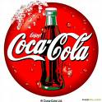

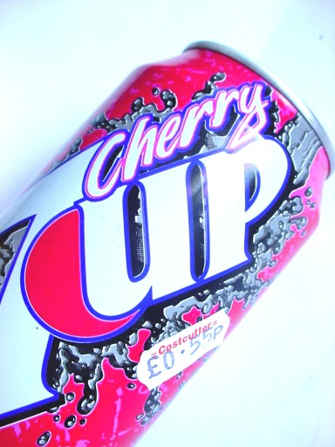

Segmentation Base
Localizes its marketing efforts to specific geographic regions

Slide 13
Segmentation Base
Demographic Segmentation
Benefits-Sought Segmentation
Geographic Segmentation
Situation Segmentation
Psychographic Segmentation
Behavior/Usage Segmentation

Slide 14
Psychological Segmentation
Motivations
Personality
Perceptions
Learning
Attitudes

Slide 15
Segmentation Base
Grouping customers together based on social class, lifestyles and psychological characteristics (attitudes, interests and opinions)
Useful but more difficult to identify and measure compared to demographic variables

Slide 16
ACTUALIZERS
High Resources
Principle Oriented
Status Oriented
Action Oriented
FULFILLEDS
ACHIEVERS
EXPERIENCERS
BELIEVERS
STRIVERS
MAKERS
STRUGGLERS
Low Resources

Slide 17

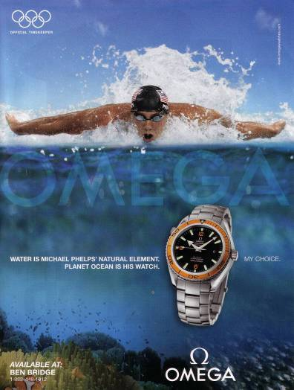
Two High-End Watches for Different Psychological Segments

Slide 18

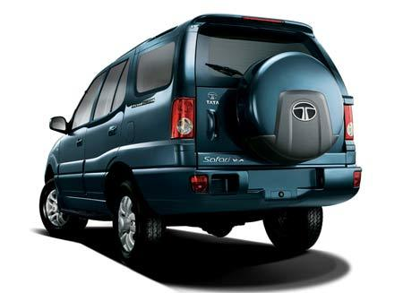
LIFESTYLE
PERSONALITY
VALUES

Slide 19

SOCIAL CLASS

Slide 20
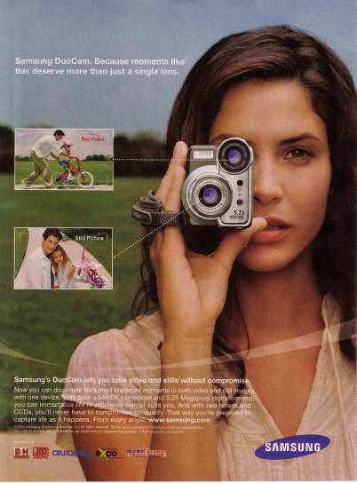
Family Life Cycle Advertising
Video cameras are often purchased by young couples with children.

Slide 21
Segmentation Base
Demographic Segmentation
Benefits-Sought Segmentation
Geographic Segmentation
Situation Segmentation
Psychographic Segmentation
Behavior/Usage Segmentation

Slide 22
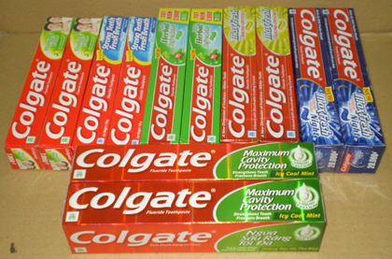
Benefit segmentation
Segmented on the basis of benefits sought by consumers
Toothpaste
General benefits that consumers seek are cleanliness and hygiene in all segments. Other key benefits are:-
Cosmetic
Fluoride
Herbal
Protection against foul smell, modernity and cosmic value. Eg-Colgate, Prudent
Family health, extra protection for children. Eg-Colgate Fluoride, Cibaca Fluoride.
Family health and welfare. Traditionally good for health. Eg-Neem, Dabur.

Slide 23
Consumers’ perceived benefits of Two-wheelers
Motorcycle brands
Enfield | sturdy, good for long rides and high resale value.
Hero&Honda | Fuel efficient, high pick up and stylish
Kawasaki & bajaj | High pickup, sleek model
Scooter brands
Bajaj chetak cub | Fuel efficient, lifelong, high resale value
Kinetic Honda | Electronic ignition, easy to ride, trouble free.

Slide 24
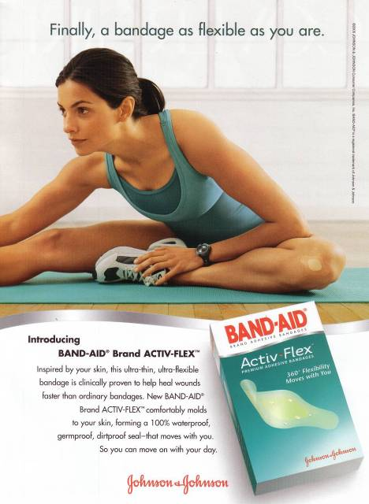
Band-aid offers “flex” as a
benefit to consumers.

Slide 25
Segmentation Base
Demographic Segmentation
Benefits-Sought Segmentation
Geographic Segmentation
Situation Segmentation
Psychographic Segmentation
Behavior/Usage Segmentation

Slide 26
Usage – Situation Segmentation
Segmenting on the basis of special occasions or situations
Example Statements:
  Whenever our daughter Jamie gets a raise, we always take her out to dinner.
  When I’m away on business, I try to stay at a suites hotel.
  I always buy my wife flowers on Valentine’s Day.

Slide 27

OCCASSIONS – COCA COLA, RASNA

Slide 28

Segmentation Base
Demographic Segmentation
Benefits-Sought Segmentation
Geographic Segmentation
Situation Segmentation
Psychographic Segmentation
Behavior/Usage Segmentation

Slide 29
Behavioral Segmentation
Decision Roles
Initiator
Influencer
Decider
Buyer
User
Behavioral Variables
Occasions
Benefits
User Status
Usage Rate
Buyer-Readiness
Loyalty Status
Attitude

Slide 30
Use-Related Segmentation
Rate of Usage
  Heavy, Medium, Light or Non users.
Awareness Status
  Aware vs. Unaware

Slide 31


BUYER READINESS STAGE – BAJAJ ALLIANZE

Slide 32
Criteria for Effective Targeting
Identifiable
Sizeable
Stable
Accessible
Congruent with the company’s objectives and resources
Notes:
There are five criteria for effective targeting, as shown on the slide. First of all, the target must be identifiable. This means that the marketer must be able to see or find the characteristic they have chosen for segmentation. The segment must also be sizeable. It must be large enough to be profitable to the marketer. A stable segment means that the consumers are not “fickle” and likely to change very quickly. A group of consumers must be accessible to be targeted. The marketer must be able to reach that market in an affordable way. Finally, the target must be congruent with the company’s objectives and resources.

Slide 33
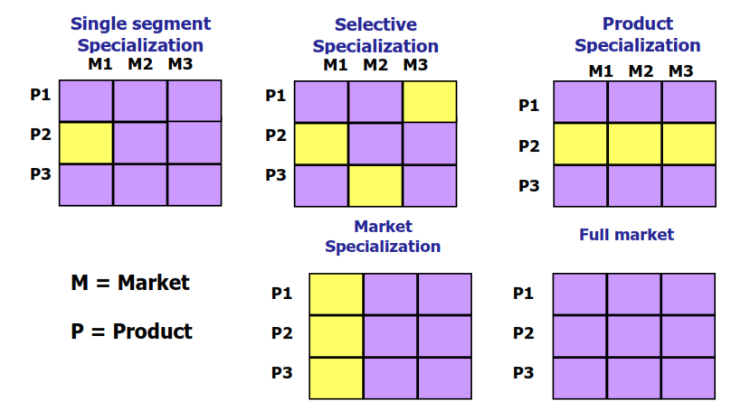

Slide 34
Targeting Strategy
1.Undifferentiated/Single/Mass marketing
2.Differentiated marketing
3.Concentrated/Focused/Niche marketing
4.Micro marketing

Slide 35
Targeting Strategy
Companies might develop one marketing mix strategy that is appropriate for all members of the total market.
Powder milk, beans
Undifferentiated targeting strategy
Concentrated strategy
Differentiated strategy
Micro strategy

Slide 36
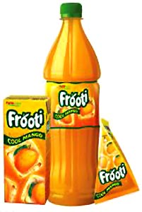
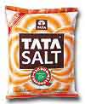

Slide 37
Targeting Strategy
Only one marketing mix is developed and directed toward a few, or perhaps one, profitable market segments.
Mont Blanc pens
Undifferentiated targeting strategy
Concentrated strategy
Differentiated strategy
Micro strategy

Slide 38
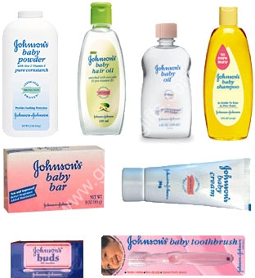

Slide 39
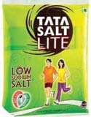
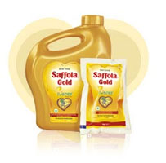
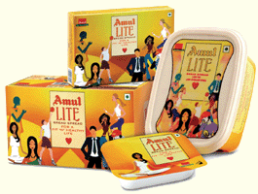

Slide 40
Targeting Strategy
Exists when a firm develops different marketing mix plans specially tailored for each of two or more market segments.
P&G
Undifferentiated targeting strategy
Concentrated strategy
Differentiated strategy
Micro strategy

Slide 41

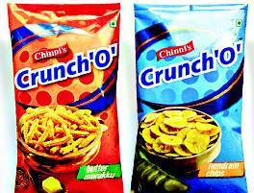
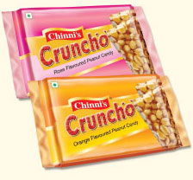
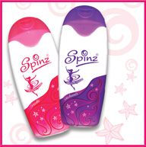
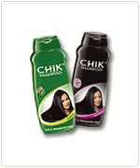
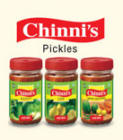

Slide 42
Targeting Strategy
Different products to different needs for local or individual customers
Undifferentiated targeting strategy
Concentrated strategy
Differentiated strategy
Micro strategy

Slide 43

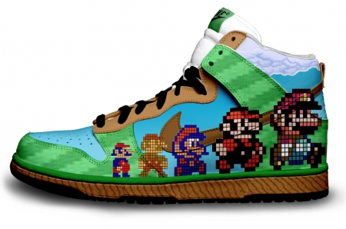

Slide 44
Product Positioning
Positioning starts with a product. A Piece of merchandise, a service, a company, an institution, or even a person... But positioning is not what you do to a product. Positioning is what you do to the mind of the prospect. That is, you position the product in the mind of the prospect.
        Al Ries and Jack Trout (1981)

Slide 45

Positioning Example
eBay’s positioning: No matter what “it” is, you can find “it” on eBay!

Slide 46
Positioning of P&G Detergents
Brand
Positioning
Tide
Tough, powerful cleaning
Cheer
Tough cleaning, color protection
Bold
Detergent plus fabric softener
Gain
Sunshine scent and odor-removing formula
Era
Stain treatment and stain removal
Dash
Value brand
Oxydol
Bleach-boosted formula, whitening
Solo
Detergent and fabric softener in liquid form
Dreft
Outstanding cleaning for baby clothes, safe
LO⁹
Ivory Snow
Fabric & skin safety on baby clothes
Ariel
Tough cleaner, aimed at Hispanic market

Slide 47
Product Positioning Dimensions
Product Attributes / Differences / Benefits
Product User / Usage
By Association
Problem Solution
Against a Competitor / Away from Competitors
Notes:
Honda Civic -- low price
Wal Mart -- low price
Arm and Hammer -- deoderizer for referigerator
VISA and American Express
Avis and Hertz
7-up uncola

Slide 48
Positioning strategies:
POP
  Category
  Competitive
POD

Slide 49
Perceptual Mapping
A means of displaying or graphing, in two or more dimensions, the location of products, brands, or groups of products in customers’ minds.

Slide 50
Perceptual Map for different brands of bar soap
High moisturizing
Nondeodorant
Deodorant
What bar soap?
What position?
Low moisturizing

Slide 51
Perceptual Map for different brands of bar soap
High moisturizing
Dove
7
4
2
5
Lux
8
Nondeodorant
3
Deodorant
1
What bar soap?
What position?
Hamam
Lifebuoy
6
Low moisturizing

Slide 52
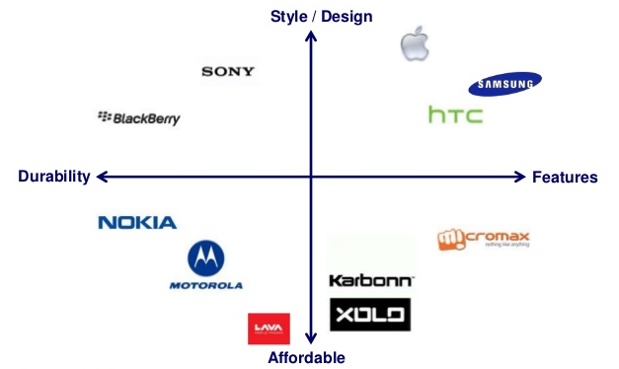

Slide 53
Bases for Segmenting Industrial Markets
Familiarity with buying task
Size and purchase of the customer
Geographical location
Differentiating end users of the product
Purchase Criteria

