Slide 1
Dear Diary,
My heart is racing to buy a car.
☹ ☹ ☹

Slide 2
1. Honda CRV
Functional and convenient
Afford – 22.5 lacs to 27.5 lacs
Promotion in line so would need a car – for work purposes which would require large amount of trunk space but job is indifferent for me
Car with plenty of seats as have 6 siblings
SUV – Honda CRV with 12 kmpl mileage.
Price – 27.5 lacs
Insurance premium also not bad
Gas consumption since large space but benefits outweigh those negative points.

Slide 3
2. Red Audi A4
Fav red color & big fan of Audi
Everything made me fall in love with it.
31.65 lacs – but sales person told me that he would bring it to 30.5 lacs.
Also insurance premium was more or less the same.
Issue was bit more gas consumption but SUV was SUV
But cant use Audi for job purpose neither for family as less seats.
In total it wasn’t functional car.

Slide 4
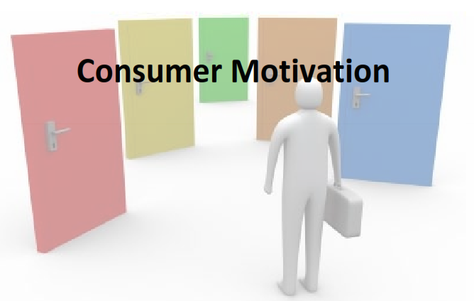

Slide 5

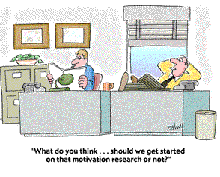
What is a motive?
from the Latin motus - to move
A motive is something that causes a person to act (or move). It answers the question Why?
Motivation?
An inner drive or process that causes a person to act to fulfil a want or need.

Slide 6
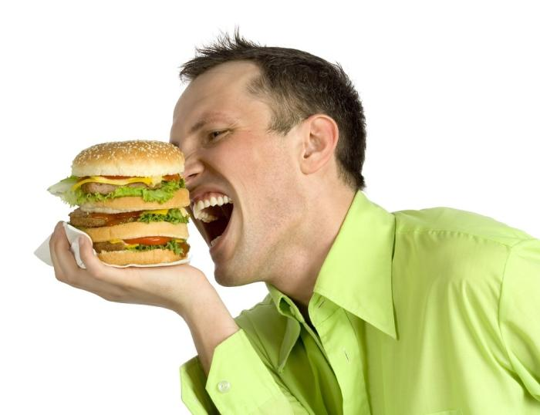
Motivation as a Psychological Force
Motivation is the driving force within individuals that impels them to action.
Needs are the essence of the marketing concept. Marketers do not create needs but can make consumers aware of needs.
Notes:
Motivation is produced by a state of tension, by having a need which is unfulfilled. Consumers want to fulfill these needs and reduce the state of tension. For example, when you are very hungry, you are extremely motivated to find food. Perhaps when you need a new pair of pants, you are a bit less motivated to fulfill this need as compared to your need for food. In the case of needing pants, it is important for marketers to help increase your motivation and/or specify your need for their products - perhaps Diesel Jeans.

Slide 7
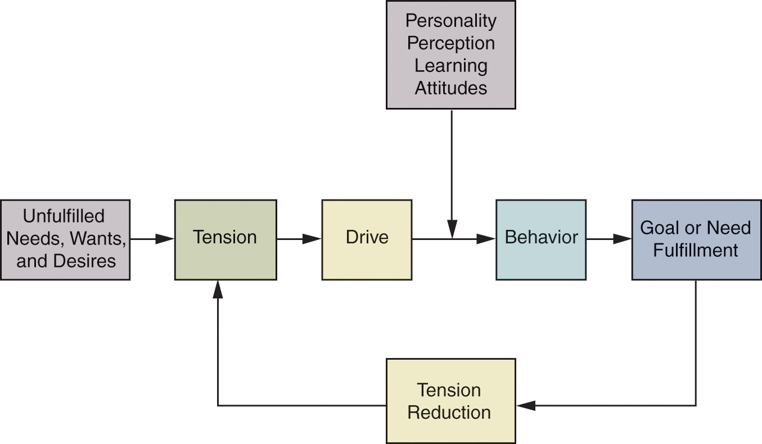
Model of the Motivation Process
Figure 4.2
Notes:
This model highlights the motivation process. We can see that the “drive” toward behavior will often end in the fulfillment of the need. The processes and effects of previous learning tie strongly into choices made when the behavior is defined.

Slide 8
Types of Needs
Innate Needs
  Physiological (or biogenic) needs that are considered primary needs or motives
Acquired Needs
  Learned in response to our culture or environment. Are generally psychological and considered secondary needs. Eg. jeans
Notes:
The example of the need for food compared to a new pair of jeans can be further described by understanding types of needs. The need for food is more of an innate need and is considered a primary need. The need for a pair of jeans would be considered acquired. The need for clothing could be considered primary, but the need specifically for a pair of jeans is acquired, especially when they are a certain brand or designer jean.
Needs may have a positive or negative direction. There are in fact some products we are NOT drawn to. For example, when people shop for funeral services, this is not something they are usually drawn to but rather must pursue and purchase.

Slide 9
Goals
The sought-after results of motivated behavior
Generic goals are general categories of goals that consumers see as a way to fulfill their needs
Product-specific goals are specifically branded products or services that consumers select as their goals
Any drink.. Any cold drink… any carbonated drink… Bisleri
mineral water
Notes:
Continuing with our example of jeans, we can understand the types of goals that exist. When a consumer states they want a pair of jeans, they have stated a generic goal. When they announce they really want a pair of Calvin Klein jeans, then they have stated product-specific goals.

Slide 10
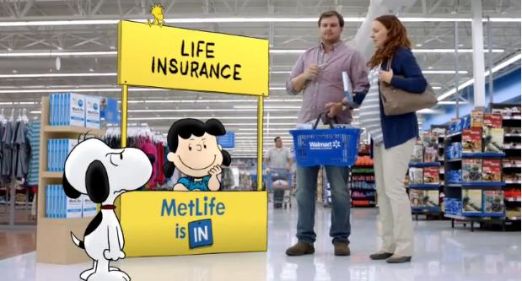
How Does this Ad Appeal to
One’s Goals?

Slide 11
It Appeals to satisfying security needs

Slide 12
The Selection of Goals
The goals selected by an individual depend on their:
  Personal experiences (e.g. surf excel)
  Physical capacity (e.g. computer)
  Prevailing cultural norms and values (e.g. go green)
  Goal’s accessibility in the physical and social environment (e.g. planning vacation trip)
Notes:
Consumers have many possible goals when making decisions. They are strongly influenced by their experiences, personality, and others’ opinions and input. When choosing goals, they have to keep in mind what is socially acceptable and what they can physically attain. Think of a recent decision you might have made to go on a vacation. How was it influenced by personal experiences, the accessibility of the goal, and the social environment?

Slide 13
Motivations and Goals
Positive
Motivation
Approach Goal
Negative
Motivation
Avoidance Goal
A positive goal toward which behavior is directed
A driving force away from some object or condition
A negative goal from which behavior is directed away
A driving force toward some object or condition
Notes:
We learned in an earlier slide that needs can be positive or negative. The same is true for goals which can be positive or negative. A positive goal would include joining a gym to get strong and train for an upcoming race. Another person, with a negative goal, might join the gym to avoid health problems that will certainly exist if they do not exercise regularly. Which are you?

Slide 14
Rational versus Emotional Motives
Rationality implies that consumers select goals based on totally objective criteria, such as size, weight, price, or miles per gallon
Emotional motives imply the selection of goals according to personal or subjective criteria
Notes:
There has been extensive research regarding rational versus emotional motives during purchase. Their existence has been tied to how consumers view marketing variables, including advertisements and pricing adjustments. Furthermore, it must be realized that the definition of emotional vs. rational motivation differs significantly from one consumer to another and in different situations.

Slide 15

Discussion Questions
What products might be purchased using rational and emotional motives?
What marketing strategies are effective when there are combined motives?
Notes:
You should consider that rational motives are often tied to products that are higher involvement and emotional motives are often used on low-involvement items.
The marketing strategies will also differ in the amount of information and the advertising appeals.

Slide 16
The Dynamics of Motivation
Needs are never fully satisfied
New needs emerge as old needs are satisfied
People who achieve their goals set new and higher goals for themselves
Notes:
Motivation is highly dynamic and constantly changes in response to life experiences. Motivations change as we age, interact with others, change careers, acquire wealth, become ill, marry or divorce, or pursue education.
Humans constantly have needs. This is due in part to the fact that our needs are never fully satisfied, or once satisfied, reappear. Hunger is a good example of a need that is often not satisfied and reappears. As humans, we also develop new needs as we satisfy existing needs. The hierarch of effects model shows how we meet our lower-level needs first and then move up the hierarchy. Finally, our needs are based on the goals that we set for ourselves. If one sets a goal to enter politics, they may feel they need a law degree. However, if they are unsuccessful in getting accepted at law school, their needs may change and they may want to pursue a few years of work experience first and need to find a job.

Slide 17
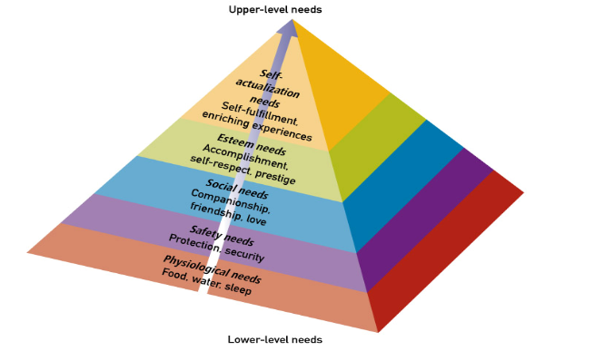
Maslow’s Hierarchy of Needs
Notes:
Dr. Abraham Maslow is well known for his hierarchy of needs. The web link on this page will bring you to www.maslow.com which reports on other publications by Dr. Maslow. The hierarchy presents five basic levels of human needs which rank in order of importance from lower-level needs to higher-level needs. The theory says that consumers will fill lower-level needs before the higher-level needs – they will eat before they enroll in a Master’s program.

Slide 18

To Which of Maslow’s
Needs Does This Ad Appeal?

Slide 19
Both Physiological and Social Needs

Slide 20

To Which of Maslow’s
Needs Does This Ad Appeal?

Slide 21
Esteem Needs

Slide 22

To Which of Maslow’s
Needs Does This Ad Appeal?

Slide 23
Self-Actualization

Slide 24
Discussion Questions
For each type of product, consider two brands. How do marketers attempt to differentiate their product from the competition?
Notes:
To answer this question, think of products that provide safety and shelter but may also vary in price.
For the second part of this question, you might want to consider companies that market coats and jackets. Some will emphasize different needs than the coat will meet and these unmet needs will exist in several layers of the hierarchy.

Slide 25









Slide 26
The Trio of Needs / McClelland’s Theory of Need Achievement
Power
  Individual’s desire to control environment
Affiliation
  Need for friendship, acceptance, and belonging
Achievement
  Need for personal accomplishment
  Closely related to egoistic and self-actualization needs
Notes:
Some psychologists believe that this trio of needs exists for most consumers and that marketers can find a tie to motivation. Power refers to the individual’s desire to control other people and objects – it is tied to a type of ego needs. Affiliation is similar to Maslow’s social need and suggests that behavior is influenced by the desire for social ties. Finally, the need for achievement, like the other needs, will vary from individual to individual.

Slide 27

Which need advertisement is focusing on?

Slide 28
It reflects the achievement need.

Slide 29
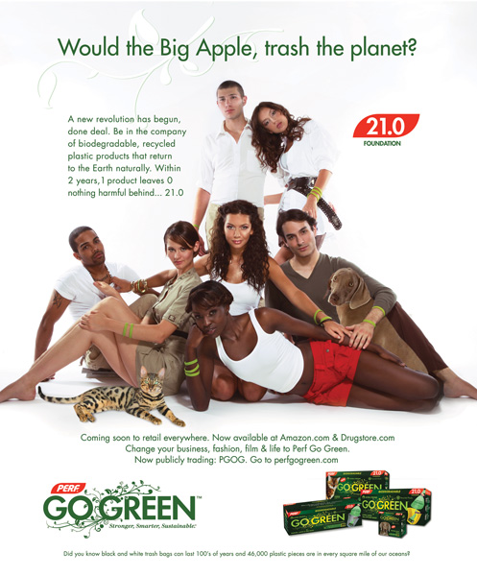
To Which of the Trio of Needs Does This Ad Appeal?

Slide 30
The Affiliation Needs Of Young, Environmentally Concerned Adults

Slide 31
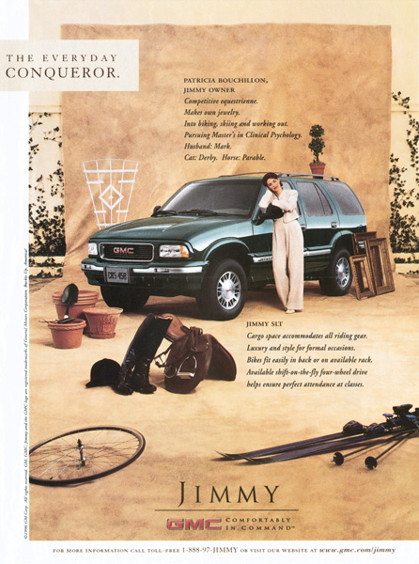
Power And Achievement Needs

Slide 32
Motivational conflict & need priorities
Satisfying a need often comes at the expense of another need – these trade-offs cause motivational conflict

Slide 33
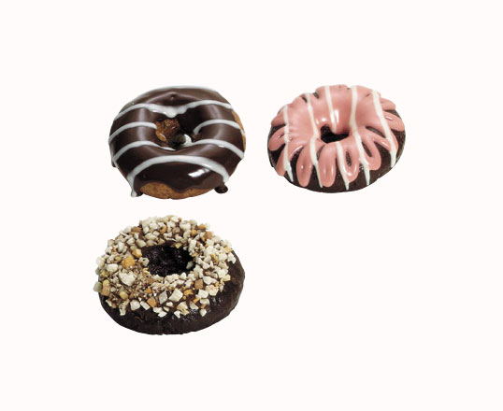
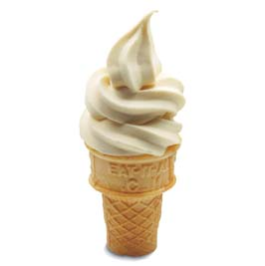
Deciding between two or more desirable options
Approach Approach

Slide 34
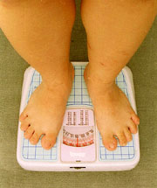
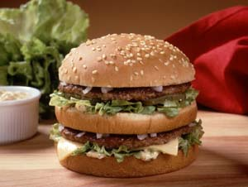
Behaviour has both positive and negative consequences
Approach Avoidance

Slide 35


Deciding between two or more undesirable options
Avoidance Avoidance

Slide 36
Cognitive Dissonance
Inconsistency between beliefs one holds or between one’s beliefs and actions.
Consumers are motivated to reduce dissonance or tension by either changing their actions or their beliefs.
Almost all major purchases result in cognitive dissonance, also known as buyer's remorse.
Often consumers are faced with two or more alternatives. Choosing one may leave us wondering if we should have purchased the other.

Slide 37
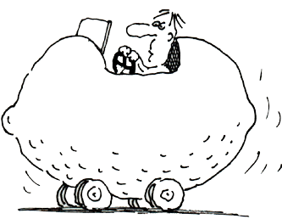
You've spent months shopping for a new car, comparing features and narrowing down the alternatives. Finally, you make your decision and purchase one that's just the right car for you. But now you’re feeling anxious about the decision, second-guessing the wisdom of your choice., i.e. you’re experiencing cognitive dissonance.
What could a marketer do to make you feel better about your purchase?

Slide 38
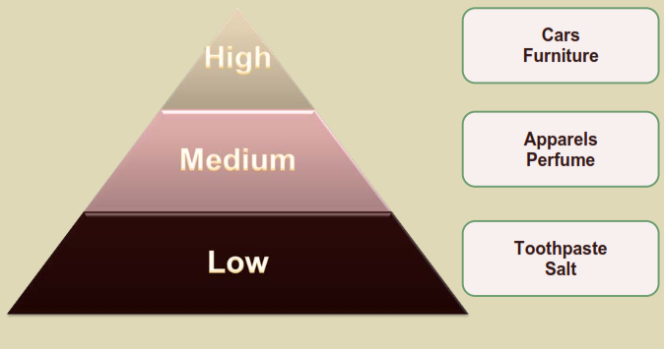
Consumer Involvement

Slide 39
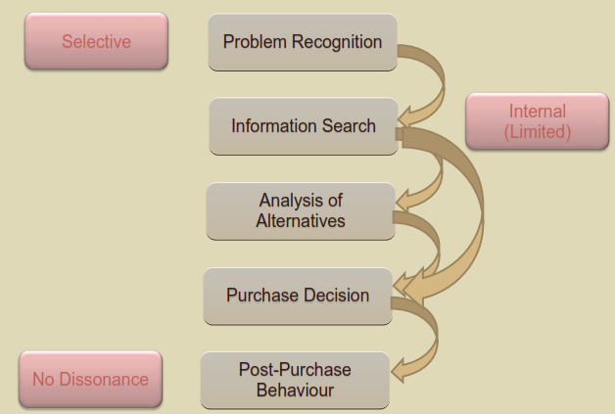
Low Involvement

Slide 40
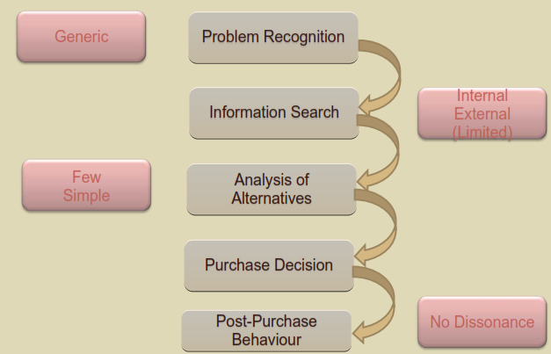
Medium Involvement

Slide 41
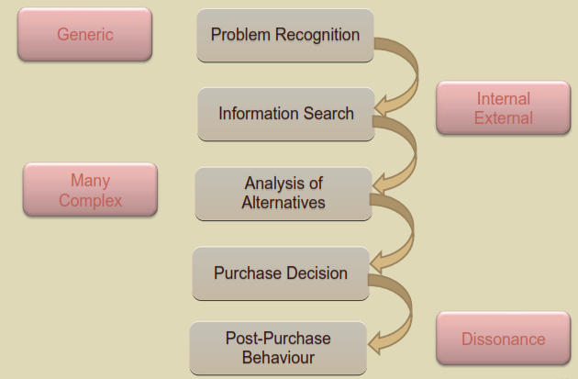
High Involvement

Slide 42
The Many Faces of Involvement
Message (Advertising)-
Response:
Refers to a Consumer’s
Interest in Processing
Marketing
Communications.
Product:
Related to a Consumer’s
Level of Interest in
a Particular
Product.
Purchase Situation:
Refers to the Importance
of the Situational
Context of Buying.

Slide 43
Test ur skills!
Define in your way the term of involvement. Indicate whether in general, level of involvement will be higher or lower in the following products?
Newspaper
Mixer and grinder
Television
Toothpaste

Slide 44
Strategies to Increase Involvement
Build a Bond
With the
Consumer
Appeal to
Hedonic Needs
Increasing Consumers’ Attention
Use Novel
Stimuli
Include Celebrity Endorsers
Use Prominent
Stimuli

Slide 45
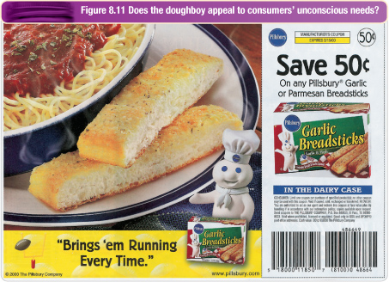
Unconscious motivation

Slide 46
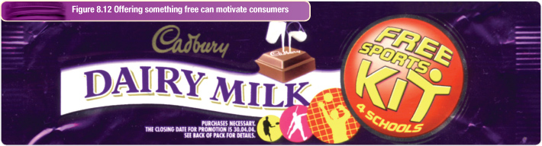
Motivating consumers
Motivating with Money
  Price cuts, specials, rebates and coupons motivate purchase
  Resulting sales may increase, but profits may not
  Attracts consumers less likely to repeat
  Price reductions may increase price sensitivity

Slide 47
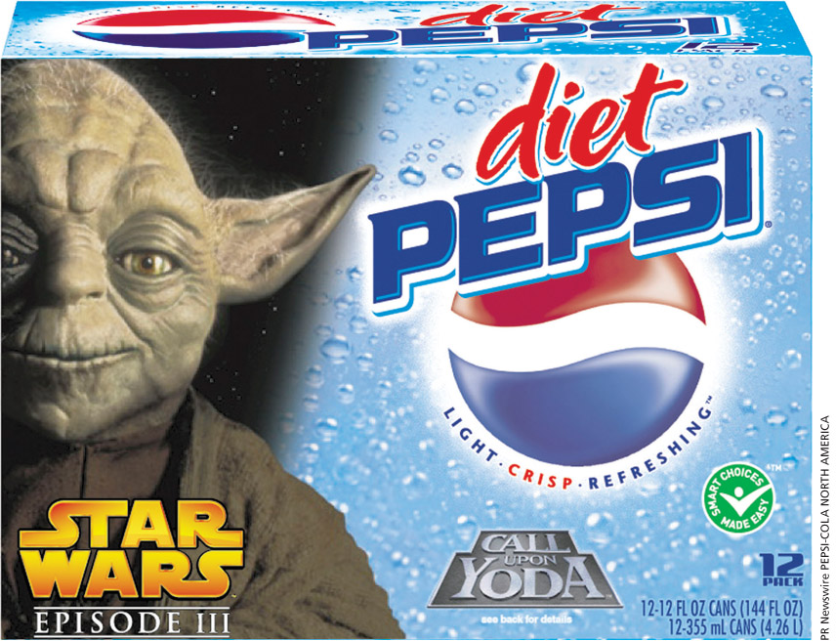
Motivating consumers
Provide other incentives:
Premiums, free products, contests and sweepstakes are designed to motivate consumers to purchase
There are limitations and shortcomings for this strategy in addition to the products offered as a premium being valued less (value-discounting hypothesis)

Slide 48
Motivating consumers
Implement a loyalty program
  Motivate repeat buying by providing rewards to customers based on how much business they do with the company
  Tracks consumer purchases and provides estimates of Customer Lifetime Value

Slide 49
Motivating consumers
Perceived risk: consumers’ apprehensions about the consequences of their behaviour (buying and consuming the product)
Greater perceived risk increases search
Educating consumers about risks may motivate them to make more informed choices that reduce exposure to risk

Slide 50

Motivating consumers
Arouse consumer’s curiosity
  For new products, educating potential customers is crucial
  Curiosity often leads to an enhanced need for information
  May advertise a benefit that is not normally associated with the product

Slide 51
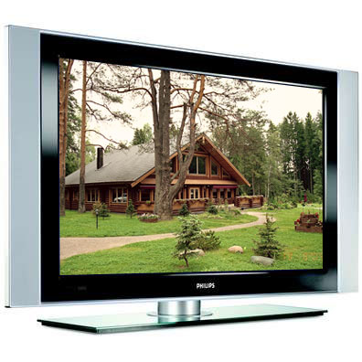
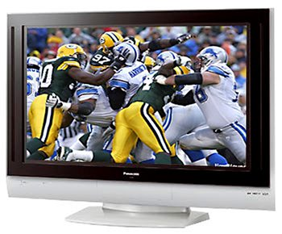
Philips Panasonic
How would you go about marketing your brand of Plasma TV against a competitor?

Slide 52

Measurement of Motives
Researchers rely on a combination of techniques
Qualitative research is widely used
Projective techniques are often very successful in identifying motives.
Notes:
Motives are very difficult to identify and measure. This is in part because they are hypothetical and not physical concepts that can be weighed and measured with a ruler. Because they are not tangible, marketers must use a variety of measurement techniques. Because consumers often cannot or will not express their motivations outright, researchers use qualitative research to uncover consumer motives. Many of these qualitative research techniques are called projective techniques because the consumer must “project” their subconscious or hidden motives onto another stimulus. The following slide summarizes some projective techniques.

Slide 53
Qualitative Measures of Motives
STORYTELLING
In this method, respondents are presented with words, one at a time, and asked to say the first word that comes to mind.
This method consists of having customers tell real-life stories regarding their use of the product under study.
WORD ASSOCIATION AND SENTENCE COMPLETION
Kimberly-Clark used this method to develop pull-ups.
Notes:
These are three commonly used projective techniques. As you can see, metaphor analysis uses pictures as a stimulus for the consumer to express their thoughts, feelings, and beliefs regarding a product or brand. Storytelling was successfully used by Kimberly-Clark when researching diapers with young mothers. Finally, word association and sentence completion have respondents filling in phrases and matching words quickly to get their genuine responses.

Slide 54
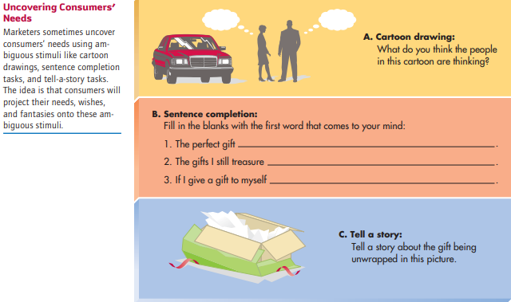

Slide 55
Motivational Research
Term coined in the 1950s by Dr. Ernest Dichter
Based on premise that consumers are not always aware of their motivations
Identifies underlying feelings, attitudes, and emotions
Notes:
Much of the research done in consumer behavior is based on motivational research. The understanding of consumers’ motives can help marketers make better products, communicate more clearly, and deliver benefits to the consumer.
This web link will bring you to the homepage for Olson Zaltman Associates. When visiting the website, you can learn more about the ZMET method and the strengths of motivational research.

