Slide 1
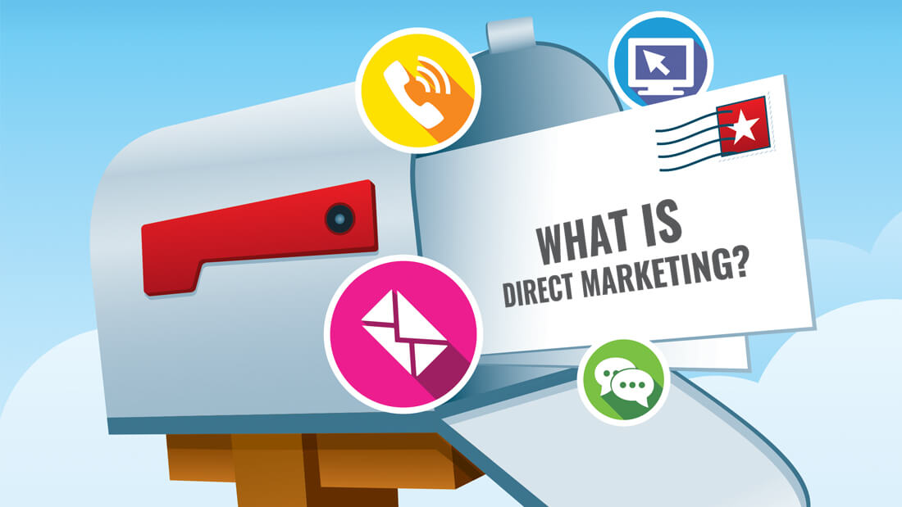
Direct Marketing
Prof Sanjit Kaur Gujral

Slide 2

Meaning
Direct marketing is the use of consumer direct channels to reach and deliver the goods and services to customers without using marketing middlemen.
It is an interactive system of marketing which uses one or more than one media to attract the target market.

Slide 3

Objectives of Direct Marketing
Raise brand awareness.
Improved Customer Relationship Management.
Sales Generation.
Provide ROI.

Slide 4
Components of Successful Direct Marketing
Deliver a Compelling Sales Message.
Follow up to attract and engage attention.
Promote Your Brand.
Nurture the New Customer Relationship.

Slide 5
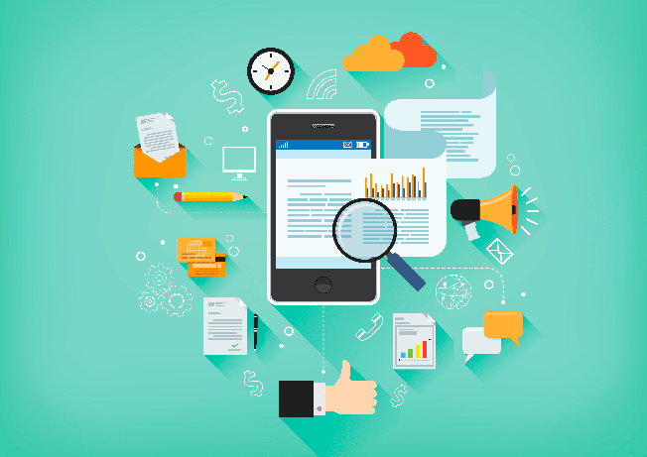
Tools of Direct Marketing
Face to Face Selling (Amway,Tupperware)
Telemarketing.
Direct Mail Marketing
Catalogue Marketing(Asian Paints)
Kiosk Marketing(Mcdonalds)
Online Marketing
Automated Vendor Machines.
Mobile Phones.
Database Marketing

Slide 6
Advantages of Direct Marketing
1.Benefit to Buyers
Convenient to Customers.
Easy Buying.
Interactive.
2.Benefit to Sellers
Powerful tool.
Personalise offer.
Quick and Prompt
Low Cost

Slide 7
Disadvantages of Direct Marketing
Inaccuracy of database.
Content Support.
Image Factor.(Direct Mail as Junk)
Reluctant Customers.
Competition.

Slide 8
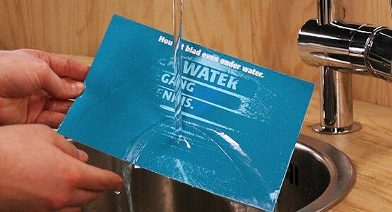
Example
World Water Day campaign
To celebrate World Water Day, a mailer was sent around to a collection of companies as well as the press. To read the message on the card, the receiver would have to hold it under running water. This highlighted the importance of water, demonstrating how it is the source of all life and knowledge. The campaign was shared across social media platforms and increased the awareness of World Water Day.

Slide 9
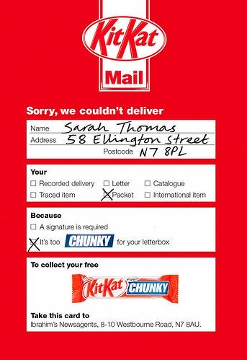
Example
Nestle’s Kit Kat Chunky campaign
To promote their new Kit Kat Chunky chocolate bar, Nestle came up with a brilliant direct mail campaign - sending customers a free candy bar. The catch was that their chocolate bar couldn’t be delivered because it was just too chunky to fit through the letterbox. The recipients could exchange their card in-store for a free Kit Kat Chunky bar.
This genius campaign was simple and to the point and because of it, Nestle saw a huge spike in sales. This campaign is a great example
of how personalization can go a long way.

Slide 10
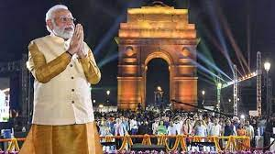
What is PR ?
It is an attempt by information, persuasion and adjustment to engineer support for an activity, cause or institution.
The ultimate goal of PR campaign is to create a positive image in the minds of the customer.

Slide 11
Tools of PR
Media Relations
Social Media
Brochures
Business Events
Speaking at Events
Sponsorship
Employee Relations
Community Relations

Slide 12
What is OTT ?
The acronym OTT stands for Over-the-Top.
This convenient little term explains the new delivery method of film and TV content over the internet whenever we want, across many different devices, without the need for traditional broadcast, cable or satellite pay-tv providers.
In simple terms, OTT streaming means paying an internet provider, for internet access to watch Netflix, without paying for cable TV.

Slide 13
Indian mindset
Spend on theatrical experience
Not much on TV
Netflix could not succeed initially – high subscription rates
Indian- Psychographic segmentation (good DVDs for Rs.100/-)

Slide 14

This became….

Slide 15
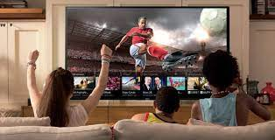
This….

Slide 16
Reasons for OTT media’s success
High-value content at low cost : cost-effective alternative to traditional cable packages (Rs.500/- to Rs.800/-)
Original content: Netflix and Amazon Prime -original content -exclusively available through their service
Compatibility with multiple devices: OTT experience from a gaming console, smartphone, tablet, or smart TV

Slide 17
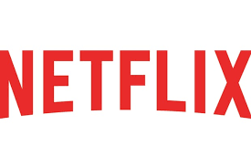
NETFLIX…American….entered India in 2016
1997 - DVD rental company
Later online rentals….expanded still..
2002 - $310m IPO, 5000 employees
For any company
1. Loans
2. IPO (selling one part of the company)

Slide 18
Netflix business
Product cost
Licensing cost (taking good serials from the existing TV channels)
TV – many ads
OTT – nil (less income)
Benefits – technology, on demand, subscription…

Slide 19
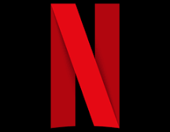
Other costs - Netflix
Server cost
Millions watch the same program – server slows down
Servers at different locations in India – cost increases, but bandwidth perfect, transfer rate good

Slide 20

HOTSTAR possessed by Novi Digital Entertainment Private Limited, a completely claimed auxiliary of Star India Private Limited

Slide 21
HOTSTAR
Live steaming (paid….so no ads)
With a delay of 5 min
The second option has more traffic
Consumer details are with them….
Consumer behaviour…clarity
Advertising based on the consumer segments
more than 100,000 hours of TV content and movies across over 9 languages, and each sport covered live.

Slide 22
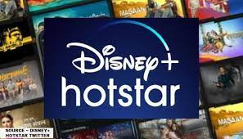
Now…

Slide 23
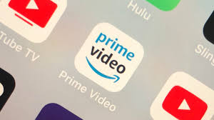
Amazon Prime
Subscribers get free delivery
30 day free trial
Rent out or buy movies / TV shows
prime at Rs.129/month or Rs.999/year

Slide 24
A part of Viacom 18 Digital Ventures, the advanced arm of Viacom 18 – one of the nation’s biggest developing media systems
English, Hindi, Kannada, Gujarati, Marathi, Bengali, Tamil, Telugu
Contents from Colours TV, MTV India, Nickelodeon India and other Viacom 18 owned television channels

Slide 25
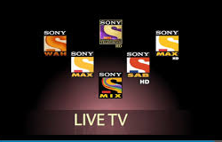

Slide 26
By Sony Pictures Networks India Private Limited (SPN), giving multi-screen commitment to users
Movies, over all Sports, TV Shows like The Kapil Sharma show, Tarak Mehta ka Ulta Chasma and Music, LIV Kids, LIV FIT

Slide 27

Hoichoi
for Bengalis
more than 500 Bengali Movies

Slide 28
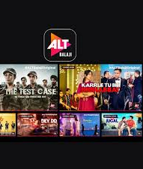
ALTBalaji
Balaji Telefilms membership-based
Accessible over various interfaces
Ekta Kapoor-2015

Slide 29
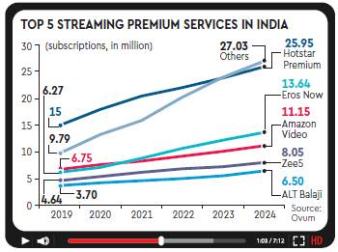

Slide 30
IMC development process
Know the potential customers
Creating situational analysis
Marketing communication objectives
Develop brand awareness
Change customer beliefs
Enhance brand image
Increase sales
Reinforce purchase decisions
Budgeting
Execution strategies
Assessment and evaluation

Slide 31
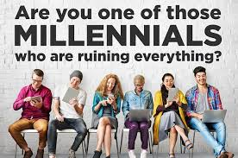
Marketing and advertising to the millennial
Technology, media fragmentation has changed the game for marketers

Slide 32
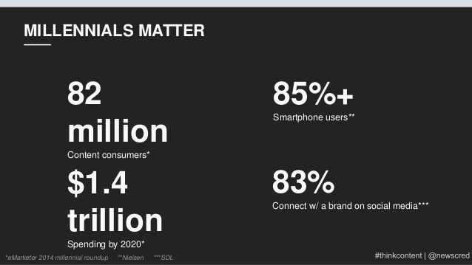
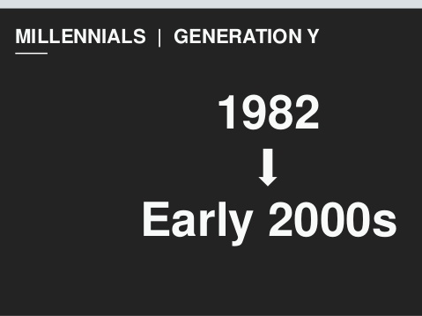
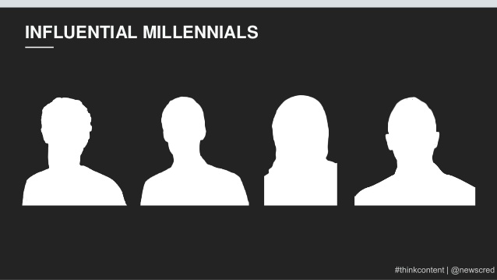

Slide 33


India -3rd largest on Instagram with 59 mn active users
241 million active users on Facebook
Social media accounts for 28% of the digital advertising market
Baby boomers – 1944-64
Gen X – 1965 – 79
Gen Y – 1980 – 94
Gen Z – 1995 - 2015
Gen Y - Millennials
Millennials demand more data
More money, more wheels
Rising incomes for India's Millennials offer unprecedented opportunities for consumer industries, such as autos, telecom, finance and real estate
SO……..
Can make or break a brand
All channels become digitally addressable

Slide 34
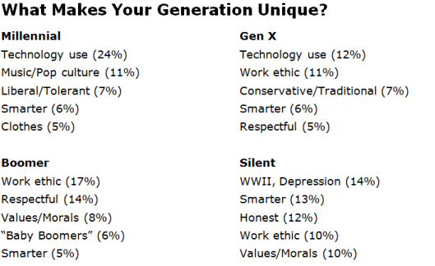

Slide 35
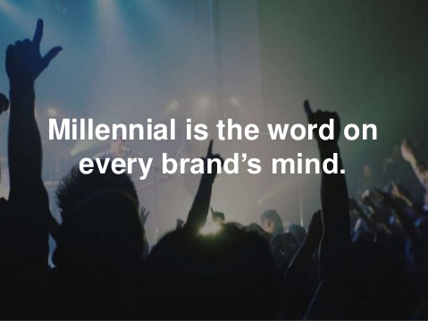

Slide 36
Current stats
1 in 3 people is currently a millennial, that’s one-third of the world’s population!
25% of them are parents
80% of them are in management roles in their careers

Slide 37
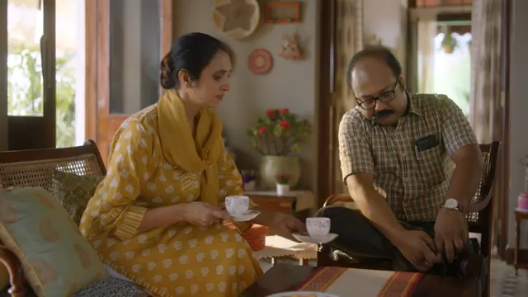
Quick glimpse through the recent women-oriented ads (millennial)
Shaadi.com – pressure hatao

Slide 38
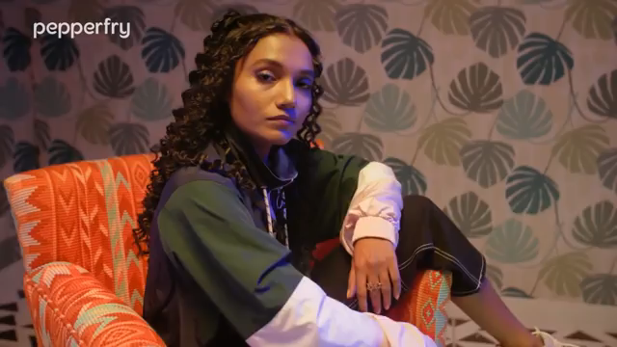
Pepperfry - Womaniya

Slide 39
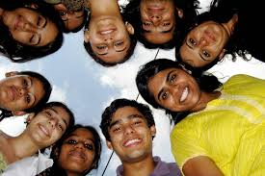
Major segments identified
# 1 Movers and Shakers – interact with the content on-the-go
# 2 Modern moms – educated, work-life balance, interact with ads
at work, home and on-the-go
# 3 Do-it-my-ways – creative and loyal
# 4 Prove it to me – millennial workforce, scientific base, value
oriented
# 5 Trailblazers – trendy, active on social media networks, under
25

Slide 40
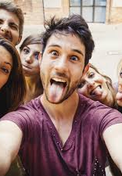
Totally different way of shopping
Sharing and choosing brands differently
Millennials……centinellials…..different segment
Brands which empower them would survive

Slide 41
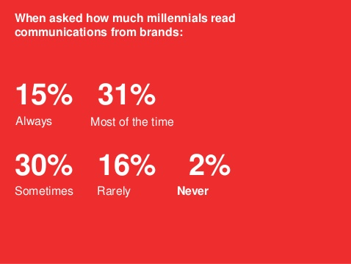

Slide 42
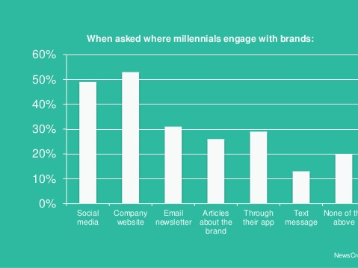

Slide 43

All about millennial..
No loyalty (highly loyal when values align)
Sociable
Digital natives
Ambitious and adventurous
Demanding
See limitless opportunities

Slide 44
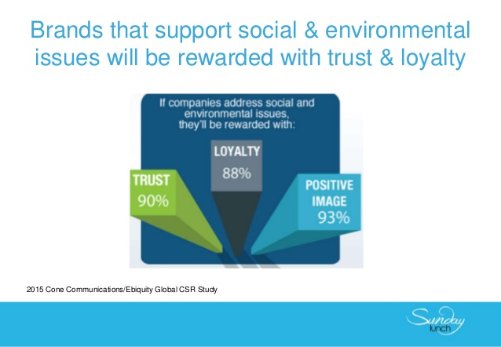
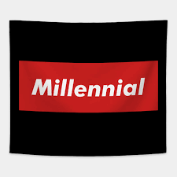

Slide 45
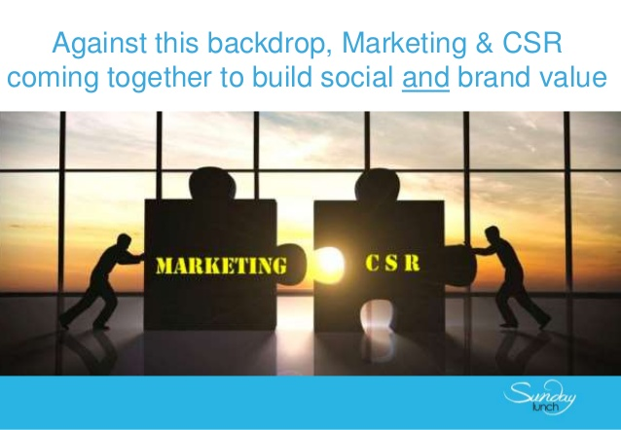
Brands that care survive in the
millennial dominated business world

Slide 46
Technology -reinforced the digital payments industry
LazyPay - app-based instant approval on personal loans, accessibility to easy EMI options
Buy Now Pay Later services on Swiggy, Flipkart
one-click-pay-later feature on Gaana.com, Sony LIV and ALTBalaji
Apps like Spotify offers an extensive catalogue of songs and playlists

