Slide 1
Advertising Agency

Slide 2
Advertising
Advertising is defined as any paid form of non-personal communication about an organization, product, service or idea by an identified sponsor
5 Ms of Advertising
  Mission
  Money
  Message
  Media
  Measure

Slide 3
Agencies: People
Account
management
(Link between client and team)
Media buying & planning
Creative concepts
Production
(Project management and task distribution)
Research & account planning
Admin
Other services

Slide 4
Functions of advertising agency
Contacting clients
Advertising planning
Creative functions
Developing and preparing advertising copy
Approval from client
Media selection and media scheduling
Ad-execution
Research and consumer insights

Slide 5
Types of Agencies
  Full-Service
  Creative Boutique (Highly skilled talent/Unique strategy)
  Media Specialists
  Interactive(Online Brand Promotion)

Slide 6
In-house Agencies
Cost saving
More control
Increased coordination
Stability
Access to top management

Slide 7
How agencies gain clients
Referrals
Solicitations
Presentations
Networking
Image and reputation

Slide 8
Reasons for break of Client-agency relationship
International alignment may cause change
Management change
Product conflicts with mergers, takeovers or product introduction
Brand failures
Conflicts

Slide 9
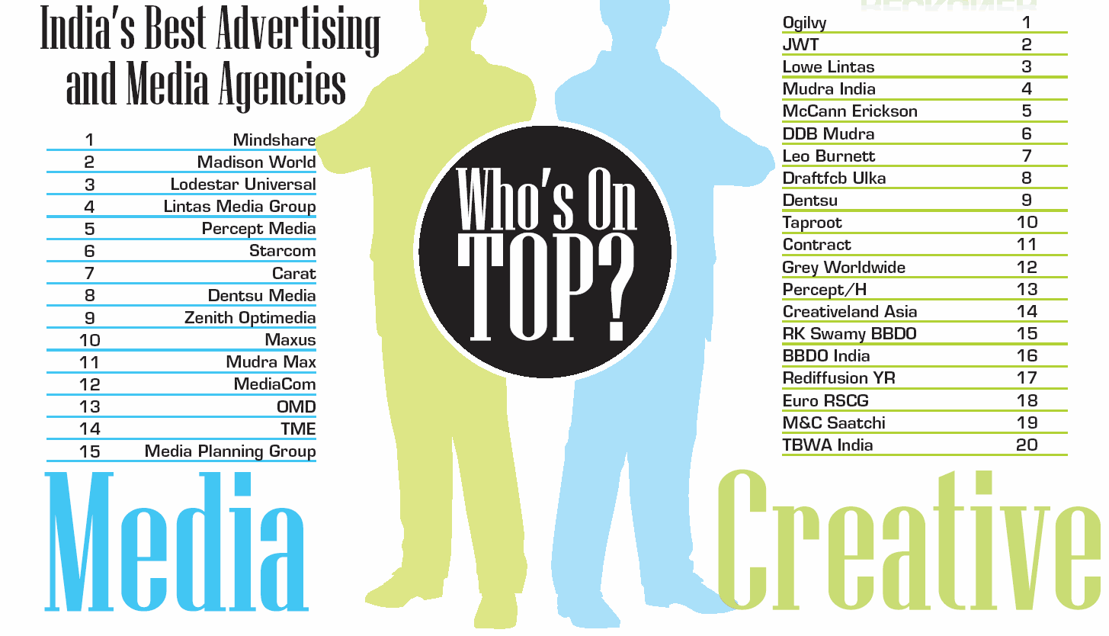
Source – Brand Equity, 16th May 2012

Slide 10
ACTIVITY
(find detailed INFORMATION ABOUT AD AGENCIES IN INDIA(clients,bestcampaigns etc)

Slide 11
Advertising Campaign Planning

Slide 12
Advertising Campaign
It is set of interrelated and coordinated marketing communication activities that centre on a single theme or idea that appears in different media across a specified time period.
It is an orderly planned effort consisting of related but self-contained and independent advertisements
Though the campaign is conveyed through different media, it has a single theme and unified approach
Coordination, balance, timing, continuity and performance are important for an advertising campaign

Slide 13
Factors influencing campaigns
The consumer profile
The product profile
The advertising and marketing objectives
The study of marketing environment
Review of previous advertising efforts
The total advertising budget
The media availability
The creative considerations

Slide 14

Nike-Just do It
Did you know that, once upon a time, Nike's product catered almost exclusively to marathon runners? Then, a fitness craze emerged -- and the folks in Nike's marketing department knew they needed to take advantage of it to surpass their main competitor, Reebok. (At the time, Reebok was selling more shoes than Nike). And so, in the late 1980s, Nike created the "Just Do It." campaign.
It was a hit.
In 1988, Nike sales were at $800 million; by 1998, sales exceeded $9.2 billion. "Just Do It." was short and sweet, yet encapsulated everything people felt when they were exercising -- and people still feel that feeling today. Don't want to run five miles? Just Do It. Don't want walk up four flights of stairs? Just Do It. It's a slogan we can all relate to: the drive to push ourselves beyond our limits.

Slide 15
Some of the best and long ad campaigns
De Beers – Diamonds are forever
Surf Excel – Daag Acche Hai
McDonald’s – I’m Loving it
Cadbury – Kuch Mitha Ho Jaye, Shubhaaramabh
Idea – What an idea sirji/ Ullu Banaoing

Slide 16
Case study on ad CaMPaiGN

Slide 17
Three phases of campaign creations
Strategy development phase
Advertising brief to the creative
The creative phase

Slide 18
Creative Brief
Basic Problem / issue the advertising must address
Advertising and communication objectives
Target Audience
Major selling idea or key benefits to communicate
Creative strategy statement (campaign theme, appeal and execution technique to be used)
Supporting information and requirements

Slide 19
The Typical Agency Work Cycle
Agency Brief
Creative brief
Creative
Media Brief
Media Plan
Production
Operations Scheduling
Feedback and response
Campaign Execution

Slide 20
Summary
Ad campaign is a series of interrelated ads giving uniform message
Advertising brief is the most important written document provided by the client to the ad agency
The creative brief includes TG, objectives, single idea, creative strategy idea.

Slide 21
Effect of celebrity endorsements
Celebrity branding is the use of famous people to generate buzz around a product or service.
Celebrity branding involves engagement from celebrities with the product or service.
Celebrity endorsement is a promotional tool that boosts brand awareness. It is a way of enhancing credibility and gaining visibility for brands.
Celebrity endorsement builds credibility and can expose a brand to new markets.
Celebrity endorsements and branding can significantly increase sales.
Social media offers a glimpse into the lives of celebrities.
The celebrity effect of seeing a star using a product on social media can thrust a brand into the limelight overnight.

Slide 22
Drawback of celebrity endorsements
A famous celebrity can overshadow a brand and detract from it.
Sometime, a brand will rely too heavily on a celebrity endorsement. When that happens, the celebrity can outshine the product or give the impression that they are not genuinely interested. This can make a brand seem inauthentic.
If consumers are not convinced that celebrities are sincere about an endorsement, it can negatively impact the brand.
Celebrities who endorse too many products may lose credibility with the public. It is important to match your product or service to the right celebrity.
It can take a long time to influence consumers through a celebrity endorsement. A celebrity endorsement from a star that is not well matched to the brand will not influence consumers at all. These are all important considerations before seeking a celebrity endorsement.

Slide 23
Endorsements gone wrong
Shahrukh-Fair and handsome.
Akshay Kumar-Levis unbutton
Malaika Arora-Zandu balm
Katrina Kaif-Hawai Chappals
Rekha-Snickers

Slide 24
activity
Select any five brands with existing brand ambassadors and give a new celebrity to the brand justifying your reason.

Slide 25
Media buying and planning

Slide 26
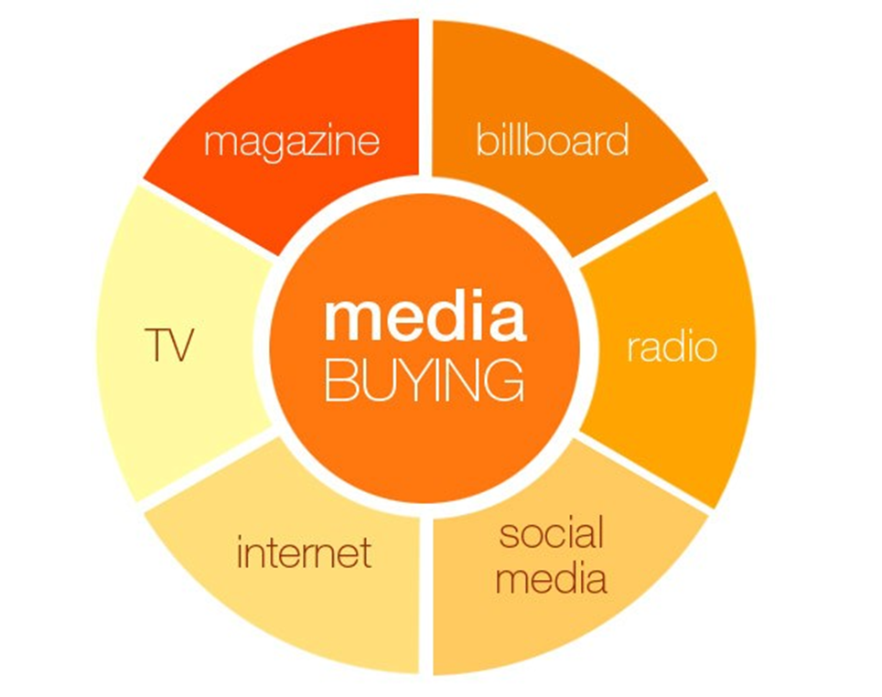

Slide 27


different forms of media channels - specialized media buyers
Broadcast media buyers (sometimes referred to as traditional media buyers)
Print media buyers
Digital media buyers
Direct response media buyers
Outdoor media buyers

Slide 28
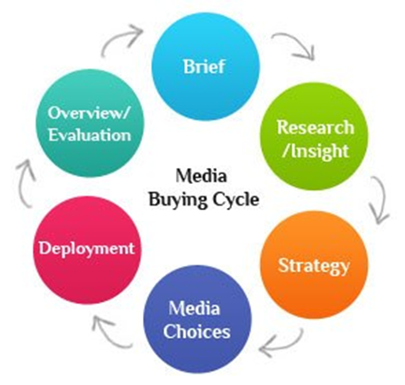

Slide 29
Media buying - a combination of three things
Negotiation skills
Strong professional relationship with the media owners (or media representatives)
Media clout (media buying agency’s influence on different media – companies engaging different agencies to rule the media)

Slide 30

Media Planning and Strategy
Basic Terms
Media planning: The series of decisions involved in delivering the message to the target audience.

Slide 31
Media Planning and Strategy
Basic Terms
Media plan: The actual document detailing media planning decisions.
the task of a media agency and entails finding media platforms for a client's brand or product to use
involves determining the best combination of media to achieve the marketing campaign objectives

Slide 32
Media Planning avenues
Television ( TVC, television commercial)
Radio
Newspapers
Magazines (consumer and trade)
Outdoor billboards
Public transportation
Yellow Pages
Direct mail (DM)
Digital advertising (such as web-based, mobile and mobile applications)
Search Engine Marketing (SEM, keyword marketing in search engines)
Specialty advertising (on items such as matchbooks, pencils, calendars, telephone pads, shopping bags and so on)
Other media (catalogs, samples, handouts, brochures, newsletters and so on)

Slide 33
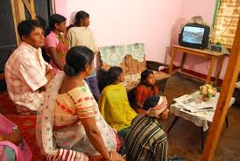
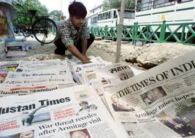
Factors to be considered in selecting media
Reach - expressed as a percentage, reach is the number of individuals (or homes) to expose the product to through media scheduled over a period of time.

Slide 34
Top 10 most Read Newspapers in India
S.NO | NEWSPAPER | LANGUAGE | READERSHIP (IN MILLION)
1. | Dainik Jagran | Hindi | 16.63
2. | Hindustan | Hindi | 14.74
3. | Dainik Bhaskar | Hindi | 13.83
4. | Malayala Manorama | Malayalam | 8.80
5. | Daily Thanthi | Tamil | 8.28
6. | Rajasthan Patrika | Hindi | 7.90
7. | Amar Ujala | Hindi | 7.80
8. | The Times of India | English | 7.59
9. | Mathrubhumi | Malayalam | 6.02
10. | Lokmat | Marathi | 5.88
https://thetoprated.in/top-10-newspapers-in-india.html

Slide 35
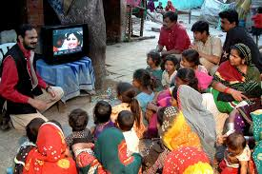
Factors to be considered in selecting media
Frequency - using specific media, how many times, on average, should the individuals in the target audience be exposed to the advertising message? It takes an average of three or more exposures to an advertising message before consumers take action.

Slide 36
There’s no single rule that determines the optimal ad frequency across every channel and every platform, though there are trends to follow for specific platforms and devices. For example, Facebook ads recommend 2 exposures per week for 10 weeks. Over that same 10-week period, TV recommends 3 to 10 exposures per week, while radio recommends 3 exposures per week. Choosing the right frequency depends on the platforms you're using--and how you're combining platforms. If you're using both digital and TV advertising, you may need to find a formula that will ensure you reach the right customers at the right time while avoiding leaving them overwhelmed and frustrated by your ads.

Slide 37


Frequency capping
Frequency capping allows you to limit the number of times ads appear to the same person. You can use frequency capping in Display campaigns and Video campaigns.
You can allow Google Ads to optimize how often your ads show to users, or you can set a frequency cap manually to manage the number of impressions on the campaign, ad group, or ad

Slide 38
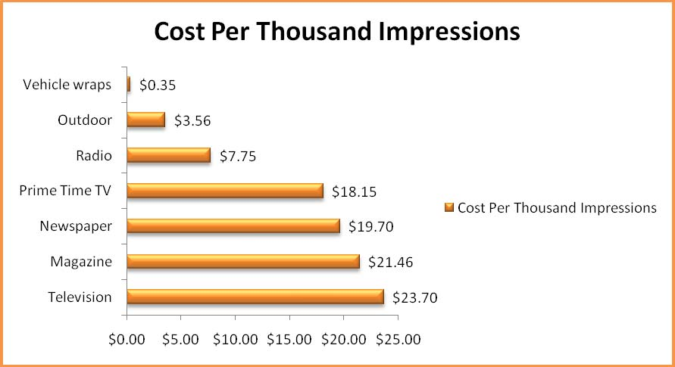
Factors to be considered in selecting media
Cost per thousand - How much will it cost to reach a thousand prospective customers
To determine a publication's cost per thousand, divide the cost of the advertising by the publication's circulation in thousands

Slide 39
Factors to be considered in selecting media
Cost per point - how much will it cost to buy one rating point of your target audience, a method used in comparing broadcast media. One rating point equals 1 percent of the target audience.

Slide 40

Factors to be considered in selecting media
Impact - does the medium in question offer full opportunities for appealing to the appropriate senses, such as sight and hearing

Slide 41

Factors to be considered in selecting media
Selectivity - to what degree can the message be restricted to those people who are known to be the most logical prospects?

