Slide 1
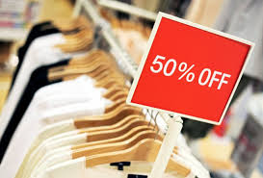
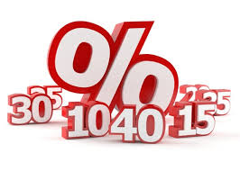
Sales Promotion
Prof Sanjit Kaur Gujral

Slide 2
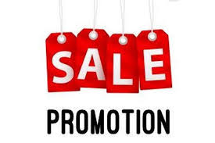
Meaning of Sales Promotion
Sales promotion is the process of persuading a potential customer to buy the product.
Sales promotion is designed to be used as a short-term tactic to boost sales – it is rarely suitable as a method of building long-term customer loyalty.

Slide 3
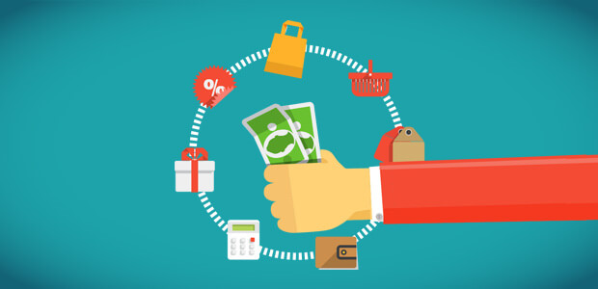
Importance of Sales Promotion
Introducing new products.
Persuading dealers to buy more or increase the size of the orders.
Overcoming seasonal fluctuations.
Stimulates demand.
To prompt existing consumers to buy more.
To meet competition in the market.

Slide 4
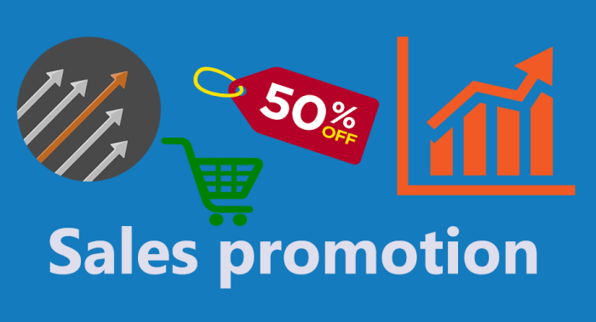
Three levels of Sales Promotion
Consumer Level called as Consumer Promotion.
Dealer Level called as Trade Promotion.
Sales Person Level called as Sales Force Promotion.

Slide 5
Advantages of Sales Promotion
Helps Create Awareness of New Products – Sales promotion is a highly effective methods for exposing customers and business partners to new products and for moving customers to take an action (e.g., sample a product).
Strengthens Customer Involvement and Loyalty – Sales promotion can be the primary mechanism organizations use to interact with their customers and ultimately build a stronger connection (e.g., offer customer rewards).
Can Be Quick to Develop – Compared to other types of promotion, some sales promotions can be quickly created and made available within a market (e.g., creation and distribution of email coupon).
Used to Support Other Promotions – Sales promotion is often used as a supporting feature of other methods of promotion (e.g., salespeople may give promotional items to give to sales prospects).
Helps Reduce Inventory – Sales promotion can be used to rapidly reduce inventory in situations where product replacement is needed (e.g.,CROMA products nearing expiration date; clearing inventory to make room for new models)

Slide 6
Disadvantages of Sales Promotion
May Condition Customers to Wait for Promotion – Repeated use of sales promotion may condition customers to wait until a product promotion is available before making their next purchase resulting in the marketer not maximizing a product’s revenue potential (i.e., customer will not pay full price).
Can Lower Perception of the Brand – The overuse of some sales promotions may condition customers to believe the lower price is the regular price, which may cause them to not believe the product’s quality compares to similar competitors’ products that offer less frequent or no price reductions.
Issues With Promotion Clutter – While in the same way an advertisement competes with other ads for customers’ attention, promotional clutter may also be an issue with sales promotions (e.g., excessive promotion sent by email, postal mail).
Distributors May Not Be Willing to Accept – Some sales promotions targeted to consumers require the assistance of distributors (e.g., retailers), however, not all distributors may accept a consumer sales promotion, especially if the promotion requires the distributor to perform extra work.

Slide 7
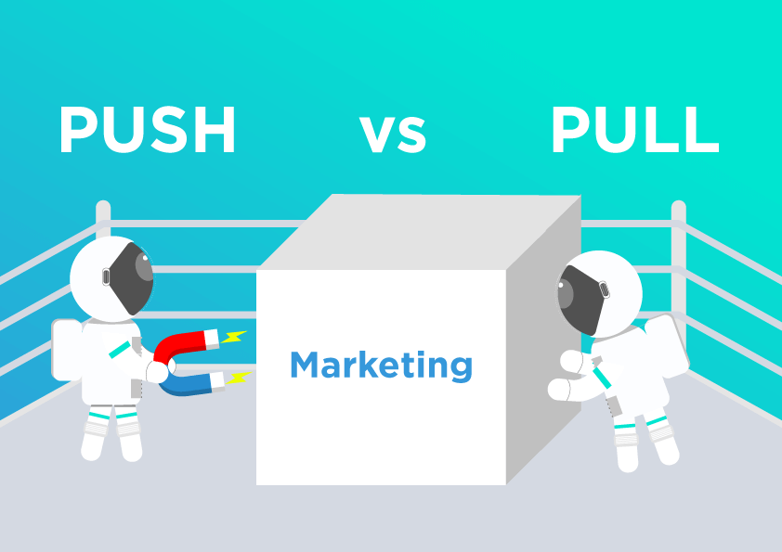
Sales Promotion Strategies
Pull Strategy – The pull strategy attempts to get the customers to ‘pull’ the products from the company. It involves making use of marketing communication and initiatives like seasonal discounts, financial schemes, etc.
Push Strategy – The push strategy attempts to push the product away from the company to the customers. It involves convincing the intermediary channels to push the product from the distribution channels to the final consumers using promotional and personal selling efforts. This strategy involves making use of tactics developed especially for resellers, merchants, dealers, distributors, and agents.

Slide 8
Consumer Promotion Tools
Free Samples: Distributing free samples increases brand awareness and triggers the psychology of ownership where the person chooses the promoted product if he liked the sample.
Free Gifts – Offering free gifts attract customers as they get more while paying for less.
Discounts/Discount Coupons – Discount coupons are a great method of increasing sales for the short term. People go for discount coupons as they let them buy the products they couldn’t afford otherwise.
Exchange Schemes – Exchange schemes attract many customers as they get some value even for their old product.
Finance Schemes – Finance schemes like no-cost EMI, low-interest EMI, etc. makes it easier for customers to purchase expensive products.
Shipping Schemes – Sometimes huge shipping costs discourage the customers from buying products. Such short term shipping schemes remove friction.
Bundle Discounts – These deals are a great way to reduce unsold inventory. It includes selling bundled products at a price lesser than when those number of products are bought separately.
Bulk Purchase Deals – This is a great sales promotion tactic to reduce unsold inventory. It includes providing discount to customers who buy in bulk.

Slide 9
Trade Promotion Tools
Point Of Purchase Displays – This includes providing free point of purchase (POP) display units to the retailers to increase their sales.
Trade Shows – Trade shows are a great sales promotion strategy where the business promotes its product to thousands of traders in the trade show. Trade shows also witness huge discounts as compared to when bought usually.
Push Money – Also known as spiffs, this technique includes extra payments to traders to motivate them to meet specified goals. For example, giving them a $50 bonus per unit for selling product A and $30 for selling product B for a specified time period.
Deal Loaders – These are the gifts provided to the traders (wholesalers and retailers) for ordering a certain quantity of product.
Trade Deals – These are special concessions provided to the merchants to encourage them to promote a specific product and increase its sales for a limited time period.
Buying Allowances – Special discounts provided to the sellers when they order a specified number of products.

Slide 10
Sales Force Promotion Tools
1.Bonus to Sales Force:
The manufacturer sets a target of sales for a year. If the sales force sell the products above the targeted sales, bonus is offered to them. This is an encouragement incentive given to the sales people to sell more products—to cross the quota or targeted sales.
2. Sales Force Contests:
To increase the interest and efforts of sales by sales force over a specified time, these contests are announced. The prizes are given to the salesman who secures the maximum sales in sales contests. Thus it stimulates the salesmen to sell more products.
3. Salesmen Meetings and Conferences:
The idea behind these is to educate, inspire and reward salesmen. Encouragement is given to them during the discussion. New selling techniques are described to them and discussed in the conference.

Slide 11
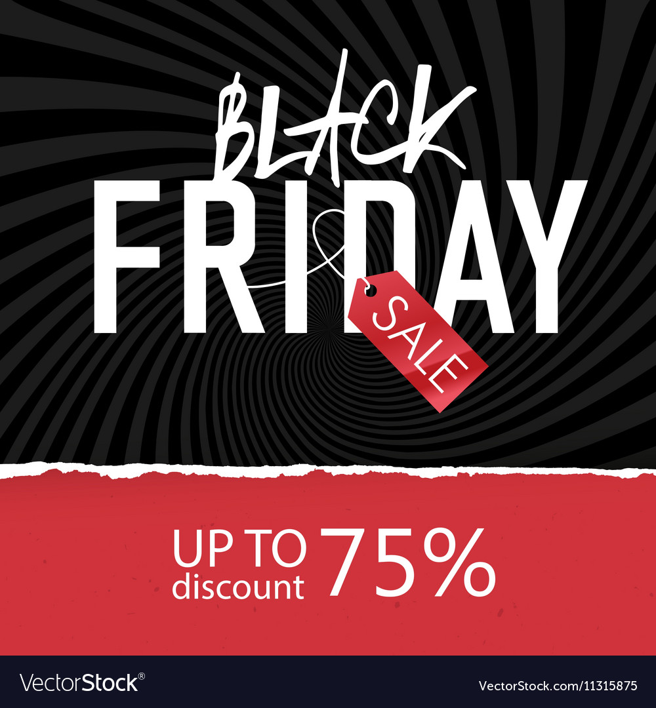
Example
Black Friday sale is a seasonal sale which occurs only once a year. It involves huge discounts and special offers which are limited to a day. As a result, it increases the sales.

Slide 12

Example
Referral marketing is a great sales promotion strategy where the company pushes its own customers to bring in new customers. This is done by providing them with special discounts, offers, cashback, or actual monetary benefits.

Slide 13
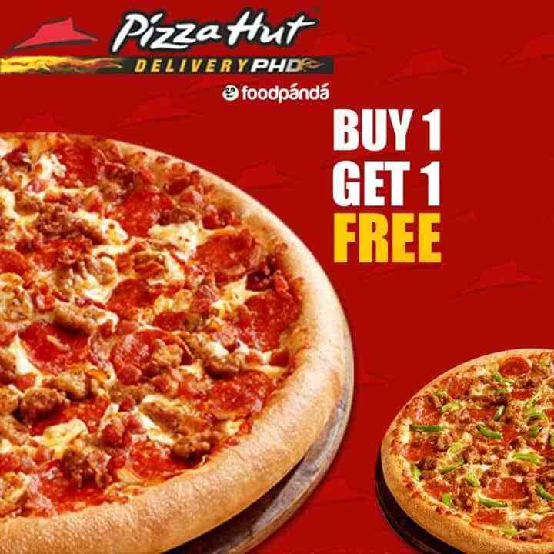
Example
Buy One Get One (BOGO) is a popular type of sales promotion where two products are offered at a price of one. This works great to promote a new product or clear the inventory at the end of the season.

