Slide 1
Advertising Agency

Slide 2
Advertising
Advertising is defined as any paid form of non-personal communication about an organization, product, service or idea by an identified sponsor
5 Ms of Advertising
  Mission
  Money
  Message
  Media
  Measure

Slide 3
Agencies: People
Account
management
(Link between client and team)
Media buying & planning
Creative concepts
Production
(Project management and task distribution)
Research & account planning
Admin
Other services

Slide 4
Functions of advertising agency
Contacting clients
Advertising planning
Creative functions
Developing and preparing advertising copy
Approval from client
Media selection and media scheduling
Ad-execution
Research and consumer insights

Slide 5
Types of Agencies
  Full-Service
  Creative Boutique (Highly skilled talent/Unique strategy)
  Media Specialists
  Interactive(Online Brand Promotion)

Slide 6
In-house Agencies
Cost saving
More control
Increased coordination
Stability
Access to top management

Slide 7
How agencies gain clients
Referrals
Solicitations
Presentations
Networking
Image and reputation

Slide 8
Reasons for break of Client-agency relationship
International alignment may cause change
Management change
Product conflicts with mergers, takeovers or product introduction
Brand failures
Conflicts

Slide 9
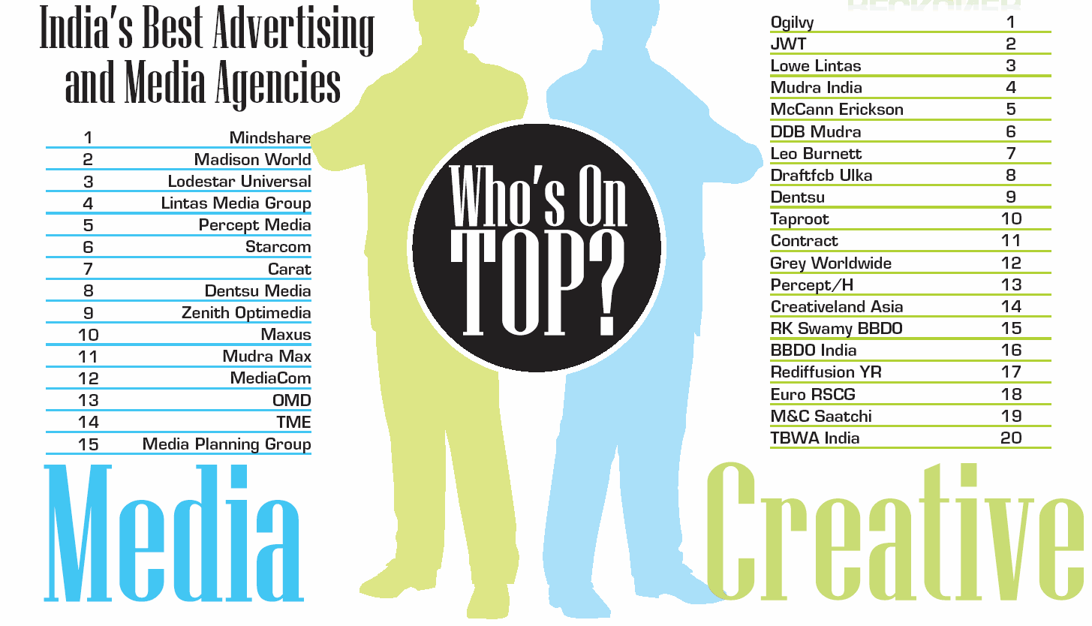
Source – Brand Equity, 16th May 2012

Slide 10
ACTIVITY
(find detailed INFORMATION ABOUT AD AGENCIES IN INDIA(clients,bestcampaigns etc)

Slide 11
Advertising Campaign Planning

Slide 12
Advertising Campaign
It is set of interrelated and coordinated marketing communication activities that centre on a single theme or idea that appears in different media across a specified time period.
It is an orderly planned effort consisting of related but self-contained and independent advertisements
Though the campaign is conveyed through different media, it has a single theme and unified approach
Coordination, balance, timing, continuity and performance are important for an advertising campaign

Slide 13
Factors influencing campaigns
The consumer profile
The product profile
The advertising and marketing objectives
The study of marketing environment
Review of previous advertising efforts
The total advertising budget
The media availability
The creative considerations

Slide 14
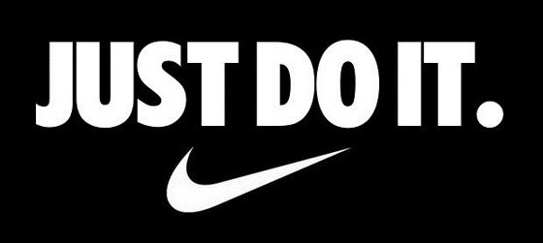
Nike-Just do It
Did you know that, once upon a time, Nike's product catered almost exclusively to marathon runners? Then, a fitness craze emerged -- and the folks in Nike's marketing department knew they needed to take advantage of it to surpass their main competitor, Reebok. (At the time, Reebok was selling more shoes than Nike). And so, in the late 1980s, Nike created the "Just Do It." campaign.
It was a hit.
In 1988, Nike sales were at $800 million; by 1998, sales exceeded $9.2 billion. "Just Do It." was short and sweet, yet encapsulated everything people felt when they were exercising -- and people still feel that feeling today. Don't want to run five miles? Just Do It. Don't want walk up four flights of stairs? Just Do It. It's a slogan we can all relate to: the drive to push ourselves beyond our limits.

Slide 15
Some of the best and long ad campaigns
De Beers – Diamonds are forever
Surf Excel – Daag Acche Hai
McDonald’s – I’m Loving it
Cadbury – Kuch Mitha Ho Jaye, Shubhaaramabh
Idea – What an idea sirji/ Ullu Banaoing

Slide 16
Case study on ad CaMPaiGN

Slide 17
Three phases of campaign creations
Strategy development phase
Advertising brief to the creative
The creative phase

Slide 18
Creative Brief
Basic Problem / issue the advertising must address
Advertising and communication objectives
Target Audience
Major selling idea or key benefits to communicate
Creative strategy statement (campaign theme, appeal and execution technique to be used)
Supporting information and requirements

Slide 19
The Typical Agency Work Cycle
Agency Brief
Creative brief
Creative
Media Brief
Media Plan
Production
Operations Scheduling
Feedback and response
Campaign Execution

Slide 20
Agency Compensation
The key issue is that compensation should be commensurate with workload
Fixed fees (retainers) – forecasting revenue, budgeting ease, annual basis
Project based – cost estimates made for each project, only for the work done
Time & materials: accurate, employee sheets, fee depends upon the cost of the materials used and also for the time spent (steel structure, artwork, electrical system)
Commonly used - Commission, Fee, Payment by Results (PBR)

Slide 21

Creativity in ads

Slide 22
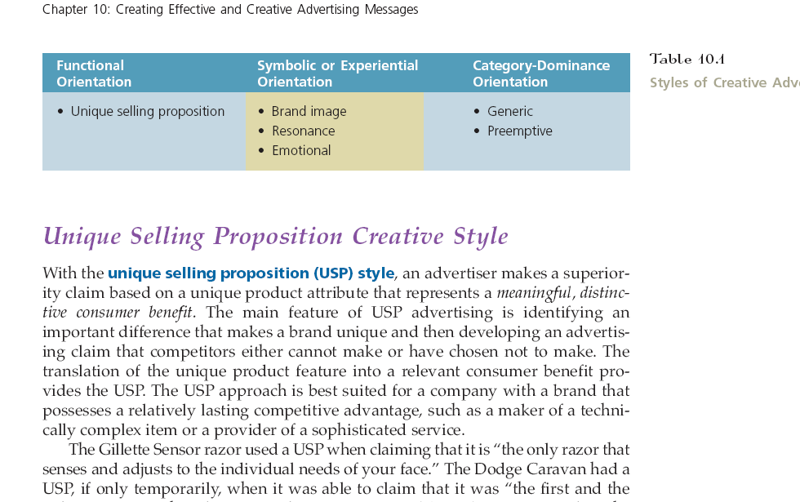
Styles of Creative Advertising

Slide 23

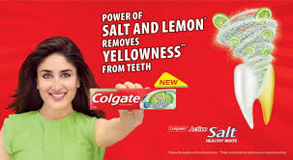
Unique Selling Proposition Creative Style (USP)
An advertiser makes a superiority claim based on a unique product attribute that represents a meaningful, distinctive consumer benefit.

Slide 24
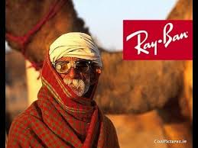
Brand Image Creative Style
The brand image style involves psychosocial, rather than physical differentiation.
Transformational advertising

Slide 25
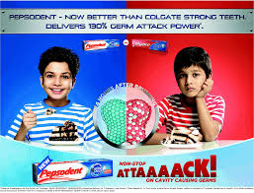
Resonance Creative Style
Does not focus on product claims or brand images but rather seeks to present circumstances or situations that find counterparts in the real or imagined experience of the target audience.

Slide 26
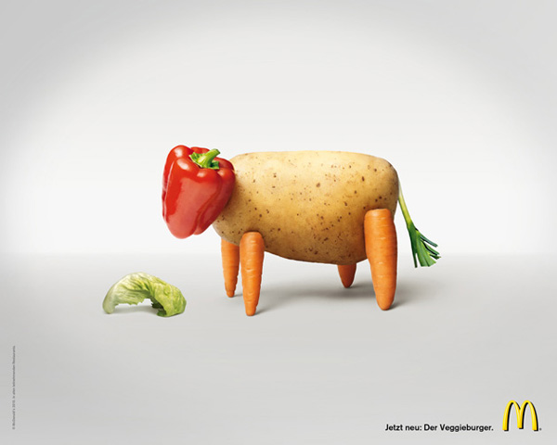
Generic Creative Style
Generic style of making a claim that could be made by any other company
for a brand that dominates a product category

Slide 27
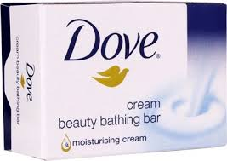
Preemptive Creative Style
A generic type of claim but does it with an assertion of superiority

Slide 28
Advertising budgets
1) Percentage-of-sales Method –
based on a predetermined percentage of
past sales or a forecast of future sales
Simple to follow relating advertising expenditures directly to sales
The U.S. auto majors follow this
Ford (1903 to the present) , General Motors (1908 till now)

Slide 29
Advertising budgets
2) Objective and task Method
budget based on the objectives of the company,
Task-accomplishment motto
Ex: In 2018, Hershey's had a market share of 44% in the U.S. for the chocolate industry. The company has many well-known brands in the U.S., including Hershey's, Reese's, Jolly Rancher and Twizzlers.
Venture into different countries.

Slide 30
Advertising budgets
3) Affordable Method
‘spend what you can afford’ method
suitable for the small company or company which just starts to work

Slide 31
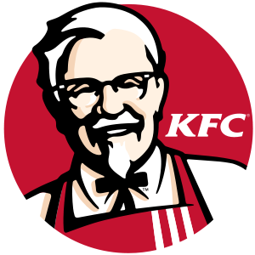

Advertising budgets
4) Match-competitor Method
budgets in comparison with the
competitors’ budgets
monitoring the competitors’ activities and
researching estimates from trade sources
In China
&

Slide 32
Advertising budgets
5) Expert Opinion method : Internal (general manager, marketing manager, advertising manager, sales manager, distribution manager)and external experts (marketing consultants, dealers, suppliers, distributors, trade associations, advertising agencies)

Slide 33
Advertising budgets
6) Arbitrary Allocation method: virtually no theoretical basis is considered & the budgetary amount is often decided by the management solely on the basis of what is felt to be necessary.
Dentsu Aegis Network (DAN) - Oppo Mobile and its sister brand OnePlus - combined annual media spend was about Rs 550-600 crore.
DAN handled the traditional, digital and out-of-home (OOH) advertising requirements of the two brands.

Slide 34
Advertising budgets
7) Incremental budget: Prepared using a previous period's budget or actual performance as a basis with incremental amounts added for the new budget period
Ex: 5% increase during 2021-2022 in the digital media promo compared to 2020-2021

Slide 35
Effect of celebrity endorsements
Celebrity branding is the use of famous people to generate buzz around a product or service.
Celebrity branding involves engagement from celebrities with the product or service.
Celebrity endorsement is a promotional tool that boosts brand awareness. It is a way of enhancing credibility and gaining visibility for brands.
Celebrity endorsement builds credibility and can expose a brand to new markets.
Celebrity endorsements and branding can significantly increase sales.
Social media offers a glimpse into the lives of celebrities.
The celebrity effect of seeing a star using a product on social media can thrust a brand into the limelight overnight.

Slide 36
Drawback of celebrity endorsements
A famous celebrity can overshadow a brand.
Sometime, a brand will rely too heavily on a celebrity endorsement. When that happens, the celebrity can outshine the product or give the impression that they are not genuinely interested. This can make a brand seem inauthentic.
If consumers are not convinced that celebrities are sincere about an endorsement, it can negatively impact the brand.
Celebrities who endorse too many products may lose credibility with the public. It is important to match your product or service to the right celebrity.
It can take a long time to influence consumers through a celebrity endorsement. A celebrity endorsement from a star that is not well matched to the brand will not influence consumers at all. These are all important considerations before seeking a celebrity endorsement.

Slide 37
Endorsements gone wrong
Shahrukh-Fair and handsome.
Akshay Kumar-Levis unbutton
Malaika Arora-Zandu balm
Katrina Kaif-Hawai Chappals
Rekha-Snickers

Slide 38

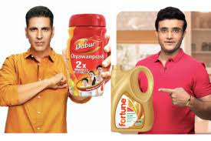

  By associating the product with a famous personality
FRED principle
Familiarity
Relevance
Esteem(Respect &Admire)
Differentiation

Slide 39

# 6
In the following slides, you will see a few celebrities and the
brands endorsed by them alongside
Write your ideas about any two of them in detail in the following sequence
The brand
The celebrity
The misalignment between the celebrity and the brand
Suggestion about a better suited ambassador and a sound reason

Slide 40
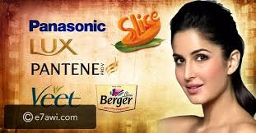

Slide 41
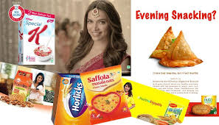

Slide 42
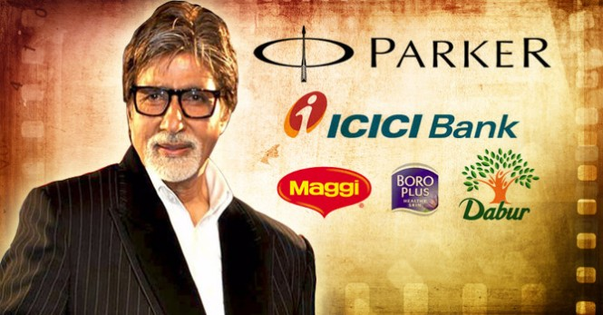

Slide 43
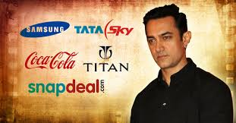

Slide 44
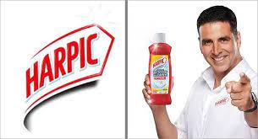

Slide 45
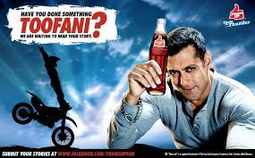

Slide 46
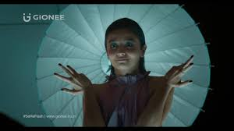

Slide 47
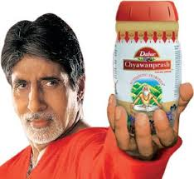
FRED principle activity
Big B - Chyavanprash

Slide 48

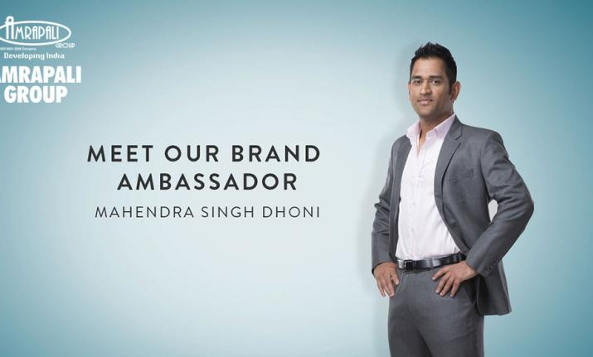

Slide 49
activity
Select any two brands with existing brand ambassadors and give a new celebrity to the brand justifying your reason.

