Slide 1
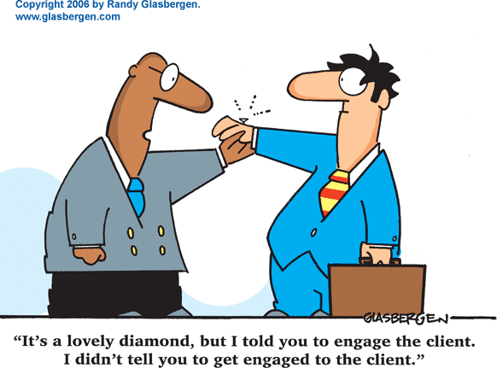
Personal Selling
Prof.Sanjit Kaur Gujral

Slide 2
Meaning
Personal selling refers to the use of speech and personal conviction to bring about some action on the part of another.
Salesperson is a man who actually performs the personal selling.
It is concerned with 'persuasive communication’.
According to William Stanton and Walker, "Personal selling is the personal communication of information to persuade somebody to buy something."

Slide 3
Need and Importance of Personal Selling
Catch Customer’s Attention
Role in Introduction Stage
It Results In Actual Sale
Creates Demand
Increase in Sales
Convincing and Creating Customers
Detail Demonstration

Slide 4
Question
You were in need of a product.
You were confused of the brand.
You went to the retail outlet.
How did the salesman react with you ?
Did he change your decision of buying the brand. State the reasons if changes made in decision making.

Slide 5
Types of personal selling
Over-the-counter selling - customers
at the seller’s place of business (MALLS)
Field selling - Sales presentations at
customers’ locations (BYJUS)
Telemarketing- By sellers to induce sales or by customers to request information(LOANS/CREDIT CARD)
Inside selling - phone, mail, and electronic commerce

Slide 6
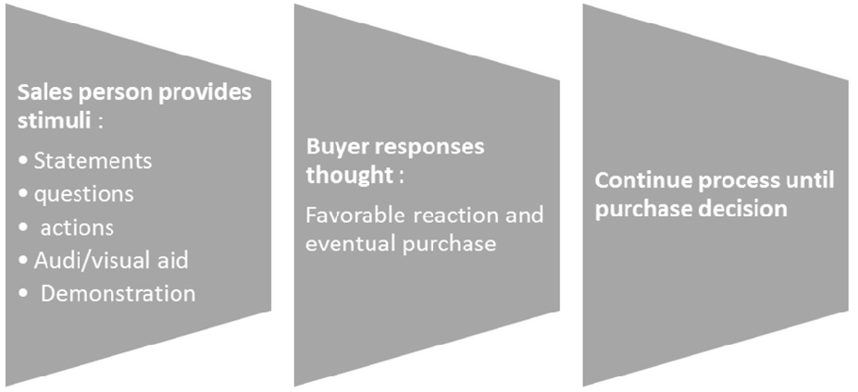
Stimulus Response Approach

Slide 7
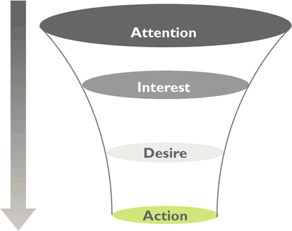
Mental State Approach

Slide 8
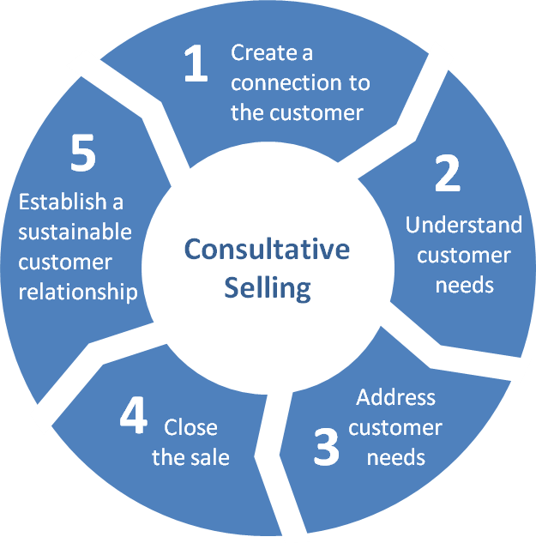
Consultative Approach

Slide 9
Qualities of a SalesPerson
Physical Quality
Ability to Persuade
Courtesy
Creative
Business Sense
Good Behavior
Enthusiasm
Emotional Intelligence

Slide 10
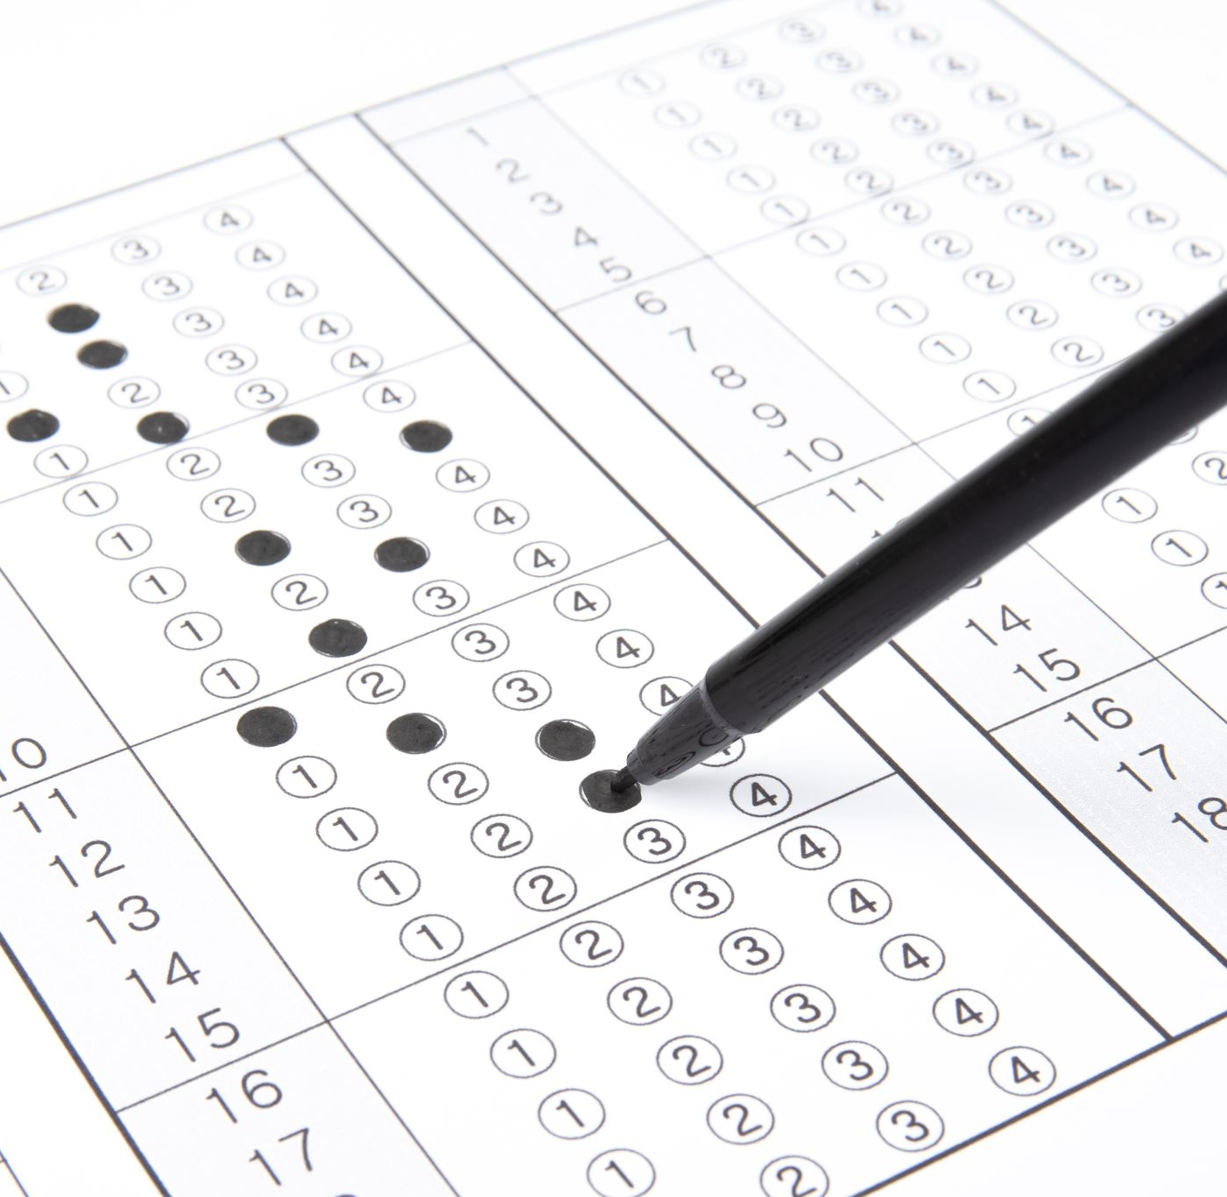
Test Yourself
Emotional Intelligence Quiz

Slide 11
Role Play (Personal Selling)
You need to enact a situation (Sell a Pen) between salesperson and the customer using any one emotion.

