Slide 1
Media Planning and Strategy
Prof.Sanjit Kaur Gujral
Notes:
Chapter Ten
Media Planning and Strategy
© 2003 McGraw-Hill Companies, Inc., McGraw-Hill/Irwin

Slide 2
Basic Terms
Media planning
The series of decisions involved in delivering the message to the target audience
Media plan
The actual document detailing media planning decisions.
Media objectives
Objectives of media plan
Media strategies
action plans to reach objectives

Slide 3
Basic Terms
Media Vehicle
Specific carrier in a media category (TOI - Newspaper)
Media Mix
The actual document detailing media planning decisions.
a particular option for placement within a media class
Medium
The general category of available delivery systems
Media Class
Broad category of media (TV, Radio , Newspaper)

Slide 4
Reach
Number of different audience members exposed at least once to a media vehicle in a given time period
Cost Per Thousand
How much will it cost to reach a thousand prospective customers
Frequency
The number of times the receiver is exposed to the media vehicle in a specific time period

Slide 5
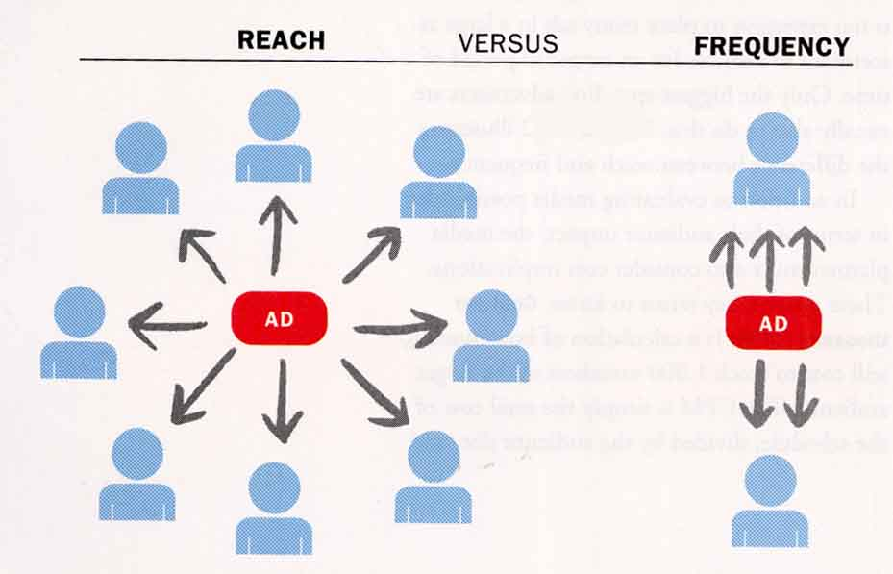
The Difference between Reach and Frequency

Slide 6
Activities involved in developing the Media Plan
Situation
Analysis
Situation
Analysis
Marketing
Strategy Plan
Marketing
Strategy Plan
Creative
Strategy Plan
Creative
Strategy Plan(Visual Stimuli)
Setting Media Objectives
Setting Media Objectives
Determining Media Strategy
Determining Media Strategy
Selecting Broad Media Classes
Selecting Broad Media Classes
Selecting Media Within Class
Selecting Media Within Class
Media Use Decision
— Broadcast
Media Use Decision
— Print
Media Use Decision
— Other Media
Notes:
Relation to text
This slide relates to material on p. 304 and Figure 10-2 of the text.
Summary Overview
The media plan determines the best way to get the advertiser’s message to the market. The basic goal is to find that combination of media that enables the marketer to communicate the message in the most effective manner to the largest number of potential customers at the lowest cost. The various steps and activities involved in developing the media plan are presented on this slide.
Use of this slide
This slide can be used to introduce and provide an overview of the activities involved in developing a media plan. More detailed discussion of these activities will follow.

Slide 7
Developing Media Plan
Market Analysis
Establishment of Media Objectives
Media Strategy development and implementation
Evaluation and follow-up

Slide 8
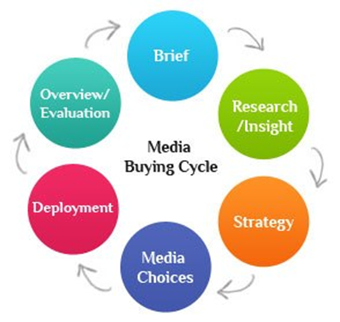

Slide 9
Specialised Media Buyers
Broadcast Media Buyers
Print Media Buyers
Digital Media Buyers
Outdoor Media Buyers

Slide 10
Three Scheduling Methods
Continuity
Flighting
Pulsing
Jan Feb Mar Apr May Jun Jul Aug Sep Oct Nov Dec
© 2003 McGraw-Hill Companies, Inc., McGraw-Hill/Irwin
Notes:
Relation to text
This material relates to material on pp. 314-316 and Figure 10-16 of the text.
Summary Overview
The primary objective of media scheduling is to time advertising efforts so that they will coincide with the highest potential buying periods. This slide shows the three scheduling methods available to the media planner:
Continuity – continuous pattern of advertising; every day, every week, or every month
Flighting – intermittent periods of advertising and no advertising
Pulsing – combination of the first two; continuity is maintained but at certain periods advertising is increased.
Use of this slide
This slide can be used to explain the various scheduling options available to the advertiser. The optimal scheduling schedule can be affected by buying cycles.
A continuity schedule can be appropriate with food products, household products and products consumed on an ongoing basis.
A flighting schedule is well suited to seasonal or other products that are consumed mostly during certain time periods.
A pulsing schedule may be used for products that have little sales variation from period to period, but might see some increase in certain times such as cold beverages in the hot summer months.

Slide 11
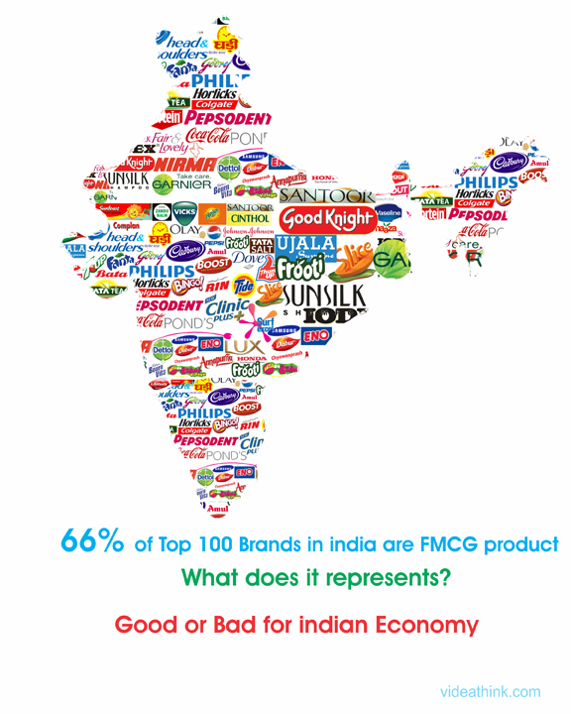
Continuity
This model is primarily for non-seasonal products and some seasonal products
Advertising runs steadily with little variation over a campaign period
There may be short gaps at regular intervals
Works as a reminder
Covers the entire purchase cycle
Positioning advantages within media

Slide 12

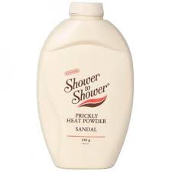
Flighting
flighting involves intermittent and irregular periods of advertising, alternating with shorter periods of no advertising at all
Little waste, since advertising concentrates on the best purchasing cycle period
Series of commercials appear as a unified campaign on different media vehicles

Slide 13

Pulsing
combines flighting and continuous scheduling by using a low advertising level all year round and heavy advertising during peak selling periods
Covers different market situations

Slide 14
Copywriting:
The Language of Advertising
Four types of ads in which words are crucial
  If the message is complicated
  If the ad is for a high-involvement product
  Information that needs definition and explanation
  If a message tries to convey abstract qualities

Slide 15
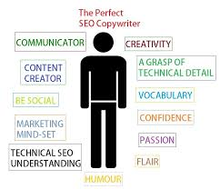
Skills of A Copywriter
The person who shapes and sculpts the words in an ad

Slide 16

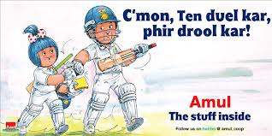

Advertising Writing Style
Copy should be as simple as possible
Should have a clear focus and try to convey only one selling point
Every word counts; space and time are expensive

Slide 17
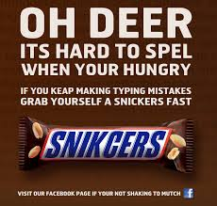
Copywriting for Print
Display copy
  Elements readers see in their initial scanning
Body copy
  Elements that are designed to be read and absorbed
The Headline
Key element in print advertising
Conveys the main message
Works with the visual to get attention and communicate creative concept

Slide 18

How to Write Headlines
A good headline will attract those who are prospects
The headline must work in combination with the visual to stop and grab the reader’s attention
The headline must identify the product and brand, and start the sale
The headline should lead readers into the body copy
  Direct-action headlines
  Indirect-action headlines

Slide 19
How to Write Other Display Copy
Captions
Have the second-highest readership and serve an information function
Subheads
Sectional headlines used to break up a large block of copy
Taglines
Short, catchy, memorable phrases used at the end of an ad to complete the creative idea
Slogans
Repeated from ad to ad as part of a campaign or long-term brand identity effort

Slide 20
Types of Headlines
Headlines Can be Grouped Into Two General Categories
Direct Action Indirect Action
Assertion
Puzzles
Command
Associations
How-to
Statements
News
Announcements

Slide 21




Assertion …

Slide 22




Command…

Slide 23

NEWS

Slide 24

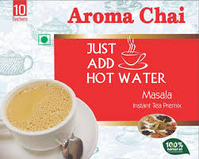

How to …
https://www.youtube.com/watch?v=LO5KcOAuzZQ

Slide 25

Principles of Effective Print Advertising
Establishing an Objective
Sell to the Objective
Designing the Ad
Evaluate the Ad

Slide 26
How to Write Radio Copy
Radio Guidelines
Keep it personal
Speak to listener’s interests
Wake up the inattentive
Make it memorable
Include call to action
Voice
Music
Sound effects

Slide 27



https://www.redfmindia.in/advertise

Slide 28
How to Write Television Copy &
Tools of Television Copywriting
Talent
Announcers
Spokespersons
Character types
Celebrities
Video
Audio
Voice-over
Other TV Tools

