Slide 1
GOOGLE ANALYTICS
It is a free Web Analytics service that provides statistics and basic analytical tools for search engine optimization (SEO) and marketing purposes.
The service is available to anyone with a Google Account . Google Analytics is now widely used Web Analytics on the Internet.
The main purpose of Google Analytics is to analyse:
Website Traffic
How the consumers are navigating through your website
Behaviour
Track Conversions
Page Views
Downloads

Slide 2
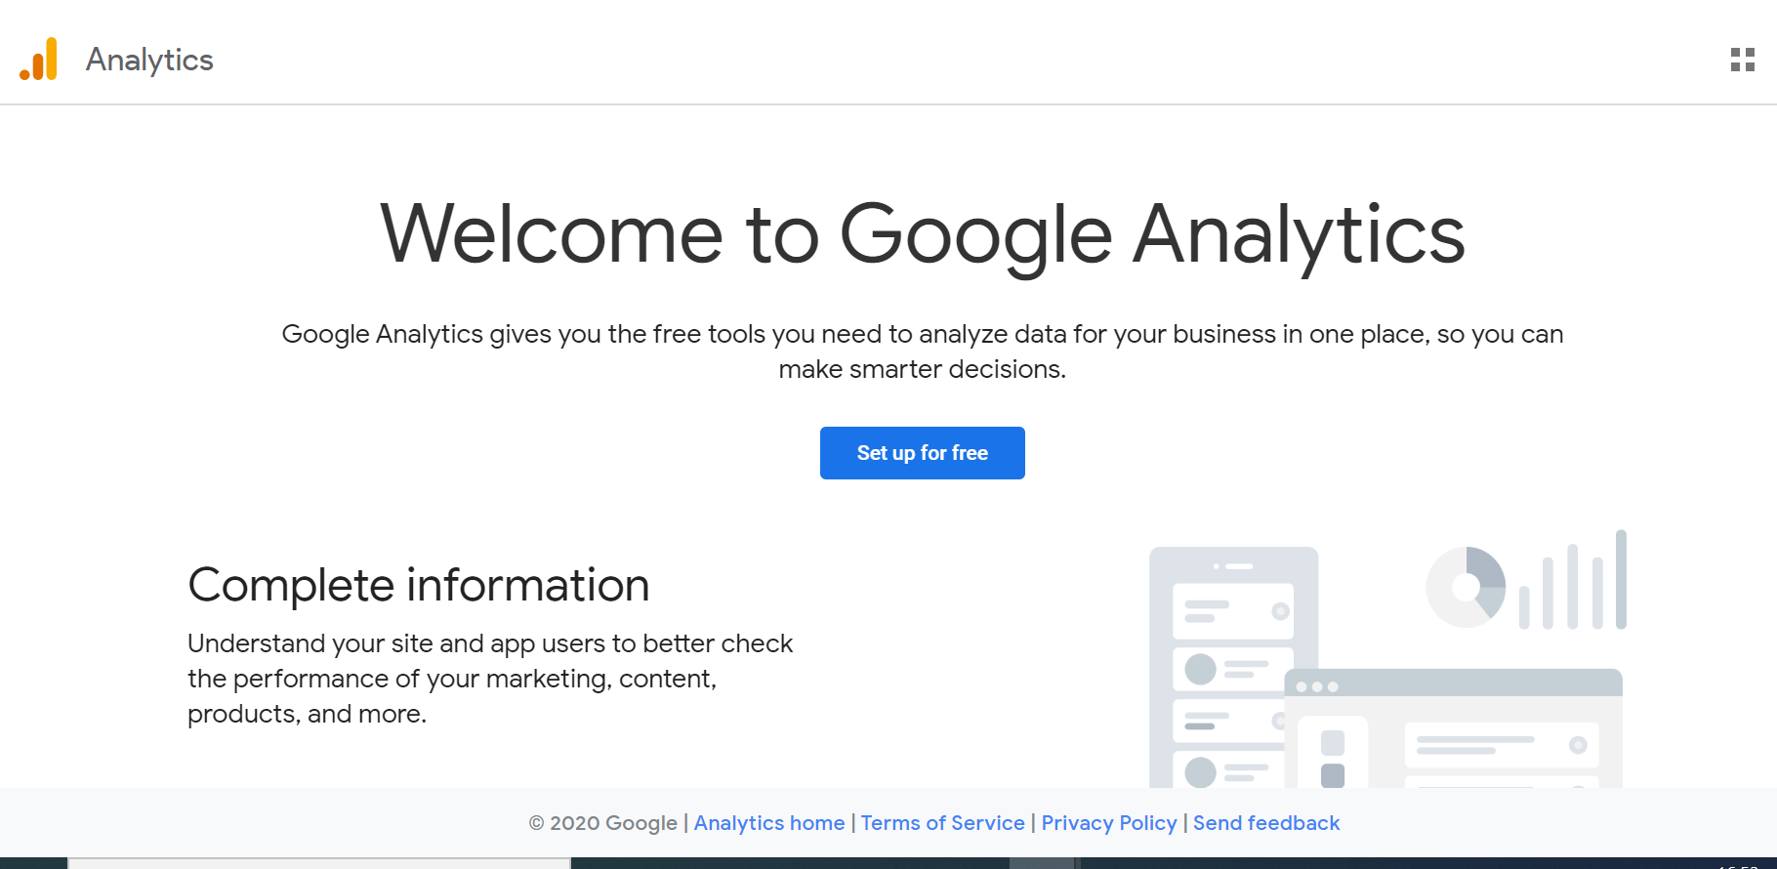
SETTING GOOGLE ACCOUNT

Slide 3
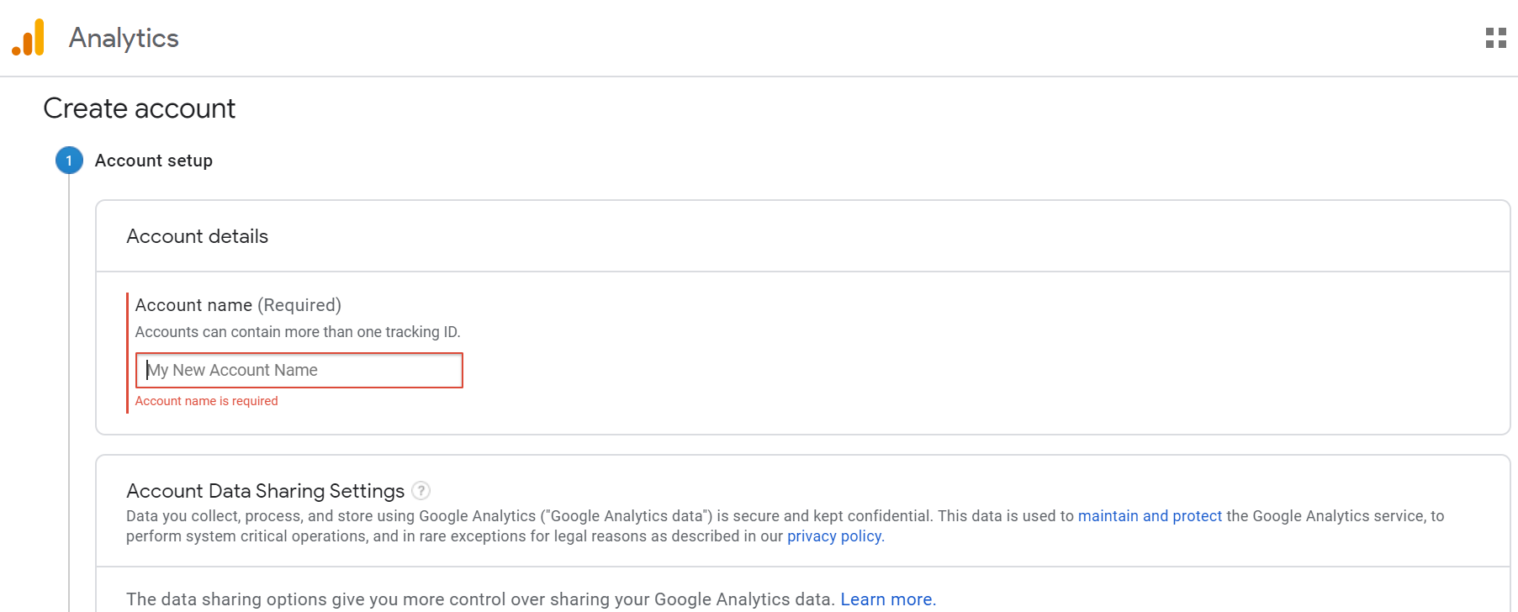
ACCOUNT CREATION

Slide 4
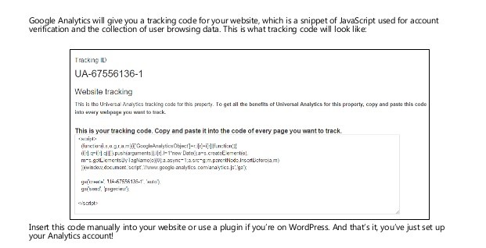
GOOGLE TRACKING

Slide 5
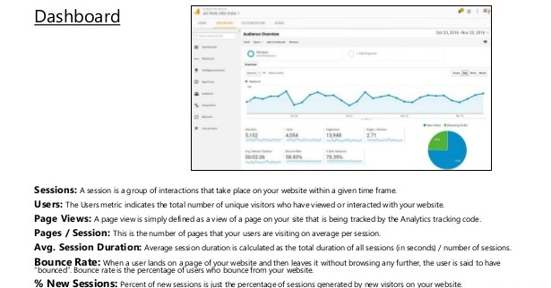
DASHBOARD

Slide 6
HOW ANALYTICS WORKS
process
When a page is displayed by the browser , the inserted JavaScript executes this code and loads the ga.js script from a Google server.
This script stores data about the visit in cookies on the user’s machine . This cookie data is sent in a query string to secure GA reporting server.
The cookie data relating to the page visit, is then extracted from the access logs of the Google secure server and stored in the corresponding GA account use in compiling reports.
NOTE
JavaScript is required on the user’s machine.
Cookies must be enabled and data is recorded when cached and reloaded pages are viewed.

Slide 7
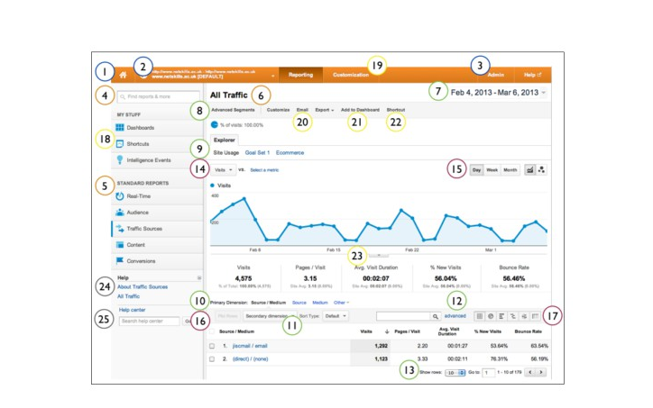
INTERFACE
Account Controls
1. Property list
2. Account/Profile Selector
3. Administrative Settings
Report Navigation
4. Report Finder
5. Directory of Reports
6. Report Title
Data Inclusion Controls
7. Date Selector
8. Advanced Segments
9. Metric Group Selector
10. Primary Dimension Selector
11. Secondary Dimension Selector
12. Table Filter
13. Table Controls
Graph & Visualisation Controls
14. Metric View Selector
15. Graph Increment Selector
16. Plot Rows
17. Data View Selector
Report Sharing,Dashboards,
and Downloading
18. Dashboards, Realtime, Intelligence
19. Custom Reporting
20. Customize, Email, Export
21. Add to Dashboard
22. Shortcuts
23. Annotations
Help Resources
24. Contextual Help
25. Help Search Box

Slide 8
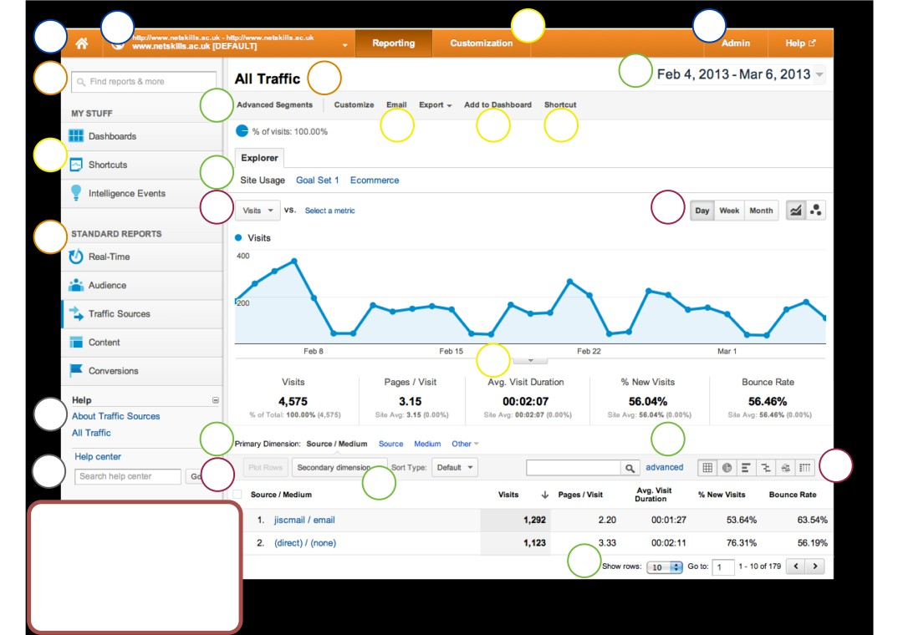
1
2
19
3
4
6
7
8
20 21
22
18
9
14
15
5
23
24
10
12
25
16
17
11
Help Resources
24. Contextual Help
25. Help Search Box
13
19. Custom Reporting
20. Customize, Email, Export
21. Add to Dashboard
22. Shortcuts
23. Annotations

Slide 9
COMMON METRICS
VISITS
A period of interaction between a web browser and a website
Closing the browser or staying inactive for > 30 minutes ends the visit
UNIQUE VISITIORS
Count each visitor once during the selected date range
Uniquely identified by a GA visitor cookie, assigns a random visitor ID to the user, combines it with the timestamp of the visitor’s first visit.
If visitor A views a site 4 times during the selected date range, visitor B views the same site once , that is 2 unique visitors.
Page views
Counts every time a page on a site loads

Slide 10
COMMON METRICS
Unique page views
Represents the number of visits during which that page was viewed.
If visitors views page A 4 times during one visit, it is 4 page views.
bounce
Calculated as a single-page view or single-event trigger in a visit or session—these qualify as bounces:
A visitor clicks on a URL sent by a friend, reads the content on the page and closes the browser
A visitor comes to your home page reads for a minute or two and immediately leaves
Page views
Percentage of visitors that view only one page during a visit to your site

Slide 11
REAL TIME REPORTS
MEASURING ACTIVITY AS IT HAPPENS
How many people viewing content right now
Pageviews per second/minute
The location of the visitors
What Traffic sources related them to your site
VERIFY IF THE TRACKING CODE IS WORKING
CHECK THE TRAFFIC WHEN SOCIAL MEDIA POST IS MADE
MONITOR THE EFFECT OF EMAILS/ TWITTER CAMPAIGN

Slide 12
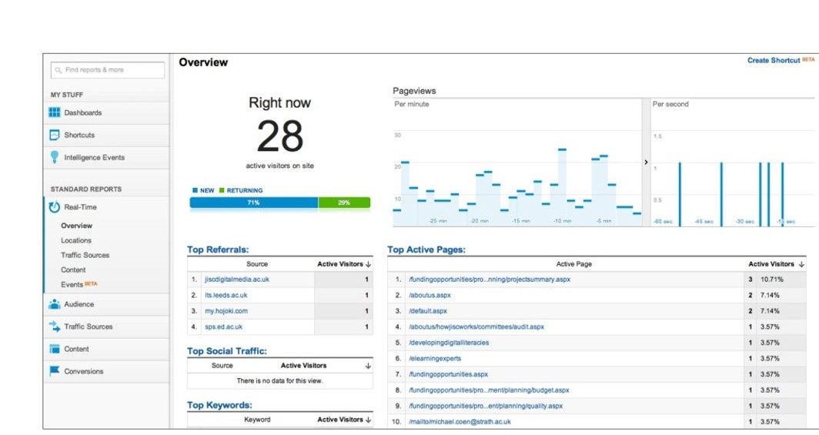
REAL TIME REPORTS

Slide 13
AUDIENCE OVERVIEW
REPORT OVERVIEW
Visits (total number of visits to your site)
Unique Visitors (total number of unique visitors to your site)
Pageviews (total number of pages viewed on your site)
Pages per Visit (average number of pages viewed per visit)
Average Visit Duration (average visit length of all visitors)
Bounce Rate (percent of single-page visits)
New Visitors (percent of total visitors who visited your site for the first time)

Slide 14
AUDIENCE REPORTS
REPORT OVERVIEW
Demographics—where audience comes from by language and location
Behavior—type of visitor, their loyalty and engagement
Technology—what browser and network they’ve used to access your site
Mobile—accesses via mobile and the devices they’ve used
Visitors flow—traces the route that visitors took through your site and left

Slide 15
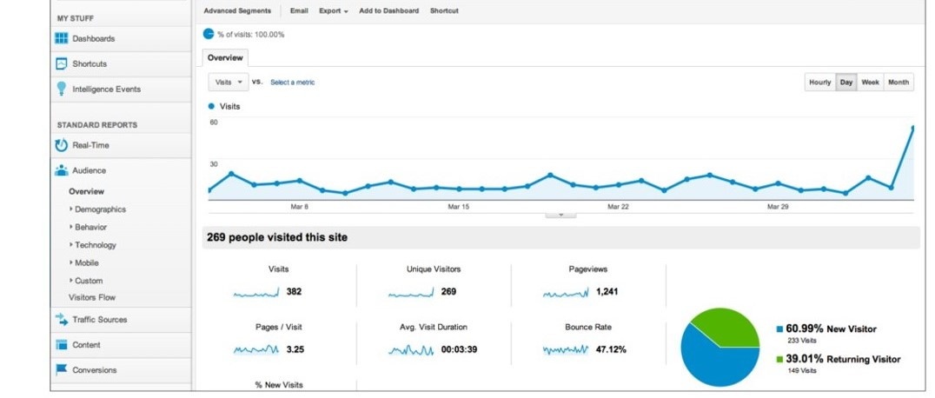
AUDIENCE REPORTS

