Slide 1
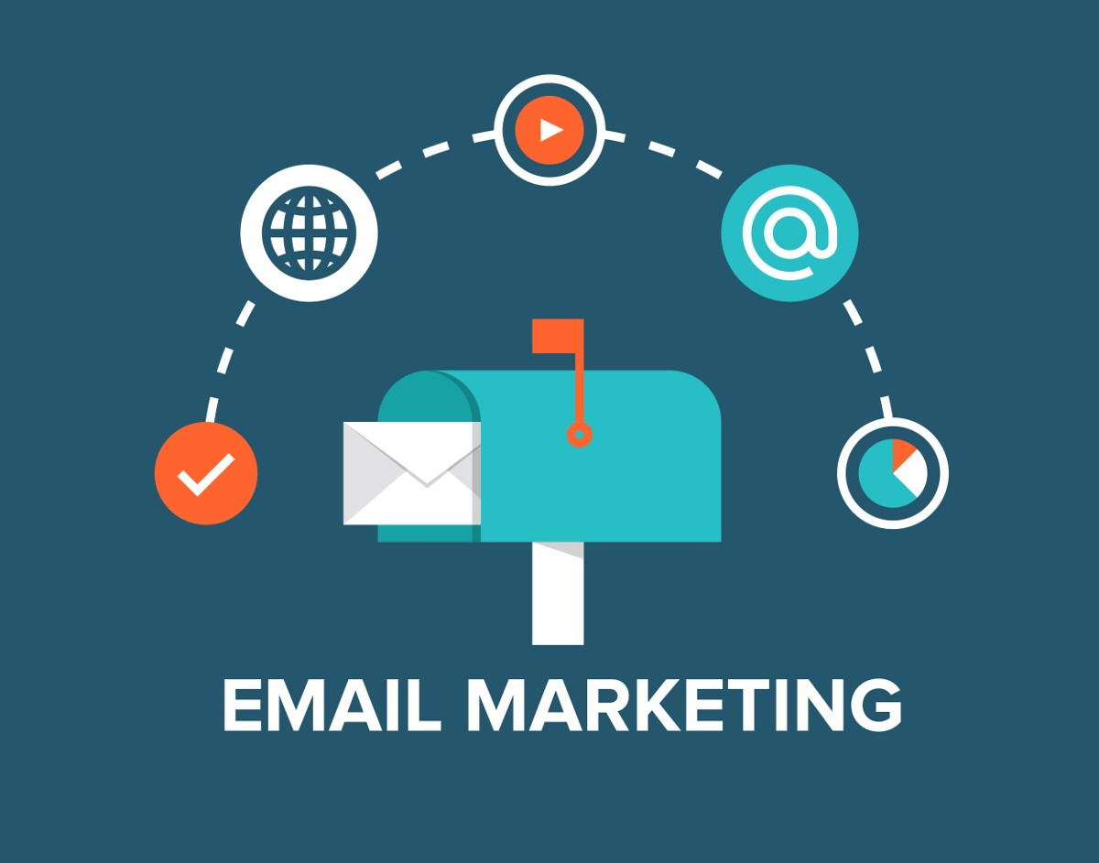

Slide 2
Meaning
Email marketing is the act of sending a commercial message, typically to a group of people, using email.
It is meant to build loyalty, trust or brand awareness.

Slide 3
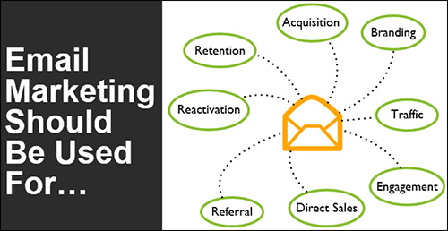
Why Email Marketing

Slide 4
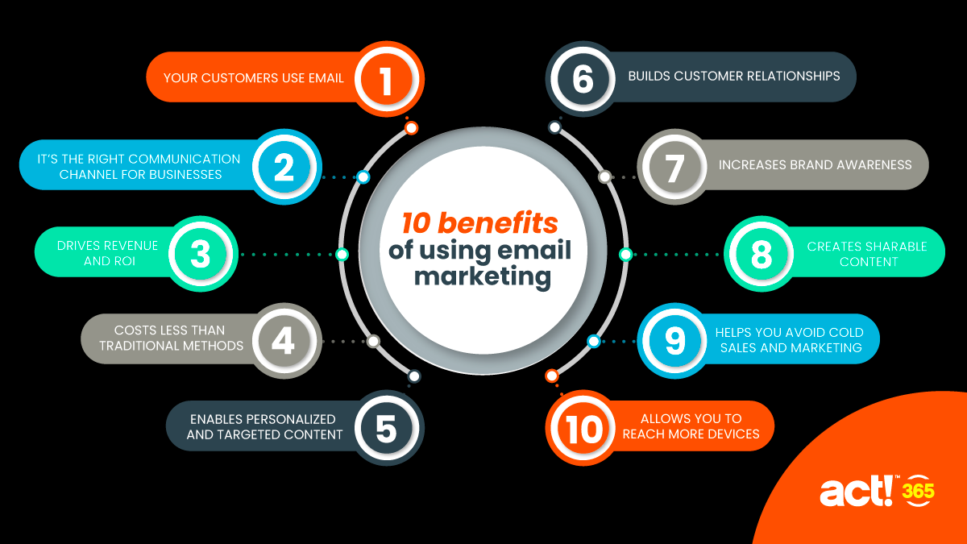
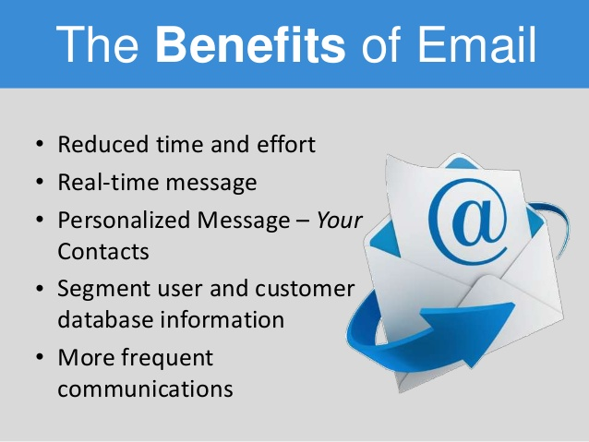
Benefits

Slide 5
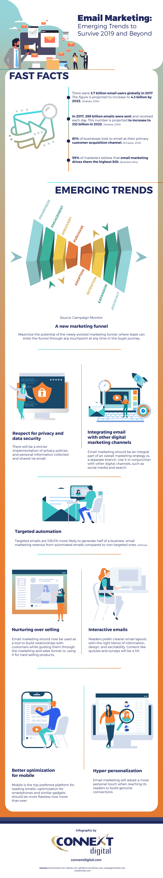

Slide 6
Types
Newsletter
Drip Marketing
One time Download
One to One email
Cold emails
Support & Transactional

Slide 7
Email Metrics
Type of Metric | What it Means | What It Indicates
Open rate | What percentage of recipient opened the given mail? | This number will creep up over time. 30% is good.
Click-Through rate | What percentage of recipient of given mail clicked on it? | This number also creeps up over time.
Bounce Rate | What percentage of recipient of given mail were not able to receive it? Soft bounces(mailbox full) vs. hard bounces(no such email). | The quality of your subscribers
Conversion rate | What percentage of recipient of a given mail took action you wanted them to take? | The strength of your conversion funnel & your value proposition.
Spam Complaints | How many recipients of given mail marked it as a spam? | The health of your email list & whatever you have acquired emails via the right channels.

Slide 8

Tools

Slide 9
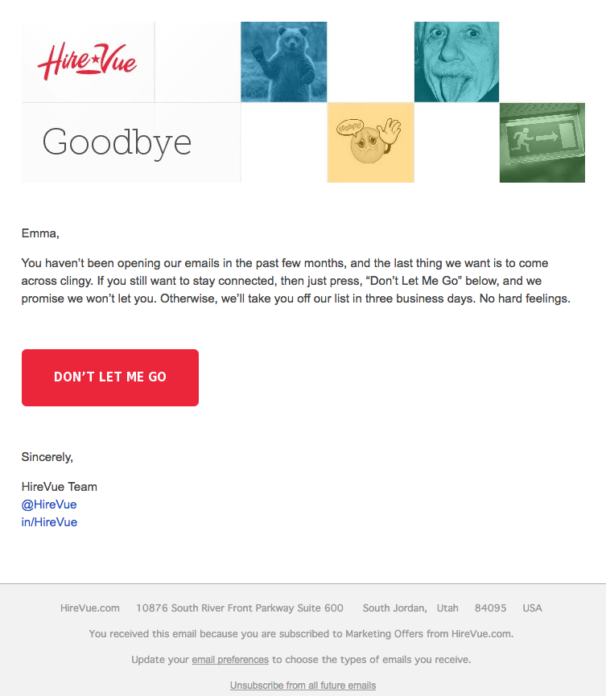
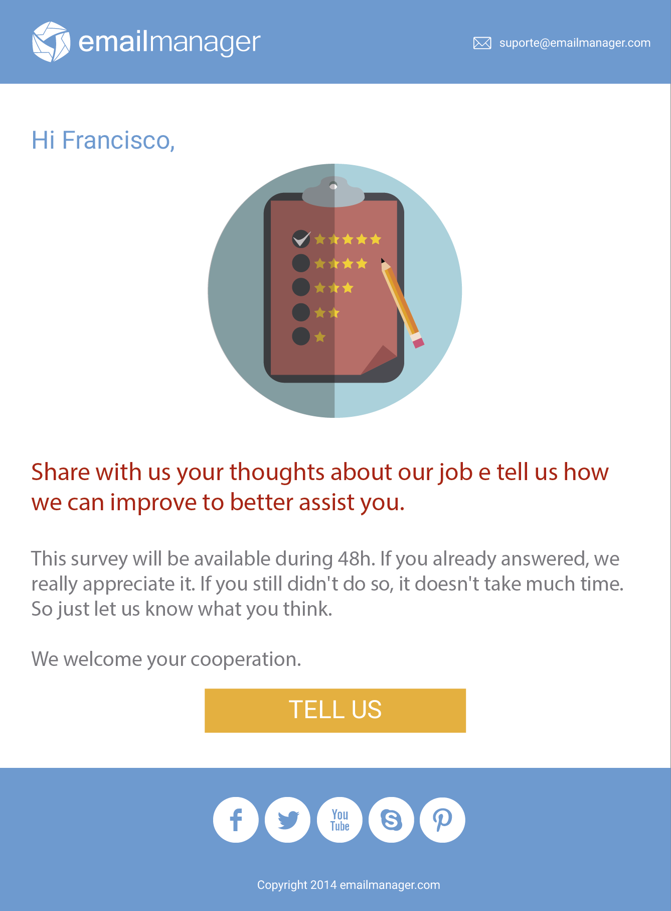
Examples

