Slide 1
Adwords
Google Adwords (earlier)
now
Google Ads

Slide 2
Choose where customers see your ads
Customers may see your ads with their search results, on Google or partner websites, or in mobile apps.
How to identify where customers may see your ads
Which ad formats can be used on each Google network

Slide 3
Google Network
"What exactly do they mean by Google Network?“
It is made up of two networks: Search and Display. They're the places where your AdWords ads can appear, including: Google sites, partner sites, and other placements like mobile phone apps.
Search Network – Ads may appear on:
Google search, Google Maps, Google Play & Google Shopping.
Search sites that partner with Google.
Display network – Ads may appear on:
Google sites like Youtube, Blogger & Gmail.
Partnering websites across the internet.

Slide 4
Ad formats on the Google Network
Text ads
Ads with extensions
Responsive ads
Shopping ads
Image ads
Video ads
App promotion ads
Call-only ads
Rich media ads

Slide 5
Search network ads types
a. Text Ads- The most common kind of Search ad includes a descriptive headline, website URL, and descriptive text like a call to action.
Where they can show: Search Network, Search Partners
b. Ads with extensions- Ad extensions provide additional information to your text ad, such as your business’s address or phone number.
Where they can show: Search Network, Display Network (depending on the extension)
c. Call - only Ads- Call-only ads allow your customers to call your business directly by clicking on your ad. They’re useful for driving phone calls to your business from devices that can make calls.
Where they can show: Search Network
Note: Text ads, Dynamic Search Ads and call-only ads: The most common kinds of ads on the Search Network. These ads appear with an "Ad" or "Ads" label on the search results page, and might have an "Ads by Google" label on partner sites. They often show with ad extensions, which allow advertisers to include business details like location or phone number in their ads.
d. Shopping Ads- In addition to an image, Shopping ads contain product and pricing information, so users get a strong sense of the product you're selling before they click your ad. They’re ideal if you’re managing a large inventory of products. They're labelled as “Sponsored”.
Where they can show: Google Shopping (in select countries),Google Search, Google Search Partner websites, including YouTube and Image Search in some countries (if your campaign is set to include search partners)
e. Image Ads- Image ads capture people's attention as they browse websites in the Google Display Network.
Where they can show: Search Network*, Display Network
*Image ads show on search partner networks, but not the Google Search Network.
f. Video Ads- Video ads are just what they sound like — a standalone video ad or a video ad that runs inside another streaming video.
Where they can show: Search Network*, Display Network
*Video ads show on search partner networks, but not the Google Search Network.

Slide 6
Display network ads types
Responsive Ads- They help build awareness, influence consideration, and drive action. To create them, simply enter your ad text, then add your images and logo. The Display Network offers ads that adjust to match the pages and apps that show them. Both new and advanced users benefit from responsive ads because they show as "native" ads, and blend into the font and feel of the publisher's site.
Where they can show: Display Network
App Promotion Ads- App promotion ads send your customers to an app store to download your app, or include a deep link directly into your app.
Where they can show: Search Network, Display Network
Rich Media Ads- Rich media ads are engaging ad formats that often include animation or other types of motion.
Where they can show: Display Network
Uploaded image ads. For more control, you can create and upload ads. You can upload ads as images in different sizes or HTML5.
Engagement ads. Run engaging image and video ads on YouTube and across the Display Network.
Gmail ads. Show expandable ads on the top tabs of people's inboxes.

Slide 7
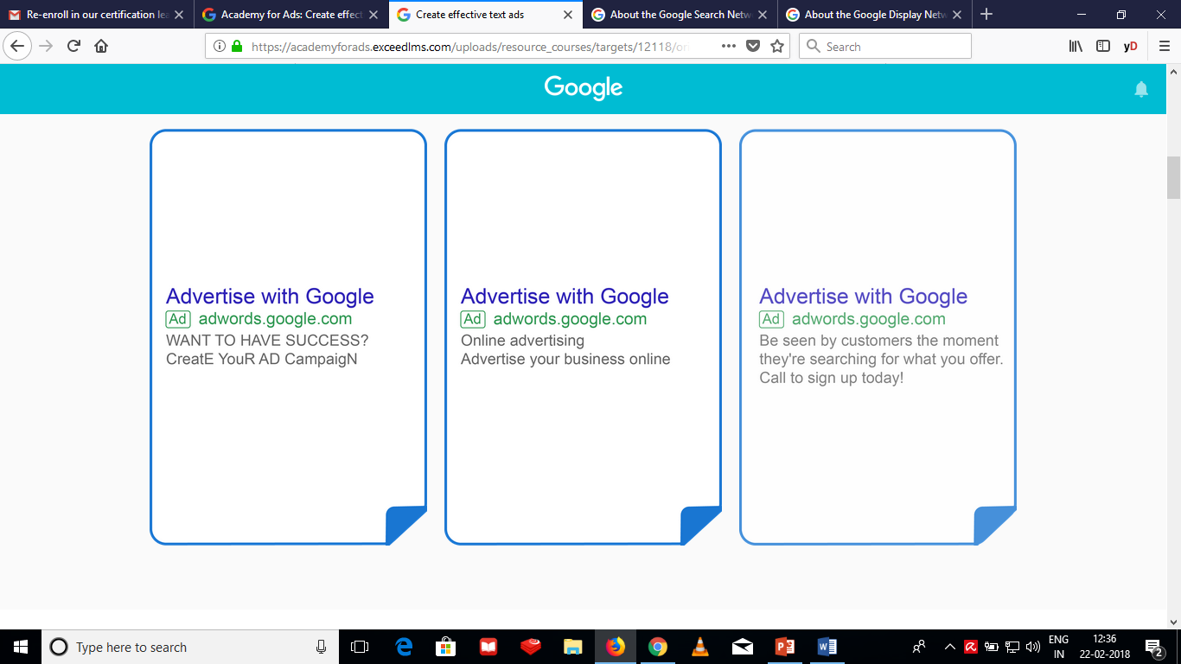
Text Ads
A text ad on Google Search is the simplest online ad that AdWords offers.
Example
Which of them is an example of a great Text Ad.

Slide 8
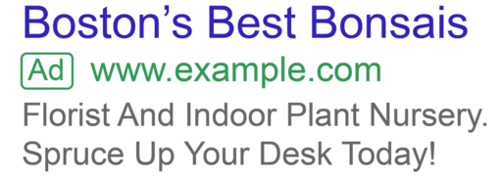
What is a text ad and what does it look like?
Text ads are just that — ads made up of text. They are a simple yet powerful way to get your business in front of customers right when they are searching for products or services like yours on the Google Search Network. Example
Only three parts are required for all text ads: headline, URL, and description.

Slide 9
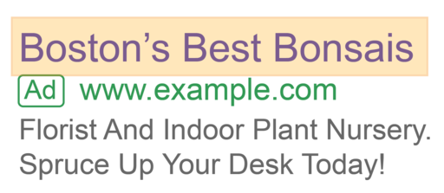
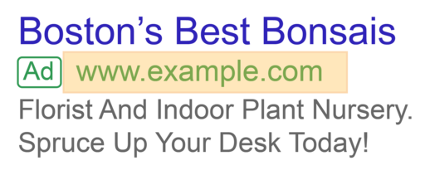
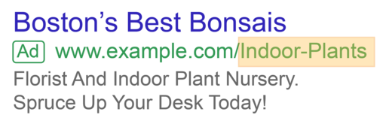
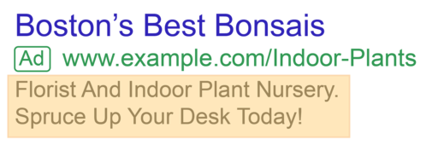
Parts of text Ad
1. Headline - People are most likely to notice your headline text. Consider including at least one of your keywords in the headline to make the ad even more relevant to the customer's search.
Details:
a. Two headline fields are available with up to 30 characters each.
b. Look out for how your longer headline — combined via a hyphen — might wrap on mobile devices.
2. URL -The URL shows your website address. It gives people an idea of where they'll go when they click your ad.
If your final URL is www.example.com/store/us/indoorplants, your ad’s display URL will show as www.example.com.
What about that path field — the “/store/us/indoorplants” at the end of the display URL?
3. “Path” field (optional) - There are two optional “path” fields, which can hold up to 15 characters. Part of your display URL, they are placed after your website’s domain to give readers an idea of the content they’ll see upon clicking your ad.
For example, if your final URL is www.example.com/store/us/indoorplants, you might want your path text to be “Indoor-Plants” so your ad’s display URL would be www.example.com/Indoor-Plants.
4. Description - Use the description field (up to 80 characters) to highlight unique details about your product or service. Be sure to include keywords that match probable search terms. On mobile, where space is tight, AdWords optimizes your ad to show the highest-performing text.

Slide 10
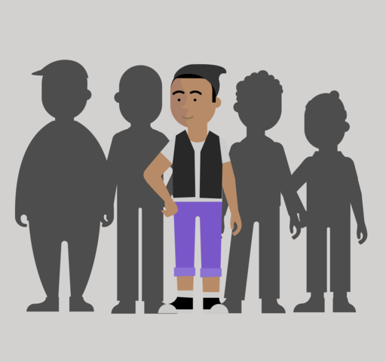
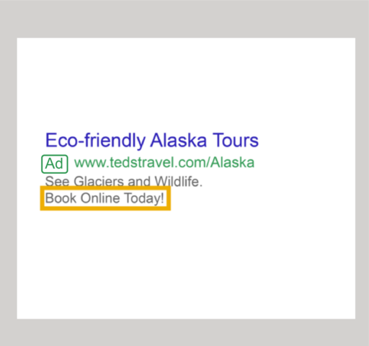
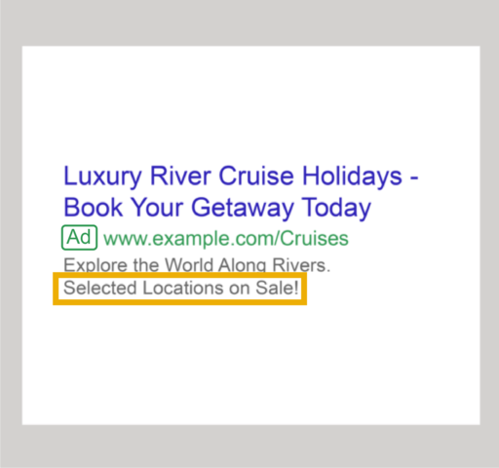
Five tips: Writing effective text ads
To effectively reach potential customers, your text ads should be specific, actionable, and relevant. Let’s take a closer look at things to keep in mind when writing text ads.
Highlight what makes you unique- Show customers what makes you stand out from the competition.
Use a call to action- Use your descriptions to tell customers what they can do on your site once they click your ad — link them right to where the ad matters.
Include sale terms-If you have a sale, make sure they know. Say it right In the ad.

Slide 11
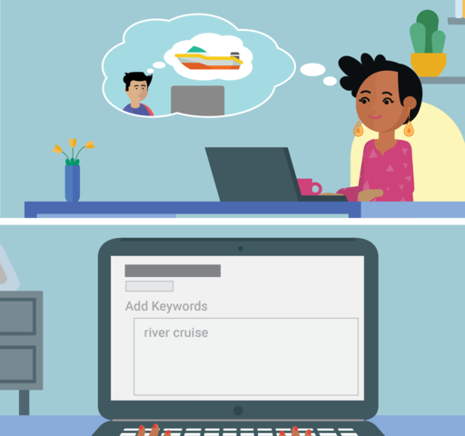
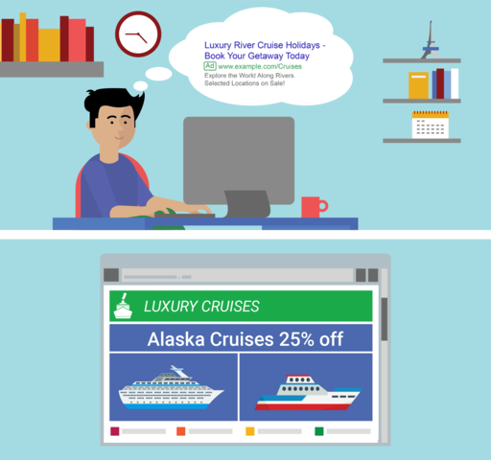
Five tips: Writing effective text ads
Match your ads to your keywords- What might customers be thinking when searching for your products or services? Include those search words as keywords in your ad text.
Match your ad to your landing page- Ensure your ad
takes customers right where they can act on it. The easier it is to find, the more likely they are to purchase.

Slide 12
Best practices for text ads
Optimize your headlines- Headlines matter...a lot. People are most likely to read the headline of your ad, so even though you have extra room now, you still need to make every word count.
Think about your mobile audience- Direct users to pages of your site that deliver a great experience through mobile-specific URLs.
And if you know about any calls to action or offers that work particularly well on mobile devices, take advantage of ad customizers to speak directly to those mobile users.
Use ad extensions- Including information below your ad, like additional deep links into your website or business location, has been shown to increase your ad’s performance.
Improve the landing page experience- Landing page experience is AdWords’ measure of how well your website gives people who click your ads exactly what they’re looking for — quickly and effortlessly.
More on exactly how to make this experience better coming up!

Slide 13
How to improve landing page experience
1. Offer relevant, useful, and original content
Strive to offer useful features or content that are unique to your site. Make your landing page directly relevant to your ad text and keyword:
Be specific when the user wants a particular thing. If someone clicks on an ad for a sports car, they shouldn’t wind up on a general “all car models and makes” page.
Be general when the user wants options. If someone’s looking to compare digital cameras, they probably don’t want to land on a specific model’s page.
2. Promote transparency and foster trustworthiness on your site
Openly share information about your business and clearly state what your business does.
Explain your products or services before asking visitors to fill out forms.
Make it easy for visitors to find your contact information.
If you request personal information from customers, make it clear why you're asking for it and what you'll do with it.
Distinguish sponsored links, like ads, from the rest of your website’s content.
3. Make mobile and computer navigation easy
Organize and design your page well, so people don’t have to hunt around for information.
Make it quick and easy for people to order the product mentioned in your ad.
Avoid pop-ups or other features that interfere with their navigation of your site.
Help customers find what they’re looking for by prioritizing above-the-fold content.
4. Be fast — decrease your landing page loading time Make sure your landing page loads quickly once someone clicks on your ad, whether on a computer or mobile device.
5. Make your site (even more) mobile-friendly
See how your site scores on mobile-friendliness and speed, and find out how to improve it. Test how mobile-friendly your site is with the link in our recap section at the end of this course.

Slide 14
Terminologies
Engagement : The number of people who liked, commented on, or shared a post compared to the # of impressions/reach. Anything above 1% is considered good.
Engagement = Likes + Comments + Clicks
Impressions
Click-through-rate (CTR): The number of times your ad was clicked compared to the number of impressions.
Higher CTR = more effective campaign. Average AdWords CTR = 2.0%; average Facebook CTR = 0.9%*.
Calculation: # Clicks ÷ Impressions
Cost-per-click (CPC): The price you pay for every click on your pay-per-click (PPC) marketing campaign. Lower doesn’t necessarily mean better. Average AdWords CPC: $1-$2; average Facebook CPC = $1.72.
Calculation: Total $$ spent on campaign ÷ # of clicks

Slide 15
Terminologies
# Leads generated: # of new leads from a campaign. A lead could be an email address, download, sign-up, etc. This number will be used to calculate other metrics.
Calculation: AdWords, create a landing page for each campaign, use a unique promo code,
Mail Chimp, etc.
Click conversion: The % of clicks that turn into a lead. Helps you better understand the effectiveness of your landing page or sales funnel. The higher the conversion the better.
Calculation: # of leads ÷ # of clicks
Cost-per-lead: How much it costs to acquire one lead. This, combined with other metrics like customer lifetime value (CLV), helps you determine if the cost to acquire a lead is actually
worth it.
Calculation: Total $$ on ad campaign ÷ # of leads

Slide 16
Terminologies
Customer acquisition cost: The total cost it took to acquire one customer. This amount must be lower than the customer lifetime value (CLV) otherwise you’re losing $$ on every new customer.
Calculation: Total spend on marketing (software, ads, salaries, etc.) ÷ Total # of customers
Example: In one year, you acquired 100 new customers but spent the following on marketing:
○ $5,000 in marketing software (CRM, design, etc.)
○ $10,000 in PPC advertising (AdWords, Facebook, etc.)
○ $25,000 in salaries
Customer acquisition cost = $400 ($40,000 ÷ 100)
Customer lifetime value: The total $$ a customer will spend over their lifetime as a customer.
Calculation: 1𝑦𝑒𝑎𝑟 𝑔𝑟𝑜𝑠𝑠 𝑝𝑟𝑜𝑓𝑖𝑡 × Yearly retention rate
1+discount rate - yearly retention rate
Gross Profit – Total revenue x Average profit margin
Discount rate – The weighted average cost of capital (WACC) 10%
Retention rate – (#customers at the end pf period-new customers acquired)
# customers at the start of the period
Assumptions
Total yearly sales $1,000
Gross profit margin 75%
Gross profit $750
Yearly retention rate 65%
Discount Rate 10%

Slide 17
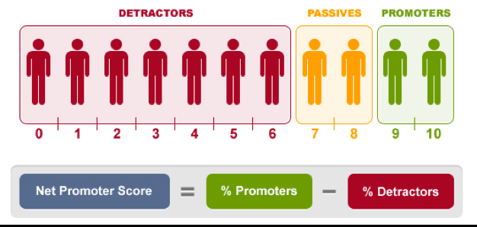
Terminologies
Net promoter score: A score between -100% and 100% that measures a customer’s willingness to recommend your company's products or services to others. These people are your true brand ambassadors.
Calculation:
Send survey that asks “On a scale of 0 to 10, how likely is it you would recommend this company to a friend?”
Calculate the % of 10s and 9s (your promotors)
Calculate the % of 0s through 6s (your detractors)
Subtract the % detractors from promotors
Net profit: The actual profit your campaigns produced after excluding all expenses for the campaign.
Calculation: Revenue – Expenses
Example: As a result of a PPC campaign, 15 customers bought your “How to become a unicorn“ course for total revenue of $1,000. The PPC campaign cost you $600. The net profit would be $400 ($1,000 - $600)

Slide 18
Terminologies
Return on investment (ROI): Ultimately the most important metric. ROI measures the efficiency of an investment. Tells you which initiative is working and which is not. This lets you know how to allocate your budget. ROI should > 500%.
Calculation:
ROI = Revenue from initiative – Initiative expenses
Initiative expenses
Example: Using the last example, you had total revenue of $1,000 and expenses of $400.
ROI = ($1,000 -$400) ÷$400 = 150%

