Slide 1
Introduction to Search
Elements of Online Marketing
Concept of Search Engine
Organic Search & Paid Search
Imp Ranking Factors
Google Search Algorithms
SEO wide usage and SEO Analytics and tools

Slide 2
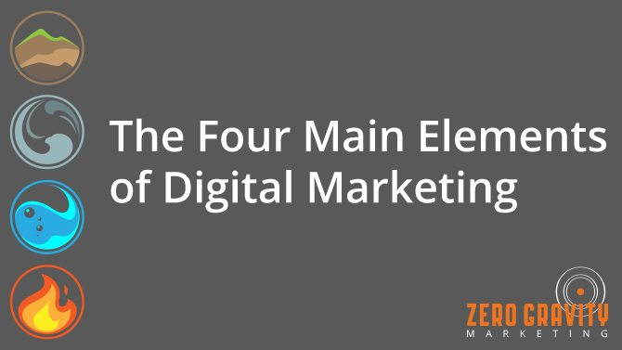
Elements of Online Marketing
Obviously, you know about earth, wind, water and fire.
But for the world of digital marketing they are - search engine optimization, email marketing, social media strategy, and a PPC campaign.

Slide 3
Concept of Search Engine
A search engine is a web-based tool that enables users to locate information on the World Wide Web. Popular examples of search engines are Google, Yahoo!, MSN, etc.
Search engines function on the Internet by allowing Internet users to find specific information from the Web based on keyword criteria that is entered by the user. They are meant to find results for your searches—hence its name.
Generally there are three basic components of a search engine as listed below:
Web Crawler.
Database.
Search Interfaces.

Slide 4
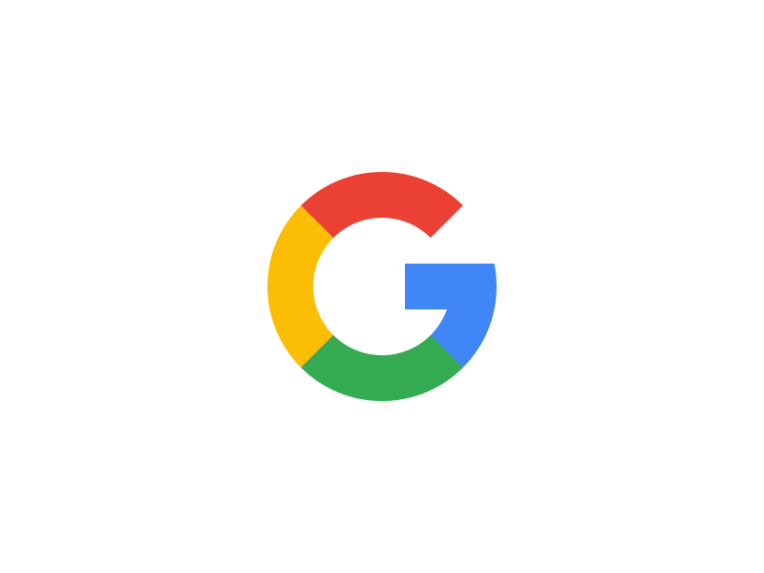


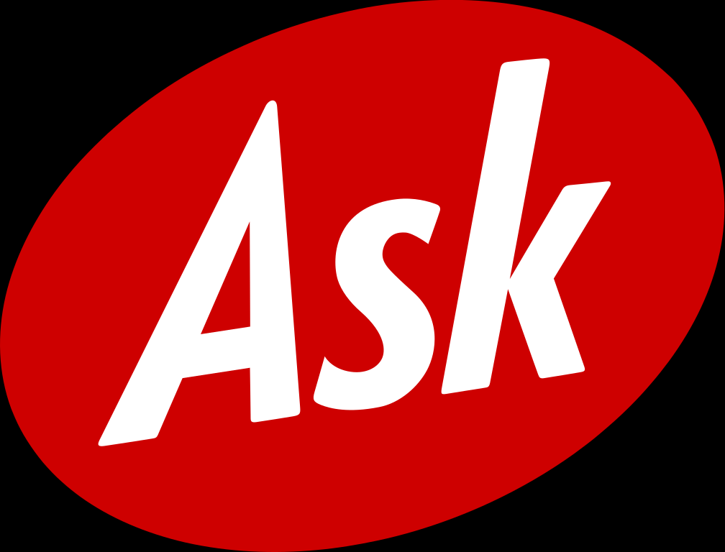
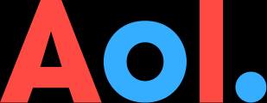




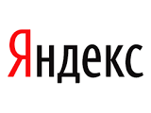
Top 10 Search Engines In The World
(Updated)
1. Google The search engine giant holds the first place in search.
2. Bing Bing is Microsoft’s attempt to challenge Google in the area of search
3. Yahoo Since October 2011 Yahoo search is powered by Bing
4. Ask.com ASK is based on a question/answer format where most questions are answered by other users or are in the form of polls. Formerly known as Ask Jeeves.
5. AOL.com The AOL network includes many popular web sites like engadget.com, techchrunch.com and the huffingtonpost.com.
6. Baidu Baidu was founded in 2000 and it is the most popular search engine in China.
7. Wolframalpha They market it as a Computational Knowledge Engine which can give you facts and data for a number of topics.
8. DuckDuckGo It has a clean interface, it does not track users, it is not fully loaded with ads and has a number of very nice features
9. Internet Archive archive.org is the internet archive search engine. You can use it to find out how a web site looked since 1996.
10. Yandex.ru Yandex operates the largest search engine in Russia with about 65% market share in that country.

Slide 5
Organic and Paid Search
These appear purely based on the quality and content of the page.
Paid search accounts are those that companies have paid to appear the top of search results (above those that earned their page one spots organically.)
Whenever you type a question into Google, or any other search engine, the list of links that appear below the ads are known as "organic results.“

Slide 6
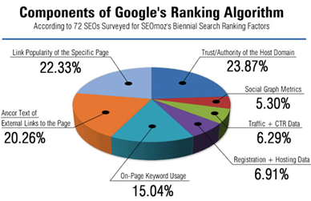
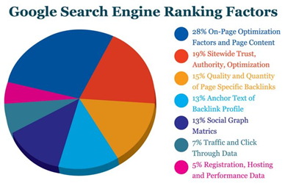

Ranking Factors
Ranking factors can relate to a website's content, technical implementation, user signals, backlink profile or any other features the search engine considers relevant.
Understanding ranking factors is a prerequisite for effective search engine optimization.
over 200 factors used by Google's search algorithm to rank websites and pages.

Slide 7
Algorithms
Google uses automated programs called spiders or crawlers, just like most search engines. Also like other search engines, Google has a large index of keywords and where those words can be found.
Google uses a trademarked algorithm called PageRank, which assigns each Web page a relevancy score.
Google is reported to change its search algorithm around 500 to 600 times each year.
Basically, a search engine algorithm is a set of rules, or a unique formula, that the search engine uses to determine the significance of a web page, and each search engine has its own set of rules.
There are certain things that all search engine algorithms have in common.
a. Relevancy – One of the first things a search engine algorithm checks for is the relevancy of the page.
b. Individual Factors – One of the most common individual factors is the number of pages a search engine
indexes.
c. Off-Page Factors – Off-page factors are such things as click-through measurement and linking.
The frequency of click-through rates and linking can be an indicator of how relevant a web page is to
actual users and visitors, and this can cause an algorithm to rank the web page higher.
** Practical to be done in the class for SEO tools

Slide 8

Audit
Website audit
It starts from a general analysis of a website aimed at revealing the actions needed to improve search engine optimization (SEO). The goal is to detect weak points in campaigns that affect web performance.
Purpose
There are many reasons to do a website audit, but in most cases SEO and content marketing are the main ones.
Types
Website Health Audits - Analysing overall health of the website while revealing all issues that require immediate attention.
Security Audits - Accessing a site for potential vulnerability issues such as high value sites and high-risk verticals.
Competitive Site Audits - The ability to monitor all gaps and opportunities for website promotion, and detect the benefits and drawbacks of competitors.
Red Flag and Recovery Audits - Analysing a website for impending penalties and site metrics.
Conversion Optimization Audits - Accessing a site for possible technical and onsite conversion problems.
Basic Things
basic things that must be in each site audit report:
Summary analysis of a website - The audit - quick understanding where the site stands, possible issues and what points of action should be taken.
Data - Audit tools must give website data and key metrics that will help in understanding when a website can be penalized. For example – duplicity of
content and poor links.
Red Flag Warnings - The tool must detect all warnings and references to any potential issues whether it’s a conversion or penalty.
Additional Recommendations - Each tool should provide tips and recommendations to improve the findings of seo site audit.
Page Speed
Page speed is a measurement of how fast the content on your page loads.
It can be described in either "page load time" (the time it takes to fully display the content on a specific page) or "time to first byte" (how long it takes for your browser to receive the first byte of information from the web server).
Site Speed - which is actually the page speed for a sample of page views on a site.

Slide 9
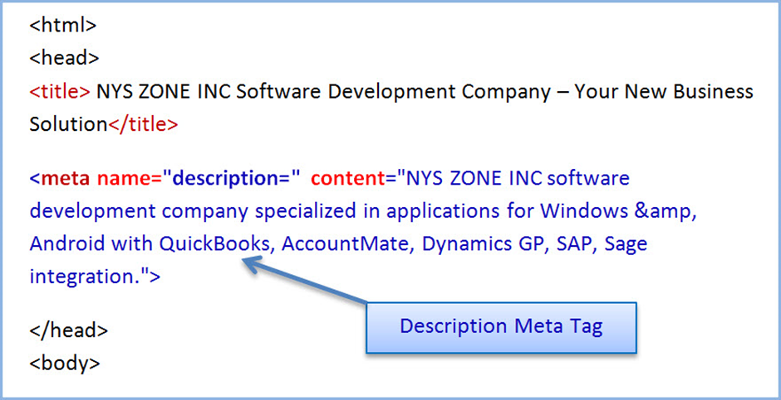
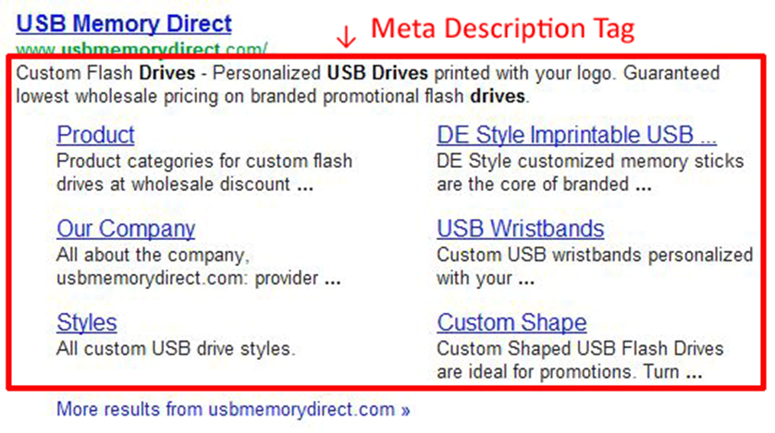
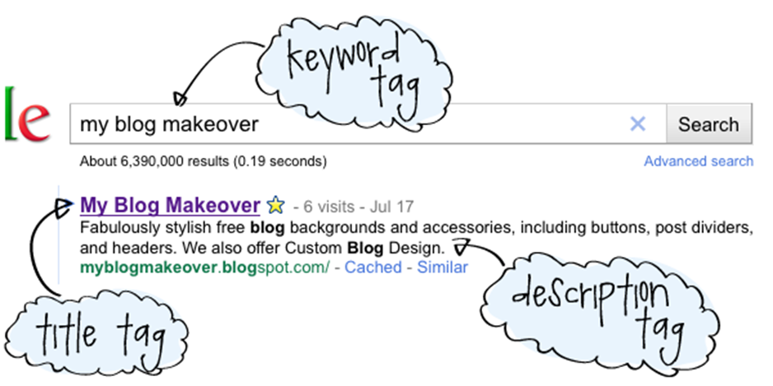
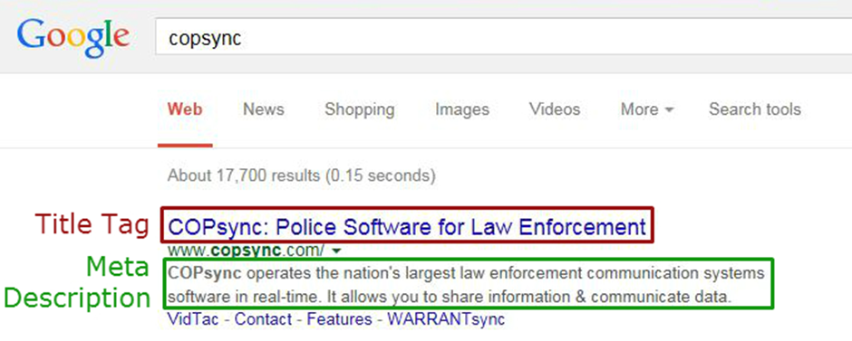
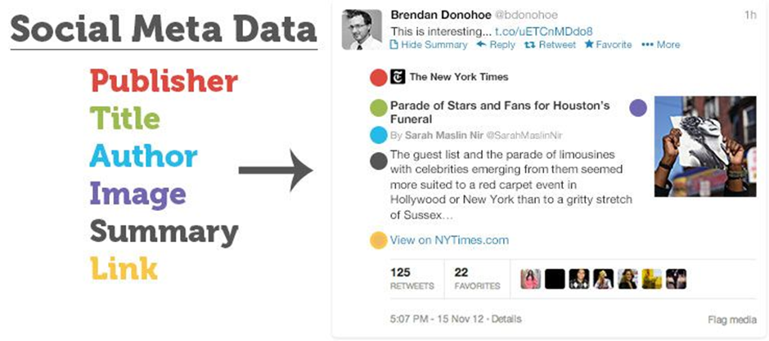
Tags
Meta Tags
A series of keywords you deem relevant to the page in question. Title Tag - This is the text you'll see at the top of your browser. Search engines view this text as the "title" of your page. Meta Description Attribute - A brief description of the page.
Character limits within each of your meta tags: Page title – 70 characters. Meta description – 160 characters. Meta keywords – No more than 10 keyword phrases.
They are typically used to specify page description, keywords, author of the document, last modified, and other metadata. The metadata can be used by browsers (how to display content or reload page), search engines (keywords), or other web services.

Slide 10
Backlink & Competitor Analysis
Many factors play a role in your site’s ability to rank well in search engine results.
One of the most important elements is backlinks, or the links from other sites that point to your site.
Search engines like Google view these links as a sign of your site’s quality and authority, and the more you have from other reputable sites, the higher you’ll rank.
Why analysis?
A backlink analysis shows you all of the links that they’re taking into consideration and gives you a better understanding of your site’s ability to rank well in search engine results. It also helps you identify bad links.
You should also conduct backlink analysis on your main competitors’ sites -
a. Because your competitors’ sites will help you see how difficult it will be to outrank them.
B. It can also show you any potential link opportunities you may be missing and give you ideas for your own link building strategy.
How to do?
1. CHOOSE THE SITES YOU WANT TO ANALYZE (SEMrush)
2. SELECT A BACKLINK ANALYSIS TOOL (SEMrush, Ahrefs, Moz Open Site Explorer)
3. ENTER EACH DOMAIN AND COLLECT THE INFORMATION YOU WANT
What you should look?
1. TOTAL NUMBER OF LINKS & UNIQUE DOMAINS
2. REFERRING DOMAINS
3. TOP PAGES
Source: https://www.webpagefx.com/internet-marketing/what-is-a-backlink-analysis.html

Slide 11
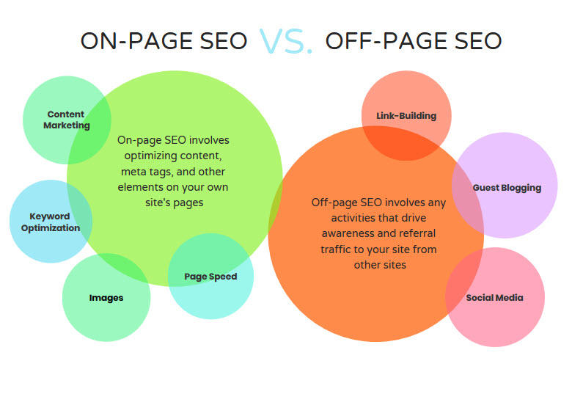
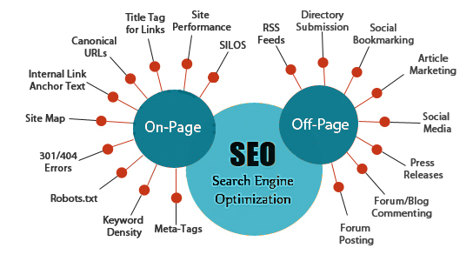
Online SEO vs Offline SEO

Slide 12
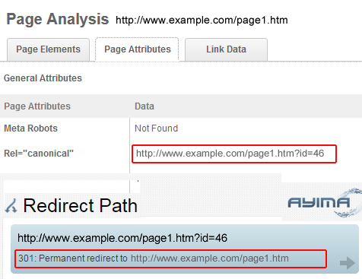
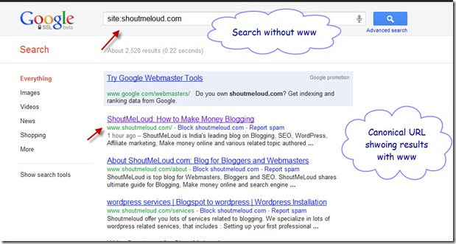
Canonical Tags

Slide 13
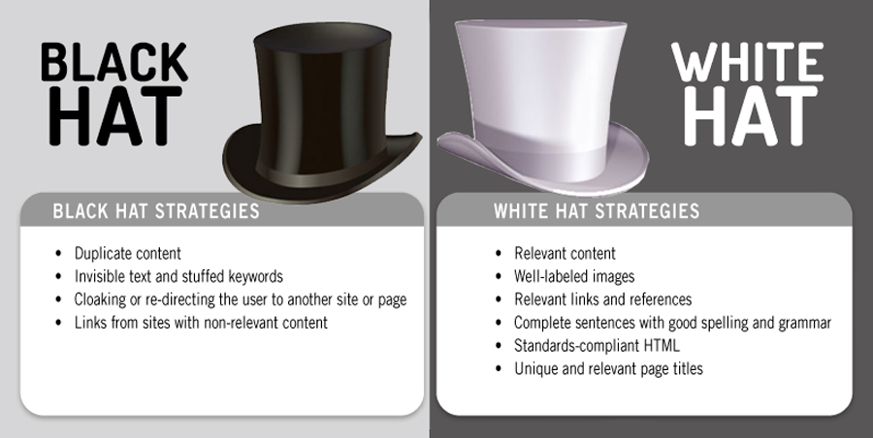
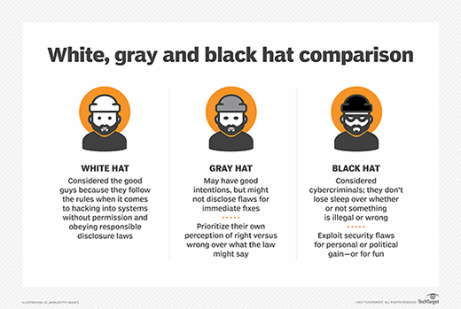
Black Hat, White Hat & Grey Hat SEO

Slide 14
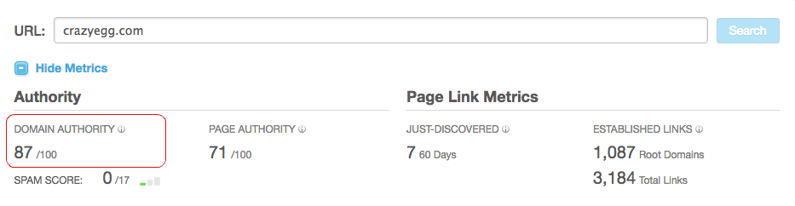
Domain Authority (DA)
Domain Authority (DA) is a search engine ranking score developed by Moz that predicts how well a website will rank on search engine result pages (SERPs). A Domain Authority score ranges from one to 100, with higher scores corresponding to a greater ability to rank.
**Show live (moz.com).

