Slide 1
Talent Analytics

Slide 2
What is HR Analytics
People analytics, also known as HR analytics and workforce analytics, is the use of people-data in analytical processes to solve business problems.
People analytics uses both people-data, collected by HR systems (such as payroll, absence management) and business information (for example, operations performance data)
Analytics is based on data. HR analytics is the science of gathering, organizing and analysing the data related to HR functions like recruitment, talent management, employee engagement, performance and retention to ensure better decision making in all these areas.
The objective of HR analytics is to actually make sense of this data and turn it into a valuable insight.
into their workforce, HR policies and practices,

Slide 3
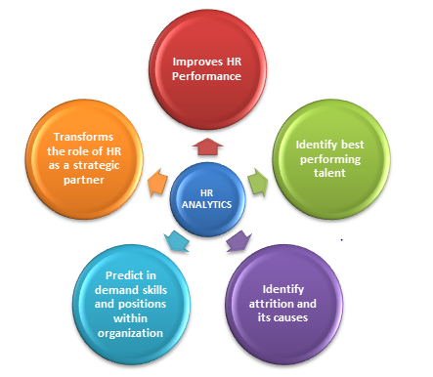
Importance of HR Analytics
Application of HR analytics results in a number of strategic and operational advantages to HR

Slide 4
Increased need for data and analytics tool in HR to make better HR decisions
An important role of HR analytics is to provide access to critical data and insights about the workforce which can be then analysed for making better decisions.
Not only does it improve the HR performance but also provides a better understanding of what motivates employees to work productively, and how do the organizational culture affects employee performance.
Identify Best Performing Talent
Induction Training Performance
Engagement in Activities
No. of Project Done
Revenue Contribution to the Organization

Slide 5
Identify Attrition of Employee & Retention
Similarly, using employee data, recruiters can recognize a pattern of high performing employees and accordingly modify their employee hiring and retention strategy.
HR analytics helps identify the departments suffering from the maximum attrition and the reasons causing it.
It can also help HR in identifying the activities which have the maximum impact on employee engagement and thus allow organizations to invest in such activities.

Slide 6
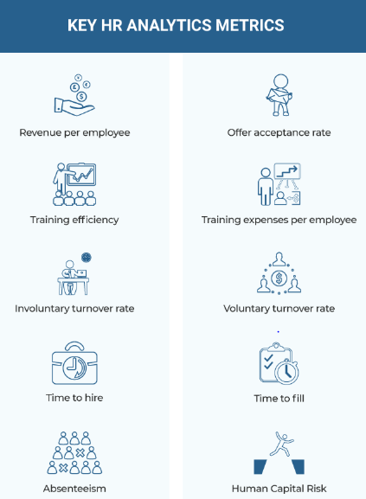
Key Hr Analytics Matrics

Slide 7
Revenue per employee
Obtained by dividing a company’s revenue by the total number of employees in the company.
This indicates the average revenue each employee generates.
It is a measure of how efficient an organization is at enabling revenue generation through employees.
Offer acceptance rate
The number of accepted formal job offers (not verbal) divided by the total number of job offers given in a certain period.
A higher rate (above 85%) indicates a good ratio. If it is lower, this data can be used to redefine the company’s talent acquisition strategy.

Slide 8
Training expenses per employee
Obtained by dividing the total training expense by the total number of employees who received training.
The value of this expense can be determined from measuring the training efficiency.
Poor efficiency may lead you to re-evaluate the training expense per employee.
Training efficiency
Obtained from the analysis of multiple data points, such as performance improvement, test scores, and upward transition in employees’ roles in the organization after training.
Measuring training efficiency can be crucial to evaluate the effectiveness of a training program.

Slide 9
Voluntary turnover rate
Voluntary turnover occurs when employees voluntarily choose to leave their jobs. It is calculated by dividing the number of employees who left voluntarily by the total number of employees in the organization.
This metric can lead to the identification of gaps in the employee experience that are leading to voluntary attrition.
Involuntary turnover rate
When an employee is terminated from their position, it is termed “involuntary.” The rate is calculated by dividing the number of employees who left involuntarily by the total number of employees in the organization.
This metric can be tied back to the recruitment strategy and used to develop a plan to improve the quality of hires to avoid involuntary turnover.

Slide 10
Time to fill
The number of days between advertising a job opening and hiring someone to fill that position. By measuring the time to fill, recruiters can alter their recruitment strategy to identify areas where the most time is being spent.
Time to hire:
The number of days between approaching a candidate and the candidate’s acceptance of the job offer.
Just like time to fill, data-driven analysis of time to hire can benefit recruiters and help them improve the candidate experience to reduce this time.
Absenteeism
Absenteeism is a productivity metric, which is measured by dividing the number of days missed by the total number of scheduled workdays.
Absenteeism can offer insights into overall employee health and can also serve as an indicator of employee happiness.

Slide 11
Human capital risk
This may include employee-related risks, such as the absence of a specific skill to fill a new type of job, the lack of qualified employees to fill leadership positions, the potential of an employee to leave the job based on several factors, such as relationship with managers, compensation, and absence of a clear succession plan.
HR analytics can be used to measure all these metrics.

Slide 12
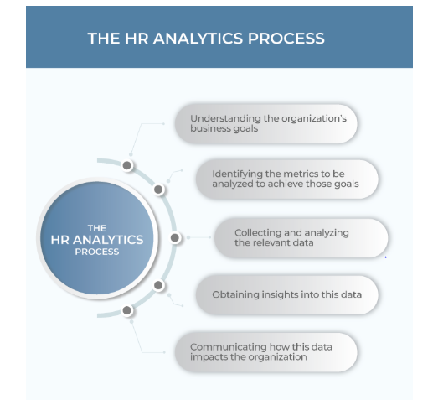

Slide 13
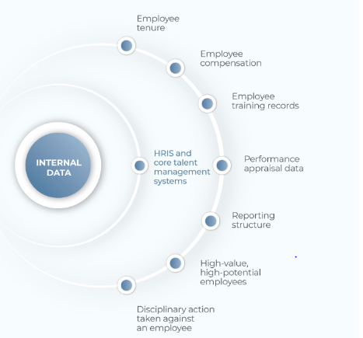
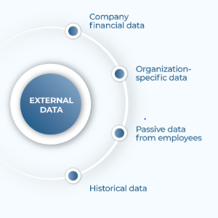
What Data Does an HR Analytics Tool Need?

Slide 14
Tools & Technique
Analytics Technique Tools or Platform
Hypothesis Testing
Linear Regression
Classification
Time Series
Machine Learning Algorithm
Artificial Intelligence
R / R-studio Software
Tableau /QlikView
Python
SAS

Slide 15
Thanks You

