Slide 1
Introduction to Sales Management

Slide 2
Definitions- Sales Management
The management of the personal selling part of a company’s marketing function.
Definition -The process of planning, directing, and controlling of personal selling, including recruiting, selecting, equipping, assigning, supervising, paying, and motivating the personal sales force.

Slide 3
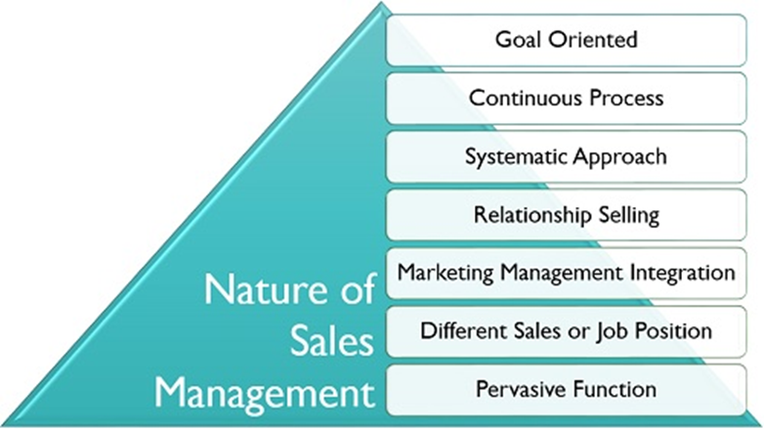
Nature of Sales Management
Head-Marketing
Its Integration with Marketing Management
Manager-
Promotion
Manager –
Marketing Research
Manager –
Sales
Manager –
Market Logistics
Manager –
Customer Service
Notes:
Goal-Oriented: Similar to other management activities, sales management also have a specific purpose and intended for the achievement of specified goals or objectives.
Continuous Process: The sales manager needs to perform sales management functions regularly, and this process is never-ending.
Systematic Approach: It is an organized way of handling the sales function of the company where every problem has a defined and proven solution.
Relationship Selling: The salespeople make efforts to build a strong customer relationship to sell the products or services effectively.
Marketing Management Integration: Marketing is a broader concept; marketing management includes all the activities related to sales management.
Different Sales or Job Position: It is the combined efforts of the whole sales team, including salesperson, sales executive, sales head, sales manager and after-sales service personnel.
Pervasive Function: It is a universally applicable concept which has been adopted and tested by every kind of business organizations.
The 7 steps. The 7 step selling process comprises: ...
Step 1: Prospecting and qualifying. ...
Step 2: Preparation/pre-approach. ...
Step 3: Approach. ...
Step 4: Presentation. ...
Step 5: Handling objections. ...
Step 6: Closing the sale. ...
Step 7: Follow up.

Slide 4
Push/Pull Strategy
A push strategy
It involves the manufacturer using its sales force & trade promotion money to induce intermediaries to carry, promote & sell the product to the end-user.
A pull strategy
It induces consumers to ask for the product.
It uses advertising to involve the intermediaries for the product and is appropriate when there is high brand loyalty & involvement in the category when people perceive differences between brands

Slide 5
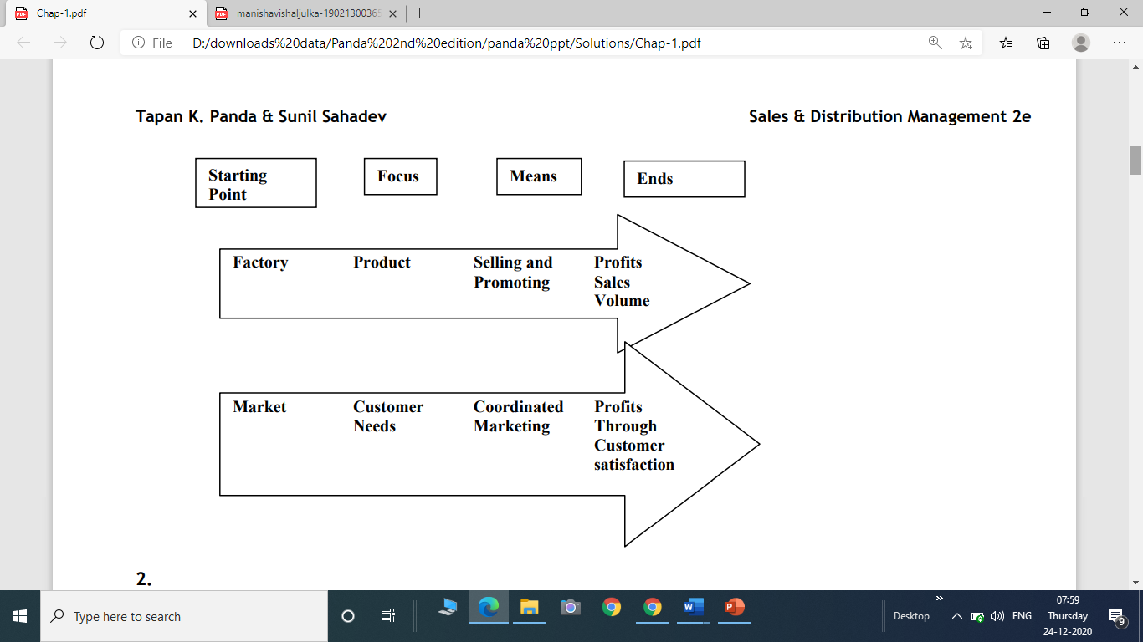

Slide 6
Roles and Skills of a Modern Sales Manager
Roles / functions of a modern sales manager are:
  Coordinate internally and externally.
  EX-Senior level sales manager is a member of the strategic management team.
  Managing multiple sales / marketing channels.
  EX-First level sales manager is a team leader, working with and managing salespeople.
  Using technologies to build superior buyer-seller relationships.

Slide 7
Importance of Sales Management
The only function / department in a company that generates revenue / income.
The financial results of a firm largely depend on the performance of the sales management
Many salespeople are among the best paid people in business.
It is one of the fastest and surest routes to the top management through many positions.

Slide 8
Levels of Sales Management Positions
V. P. Sales /
V. P. Marketing
National Sales Manager
Regional / Zonal / Divisional
Sales Managers
District / Branch / Area Sales Managers
Sales Trainee / Sales Person / Sales Representative
CEO /
President
Top-Level Sales Managers / Leaders
Middle-Level Sales Managers
First-Level Sales Managers

Slide 9
Skills of a Successful Sales Manager
People skills include abilities to motivate, lead, communicate, coordinate, develop team-oriented relationships, mentor, and resolve conflicts.
Managing skills consist of planning, organizing, controlling and decision making.
Technical skills include training, selling, negotiating, problem-solving, and use of computers.

Slide 10
Scope of Sales Management
Narrow Perspective. :
(i) recruiting, (ii) selecting (iii) training, (iv) motivating and (v) supervising salespeople
Broader Perspective.
Includes along with above tasks, following also:
(vi) forecasting sales, (vii) designing sales territories, (viii) coordinating internally & externally, (ix) participating in budgeting & strategic planning processes.

Slide 11
Nature of Personal Selling. It Includes:
(i) Transactional and relationship selling.
(ii) Varying sales positions.
(iii) Sales as a career.
Transactional and Relationship Selling
* Transactional selling focuses on getting
an order or closing the sale.
* Relationship selling builds long-term
relationships with key customers.

Slide 12
Types of Selling
Developmental selling aims to convert prospects into customers.
Developmental selling seeks to create customers out of people who do not currently view the salesperson’s company favorably, and who likely are resistant to changing present sources of supply

Slide 13
Response Selling is a elementary form of selling, common in retailing, in which the salesperson simply responds to the customer's demands; little creativity or persuasion is used.
Creative Selling- an approach to selling in which salespeople aggressively seek out customers and use well-planned strategies to secure orders.
Maintenance Selling -generating sales volume from existing customers.

Slide 14
Cont..
Missionary selling is a form of personal sales in which the salesperson provides information to an individual who will influence the purchase decision.
This is an indirect sales technique; the goal is not to close a sale, but merely to get information into the hands of a key decision-maker.

Slide 15
Consultative Selling
Consultative selling is a sales approach that prioritizes relationships and open dialogue to identify and provide solutions to a customer’s needs.
It is hyper focused on the customer, rather than the product being sold. This technique helps sales professionals better understand the challenges faced by customers so they can position their solutions in a more compelling and effective way

Slide 16
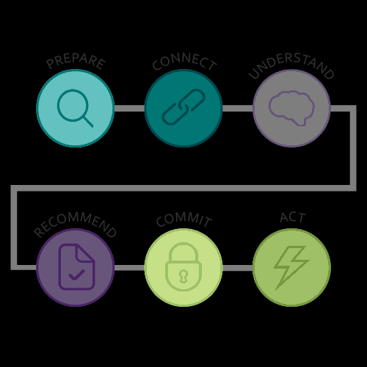
The Consultative Selling Framework

Slide 17
The Consultative Selling Framework
Cont..
Prepare: Effective call planning leads to more productive customer meetings, increased credibility, a shortened sales cycle, and increased sales results.
Using an efficient methodology for call planning helps ensure that each customer call advances the sale.

Slide 18
The Consultative Selling Framework
Cont..
Connect: The connect phase of the sales call opens the meeting, creates an impression, and sets the tone. A strong opening helps build credibility.
Understand: Understanding is at the heart of consultative selling. Sales professionals need to connect with customers, gain and keep their openness and willingness to engage in a dialogue, and ask a full range of questions.

Slide 19
The Consultative Selling Framework
Cont..
Recommend: The way a sales professional positions a specific solution can make it easy or difficult for the customer to understand. It can also make the sales professional sound compelling or boring. To be persuasive, sales professionals need to describe capabilities and solutions using clear, concise, and compelling messaging that links value to customer needs.

Slide 20
The Consultative Selling Framework
Cont..
Commit: Treating closing like a process lowers the risk of rejection and increases the likelihood of gaining commitment and winning the business.
Act: Flawless follow-up with the customer is one of the fastest ways sales professionals can build credibility and differentiate themselves because many sales professionals are not strong in following up. Internal reflection and action planning after the call is necessary to ensure that each customer interaction is fully leveraged in order to learn and plan an appropriate action to win.

Slide 21
Types of Selling
Inside Order Taker
Order
Takers
Delivery Sales People
Outside Order Takers
Selling
Function
Order Creators
Missionary Sales People
New Business Sales People
Front Line
Sales People
Organizational
Sales People
Order Getters
Consumer
Sales People
Sales Support
Sales people
Technical Support sales People
Merchandisers

Slide 22
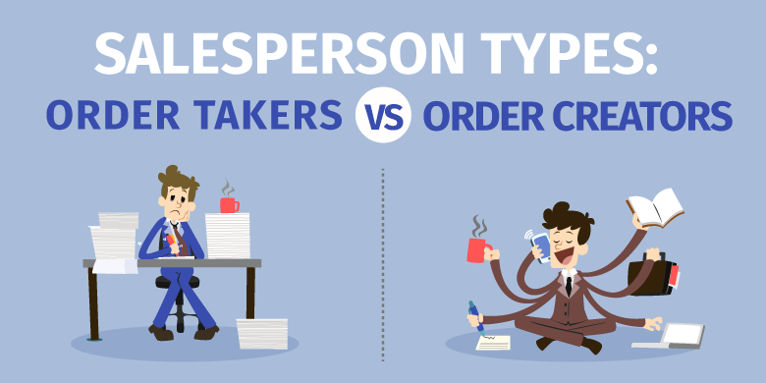

Slide 23
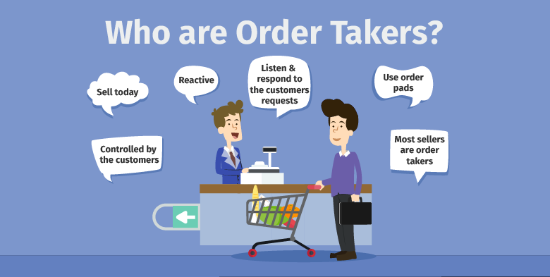

Slide 24
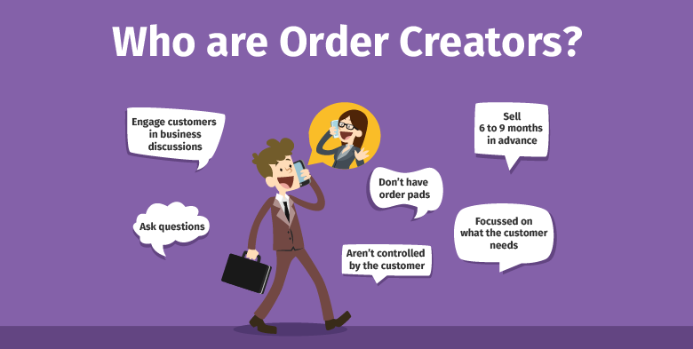

Slide 25
Varying Sales Responsibilities / Positions / Jobs
Sales Position | Brief Description | Examples
Delivery salesperson | Delivery of products to business customers or households. Also takes orders. | Milk, newspapers to households Soft drinks, bread to retail stores.
Order taker salesperson. | Inside order taker. •Telemarketing salesperson takes orders over telephone. Outside order taker. Also performs other tasks. | Behind a counter in a garment shop • Pharmaceutical products’ orders from nursing homes. Food, clothing products’ orders, market information from retailers.
Sales support salespeople Missionary selling Technical selling | Provide information, build goodwill, introduce new products Technical information, assistance | Medical reps. & EXECUTIVES in pharmaceutical industry. Steel, Chemical industries
Creative, Problem-solving, Consultative sellers. | Getting orders from existing and new household consumers Getting orders from business customers, by solving their business and technology problems | Automobiles, refrigerators, insurance policies Software and business solutions.
Key account sales executive | Responsible for few important customers. | OEM customer like Tata Motors for a tyre manufacturer.

Slide 26
Sales Objectives, Strategies and Tactics
Sales Planning Includes
The main components of planning in a company are objectives, strategies and tactics. Their relationship is shown below
Decide / Set
Objectives
Develop Strategies
Evolve Tactics /
Action Plans
.

Slide 27
A company wants to increase sales of electric motors by 15 percent, as one of the sales objectives
Sales Goals / Objectives | Marketing Strategy | Sales and Distribution Strategies | Tactics / Action plans
Increase sales volume by 15 percent | Enter export markets | Identify the countries Decide distribution channels | Marketing / sales head to get relevant information Negotiate and sign agreements in 3-5 months with intermediaries
 | Penetrate existing domestic markets | Review and improve sales force training, motivation and compensation Use effective and efficient channels. | Add channels and channel partners. Train salespeople in deficient areas. Train field sales managers in effective supervision. Link sales volume quotas to the incentive scheme of the compensation plan.

Slide 28
Emerging Trends in Sales Management
Global perspective.
Revolution in technology.
Customer relationship management (CRM) / Sales Force Automation ( SFA )
Sales force diversity.
Team selling approach.
Managing multi-channels marketing systems.
Ethical and social issues.
Sales professionalism.
E-Selling.

Slide 29
Sales Process
Prospecting
Preparation
Approach
Presentation
Handling objections
Closing
Follow-up

Slide 30


