Slide 1

SELLING SKILLS
INTRODUCTION TO SALES

Slide 2


Slide 3
Sell Positive Change
Let us start not by considering what you need to do to become a great salesperson or how good your products or services need to be.
Let us start by thinking about customers and the real reasons why they might spend their money with you.
It is often little to do with technical excellence of your product but because they want to change something!

Slide 4
Many people think selling is a science and want to find a mechanical formula which will always work.
Although there are indeed proven techniques that you can learn selling is much more of an art - it is about behaviours, emotions, communication, and people

Slide 5

Agenda
Define selling & the sales process
How is sales different from marketing?
Difference between a product and a service
Importance of product Information – Financial instruments
Sales and the finance industry

Slide 6
What is Selling?
Selling is a marketing function
Determines client needs and wants
Responds through planned, personalized communication
Influences purchase decisions
Enhances future business opportunities
Notes:
Many people often use the words ‘marketing’ and ‘selling’ as synonyms.
Selling is a marketing function that involves determining client needs and wants and responding through planned, personalized communication that influences purchase decisions and enhances future business opportunities.

Slide 7
Sales Process
Systematic approach involving a series of steps
Enables a sales force to close more deals
Increase margins and make more sales through referrals
It’s a complete cycle
Starts from identifying the customers to closing the deal with them
Notes:
Sales process is a systematic approach involving a series of steps that enables a sales force to close more deals, increase margins and make more sales through referrals. It’s a complete cycle which starts from identifying the customers to closing the deal with them.

Slide 8
The Basic
Sales Process
Gaining Product/Process Knowledge
Prospecting
Approaching
Assessing Needs
Presenting
Closing
Follow Up/On-Boarding

Slide 9
Sales Vs Marketing
Focus
Approach
Competition
Notes:
The selling concept focuses on the needs of the seller while the marketing concept focuses on the needs of the buyer
The selling concept works to turn products into cash while the marketing concept works to satisfy the customers' needs through the product
In the selling concept, competition is predominantly centered on sales while in the marketing concept the competition is centered on consumer satisfaction

Slide 10
Product vs Service
Parameter | Product | Service
Tangibility | Tangible | Intangible
Returnability | Can be returned | Cannot be returned
Storage and Consumption | Can be stored and consumed later | Cannot be stored and consumed later
Ownership | Can have permanent ownership | Cannot have permanent ownership
Comparison | Easy because of relative standardisation | Difficult because of variability
Focus on | Specific Features | Customer Service and Experience
Quality | Controlled by Data | Controlled by Experience
Repeatability | Easy | Difficult

Slide 11
Product vs Service (contdd)
Parameter | Product | Service
Level of customisation | Low in most cases | Extremely High
Value | Value retained for long | Value retained only when service is being experienced
Produced by | Manufacturing Team | Different sets of interconnected departments
Customer Involvement | Fairly Low | Extremely High
Resource Intensity | Capital Intensive | Labour Intensive

Slide 12
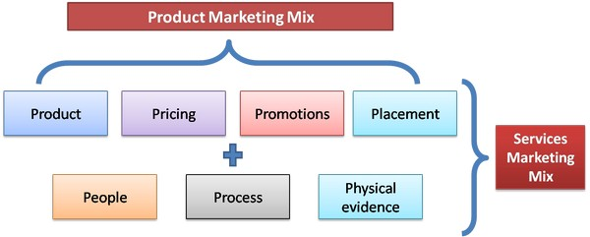
Product vs Service (contdd)

Slide 13
Every successful sale happens because the buyer comes to believe the product or service will make a positive impact
The customer needs to see that the value of your product or service over its price
Be open honest and interested in your customer to build trust

Slide 14
Have you done the segmentation of the Finance industry?
You need to tell me some examples of organizations that are into such services…
Notes:
Let us look at 10 Types of Financial Services from here>>

Slide 15
Banking
Do’s and Don’ts of the Role
Banking is the backbone of India’s financial services industry. The country has several public sector (27), private sector (21), foreign (49), regional rural (56) and urban/rural cooperative (95,000+) banks.
The financial services offered in this segment include:
Individual Banking (checking accounts, savings accounts, debit/credit cards, etc.)
Business Banking (merchant services, checking accounts and savings accounts for businesses, treasury services, etc.)
Loans (business loans, personal loans, home loans, automobile loans, working-capital loans, etc.)
The banking sector is regulated by the Reserve Bank of India (RBI), which monitors and maintains the segment’s liquidity, capitalization, and financial health.

Slide 16
Professional Advisory
Do’s and Don’ts of the Role
India has a strong presence of professional financial advisory service providers, which offer individuals and businesses a wide portfolio of services, including investment due diligence, M&A advisory, valuation, real-estate consulting, risk consulting, taxation consulting.
These offerings are made by a range of providers, including individual domestic consultants to large multi-national organizations.

Slide 17
Wealth Management
Do’s and Don’ts of the Role
Financial services offered within this segment include managing and investing customers’ wealth across various financial instruments- including debt, equity, mutual funds, insurance products, derivatives, structured products, commodities, and real estate, based on the clients’ financial goals, risk profile and time horizons.

Slide 18
Mutual Funds
Do’s and Don’ts of the Role
Mutual fund service providers offer professional investment services across funds that are composed of different asset classes, primarily debt and equity-linked assets. The buy-in for mutual fund solutions is generally lower compared to the stock market and debt products.
These products are very popular in India as they generally have lower risks, tax benefits, stable returns and properties of diversification.
The mutual funds segment has witnessed double-digit growth in assets under management over the last five years, owing to its popularity as a low-risk wealth multiplier.

Slide 19
Insurance
Do’s and Don’ts of the Role
Financial services offerings in this segment are primarily offered across two categories:
General Insurance (automotive, home, medical, fire, travel, etc.)
Life Insurance (term-life, money-back, unit-linked, pension plans, etc.)
Insurance solutions enable individuals and organizations to safeguard against unforeseen circumstances and accidents.
Payouts for these products vary across the nature of the product, time horizons, customer risk assessment, premiums, and several other key qualitative and quantitative aspects. In India, there is a strong presence of insurance providers across life insurance (24) and general insurance (39) categories. The insurance market is regulated by the Insurance Regulatory and Development Authority of India (IRDAI).

Slide 20
Stock Market
Do’s and Don’ts of the Role
The stock market segment includes investment solutions for customers in Indian stock markets (National Stock Exchange and Bombay Stock Exchange), across various equity-linked products.
The returns for customers are based on capital appreciation – growth in the value of the equity solution and/or dividends – and pay-outs made by companies to its investors.

Slide 21
Treasury/Debt Instruments
Do’s and Don’ts of the Role
Services offered in this segment include investments into government and private organization bonds (debt). The issuer of the bonds (borrower) offers fixed payments (interest) and principal repayment to the investor at the end of the investment period.
The types of instruments in this segment include listed bonds, non-convertible debentures, capital-gain bonds, GoI savings bonds, tax-free bonds, etc.

Slide 22
Tax/Audit Consulting
Do’s and Don’ts of the Role
This segment includes a large portfolio of financial services within the tax and auditing domain. This services domain can be segmented based on individual and business clients.
They include:
Tax – Individual (determining tax liability, filing tax-returns, tax-savings advisory, etc.)
Tax – Business (determining tax liability, transfer pricing analysis and structuring, GST registrations, tax compliance advisory, etc.)
In the auditing segment, service providers offer solutions including statutory audits, internal audits, service tax audits, tax audits, process/transaction audits, risk audits, stock audits, etc. These services are essential to ensure the smooth operation of business entities from a qualitative and quantitative perspective, as well as to mitigate risk.

Slide 23
Capital Restructuring
Do’s and Don’ts of the Role
These services are offered primarily to organizations and involve the restructuring of capital structure (debt and equity) to bolster profitability or respond to crises such as bankruptcy, volatile markets, liquidity crunch or hostile takeovers.
The types of financial solutions in this segment typically include structured transactions, lender negotiations, accelerated M&A and capital raising.

Slide 24
Portfolio Management
Do’s and Don’ts of the Role
This segment includes a highly specialized and customized range of solutions that enables clients to reach their financial goals through portfolio managers who analyze and optimize investments or clients across a wide range of assets (debt, equity, insurance, real estate, etc.).
These services are broadly targeted at HNIs and are discretionary (investment only at the discretion of fund manager with no client intervention) and non-discretionary (decisions made with client intervention).

Slide 25

Importance of sharing correct product information
Every product or service sold generates revenue to the company
You customers’ resources are hard-earned and limited in nature
You need to bridge the gap between the organization you represent and customers/clients in the most ethical and faithful manner.

Slide 26
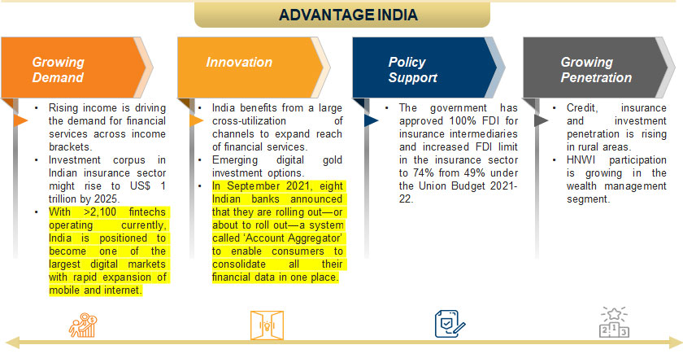
Do’s and Don’ts of the Role

Slide 27
You are the Difference
One of the most powerful ways of winning against the competition is through the relationship that you build with your customers you and the approach you take make the difference

Slide 28
Case Study
Ram's sales manager was unhappy that Ram was not visiting the customers more regularly. Ram thought he could be more efficient just telephoning and sending emails. His boss did not see it like that.
I might as well send out a catalogue instead of employing expensive salespeople he told Ram.
The point of employing Ram as one of the company’s salespeople was that he could build strong relationships and add value to the selling process through person-to-person communication. He could influence the customers decision process and build trust for the longer term.

Slide 29
To give real service you must add something which cannot be bought or measured with money and that is sincerity and integrity.
Be visible. Stay in regular touch with your customers and prospects. This is sometimes called the mindshare. Find reasons to call, visit and keep yourself at the forefront of the customer’s mind.
Keep a balance between pushing and pulling. Pushing means keeping yourself visible without annoying the customer and pulling means drawing the customer into the relationship. For example, by showing empathy being curious and adding value

Slide 30

Do’s of Selling
Do’s and Don’ts of the Role
Features & Charges
Documents
Transparency
Treatment
Customer requirements
Capturing correct details
Punctual
Notes:
DOs
Should explain all features and charges in detail
Should give thorough details of documents which are collected
Should inform rates and charges effectively and transparently
Should not force the customer into taking the loan.
Should be gentle and nice in treatment towards the customers
Pay attention to the customer demands and requirement
Ensure the details like mobile number are correctly captured
Visiting the customer at committed time
OSV is mandatory on KYC, OVD collected
Any referral that customer is willing to provide

Slide 31

Don'ts of Selling
Do’s and Don’ts of the Role
Force
Wrong Commitment
Follow up Time
Incomplete information
Notes:
DON’T
Never to Force any customer into buying the loan
Never to take cash from the customer at any time.
Never to give wrong commitment to the customer
Never to follow with customer before 8 AM and after 7 PM
Don’t mention incomplete information in any document
Don’t force the customer for any other product apart from Vehicle Finance.

Slide 32

Summarize

