Slide 1

SELLING SKILLS
ATTRIBUTES OF A PROFESSIONAL SALES PERSON

Slide 2

Notes:
Play the Human Knot Game
Connect:
Common Goal
Communication
Listening
Coordination
Leadership

Slide 3

Agenda
Teamwork
Effective communication
Assertiveness
Emotional Intelligence
Famous salesmen through the ages

Slide 4
Qualities
Effective Communication
Assertiveness
Team Playing
Emotional Intelligence

Slide 5
Fosters Creativity & Learning
Blends Complementary Strengths
Builds Trust
Teaches Conflict Resolution Skills
Promotes a Wider Sense of Ownership
Encourages Healthy Risk Taking
Teamwork
Notes:
Creativity thrives, Brainstorming ideas as a group prevents stale viewpoints, maximizes shared knowledge, learn new skills, combining unique perspectives from each team member creates more effective selling solutions.
Learning to combine each team members strengths to build complimentary strengths for yourself
Establish strong relationships with co-workers, provides feeling of safety, produces effective solutions in difficult group projects, generates confidence in each other
When trust build, team members are forced to resolve the internal conflicts, instead of involving management
Feeling of accomplishment, sense of pride of their contributions, feels connected with company and workplace which develops ownership
Allows members to take risk as they have support of the entire team to fall back in case of failure

Slide 6
Master your Body Language
Learn to empathize with customer
Never stop improving your knowledge
Get down to specifics
Be honest about what you don’t know
Be inquisitive
Be prepared
Effective Communication
Notes:
A salesperson’s success is linked to his or her ability to communicate clearly, concisely, and openly, while maintaining positive client relationships.
This involves strong presentation skills, the ability to engage in business conversations with customers at all levels, negotiating from win-win stance, and communicating customer needs within their own company.
1. Research shows that more than half of all communication is non-verbal. Every hand gesture, every smile and every change of vocal intonation send a signal to the person you are speaking too. Its important to access your body language flaws. Assess your body language, either by standing in front of mirror, or asking a friend to help you. Work on your stance, hand gestures, and other areas that needs improvement.
2. Empathy means showing you understand customer’s problem, and that you care about helping them solve it. Hear their problem, think about which product is the best match, and present the selling points that are most relevant.
3. When you know your product well, you can: 1. Answer any customer question with confidence, which increases trust of the customer on you. 2. Pick the most persuasive selling points for each customer, based on the information they shared with you about their needs. 3. Impress customer with your overall expertise.
4. Use benefits, numbers, proven statistics, to make the conversation more focused and effective for selling.
5. Apologize, and clear them that you will find out and let them know.
6. Inquisitiveness to ask questions, to understand needs, can give you insights into new needs and ways of approaching to customer with need based solution.
7. Being prepared, means knowing your product, knowing as much as about your customer as possible, and knowing your script thoroughly which you will use for making your sales pitch.

Slide 7

Take the Quiz
Notes:
Communication Style Quiz: What’s Your Communication Style? | BrainFall

Slide 8
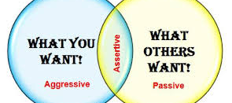
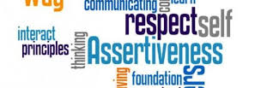
Assertiveness
Establish your presence
Work on your presence
Prepare ahead of time
Active Listening
Control your body language
Trust your judgment
Tone of voice
Time Management
Learn what customers needs are
Be realistic about your aims
Be friendly
Notes:
Establish your presence –
Work on your presence – 55% of the message you send out when you meet people is through your body language, Dress appropriately, make eye contact.
Prepare ahead of time – Know what you want, Practice
Active Listening
Control your body language
Trust your judgment
Tone of voice – Use a clear and calm voice
Time Management
Learn what customers needs are
Be realistic about your aims
Be friendly

Slide 9
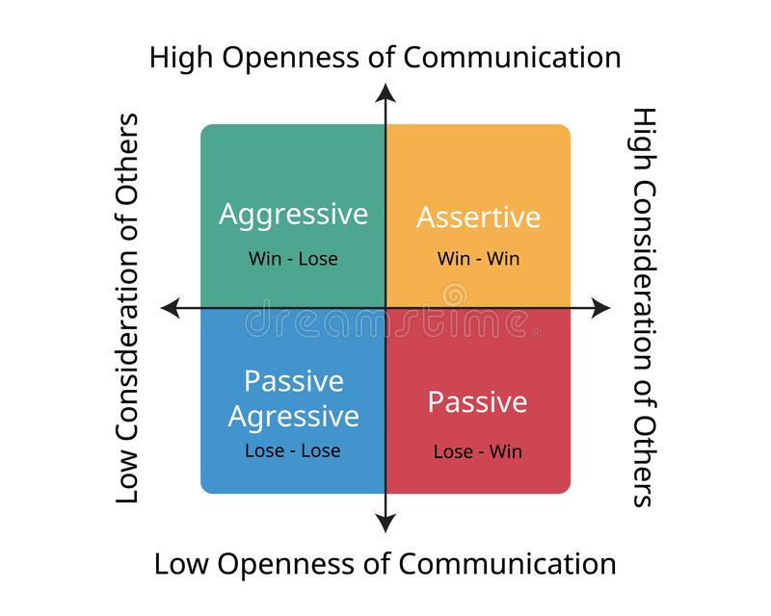

Slide 10
Assertiveness is the ability to honestly express your feelings, thoughts, beliefs, and attitudes while respecting the other person’s wants, needs, and feelings as well.
Few people have perfect communication skills that they implement 100% of the time, and many people could brush up on their assertiveness communication skills.

Slide 11
There are negative repercussions that occur when you don’t communicate assertively – some short-term and some long-term.
Let’s say your friend wants you to come over to her house right away because she’s cleaning but her three kids are on her last nerve. You are currently in the middle of a household project of your own, and you feel as if you always do for this friend, but she rarely does anything for you.

Slide 12
Let’s say you decide to take a passive stance. Once again, you drop the important project you’re working on to drive over and help her out. Initially, you may feel resentful and a bit angry at yourself and at your friend. Your self-esteem takes another hit as you berate yourself with thoughts like, “Why am I always the one who has to sacrifice? Why can’t I just be honest and say ‘No, not now’?”. Those are some of the possible short-term effects.
But studies also show that those who repress their emotions, desires, and needs are more likely to suffer from depression, low self-esteem, loneliness, and even some physical disorders.

Slide 13
If you take an aggressive stance, you might get angry and throw some items around the room or yell at your friend, or at someone else nearby. You might berate, belittle, or otherwise verbally abuse her. Of course, the immediate repercussions of aggressive behavior is that the other person becomes either angry, scared, or guilty. If you regularly engage in this behavior, you’ll probably find yourself alone since people do not want to tolerate such behavior.
Prolonged, excessive outbursts that come from such aggression has also been indicated as a risk factor in heart disease.

Slide 14
If you tend to use passive-aggressive strategies, you’re not really making your desires known. Maybe you state what you want then mask it by saying something like, “I was only joking. Can’t you take a joke?” In essence, you kind of hint at what you need, but you’re basically wanting the other person to guess what it is you want or need.
It’s an ineffective way to communicate, and you’re not standing up for yourself and being honest.

Slide 15
Scenario: Your boss wants you to do your co-worker’s report because she has fallen behind schedule, and he knows you work efficiently. This has happened frequently.
“This is the fourth time this month that I’ve been given extra work because Suzie has fallen behind. I want to be a team player, but I feel stressed when I’m overburdened. What can we do to make sure this doesn’t happen again?”
Stating the facts and expressing your own feelings helps avoid making the other person get their defenses up. Offering to help solve the problem expresses your concerns.
Notes:
Examples
Scenario: Your mother wants you to come over to her house right away so you can help her sort through items she wants to sell at a garage sale. You had planned to spend the evening relaxing, taking a soothing bath, and just lounging around because you’ve had a rough week at work.
“I understand you need help, and I would like to help you. Today, I need to take care of myself because I’m very run-down. I can better help you tomorrow. Would that work for you?”
Part of being assertive is caring for yourself and valuing your needs just as much as the other person’s needs. An assertive person says, “I am worthy of this. I deserve this”.
Scenario: You planned to meet up with your girlfriend to have a nice meal at a restaurant. You get there, but she’s late – again. Every time you make plans, she seems to leave you waiting while she shows up 20-30 minutes after the scheduled meeting time.
“Did something happen unexpectedly that made you late? I feel hurt when I have to wait time and time again because you are often late. It makes me feel anxious and like I’m not a priority. Is there something I can do to help you fix this problem?”
Assertive people use “I” statements instead of hurling blame or insults at the other person. Offering to help come up with a solution lets the other person know that you care.
Scenario: Every day when you come home from work, your husband and kids ignore you and continue doing whatever they’re doing. No one acknowledges you or ask you how your day was.
“I feel sad when I come home and no one seems happy to see me or asks how my day was. I feel lonely and not appreciated.”
Assertive people always state what the problem is instead of assuming that others know what they think, feel, or need.
Scenario: Your teenage son is known to get angry every time you try to tell him to clean up his room or help out around the house.
“I feel overburdened when you don’t pitch in and help keep the house clean and tidy. I understand that you don’t like having me remind you to clean your room, but it’s a task that needs to be done, and everyone needs to do their part.”
Sometimes we don’t express ourselves because we’re afraid of how the other person will react (Will he get angry? Will he not like me if I say this?). Assertive people understand that they have no responsibility for how the other person chooses to react – that’s on them. A normal human being will understand that we all have needs and desires and should be allowed to express them freely.
Scenario: Your boss wants you to do your co-worker’s report because she has fallen behind schedule, and he knows you work efficiently. This has happened frequently.
“This is the fourth time this month that I’ve been given extra work because Suzie has fallen behind. I want to be a team player, but I feel stressed when I’m overburdened. What can we do to make sure this doesn’t happen again?”
Stating the facts and expressing your own feelings helps avoid making the other person get their defenses up. Offering to help solve the problem expresses your concerns.
Scenario: You work full-time, have 3 small kids at home, and you teach yoga classes two nights a week. Some members of your church are badgering you to get involved in a fundraiser they’re having that requires a lot of work.
“This is not a priority for me. I will help out on the next fundraiser if I have time.”
Assertive people know that it’s perfectly fine to say no to something you don’t want to do. Explaining why you’re declining may be helpful, but it’s not necessary. Acquiescing doesn’t do anybody any good.
Scenario: Your brother-in-law asks to borrow $500 and you doubt he has a history of defaulting on his financial obligations.
“My policy is to never lend money to friends or family members”.
Using a “policy statement” is a good way to express your core beliefs and delineate what you will and won’t do.
Scenario: Your spouse is yelling and complaining that you’re not devoting enough time and attention to the household. He launches into a long list of what he perceives to be your character flaws.
“I see you are angry. I hear you saying that you think I should spend more time doing ___. However, I disagree with you, and here’s why.”
Assertive people don’t get caught up in anger or strong emotions. They acknowledge the other person’s thoughts and feelings, but then honestly express their own as well.
Scenario: Someone in the car you are riding in decides to sing offkey and continues doing it for 20 minutes. It begins to get on your nerves and you politely ask her to stop, but she doesn’t.
“I know you like to sing, but I simply can’t tolerate it right now. If you don’t stop, I’m going to stop the car and get out.”
Sometimes being assertive involves telling the other person the consequences of their actions. It’s alright to assert your needs and follow through with action that solidifies your own beliefs and desires.
Being assertive is something everyone gets better at the more they practice. No one responds assertively 100% of the time. When we get angry, we might slip into an aggressive mode. When we find ourselves in a situation where we face authoritative people, we might slip into passive mode. Your goal should be to practice your assertiveness skills and bring them into your relationships more and more. Maybe you have no problem being assertive with your family, but you have trouble with it at work. The most important part of being assertive is taking the time to notice how you feel and realize that you have the right to be true to yourself and express your thoughts and desires honestly.

Slide 16
2. Scenario: Your teenage son is known to get angry every time you try to tell him to clean up his room or help out around the house.
“I feel overburdened when you don’t pitch in and help keep the house clean and tidy. I understand that you don’t like having me remind you to clean your room, but it’s a task that needs to be done, and everyone needs to do their part.”
Sometimes we don’t express ourselves because we’re afraid of how the other person will react (Will he get angry? Will he not like me if I say this?). Assertive people understand that they have no responsibility for how the other person chooses to react – that’s on them. A normal human being will understand that we all have needs and desires and should be allowed to express them freely.

Slide 17
Could you give me a call when you've made a decision?
Would you mind if I sent you a brochure to help you decide?
How about I call you in a few days to see if you've made a decision?
Which sales approach is this?
The passive approach does not move the sale forward but instead creates a next step that's irrelevant to the decision-making. Sellers take the passive approach out of fear of losing the sale, fear of offending, and fear of, well–pretty much fear of selling.
Notes:
When you're moving a sale forward, it's a mistake to be either too passive or too aggressive. Instead, be assertive, which is a completely different thing altogether.

Slide 18
If you don't buy now, the offer is off the table.
If you don't want to do business with us, please tell me so we won't be wasting our time.
What do I need to do to decide now?
Which sales approach is this?
The aggressive approach often antagonizes customers. Even if the customer decides, he or she may resent being pressured–and often as not will find a way to get out of the deal or delay it until the pressure is off.
Notes:
When you're moving a sale forward, it's a mistake to be either too passive or too aggressive. Instead, be assertive, which is a completely different thing altogether.

Slide 19
Can you give me a specific date when you'll decide?
What factors might cause the delay in the decision-making process?
What steps will you be taking in order to decide?
Which sales approach is this?
The assertive approach is neither pushy nor flaccid, but instead creates a discussion that helps you and the customer better understand what's going on, and what you can do to help the decision-making process along.
Notes:
When you're moving a sale forward, it's a mistake to be either too passive or too aggressive. Instead, be assertive, which is a completely different thing altogether.

Slide 20
Take the Quiz

Slide 21
Developing Emotional Intelligence - YouTube

Slide 22
Know Yourself
Schedule Downtime
Cultivate Empathy
Maintain Assertiveness
Earn the reward
Do a reality check
Boosting EI
Notes:
Customer satisfaction and future business is based on an emotional connection with the salesperson. Customers who like their salespersons are 10 times likely to continue to purchase or do business. Salespeople need to posses both high-concept and high touch skills in order to sell today. High concept is the ability to synthesize data, recognize trends and patterns, and transfer them to creative solution. High touch skills are connected to emotional intelligence skills, such as critical thinking, problem solving, and relationship building.
What is Emotional Intelligence –
Is the ability to recognize, understand, and manage our own emotions, and recognize, understand, and influence the emotions of others.
Boosting Your Emotional Intelligence Quotient –
Know Yourself – Identify your hot buttons and the situations that trigger you to react in a way. Make a plan for acting professionally and productively once those arise.
Schedule Downtime – Regularly unplug yourself so that you can clear your head and get in touch with yourself.
Cultivate Empathy – Buying is an emotionally charged process and call upon patience to get you through frustrating parts of prospecting and selling. Cultivating more empathy for your buyers, you can better prepare for conversations and interactions that are more likely to resonate with them. Better understanding your prospect’s emotions will make you better at working with them.
Maintain Assertiveness – Being assertive, means you stick to ground rather than give up under situation of pressure or stress.
Earn the reward – Delayed Gratification – Working on this is critical while prospecting and working on opportunity over an extended time because the reality is that you likely aren’t going to instantly get what to want. It make you better at managing your time because you understand you need a formal plan for being productive and achieving your desired outcome.
Do a reality check – Doing timely reality check on the consistency in business development approach, engaing prospects in relevant conversations, uniqueness and personalization in value proposition for each prospect.

Slide 23

Self-Awareness
Self-awareness is the ability to identify and understand one’s own emotions and the impact they may have on your actions and on other people.
A self-aware salesperson is better able to manage their time and energy around their emotional states. They are less likely to anger or annoy a potential customer with their own negative emotions. And they bounce back from disappointment and rejection faster than sales reps who ignore or are unaware of their negative feelings.
Notes:
Emotionally intelligent sales professionals perform better than their non-emotionally intelligent peers.
To understand why that is, let’s take a look at how the 5 types of EQ affect sales performance.

Slide 24

Self-Regulation
Self-regulation, also referred to as impulse control, is the ability to control and adapt one’s own emotions to fit the situation or to avoid disrupting others.
A self-regulated salesperson can avoid bringing their negative emotions such as fear, anxiety, or irritation to sales conversations. They are better able to adapt their behavior to the needs of their job. And they’re capable of generating enthusiasm and motivation over the long term to fuel their job performance.

Slide 25
Social Skills
Social skills are the ability to have social awareness, make meaningful connections, build rapport, and maintain relationships over an extended period of time.
A sales professional with strong social skills will be successful at prospecting because they’re able to maintain a larger, stronger network from which to draw sales opportunities. They’ll be good at collaborating and cooperating with their peers. And they’ll know how to “read a room” and make adjustments to their own behavior to get the outcomes they desire.

Slide 26
Empathy
Empathy is the counterpoint to self-awareness. It’s the ability to identify and understand other people’s emotions, and the desire to respond to them productively.
An empathetic salesperson is good at judging how the customer or prospect is feeling, so that they can adapt their approach and steer conversations in the right direction. Empathy also helps the salesperson visualize the customer experience to better understand their needs, their goals, and their pain points so that they can address them in the most effective way.
Notes:
Note: For a salesperson to be effective, their empathy levels shouldn’t be too low or too high. After assessing thousands of salespeople, we’ve found that too much empathy can cause a rep to be overly sensitive to the feelings of others, resulting in avoidance during the sales process.
For example, they may avoid:
Asking who else is involved in the decision-making process
Inquiring about budget
Asking for the business because they feel the other person may find it rude, pushy, or confrontational

Slide 27

Motivation
Motivation is the internally generated desire to complete a task or accomplish a goal.
Salespeople with strong motivation get more done in a day. They respond better to rejection and seek out training and opportunities to improve their skills. They embrace new behaviors and activities that help them reach their goals. They listen to coaching and apply it to their work. And they pursue promising leads and follow up on opportunities more assertively than their peers.

Slide 28
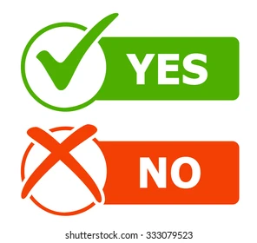
Express openly and respectfully without fear of offending others
Flexible
Open to creativity and consistent about it
Active listening in meetings is the norm
Lending a compassionate ear when needed, as we all have bad days
Notes:
High EI
People express themselves openly and respectfully without fear of offending coworkers
Resilience is evident when new initiatives are introduced
Flexibility is present
Employees spend time together outside of work
Freedom of creativity is celebrated and consistent
Active listening in meetings is the norm
Employees will find a compassionate ear when needed, as we all have bad days

Slide 29
Emotional outbursts, typically out of proportion to the situation at hand
Difficulty in listening to others
Believing that others are overly sensitive
Difficulty maintaining friendships and other relationships
Stonewalling, or refusing to see other’s points of view
Notes:
Examples of people with Low EI
A person with low EQ will likely have emotional outbursts, typically out of proportion to the situation at hand.
People with low EQ also have difficulty listening to others.
Becoming argumentative is another example of behavior that is elicited from someone with low EQ.
Another sign of low EQ is blaming others.
Another example is believing that others are overly sensitive because the person with EQ cannot understand how others feel.
Difficulty maintaining friendships and other relationships with others is another sign.
Stonewalling, or refusing to see other’s points of view, is another example.

Slide 30
Emotionally intelligent sales professionals are:
Aware of their own strengths and weaknesses
Resilient and able to bounce back from setbacks and losses
Capable of establishing and maintaining strong internal and external connections
Assertive in obtaining what they need to do in their work
Eager to learn and apply new skills to improve their performance
Capable of generating their own internal motivation
Skilled at recognizing other’s behavior styles and adapting their own to match
Notes:
How to Develop EQ on Your Sales Team

Slide 31
The definition of a great salesperson varies…
As the stereotype goes, the archetypal salesperson is extroverted, aggressive and pushy among other traits. Are these the qualities and qualifications of a great salesperson? The best way to learn what defines a great salesperson is to consider examples of famous salespeople and identify their defining traits. Let’s take a look at 3 of them…

Slide 32
Mary Kay Ash
American businesswoman and founder of Mary Kay Cosmetics, Inc
Highly famed for developing the very first multi-level marketing strategy, Mary Kay Ash is considered a pioneer for businesswomen. Ash had humble beginnings, selling books door-to-door.
Her main sales tactic involved convincing women to host parties where they would sell to their friends. The principle behind this was that people are more likely to buy from friends rather than strangers. Another signature strategy was the use of sales incentives. Her company made headlines for awarding the top salesperson with a pink Cadillac.
Due to frustrations at her workplace that kept her from advancing because she was a woman, she founded her own cosmetics company. Here she applied her sales philosophies. One of her rules was to treat others as you want to be treated. By its second year, the company sold almost $1 million worth of products and has received countless accolades since then.

Slide 33
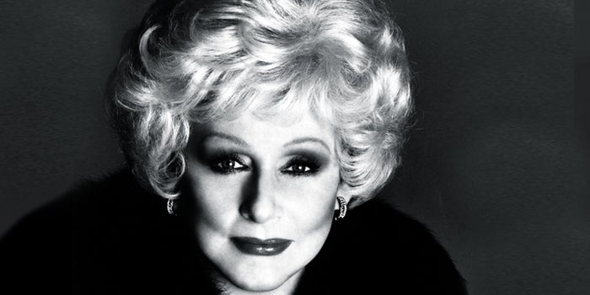
If you are in a position of power, empower the people around you and offer incentives and rewards for great performance. Treat everyone as you would like to be treated and use frustrations as opportunities. And always expand your network to increase sales.

Slide 34
Dale Carnegie
Most highly famed for his book “How to Win Friends and Influence People” Dale Carnegie came from a really humble background. In spite of this, he realized early on that he had a way with words and went on to become a pioneer in modern sales.
He was so good at public speaking that his college mates were willing to pay him to get his skills. Soon, he started adult public speaking classes, and two years afterward, he founded the Dale Carnegie Institute. The book mentioned at the onset was his second and has sold over 8 million copies to date.
He outlined lots of social and business lessons in the 1936 book which still remain relevant to date for salespeople.

Slide 35
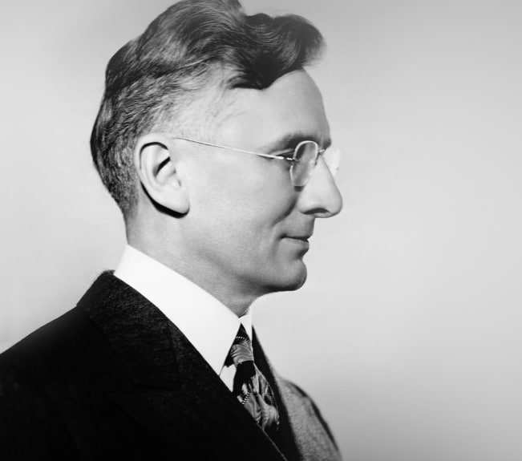
Carnegie believed that influence began with relationships and that to engage someone, you need to make them feel important.
His sales secret to success was to show genuine interest in people, asking questions, remembering names, and avoiding flattery.

Slide 36
Zig Ziglar
One of the world’s most popular motivational speakers, Zig Ziglar, left a rich sales legacy in the form of books, recorded speeches and so much more. He started out as a humble salesman, becoming exceptionally good at it, and later went on to be a renowned author.
As a salesperson, he started out selling pots and pans, and later cooking equipment. Following his success at sales, he became field manager and later, supervisor. Later, he left sales to become a full-time public speaker and then started authoring books.
In his lectures and writings, he taught attitudes needed to succeed in life and professionally.

Slide 37
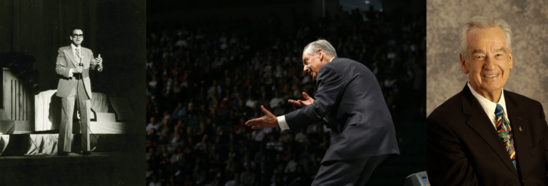
Confidence in your ability to help others, being able to showcase your value to prospects and the ability to get up when knocked down are the qualities that make famous salespeople what they are.
He also emphasized the value of teamwork saying you can achieve more with others than you can alone.

Slide 38

Summarize

Slide 39

Lessons from the Movie
Notes:
The participants watch the movie from Rocket Singh and talk about some important lessons learnt.

Slide 40
Thank You

