Slide 1
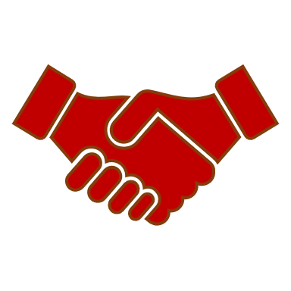
SELLING SKILLS
SESSION 4
UNDERSTANDING CUSTOMER BASE

Slide 2
One of the most common mistakes made by salespeople, even those with years of experience is trying to sell to the wrong people.
Identifying the individuals who have the power to make change happen and the value of analysing the customers organization to discover the roles that people play in the buying and selling process is important.

Slide 3
Understand your Customer
Because salespeople are often under pressure to find new prospects and constantly add more opportunities to the pipeline. they find themselves tempted to chase every possible sales lead
Not everyone who expresses interest actually has the authority motivation and ability to buy .

Slide 4

Agenda
Customer profiling – why is it necessary?
Demographics & Segmentation
Types of customer personalities
Handling different types of customers
Influencers

Slide 5
Customer Profiling
Business marketing tool
Understand customers
Better business decisions
Description of customers
Set of attributes
Notes:
Customer profiling is a marketing tool that businesses use to understand their customers and helps to make better business decisions. Profiling results in customer profiles which provide a description of your customers based on a set of attributes. You can group similar profiles by shared characteristics such as demographic, geographic, psychographic and behavioural characteristics.

Slide 6
Why profile customers?
Who they are
What they look like
Interests and wants
Characteristics
Behaviour
Traits
Notes:
Why profile your customers?
Customer profiling will help you to understand your customers, highlighting who they are, what they look like, their interests and wants. This insight will help you to recognise your customer’s characteristics, behaviour and traits. Having a better understanding of your customers, you will understand what they are interested in and will be able to communicate with them more effectively.

Slide 7
Customer Segmentation
Approach
Needs
Communication
Notes:
Understanding similar traits amongst your customer base enables you to segment them into similar groups by shared characteristics and traits. The benefit of customer segmentation is that you can target each customer segment with a bespoke approach rather than a one size fits all technique. Targeting by specific segment makes it easier to communicate with your customers with message relevant to them, providing a more personalised approach with appropriate marketing communications

Slide 8
Types of customer segmentation
There are different factors of segmentation that should be given careful consideration. These are not one-size-fits-all, and you should do what is right for your business.
Customer segmentation can be broken down into two types:
Segmenting customers based on who they are
The process of understanding who customers are typically focuses on demographics. This will include factors such as:
Age
Geography
Urbanization – are they city or rural?
Income
Relationship status
Family
Job type

Slide 9
Segmenting customers based on what they do
You can also segment customers based on how much they spend (share of wallet), how often, and what products (this allows you to see how much you can increase spend). This is more behavior focused.
Breaking this down even further, behavior can vary and you might want to look to separate as follows:
Basket size
Share of wallet
Tenure (how long they stay with you)
Longterm loyalty (a function of share of wallet and tenure)
Notes:
6 types of customer segmentation models
Common customer segmentation models range from simple to very complex and can be used for a variety of business reasons. Common segmentations include:

Slide 10
The five types of market segmentation include:
Behavioral Segmentation
Psychographic Segmentation
Demographic Segmentation
Geographic Segmentation
Firmographic Segmentation

Slide 11
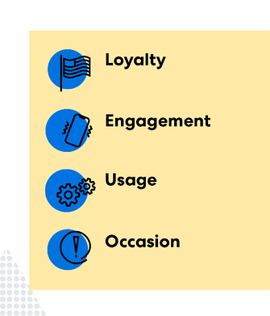
Behavioral segmentation digs deeper into customers' purchasing habits
Behavioral segmentation comprises behavior patterns, like customer loyalty or engagement level, specific to customer interactions with a brand or company.

Slide 12
Behavioral Segmentation Examples
Benefit(s) sought from product or service
Readiness to buy or purchase
Usage-based segmentation
Common characteristics
Notes:
You can use behavioral segmentation to gain insights into customer experience, allowing for improvements in customer success. Some questions to consider:
How engaged are shoppers throughout the customer journey?
What specific trends in timing or occasion do your customers tend to prefer your products?
How much time are your customers spending in the buyer’s process?
How does your business define a "good customer?"
Behavioral segmentation is also used for marketers to determine future customer leads and prospects in the market who are more likely to purchase your product.

Slide 13
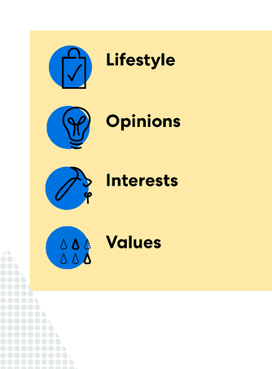
Psychographics is a type of customer segmentation that focuses on inner or qualitative traits.
Psychographic attributes are the ones that aren’t obvious just by looking at your customer.
Instead, psychographics requires deeper analysis.

Slide 14
Psychographic Segmentation Examples
Habits
Hobbies, activities, or interests
Values or opinions
Personality or attitude
Lifestyle
Social status
Notes:
By defining a customer persona this way, you’ll be more equipped to tailor your marketing strategies. And, you’ll appeal to customer tastes.

Slide 15
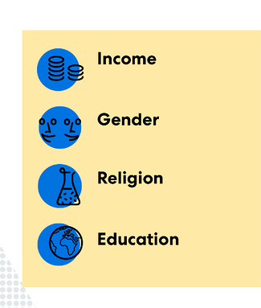
Demographics are the breakdown of your customer personas in the market for cursory traits like age or gender.
These traits offer basic information on your customers and are often considered one of the broader segmentation types.

Slide 16
Demographic Segmentation Examples
Occupation
Marital status
Political party status
Race
Religion
Living status (if your subject is a homeowner or renter)
Age
Income
Family size
Education
Gender

Slide 17
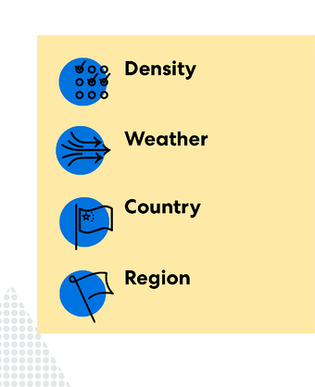
Geographics are the study of your customer based on their physical location, which can affect more physical interactions in the market.
Consumers grouped in similar areas may share similar preferences.

Slide 18
Geographic Segmentation Examples
City
State
Country
Population density
Economic status
Zip Code
Regional climate
Notes:
However, geographic segmentation can also include geographic regions that aren’t technically defined, such as neighborhoods.
For example, consider a company that is advertising a lawn care service that utilizes a subscription model. The company would likely be more successful in targeting a suburban area where residents need extra yard care. The campaign would be less successful in an urban area, where consumers might be more interested in a food delivery service.

Slide 19
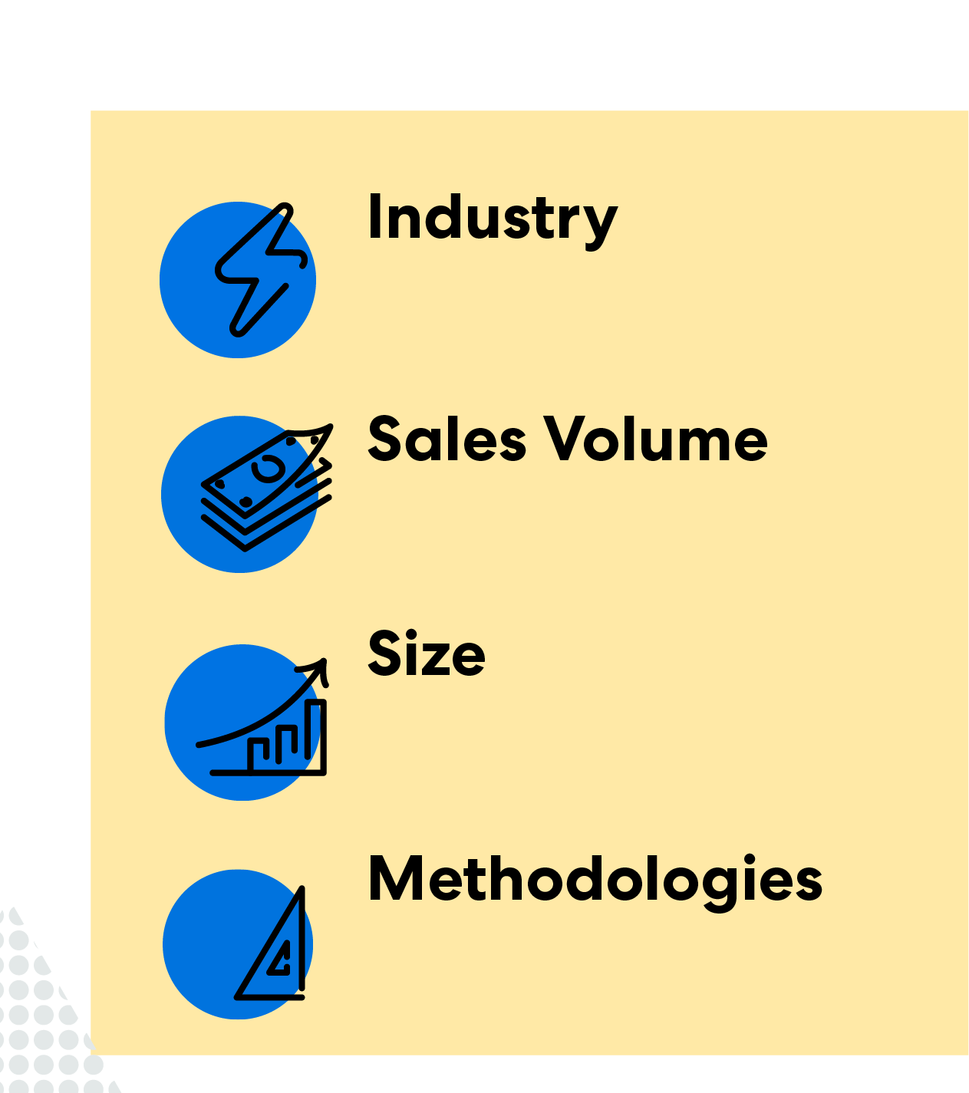
You can use firmographics to describe the attributes of firms or businesses. Firmographics are to firms and investors as demographics are to people.
Companies can use this type of segmentation to determine whether a smaller firm is apt for an investment.

Slide 20
Firmographic Segmentation Examples
Performance and annual revenue
Average sales cycle
Size and employee population
Ownership (public, private, government, etc.)
Organizational trends

Slide 21
Common Segmentation Mistakes to Avoid
Making your segments too small or specialized
Segments that are too small will be more challenging to organize or inaccurate, and they can distract from your objective.
Not allowing your segments to change
Stay focused on ROI. If your strategy isn’t working efficiently for your business, it may be time to switch things around.
Ignoring new potential personas
Customer profiles change. Try not to get too attached to your segments, as they will evolve with the market.
Notes:
Common Segmentation Mistakes to Avoid
Once you’ve created segments, keep an eye out for common mistakes that marketers and researchers make.
Making your segments too small or specialized
Segments that are too small will be more challenging to organize or inaccurate, and they can distract from your objective. Like sample size, an over-segmented group can yield data that is not statistically or directionally significant.
Not allowing your segments to change
Stay focused on ROI. If your strategy isn’t working efficiently for your business, it may be time to switch things around.
Ignoring new potential personas
Customer profiles change. Try not to get too attached to your segments, as they will evolve with the market.

Slide 22
Customer Profiling
Transactional data
Identify patterns & trends
Develop a strategy
Improve return on investment
Notes:
Customer Profiling and Transaction Analysis
Once you have developed a profile of your customers you can then analyse transactional data to identify patterns and trends amongst your customers by segment. As a result, your customer profile is not only based on demographic information but also takes into account past behaviour.
You can analyse your customer profile by product type, value, frequency and patterns of spend. Analysing the different patterns of behaviour or spend by customer profile, provides a clear picture of your most profitable customers. Once you understand who your best customers are, you can develop a strategy allocating the resource you would like to allocate for each segment group. Optimising your marketing budget and improving return on investment.

Slide 23
Acquiring Customers
Prospects
High propensity
Cost-effective means
Target new customers
Notes:
Using Customer Profiling for Prospect Acquisition
After you have identified the profile of your best and most profitable customers, you can then find look alike prospects and target them in an effective manner. These prospects should have a higher propensity to take up your offer and therefore provide a more cost-effective means of targeting new customers.
In conclusion, customer profiling and segmentation provide the tools to fully understand your customer base, improve customer engagement and target look alike prospects.

Slide 24
Case Study
Allison represented a large software company as the account manager for British Telecom an enormous UK company
she made it her business to try to talk to every part of their organization and make contacts at many levels of their hierarchy . it took some time but eventually she had formed a pretty good picture of how these different teams and departments influenced each other and even competed against each other .
One day a British Telecom Director told Allison that he always enjoyed speaking to her because she knew more about how their company worked than he did.

Slide 25
Understand your Customers and their Organization
Whether you are approaching a new prospect for the first time or selling to an existing customer it is vital to understand the personal preferences if it is B2C and who are the decision makers and how the organization is structured if it is a B2B.
Remote Profiling

Slide 26
Understand your Customer’s Organization
Whether you are approaching a new prospect for the first time or selling to an existing customer it is vital to understand how the organization is structured and who does watch doing this will help you target the right people with the right messages .

Slide 27
Know the Rules that Buyers Play
User. This describes anyone who is simply the intended user of your product or service think of them as the ultimate end customer within the organization don't overlook them, they have very valuable information to give you about how your product or service might benefit their organization
Influencer. Anyone whose opinion is respected and who has particular knowledge or interest in your product can be an influencer of a buying decision. often more senior people who make the ultimate decision will rely heavily on people they trust to advise them .

Slide 28
Know the Rules that Buyers Play
Coach. The term coach is used to describe someone who for whatever reason wants to help you win the business. they may particularly like your company or product or dislike the alternatives perhaps they believe that supporting you is the best way to influence the decision.
Blocker. The opposite of a coach these people will either be positively obstructive or just never do or say anything useful to help you perhaps because they are afraid of change or have some other personal reason not to want you to succeed. they will waste your time so try to spot them early on

Slide 29
Know the Rules that Buyers Play
Technical decision maker. This describes someone with the responsibility of making the product decision first and foremost . Usually they are middle managers tasked with evaluating and deciding which technical solution is right for them
Business decision maker. Usually, the owner of the business problem or paying this person is likely to be the senior manager responsible for business functions that will benefit from your product or service
Financial decision maker. Usually, the finance director is the person who controls the final decision about whether the money has to be spent

Slide 30
Identify the agents of change
Despite vote many salespeople think it is not always the person with the most senior job title who holds true authority in a buying decision
In fact it may be a mistake to rely solely on people's job titles as a guide to who wwields the authority to buy
Look for the rare individuals who combine authority with a willingness to change

Slide 31
Get Access to Authority
Ideally it should be your goal to seek access to those with authority to make buying decisions even though we will also need to form relationships with people in other buyer roles who will influence them
Make every effort to network your way upwards

Slide 32
Customer profiles in Finance Context
HNI
NRIs
Business / HUFs
Partnerships / Sole-Proprietors
Life Stages of Customers
MSMEs

Slide 33
5 Types of
Difficult Customers
Irate
Talkative
Mistaken
Elitist
Positive
Notes:
Here are the five different types of customers you might encounter
1. The irate customer
Known for their anger that explodes as soon as you pick up the phone, irate customers are among the most common callers you'll encounter. Some of them may be fuming even before they begin their interaction with your call center. Others, on the other hand, were only annoyed at the start of the call but got increasingly aggravated with every unanswered inquiry, unnecessarily long hold times, and call transfers.
2. The talkative customer
Talkative customers are the bane of a call center's productivity, as they can slow transactions down. These customers tend to drone on about topics unrelated to the issue they're discussing with agents. Because conversations with them take too long, you may have to put other queued customers on hold. This means you'll be losing the opportunity to help other customers.
3. The mistaken customer
This type of customer insists that they know more than you do, but in fact, they may be misinformed. So when given a solution, they might not believe you immediately. This makes it hard for agents to deal with them.
4. The elitist customer
Elitist customers don't like dealing with frontline agents, as they think that the problem they're facing are too special or too complex for employees to handle. Thus, after explaining things to them, you may hear them say, "I want to talk to your supervisor" instead of giving your recommended solutions a shot.
5. The positive customer
This type of customer is the best one there is. They are friendly customers who just want to get their problems fixed. Customers with a positive mindset can be beneficial for your company. They can provide you insights regarding your products, services, or business, which can help your company grow. They can be your brand's promoters as well. Just continue giving the best service to them and they'll likely to stick to your brand.

Slide 34

Notes:
Tips to communicate with them
1. The irate customer
The key to interacting with this kind of customer is to be calm throughout the call. The trouble will only escalate if you let your own irritation and impatience take over the conversation. Instead, assure the customer you know how to solve the problem, and then provide a solution as soon as you can.
2. The talkative customer
To maintain control over the conversation with a chatty caller, focus on the reason why the customers called. Should the conversation digress from the topic, politely redirect the discussion back to the main issue.
3. The mistaken customer
Telling them outright that they're wrong can easily anger them, so it's best to make them feel that you're their ally in uncovering the answer they need. Be careful not to come off as high and mighty. Be polite as you explain to customers how the solutions you recommend can help them better.
4. The elitist customer
When handling this type of customer, assert that you are qualified to fix their issues, but do so in a polite manner. If the problem can be solved without a manager's intervention, inform them that it's not advisable to escalate the call to a supervisor. Make sure, however, that you can thoroughly address their issues.
5. The positive customer
It's important for call center reps to know how to handle customers with varying personalities in order to ensure that interactions will go smoothly. Be intuitive and adapt an effective strategy in handling different types of customers. That way, you can keep all clients happy and loyal to your brand.

Slide 35

Summarize

Slide 36
Thank You

