Slide 1

SELLING SKILLS
Identify Customer Needs

Slide 2
Being customer-focused help in understanding customers better and align offerings to create great value. You can not persuade consumers without knowing what they are looking for. Identifying and meeting customer needs should be the focal point of every business to build a solid customer base.
Once you have a clear knowledge about the same, you can further use it to persuade your customers.

Slide 3
The more you know about your customers, it helps you in positioning offerings around their needs:
Provide faster solutions – One of the common things customers want is real time support. By identifying the needs of your customers, you can provide faster and effective support.
Improve your products & services – Customer research helps understand the motives behind the buying process. You can learn about the areas you are missing out and create an effective USP. The insights can be used to enhance the products or services to satisfy customer needs.
Reduce the number of support tickets – Building the product and services considering the needs of the target customers ensures effective solutions to customer issues

Slide 4

Agenda
Identify Customer Needs
Listening skills
SPIN Technique
Probing and questioning skills

Slide 5

Types of customer needs
Customer needs can be classified on the basis of customers of the market demographics. However, customer needs can be bifurcated under two verticals.

Slide 6
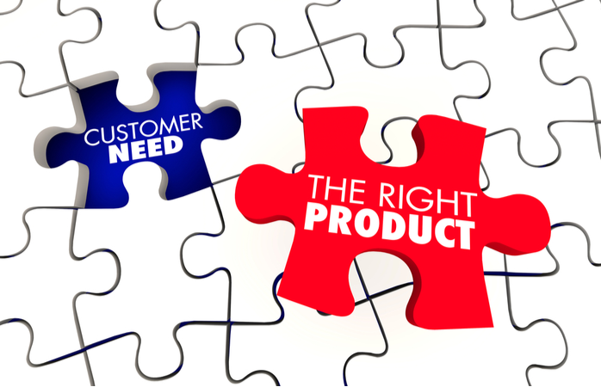
Product needs
Product requirements are associated with and around the product. If your product matches your customer needs, they become your potential buyers and vice-versa. The main attributes of product needs can be:
Price – Customers generally set their budgets for any product purchase.
Features – Customers look for features that would solve their problem and reliability in functioning while using the product.
Effectiveness – The product should be effective in streamlining the process to save time.

Slide 7

Service Needs
Service needs refer to the emotional needs of the customers. Being able to quench the customer service needs, can give your business a competitive edge and set good example for other brands to follow. The key attributes of good service can be:
Empathy – Customers stick to brands that serve them with an empathetic attitude.
Clarity– Customers look for transparent information from the brand related to pricing, refund policy, etc.
Information – Customers need information from the point of interaction until the end. Build FAQ pages, Knowledgebase, how-to videos to educate the customers

Slide 8

Why are Questions So Important?
The best kind of salesperson is the problem solver, and we have to ask great questions and take the time to listen so that we can decide how best to help identify a prospect’s needs and the best solution.

Slide 9

Great questioning techniques…
Establish the prospect’s objectives, goals and thought processes
Are successful in maintaining a 30%-70% balance in sales discussions
Help you maintain control of the sales meeting
Encourage or prompt buying signals
Assist in handling and overcoming objections
Help in closing the sale
There are various traditional types of questions that have always been used in the sales process.
These questions help salespeople to strengthen sales presentations and meet the needs of their potential customers.

Slide 10
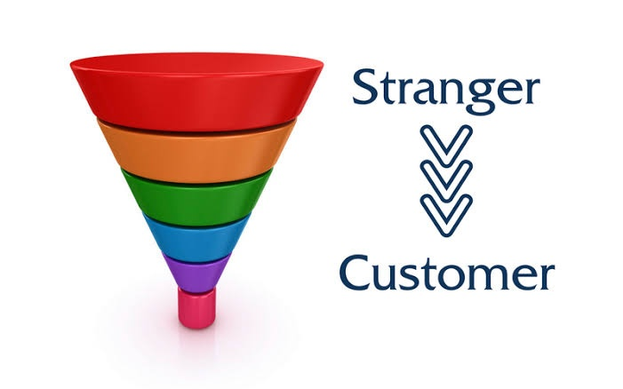
The Question Funnel
Imagine a funnel: at the top we ask broad, open-ended questions, then we drill down into more specific questions before we offer solutions, check we’re on track and then get into the detail of the sale.

Slide 11

Open-ended questions
Open questions are questions the prospect cannot answer just with a YES or NO reply. They prompt more detailed answers, therefore giving you more information which, if you listen and notice, will help you to direct the meeting more your way.
Open Questions often begin with WHY, WHEN, WHERE, WHAT, WHO AND HOW?
We do need to remember to avoid using a “20 Questions” approach. Use questions naturally in a conversational manner aiming to create a feeling of your genuine interest in them. Use question “softeners” like:
“Can I just ask … ?”
“By the way … “
“Incidentally … “

Slide 12
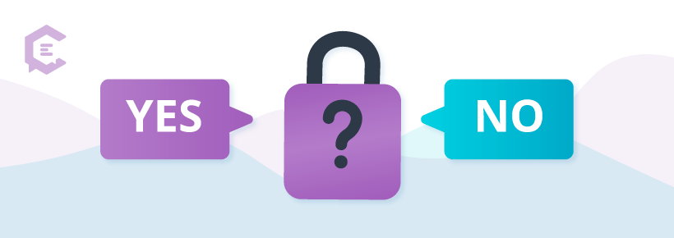
Closed questions
Closed questions will add value to a sales meeting if asked at the right time. If the open questions have been asked correctly and listened to, closed questions provide confirmation – allowing you to move forward, so they are typically used in the later stages of a sales meeting.

Slide 13

Reflective questions
. We are changing answers already given, or statements already made by the prospect, to lead them into recognising the opportunities and solutions that your offering will bring.
These types of questions will lead to the scenario that the prospect is buying from you which can also serve as a useful tool in the process of handling objections. Some examples might be:
“So, what you are actually saying is …”
“In other words, you feel that if we can overcome …”
“If I may be sure and summarise your main goals, could we really say that …”

Slide 14
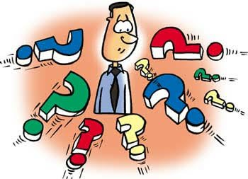
Directive questions
And then we get to the stage where we have some leading questions. These guide the prospect and subtly bring their patterns of thought around to focussing on you and the solutions you can provide.
They are also a subtle way of you maintaining control of the meeting. Examples could be:
“You mentioned earlier that …”
“What is most important to you is …”
“The problems you are having …”

Slide 15
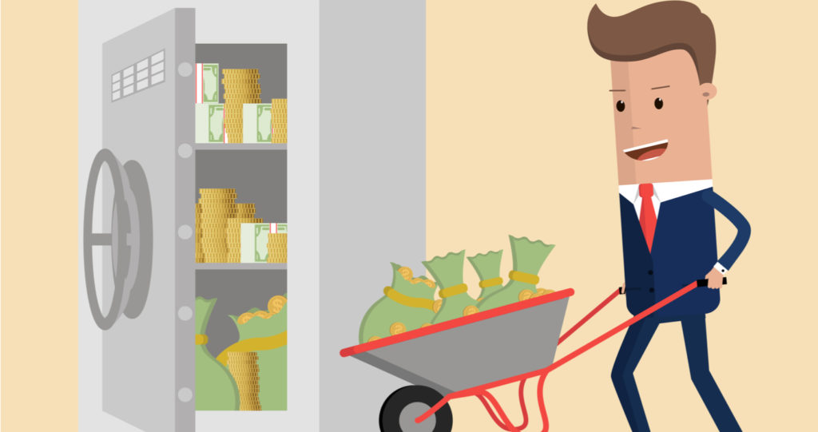
Closing the deal question
Once you’ve checked that you’re on track that the solution you have in mind matches your prospect’s needs, and the prospect has confirmed, you close by asking something like:
“Would it be OK if I outlined what we need to do to get that underway?” or
“Which fits best with what you had in mind?”
And then, finally, you shut up and wait for the answer …

Slide 16
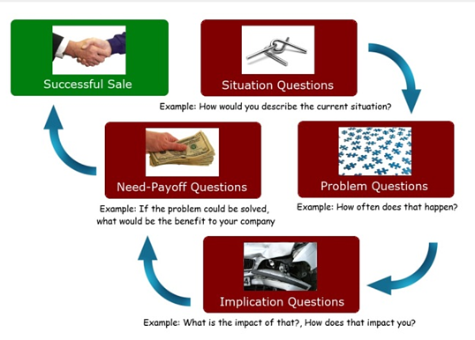
B2B – Questioning Technique

Slide 17
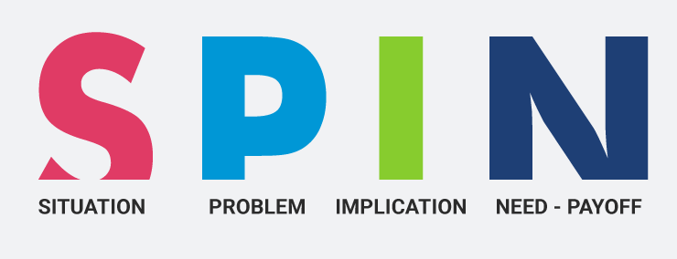
Situation questions
Situation questions should be asked at the beginning of a sales call once you’ve established rapport and the buyer is talking freely. These questions are meant to give you a sense for what the buyer is doing currently. Here are some examples…
“How are you training your sales staff currently?”
“How are you investing in the continued development of your sales team?”
“What sales training programs have your salespeople completed?”
Questions of this nature get the buyer talking about what he has been and/or is doing relative to the services you are selling.

Slide 18
Problem questions
Problem questions come next and are designed to uncover “pain points” or problems the buyer is having. Following the Situation questions, here are some examples of Problem questions…
“What improvements have you seen in the performance of your salespeople after their training?”
“How well are you achieving your sales goals?”
“How consistent are the sales performance levels of your individual salespeople?”
These questions will enable you to uncover what might be working and what’s not working. They help you determine what problems need to be solved and/or what pain the buyer is experiencing with his current situation.
It is important for me to emphasize that I never suggest a salesperson sell something to a buyer unless it will truly add value and solve a real problem. If after asking a series of good Problem questions you aren’t able to uncover a problem, congratulate the buyer and move onto to a better sales opportunity.

Slide 19
Implication questions
While Situation and Problem questions are common, Implication questions are somewhat unique. They are meant to transform the problems you discovered and bring to the surface the consequences or impact of those problems. Here are some examples of Implication questions…
“How has the lack of improvement in sales performance affected overall company performance and profitability?”
“What impact has the lower sales performance had on the morale and retention of your salespeople?’
“What impact has not meeting your sales goals had on you personally?”
You can see Implication questions take the problem and make it real. It is best to prepare Implication questions ahead of time. In fact, I recommend you make a list of the 10 most relevant Implication questions associated with your product /service. Implication questions require you to think fast, so preparation will support your success.

Slide 20
Need-Payoff Questions
Here are some examples…
“If you saw just a 10% increase in sales performance from your sales team, what impact will that have on profitability?”
“If your salespeople were more consistently achieving your sales commissions and bonuses, what impact would that have on salesperson retention?”
“If you didn’t have to invest so much time coaching your lesser performers, how could you use that extra time to benefit overall company performance?”
In essence, Need-Payoff questions position to buyer to tell you how your product/service will benefit them, rather than you having to explain the benefits to the buyer. Wouldn’t it be great to have your buyer sell himself? That’s what Implication questions are designed to do.

Slide 21

Listening
Listening is not the same as hearing. Hearing is a physical act while listening involves so much more—which is why mastering this skill is crucial to the success of all people, be they students or not.
Listening is following, understanding, and processing what one hears; it is hearing with a purpose

Slide 22

Triple A Listening
Maintain a Constructive Attitude: A positive attitude paves the way for open-mindedness. Refrain from making assumptions.
Strive to Pay Attention: When you actively listen, the words enter your short-term memory and are processed into ideas. Attentive listening assures that the ideas are processed.
Cultivate a Capacity for Adjustment: You need to be flexible enough to follow regardless of the direction it may take.

Slide 23

The Ten Commandments of Good Listening
1. Stop Talking…You cannot listen while you are talking.
2. Put the Speaker at Ease…Help him/her feel he is free to talk.
3. Make Eye Contact…Look and act interested. Don’t ignore him/her while he talks. Listen to understand rather than to reply.
4. Remove Distractions…Don’t doodle, tap your foot, or shuffle papers.
5. Empathize with Him/Her…Try to put yourself in his/her shoes to better see his point of view.

Slide 24

The Ten Commandments of Good Listening
6. Be Patient…Allow plenty of time, don’t interrupt, and don’t start for the door while he/she is talking.
7. Hold Your Temper…An angry listener gets the wrong meaning from words. “He who angers you, conquers you.”
8. Go Easy on Argument and Criticism…This puts him/her on the defensive. He or she may clam up or become angry.
9. Ask Questions…This encourages him/her and shows that you are listening. It also helps develop further points.
10. Stop Talking…This is the first and last commandment because all the others depend on it. You simply can’t actively listen while you are talking

Slide 25

Summarize

Slide 26
Thank You

