Slide 1
Attributes of a Good SalesPerson
Prof:Sharlot Bency

Slide 2
Joe Girard-World’s Best Salesman
https://youtu.be/_vOdePXsFVY

Slide 3
Selling Strategies
Traditionally- “Lone Wolf “Strategy
Modern Method- Team Selling

Slide 4


Slide 5

The Impossible Lifting Trick!!
Fun and Learn!
This Photo by Unknown Author is licensed under CC BY-SA

Slide 6
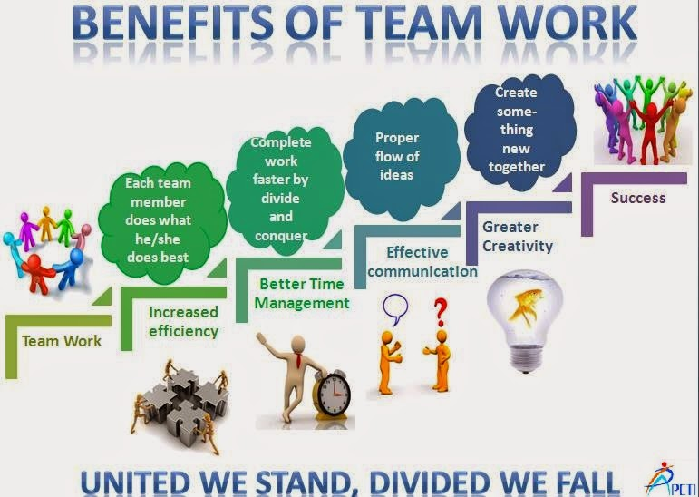
Advantage Team Selling!!

Slide 7
Advantages of Teamwork
Synergy
Confidence
Problem Solving
Faster ,better decisions
Continuous Improvement
Better Sales Strategy
Innovation
Self –motivation
Empowerment
Greater Job satisfaction
Faster ,Better Decisions
Notes:
1.Synergy-1+1=11.Whole is greater than the sum of its parts.Each Team member-Unique life experiences,perspectives,talents, and communication styles.Leaning into each others strength the team can get the best possible work done. Mixed skill sets leads to better results.
2.When teams starts achieving success the members involved believe that they are part of a winning effort.Achieving results create a positive momentum.
3.Problem solving is maximized in a team.Everyone approaches a problem with a different perspective and working together makes problem solving easier,Ur team mates may think of a solution that you might not have thought of.
4.

Slide 8
Disadvantages???
Open Discussion..!!

Slide 9
Case Study
Analyse the following case study and discuss about the strategies used by Philip Stryland to retain their key strategic account of Control Data.

Slide 10
Story of Philip Stryland-CEO of Summit Group
Consulting and Sales Training Group
Philip Styrland Worked for AT &T in the USA in 1985.The company had strategic accounts(major customers) which included Control Data, Honeywell, General Mills, Northwest Airlines, Medtronic, and 3M.
Philip Styrland had a technical role in AT &T at that point of time.He was one day called by the local CEO Ron James at Minnesota to his office for a conference.Philip was startled when Ron announced that he was putting Philip in charge of Control Data.
Philip said,”I ‘ll do what ?This is a senior sales position and i have never been in sales before”.
Ron said,”It dosen’t matter.I know you will do just fine”.
Ron said that your job is to salvage the relations between Control data and AT &T.The relationship between Control Data and AT &T had deteriorated over the years.In terms of revenue they contribute the highest to our company.So it was very important to improve the relations and keep Control data as our customer.

Slide 11
While Ron has full confidence that Philip could save the account,Philip certainly did not.How could he?he had never sold anything in his life.Ever! Philip was in his 20’s and he had no clue what to do.
Philip first of all moved his office to the office of Control Data in Minnesota. He spent my first two days there just listening to all the problems, issues, and challenges they had with this account. It seemed overwhelming, and he kept thinking, "What did I get myself into?“
On the third day, He went to a local office supply store and bought the biggest whiteboard in stock. he put it up on my office wall and invited the two key players on the customer's side to come in. These gentlemen were Bill Miller, director of IT and Telecommunications, and Harry Hurley, manager of Telecommunications. They were the key decision makers. They were the customer. Period

Slide 12
I asked them to tell me everything they considered to be problems. I listened intently, and then I said, "I'm brand-new. I've never been in sales. Guys, tell me what to do. How should we go about mending this relationship? What needs to happen?“
At first, they didn't know what to make of me. "The more you can share with me," I stressed, "the more I can help you. I can't fix things I don't know about.“
They talked, and I listened. After they were finished, I said, "I've got this big whiteboard here, so let's make it simple. Take this pen, draw out what needs to happen, and list the things that we need to get done. As each gets taken care of, we'll wipe it off, and when that whiteboard is clean, our relationship will be clean."

Slide 13
They consented, and for the next few hours, we filled the whiteboard with everything we needed to do to mend the relationship and help them serve their internal customers. When we were finished, we agreed that the three of us would meet at least once a week, and during these meetings, we would sit in front of that whiteboard and wipe off items that had been resolved, if we all agreed they were complete.

Slide 14
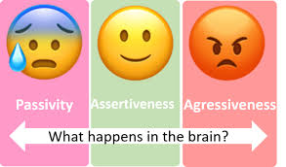
      Assertiveness

Slide 15
3 Approaches to Sale

Slide 16
1st Approach
"Could you give me a call when you've made a decision?"
"Would you mind if I sent you a brochure to help you decide?"
"How about I call you in a few days to see if you've made a decision?“
Identify the type of Approach used?
Options: a)Assertive Approach
b)Passive Approach
c) Aggressive Approach
Ans:Passive Approach

Slide 17
2nd Approach
"If you don't buy now, the offer is off the table."
"If you don't want to do business with us, please tell me so we won't be wasting our time."
"What do I need to do to make a decision happen now?“
Identify the type of Approach used?
Options: a)Assertive Approach
b)Passive Approach
c) Aggressive Approach
Ans:Aggressive Approach

Slide 18
3rd Approach
"Can you give me a specific date when you'll make a decision?"
"What factors might cause the delay in the decision-making process?"
"What steps will you be taking in order to make a decision?“
Identify the type of Approach used?
Options: a)Assertive Approach
b)Passive Approach
c) Aggressive Approach
Ans:Assertive Approach

Slide 19
Why Should You Embrace Assertiveness in Sales?
Purposive assertiveness is used to pursue three outcomes. Disrupt, Reframe and Direct.
Disrupt: They disrupt the flow of thinking or action a buyer may be considering. When a buyer is set in their thinking or their direction, they’re on autopilot. When a seller can get a buyer to question their direction and strategies, they get them thinking and open the buyer's mind.
Reframe: When the buyer's mind is open, sellers reframe issues. A buyer often misses opportunities because of their mental models. When a seller introduces a buyer to new mental models, they open the buyer to new possibilities for strategy and action.
Direct: And what should those strategies and actions be? Insight sellers direct buyers to ways the seller can help them solve problems and reach goals with the seller's help.
Eg. Mutual Funds Vs FDs
Stock market vs MFs

Slide 20
Assertive Vs Aggressive
Assertive" and "aggressive" are sometimes used interchangeably, but there are key differences between these descriptors. Being assertive involves pursuing a desired outcome or stating and standing by an opinion while still being mindful and respectful of the desired outcomes and opinions of others. Aggressiveness, meanwhile, is characterized by relentlessly pursuing your desired outcome while ignoring or attacking the opinions or desires of others.

Slide 21
Assertive vs Aggressive Behaviour:
– calm and positive vs irrational and condescending
– enthusiastic vs fake
– honest and genuine vs manipulative
– direct vs intimidating
– understanding vs uninterested
– concerned vs indifferent
– respectful vs harassing

Slide 22
Effective Communication
Activity-2 lines and One Action
Fun n Learn !

Slide 23
Can you solve the following three problems?
1.Peter was with a client’s Vice President to make a presentation. The client had given all the inputs in his earlier meetings for Peter’s company to propose a solution. The presentation was off to a lively start and the VP was listening carefully to Peter. Five minutes into the presentation, however, Peter could sense that the VP’s attention had wandered, to flowers in the garden overlooking his office window. Peter was puzzled. Was the VP no longer interested? Or was something wrong with his presentation? If indeed, there was something amiss, how could he find out?
If you were in Peter’s shoes what would you do?

Slide 24
Scenario 2
An animated debate is on between salespeople at a party event following a sales conference. A sales veteran has taken a position that to ‘really’ communicate with a Customer, a face to face meeting is a must. To him, selling on phone is a strict no-no as it amounts to a short cut. The view is contested by the younger salespeople. They contend that in today’s time starved world, even Customers prefer to do business over phone and digital channels. Sales should therefore accept and leverage this new reality. Other veterans in the party don’t agree. Opinions are polarized on both sides.
Which side are you on and why?

Slide 25
Scenario 3
David is a senior sales engineer with a hi-tech engineering firm. Chan has joined the company as trainee and has been assigned to work with David to pick up the basics. They have been working on an enquiry of a high-profile Customer. Their first client meeting has been scheduled where they would make a presentation to the senior management of the company. David briefed Chan on the presentation outline and asked him to come up with the slides. When Chan returned with the slides, David was impressed. Complimenting Chan on his good work, David said he just had one concern – excessive jargon in the slides. Chan believed the use of jargon would impress the Customer. “It will let the Customer know that we speak his language and understand his business. Surely, that should get us the business” said Chan.
Do you agree with Chan?

Slide 26
Definition-Sales Communication
Sales communication is defined as the passing of meaningful messages between Customer and salesperson. Thus, both salespersons and Customers send messages and receive messages, when they interact, whether face to face or on various media.
‘Meaningfulness’ implies that an action or a reaction is expected from the other side – ‘other side’ could be Customer or could be salesperson. If the Customer says “I have not understood what you said” that too is perfectly fine; since it is a reaction in the quest to understand the message and not dismiss the salesperson!

Slide 27
Essentials of a Good Sales Communication
11.The Opening and Closing of a sales presentation is extremely important-Make an Impact!!
2.Getting people to open up.
3.Asking Questions to understand their needs
4.Active listening
5.Building rapport and trust
6.Include Statistics,Testimonials, cases,Illutrations to make it more interesting
https://www.mercuriindia.com/download/sales-communication-5-Stages-and-3-Traps.pdf

Slide 28
  Activity-Communication Game -Two Teams in a line and one action
  Communication -Paper Tear Activity
Notes:
One team standing sideways.The person in the last is given an action to perform.Without talking he /she has to show the action to the person standing in front.
Analyse what the action is when the last person performs.
Paper Tear Activity-Objective is that your paper should like exactly like mine at the end of the activity.
take a sheet of paper and tear into half.Tear the top right corner of the paper.Fold it again and tear the top left corner and then the top right corner.Fold again one last time time and tear the top left corner again.
Analysis-Why ois it the we go so many different outcomes.look round the table.How often does this happen in our organisations?When we are given a set of expectations just like this and we have a pic in our head as to how the outcome should be.But someehow the outcomes start to look like this.So who do the managers start to blame for this kind of outcome?The Employees.And the Employees think tht it was because of the manager.he was incompetent ,dint give enough details.The reality Is who is really to blame.Was this responsibility solely the mangers??Or would it have helped if the meployees ask questions and be clear on what they are expected to do.
In a sales setting how often do we ask questions to our customers?What fears do we have prpopgate in our minds that prevents us from asking questions?Now imagine you are dealing with customers of different ethinicity and diversity .And imagine the problems that could arise from communication gaps and not understanding each other.
So this little experiential exercise has brought the point real quick that we communicate very vague terms and the results are going to be very vague.

Slide 29
FIVE STAGES OF SALES COMMUNICATION

Slide 30
7 TRAPS-90% OF Problems & How to Avoid Them

Slide 33
                Emotional Quotient

Slide 34
Four old friends head to dinner at their favorite restaurant to celebrate. After they consume their selections, with laughter and raised voices, the waiter heads over to clear the empty plates. Smiling as he catches the friends’ heightened mood, he offers to show them the evening’s desserts. One friend says, “Absolutely! Let’s keep the celebration going.”
Returning with a tray-o-delights in hand, the waiter steadies the platter on his arm to be sure all eyes take in the view. Finally, another friend says, “Look how rich they all are. I’m trying to cut back. Just look at that one!” With a knowing look and a nod, the waiter suggests, “Just skip breakfast in the morning.” Chuckles resound, and four orders of “that one” are placed. The celebration continues for the friends, the waiter, and the restaurant, because the waiter picked up on the group’s mood and ran with it. The waiter’s actions required emotional intelligence (EQ)—a set of skills that, when used intentionally, boost sales from the golf course, to the boardroom . . . even the table.

Slide 35
Definition
The capacity to recognize our own feelings and those of others to for motivating ourselves and managing emotions well in social interactions.
It has 4 important dimensions
1.Self Awareness-The capacity of understanding ones emotions, strengths,weakness and self confidence.
2.Self Management-the capacity for efficiently managing one’s motives and regulating one’s behavior, adaptability, achievement, orientation ans initiative.
3.Social Awareness—the capacity of understanding what others are saying and feeling.And why they act and feel as they do.
4.Social Skills-the capacity of acting in such a way that one is able to get the desired results,from others and reach personal goals,developing others ,leadership ,conflict management and teamwork.

Slide 37
What do people do ??

Slide 38
How Emotional Intelligence Skills Help Make the Sale
Those sales professionals who can spot their emotions when they happen, understand them, and manage them well will be the ones who find it in them to manage their schedule well, remain positive when their clients aren’t, and make one more sales call when everything says it will be tough. These sales professionals’ ability to be self-aware and self-manage will help them stop formulating their next pitch while the customer is talking. They’ll become great listeners, and they’ll hear what the customer is really saying. This makes spotting the pitch that will resonate and stick so much easier and more authentic. Good personal competence skills, the first half of a high EQ, will help sales people self-motivate, will prevent them from getting in their own way, and will give them the confidence to ask for the sale.
At L’Oréal, sales professionals hired based on their emotional intelligence outperformed their peers by $91,370 at the end of the first year.1
In a national insurance company, insurance sales agents weak in specific emotional intelligence skills such as self-confidence, initiative, and empathy sold average premiums of $54,000, while those who were strong sold average premiums of $114,000.2

Slide 39
Thank You!!

