Slide 1
Sales & Ethics
By Sharlot Bency
Notes:
Insimple terms ethics is what you do when no one is looking.We all face ethical dilemmas in our lives.for eg-If we find a bag of money on the road should we take it or should you use your company car for persona use.The answer is wrong is wrong even if everyone is doing it.Right is right even if no one is doing it.
So it is very important for everyone to set their standards of moral conduct.Similarly a business enterprise is also expected to have a set of laws about how it conducts its activities.

Slide 2
Ethics-What you do when no one is looking!
Definition: It is broadly defined as the set of moral principals by which people conduct themselves personally, socially and professionally.
Business Ethics refers to a set of laws about how a business should conduct itself.
Selling ethics refers to moral principles and values that dictate selling and sales management conduct and behavior”. Sales ethics refers to a set of behaviors that ensure that every lead, prospect and customer is treated with respect, fairness, honesty and integrity

Slide 3
The Journal of Business Ethics stated that “an ethical brand acts with responsibility, honesty, respect and accountability.” In their research, they found 8 major benefits for brands that engage in ethical behavior:

Slide 4
Importance of Ethics to a Business Enterprise
Building a Reputation.
To Develop a lasting base of customers.
Minimising complaints and Avoiding any legal risk.
Respect among competitors,peers and customers.
Loyalty& trust among customers.
Higher spend by customers.
Positive Word of Mouth
Lower cost of running a business.
Notes:
So why is ethics so important for a business enterprise?We know that a company works very hard to build a reputation as to be seen as a fair and professional company.The company or business also wants to have repeat business and highr sales over a period of time.If you are ethical in approach it helps you to develop a lasting base of customers.You not only earn the respect of your peer group,but also your competitors and your customers.For salespeople it minimises the complaints about the product being sold or it also helps to remove any legal or consumer right risk that can arise in the course of selling and above also helps you to develop a peace of mind.So overall it is good for the company to practice ethics & have an ethical code of condut.

Slide 5
What influences Ethical Behaviour?
Individual influences-Personal value system.
Organisational Influence-Commitment and Integrity of top management.
Notes:
There could be individual influences ,your personal moral value system-It could be a value system in which a person is raised,There could be organisational influences,the commitment and intergrity of the top management which sets the course in an organisation where everybody works in an ethical fashion.
There could be individual influences ,your personal moral value system-It could be a value system in which a person is raised,There could be organisational influences,the commitment and intergrity of the top management which sets the course in an organisation where everybody works in an ethical fashion.
N\salespeople will encounter many instances where it will not be covered by the companys statements.They will have to develop their own personal set of ethical standards in such situations,otherwise they will lose respect in the company or in their own eyes.
Over a period of time the salespeople with a strong sense of ethics are the ones who become successful over ones who compromise their own and society’s ethics for short term success.

Slide 6
Ethical Behaviour in Sales
Always be honest about the impact your product makes.
Don’t attack your competitors.Use Competitor questions as an opportunity to showcase your product.
Notes:
What is ethical behavior when it comes to sales?
What does ethical behavior look like in a real-life sales team? Here are some examples to follow.
Always be honest about the impact your product makes
Picture this: You’re on a sales call. It’s going well and you’ve built a great rapport with your prospect. But then they ask you for more insights into your product’s specifics, including features, capabilities and pricing options.
You may feel tempted to say exactly what your prospect wants to hear just to close the sale, even if it’s not completely true. For example, you could exaggerate the results other customers got with the product or completely make up figures.
Not only does this make your product attractive, but it also makes you sound smart. What could go wrong?
The answer: a lot. When the customer uses your product, they won’t just realize you were dishonest—they’ll lose trust in the entire company.
Many customers will never do business with a company again after just one negative experience. These unhappy customers may also overload your customer support department with complaints and refund requests.
The fallout doesn’t end with a lost customer. A study by American Express revealed that Americans tell an average of 15 people about a poor service experience, but only 11 about a good experience.
Instead of winning a happy, satisfied customer, you’ll end up with a negative referral engine.
What is ethical behavior when it comes to sales?
What does ethical behavior look like in a real-life sales team? Here are some examples to follow.
Always be honest about the impact your product makes
Picture this: You’re on a sales call. It’s going well and you’ve built a great rapport with your prospect. But then they ask you for more insights into your product’s specifics, including features, capabilities and pricing options.
You may feel tempted to say exactly what your prospect wants to hear just to close the sale, even if it’s not completely true. For example, you could exaggerate the results other customers got with the product or completely make up figures.
Not only does this make your product attractive, but it also makes you sound smart. What could go wrong?
The answer: a lot. When the customer uses your product, they won’t just realize you were dishonest—they’ll lose trust in the entire company.
Many customers will never do business with a company again after just one negative experience. These unhappy customers may also overload your customer support department with complaints and refund requests.
The fallout doesn’t end with a lost customer. A study by American Express revealed that Americans tell an average of 15 people about a poor service experience, but only 11 about a good experience.
Instead of winning a happy, satisfied customer, you’ll end up with a negative referral engine.
2. “Why should I pick you over your competitor?” is a question you’ll hear more times than you want to.
When that happens, you have two options:
Slander and criticize your competitor for everything they do worse than you
Use this as an opportunity to show your knowledge of available options and why your product stands out, brings better results and is more suited to the prospect’s needs
Belittling your competitors won’t make you look better in your prospect’s eyes. Instead, they’ll see you as dishonest and unethical.
Instead, use the competitor question as an opportunity to showcase:
Use this as an opportunity to show your knowledge of available options and why your product stands out, brings better results and is more suited to the prospect’s needs.
Case studies and success stories of existing customers that switched from a competitor to you.
A feature comparison, with an explanation of why your product is a better match to your prospect’s pain points
What makes you and your product unique, like onboarding, product documentation, walkthroughs and anything else that makes your customer’s experience exceptional
Simply put: make your product stand out because it’s good, not because your competitors are bad.
3. Serve the customer the same way you would like to be served if you visited a retail store. See the customer as a family member or a close friend whom you’d genuinely want to help to the best of your ability. Smile, be patient, and treat them with respect. Go the extra mile to make them feel welcomed and comfortable while they’re there. Remember, people buy people first, products and services come second. Focus on building the relationship first and the sale will follow.This method is used across all Apple stores.
From your customer’s perspective, you’ll make a genuine difference in their life or business. And from your company’s perspective, you’ll have a loyal customer that’s happy to keep paying for what you offer.
So by adopting these strategies you won’t sell just for the sake of selling; you’ll grow your company in an ethical, honest way in the long run.

Slide 7
Ways to Make Ethics a Habit in Sales
Encourage open communication around goals and expectation.
Hire the right sales people.
    Honest
    Humble
    Helpful
    Courteous
    Caring
    Resilient
Run ethics based training sessions.
Develop a code of ethical selling.
Your business values
Desirable and appropriate steps for prospecting and approaching potential customers
Communication principles
Steps and guidance for handling complaints and conflicts
Undesirable and unacceptable practices for prospecting, outreach, negotiation and more
Notes:
How to foster an ethical culture in your sales team and business
Growing and managing your company in an ethical manner is no easy feat. Building an ethical culture needs to happen from every facet of the company. It also has to be intentional.
Here are the main ways you can make ethics in sales a habit for your company.
Setting sales goals is essential to moving the entire company forward. When you use the SMART approach in setting goals—making them specific, measurable, achievable, realistic and time-based—they can be huge motivators for your sales team.
But when you set ambitious sales quotas and don’t outline a solid plan detailing how to achieve them, you’re setting yourself up for failure.
At best, you’ll end up with bad, high-churning deals. You might also see a drop in your sales team morale, from a dip in performance and a longer sales cycle to an increase in tension.
The worst-case scenario? Driving your sales team to commit fraud.
Each step of the way, from setting goals and defining your sales cycle to tracking sales results, make it easy for reps to openly share thoughts and concerns. Create a safe space for them.
This can happen through one-on-one meetings, written feedback, regular surveys and any other way that gives your team a voice.
2. A surefire way to make ethical selling a default for your sales team? Hiring ethical salespeople.
Of course, being an ethical salesperson isn’t just one thing. It’s a range of traits. Here are some qualities to look for when hiring sales reps:
Honest: How would they treat a ‘grey area’ scenario? Would they try to get away with a white lie and tweaking the numbers on even a small deal?
Helpful: How would they help a prospect or a customer that has a specific pain point?
Courteous: How are their manners? How do they treat people they interact with?
Humble: Can they leave their ego at the door? How do they talk about their accomplishments, especially when talking about group achievements?
Caring: Do they display empathy? How do they talk about issues they care about?
Resilient: How do they cope with stress and rejections?
3. Sales reps have lots of influence on their prospect’s decisions; with this influence comes responsibility.
After you’ve hired ethical salespeople and created an open, safe space for them to talk about sales goals and expectations, the next step is to solidify what ethical selling means.
By developing a code of conduct for ethical selling, you’ll have a tangible guide that reps can refer to at any time. It leaves no room for confusion and it makes decision-making during the sales process easier.
Your code of ethics for marketing and sales can include:
Your business values
Desirable and appropriate steps for prospecting and approaching potential customers
Communication principles
Steps and guidance for handling complaints and conflicts
Undesirable and unacceptable practices for prospecting, outreach, negotiation and more
Use real and/or fictional examples to paint a vivid picture of the ethical culture you’re aiming for.
This document should be a living, breathing asset you can update and improve as your company evolves. Make it available to every sales rep and ensure it’s not something that collects dust on your hard drive.
It should be a core driver of your sales team’s everyday activities.

Slide 8
Ethical Dilemmas
The Runaway Train Scenario-Thought ?

Slide 9
Scenario Change-Do you pull the lever if…
1)A Small Child on one track and 5 people unknown to u on the other.
2)Your son on one side and five of your relatives on the other.
3)your very close friend on one side and Five prople unknown to you on the other side but your friend tells you to move the track to the other side.
4)A world famous cancer specialist on the edge of a breakthrough on one side and five of your relatives on the other.

Slide 10
Which statement most closely reflects your values?
A)Five lives are more important than one life.
B)One life is just as important as five lives.
C)All moral wrongs and rights are just a matter of opinion
D)None of the above

Slide 11
Misselling
Miselling is a practice in which a product or service is deliberately misrepresented or a customer is misled about its suitability.
Eg.If an agent or a banking staff tries to sell you an insurance product in the garb of a mutual fund.
Notes:
According to a survey conducted by Money life magazine nearly 90% of the responders had told that they were missold a financial product or service.They also mentioned that 70 % had found the internal Grevience system of banks to be ineffective.
On 1st July 2017 the banking Ombudsman was amended to include sale of insurance,mutual funds,third party investment products by banks.

Slide 12
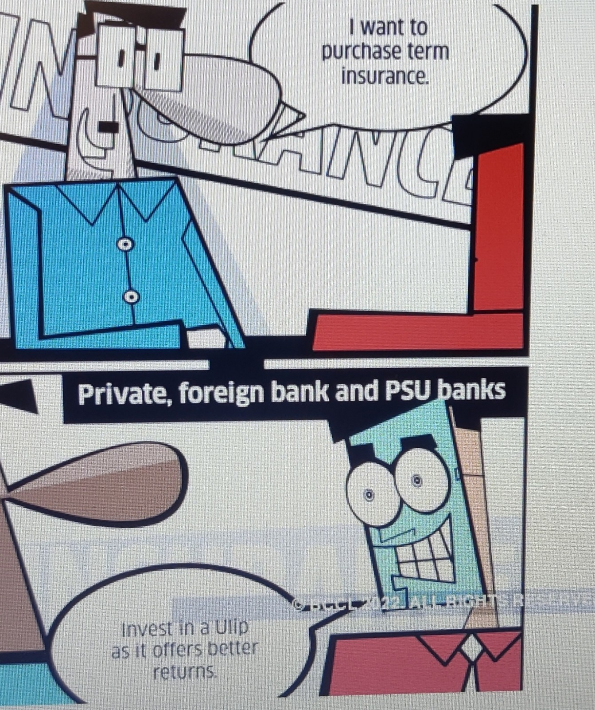

Slide 13
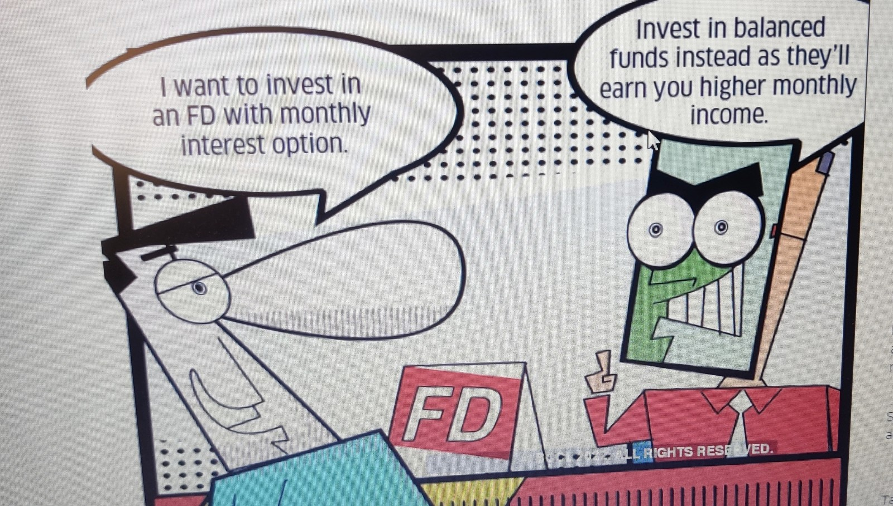

Slide 14
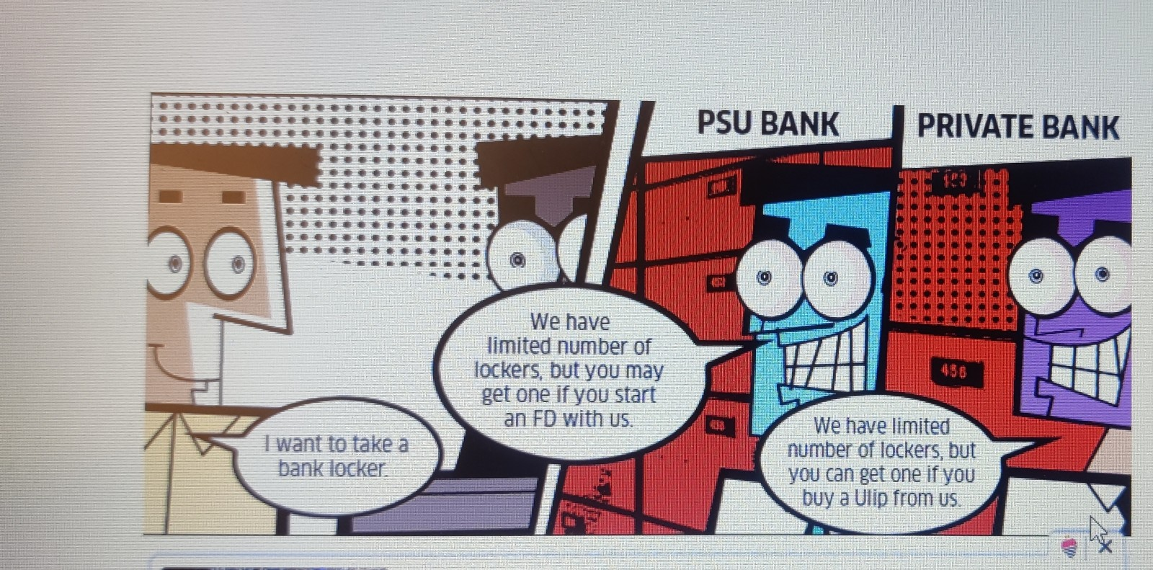

Slide 15
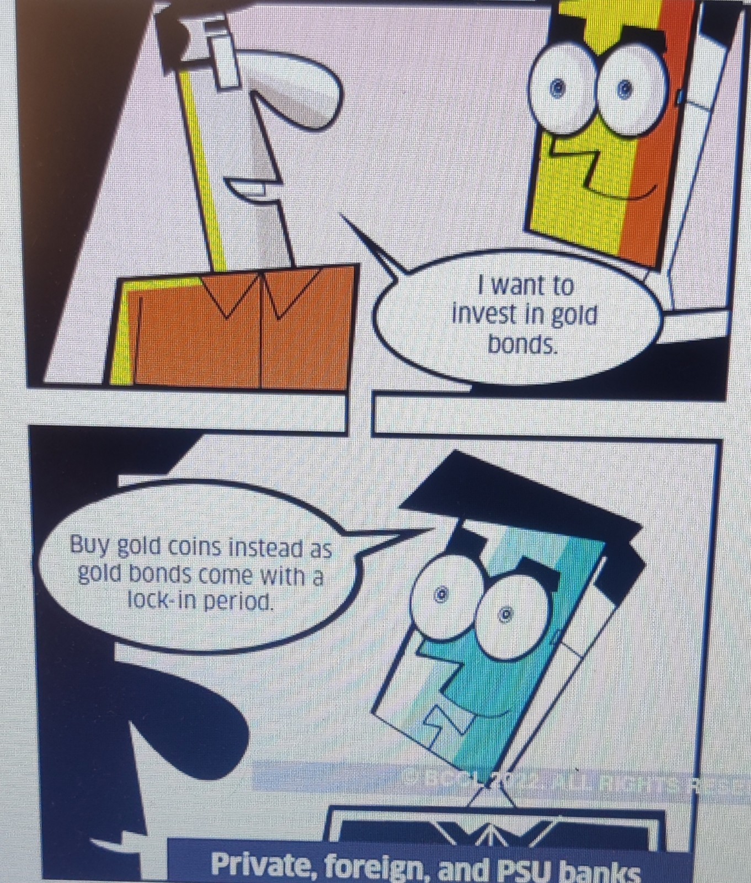

Slide 16
Consequences of Misselling
When u manipulate a buyer by giving them false promises and misrepresenting facts.
A satisfied customer goes and tells 4 persons about his experience whereas a dissatisfied customer goes and tells 20.
Damages the customer and service provider relationship
Downgrades the brand name
Reduces the chance of customer retention and new customer addition
Loss of customer trust.
Notes:
A lot of companies in India adopt .Social media gives a lot of power to consumers.Customer aware ness is very high.Cos cannot fool the customers.Very commonly seen in insurance companies,Mutual funds,bank charges.
Sometimes the top management puts pressure on salespeople to missell their products and those who missell are often promoted.
Sometimes the agents are trained in a such a way that they are only told about commissions and payouts and not the right purpose of the product.Many a times people are sold insurance policies as investment products.They are given many promises like guarantee returns,bonus proceeds.double income etc.Many people have so many life insurance policies without even knowing why they are having these plans .
If a person invests rs 1 lakh in a life insurance policy that gives 6% returns and you pay for a term of 12 years ,at the end of 22 years he will get a return of 25 lakhs.and had he invested this amount monthly -8000in in a SIP with a return of 12% he will havev got a return of 25 lakhs at the end of 12 years itself and at the end of 22 years it would have been 68 lakhs.So this will show you the difference between investment and insurance.

Slide 17
Additional Resource-Serve Don’t Sell Episode on Spotify
                Thank you

