Slide 1

The how & why of Competitor analysis
Prof:Sharlot Bency
Notes:
Many of you nurse start up dreams.Lets say you have started a venture and your company has serious potential to disrupt the industry. But, before you can start thinking big, you need to get a better picture of the landscape for the product to find how similar products in your industry are doing — and more importantly, what they’re doing. You need to do a competitive analysis.
A competitive analysis needs to go much deeper than looking at your competitors' social media or advertising efforts for comparison. Take a look into their history, who they consider their closest competitor and where they’re succeeding and falling short on selling their products.

Slide 2
Competitive Analysis. Definition:
Competitive Analysis is an exploration of the companies in a given industry sector of the market niche that are competing with your company’s products for the market share.
The analysis may be an indepth exploration of the top competitors and is a critical path of your company’s marketing plan.
Notes:
New strategies,new tactics are required to cope up in the cut throat completion in this new world which you are a part of.One very important aspect is to understand the competition.Competitor analysis will help you in this regard.Any firm be it local or global has many competitors in and around.Look at the variety of financial products available in the markets.Look at the number of banks-Private Sector banks,Public sector banks,Foreign banks ,Insurance companies,Mutual Fund companies,Portfolio management companies.

Slide 3
Industry Analysis and Comparitive study of banks
Market Size- worth US $ 2.67 Trillion
Public Sector Banks- 12
Private Sector Banks -22
Foreign Banks-46
Regional Rural Banks -56
Urban Cooperative Banks-1485
Rural Cooperative Banks-96000
(**ibef.org,Sept 2022)

Slide 4
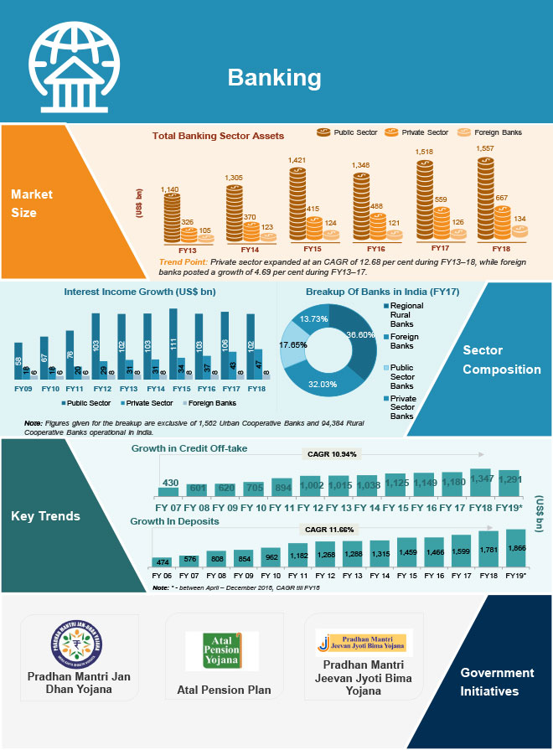

Slide 5
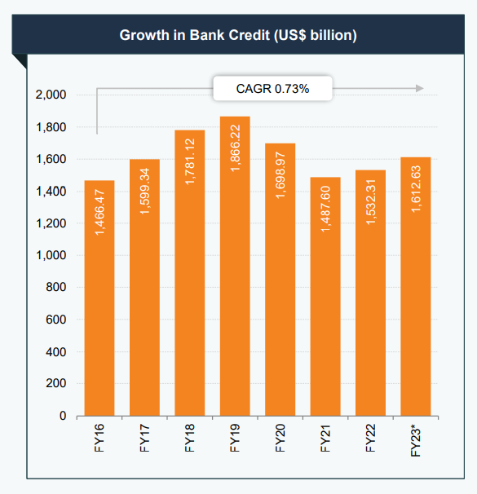
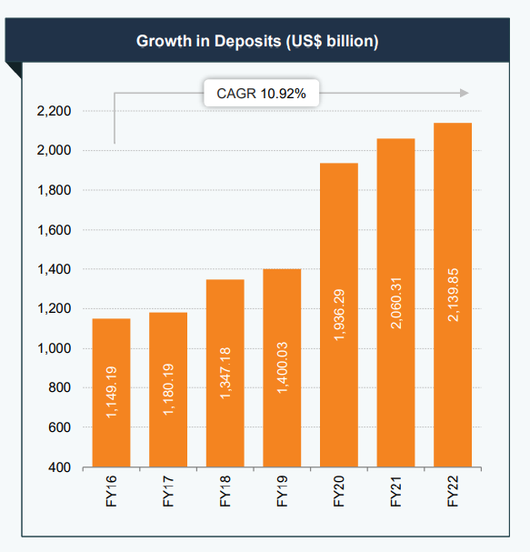
Banking Industry Analysis

Slide 6
Industry Scenario of insurance business
India Insurance market stands at $131 Bn as of FY22.
Insurance industry has 58 insurers including 34 non life insurers(25 general insurers, 7 standalone health, 2 specialized insurers).
Private Life Insurers are expected to grow their retail APE at a CAGR of over 17% between 2021-23, and new retail term premiums are expected to double in 5 years. The Private Non-Life insurance segment is forecasted to grow at 16% in FY22 and 14% in FY23. Standalone Health Insurers are expected to grow by over 25% in FY22 due to the increased focus on healthcare.
The New Business Premium for Life Insurers has grown at a CAGR of 14% over FY14-20 and the insurance industry size in India is expected to grow at 12.5% CAGR over the next decade 2020-30 led by specialized products such as protection and annuities.
Non-life insurers Collective gross direct premium underwritten for non-life insurance companies grew 22.99% y-o-y to INR 54,491.27 cr for the first quarter this fiscal year.
Notes:
APE-Annual Premium equivalent

Slide 7
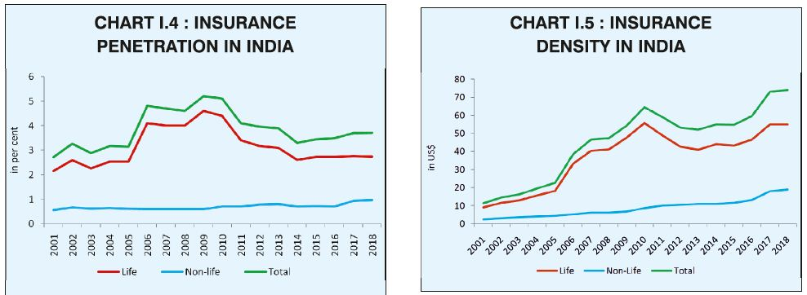
Comparative study of Insurance Products
Notes:
Insurance penetration Rate –Means the level of penetration of insurance sector in a country.It is a ratio of premium underwritten in a particular year to the GDP.
Coronavirus did what no amount of advertisement by life insurers could do. It pushed life insurance penetration in India from 2.82% in 2019 to 3.2% in 2020 (the year Covid hit) which is close to the global average.
Read more at:
https://economictimes.indiatimes.com/wealth/personal-finance-news/covid-brings-life-insurance-penetration-in-india-to-global-levels/articleshow/89243583.cms?utm_source=contentofinterest&utm_medium=text&utm_campaign=cppst
Insurance Density-Ratio of premium to total population
According to the report, the life insurance penetration was at 4.6% in 2009 but visibly showed a downward trend after that. According to Pankaj Razdan, CEO, Aditya Birla Sun Life Insurance Co. Ltd, volatility in the stock market in 2008-2009 and regulatory changes in 2010 adversely impacted the sale of Ulip (unit-linked insurance plan) products and premiums. “Penetration in India reflected a flat trend of 2.7% from FY 2014-15 to 2016-17. However, since 2014, the industry witnessed an increase in the premium per person

Slide 8
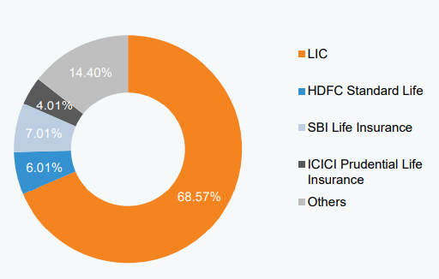

Slide 9
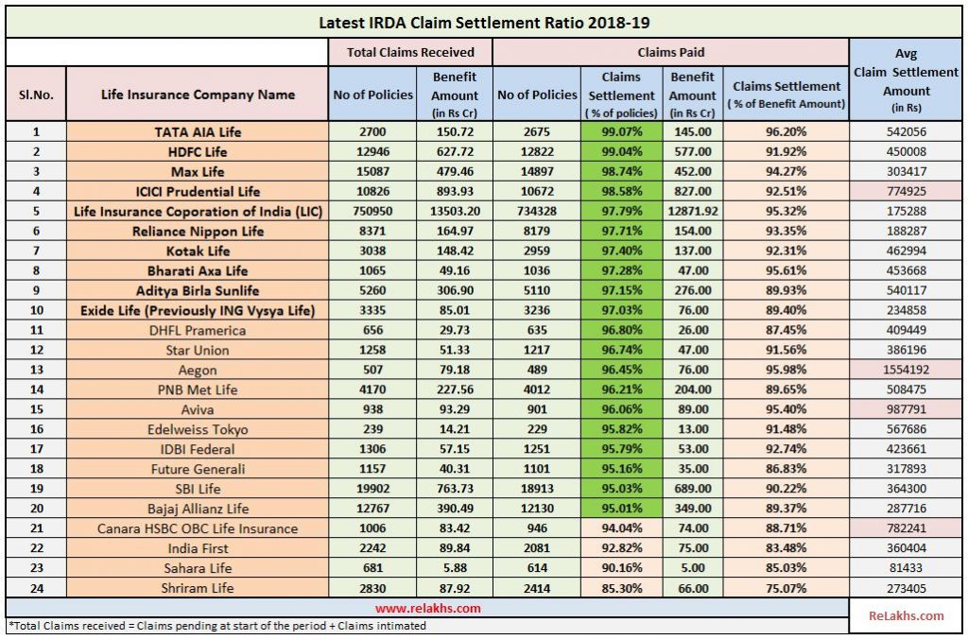

Slide 10
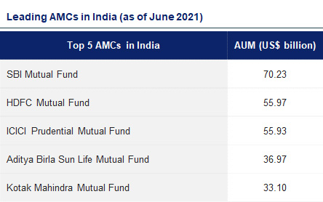
Leading AMCs of India

Slide 11

Determine who your competitors are.
Determine what products your competitors offer.
Research your competitors' sales tactics and results.
How to do a Competitive Analysis

Slide 12
Take a look at your competitors' pricing, as well as any perks they offer.
Ensure you're meeting competitive shipping costs.
Analyze how your competitors market their products.
How to do a Competitive Analysis (CONTD.)

Slide 13
Take
Take note of your competition's content strategy.
Learn
Learn what technology stack your competitors' use.
Analyze
Analyze the level of engagement on your competitors' content.
How to do a Competitive Analysis (CONTD.)

Slide 14
Observe
Observe how they promote marketing content.
Look
Look at their social media presence, strategies, and go-to platforms.
Perform
Perform a SWOT Analysis to learn their strengths, weaknesses, opportunities, and threats.
How to do a Competitive Analysis (CONTD.)

Slide 15
What to look for in a competitor analysis?
1.Feature matrix
2.Market share percentage
3.Pricing
4.Marketing
5.Differentiators
6.Strengths
7.Weaknesses
8.Customer reviews.
Notes:
Find all the features that your competitor’s products and services include. And save it in a competitor insight spreadsheet to conceive how companies stack up against one another.
help identify the main competitors in your niche industry.
3You must know how much your competitors charge for their products and services and where they fall on the quantity vs. quality spectrum
. What type of marketing strategy are your competitors using? Look at their websites, social media accounts, SEO strategies, types of ads, and current marketing campaigns. You can use PowerAdSpy to see all the popular ads working in your niche market.
What are the unique selling points of your competitors, and how do they advertise their best qualities?\
What are they good at.?Check their reviews if they habe a better pdt.
7.Do they have a weak social media strategy?Or Is their website not well optimised?These info can give you an edge.
8.Analyse both pros and cons of their reviews.Look at 5 star,3 star and one star reviews. Generally the 3 star reviews are the most honest.

Slide 16
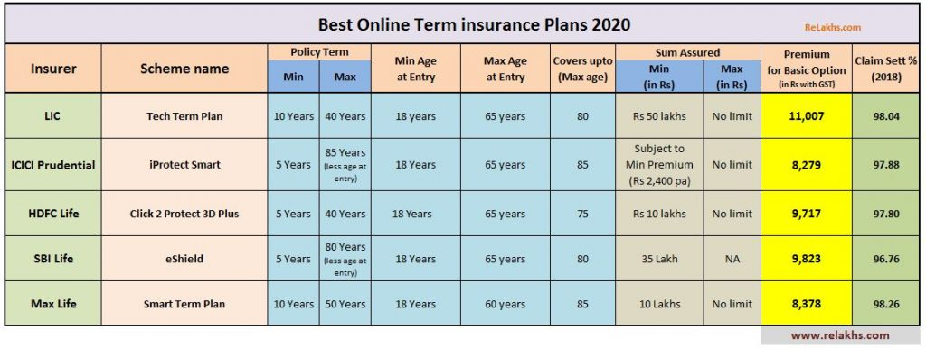
Feature matrix of Life Insurance Companies

Slide 17
How to conduct a competitive analysis.?
https://youtu.be/0KyCAcV_y7o
SWOT Analysis
Assignmenet
Conduct a SWOT analysis of LIC Tech Term Plan and SBI Life e Shield plan and find out if you can suggest any Competitive strategies against each other.

Slide 18
How to conduct a Competitor Analysis ?
1.Identify your competitors-
a) Direct Competitors
b) Secondary or Indirect Competition
2.Gather information about your main competitors
a)Products and Services
b)Pricing
c)Market Reputation
3.Analyse the competitions strengths and weaknesses.
4.Talk to you competitors directly
5.Identify your competitive advantage.
Notes:
1.Direct Competitors-Offer products and services that are similar to yours and serve the same customers.Eg-Netflix and Disney Hotstar.Streaming services.,Pepsi &Coke,Android vsApple.
2.Indirect Customers-Another company that offers same products and services but their end goals are different..Eg-Amazon and Hypercity.Amazon focuses on Convenience and fast shipping so that you don’t have to leave home.Hypercity is a one stop shop providing strong in person shopping experience.Taco bell vs Subway.Adrees the same need but with different menu options/
3.Substitute competition-They offer an alternative to the product or service offered by you.Eg.A restaurant or a coffee shop.

Slide 19
Other Methods for comparision
SWOT Analysis

Slide 20
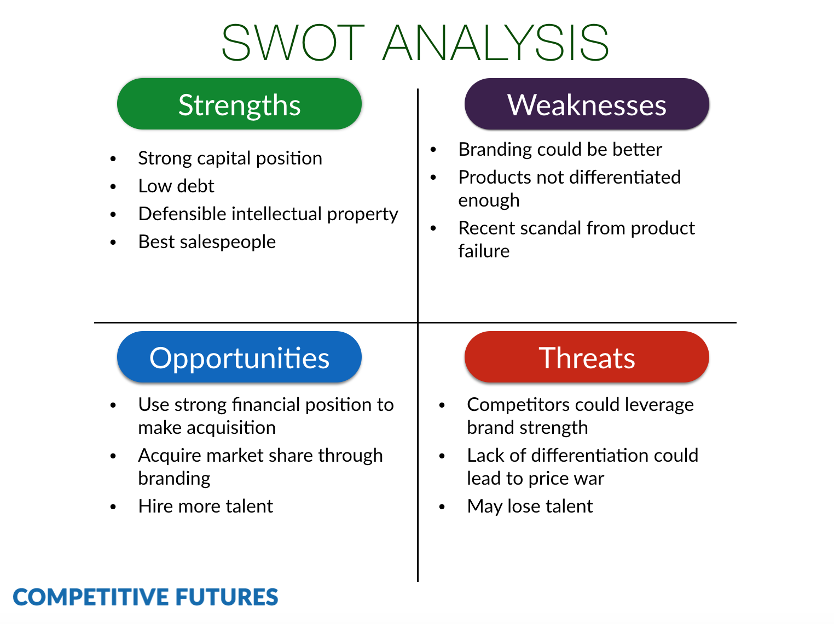
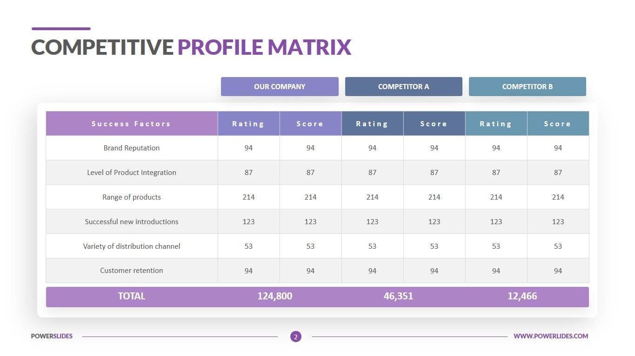

Slide 21
Websites for financial product comparision
Bankbazaar.com
Policybazaar.com
Moneycontrol.com
Equitymaster.com

