Slide 1
FAB Technique
Prof:Sharlot Bency

Slide 2
Learning Outcomes
Anaysing the FAB technique of Selling.
Apply the FAB technique in your sales pitch.
Evaluate the benefits of various financial products in real life.

Slide 3
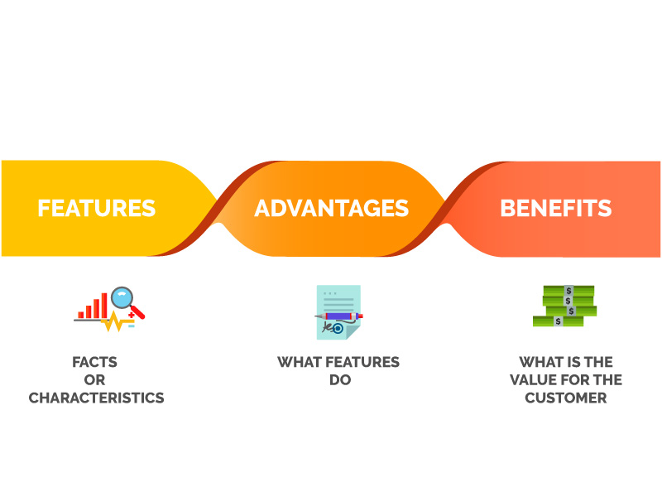
SELL FAB..ULOUSLY!!!
Features-Factual attributes of your products.
Advantages-A positive description of what the features mean.
Benefits-are the “WIIFM”.

Slide 4

Benefits = WIIFM→ What is in for me??
The emotional element of the process of selling
The value that you create for the customer.
Those things that motivates the sale
Generally not price driven.
Changes according to each customer.
Provides upselling and cross selling opportunities

Slide 5
This Phone has 16Gb Ram Which means it can load data much faster helping you to enjoy a smoother
Experience

Slide 6
This Phone has 16Gb Ram Which means it can load data much faster helping you to enjoy a smoother
Experience

Slide 7
This Phone has 16Gb Ram Which means it can load data much faster helping you to enjoy a smoother
Experience

Slide 8
This Phone has 16Gb Ram Which means it can load data much faster helping you to enjoy a smoother
Experience

Slide 9
Using FAB Technique in Sales
1.Reverse FAB to BAF in your sales pitch.
2. FAB Analysis of your product or company.

Slide 10
Using FAB technique in Sales.
Reverse FAB to BAF in your sales pitch.
FAB Analysis of your product or company.
Practice!

Slide 11
Sell me this pen..!! Using BAF Technique

Slide 12
CONCLUSION
A Great FAB/BAF analysis gives an idea of what would cause a customer to purchase a product
The analysis gives a consumers a greater understanding of a product and why should choose it over alternatives
Understanding the customer's needs and behavior will tell what specific pieces of information should be included in a FAB /BAF document

Slide 13
Financial Products and their FAB Attributes.
https://finance.advids.co/20-excellent-financial-product-video-examples/
Analyse different financial products using this video and discuss the FAB method used.
Identify at least 5 benefits used in this video.

