Slide 1
SPANCO
Prof: Sharlot Bency
Notes:
SPANCO-Abbreviation of 6 stages of a typical sales cycle. Follows a funnel process of sales.A method that was followed in Xerox company and were highly successful in sales using this method.
Suspect
P - Prospect
A - Approach
N - Negotiate
C - Close
O - Order

Slide 2
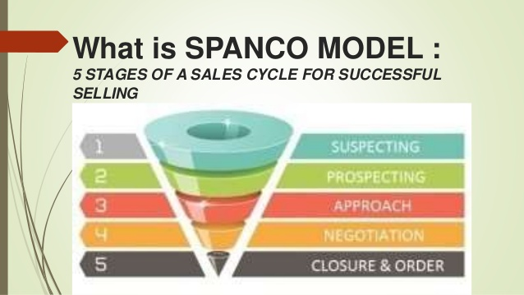

Slide 3
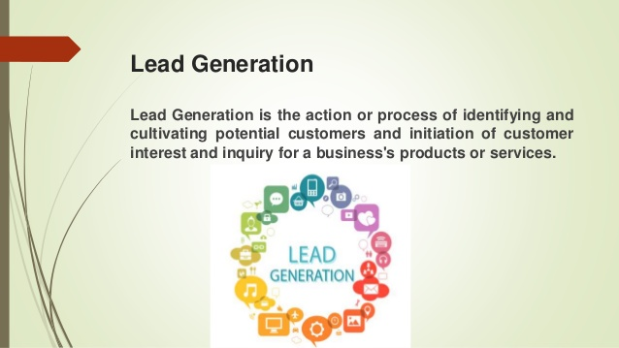

Slide 4
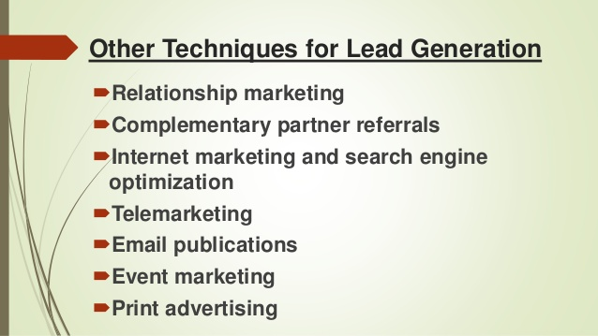

Slide 5
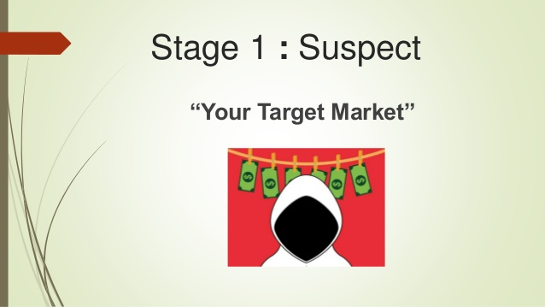

Slide 6
SUSPECT(Definition of the target)
In this stage, a list of leads are identified who are suspected to be potential customers. But at this stage of Sales Cycle, it is not confirmed whether they are interested to buy the product offered by the Salesperson or not. It is just a list of leads which has been gathered from multiple sources like Directories, Mail Opt-in lists, Networking platforms, Referrals, etc
Notes:
Sift through this huge pool of suspects to identify qualified leads who habe the potential to buy the service from you.You can call up people or go out and meet them to find out if they are qualified enough for your product or service.Sales is a numbers game.So get ready to be a dialing machine or get someone to do it for you.The more people you speak to the more you sift buyers from non buyers.Once you separate the buyers from non buyers then things start changing.You will now be presenting to qualified people who can provide value to your business.

Slide 7
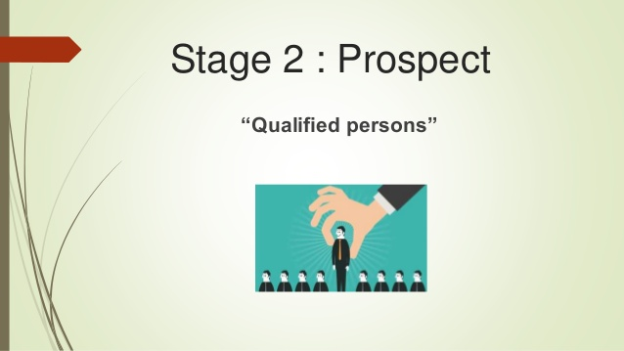

Slide 8
Stage 2 :Prospect(Identification of the lead)
During this stage, a few prospects are identified out of the huge list of Suspects. These prospects are the potential customers who express their interest during the previous Suspecting stage. For. E.g. Consider that you are selling Softwares to a B2B firm. You have been cold calling every lead you had during Suspecting Stage. Let us suppose, out of 100 calls made, 20 leads were found to be interested and would like to meet further. Then those 20 leads are said to be your Prospects

Slide 9
Four Essential Conditions for a Prospect
Need
Time
Budget
Authority
Notes:
NEED: They have a need or problem that your product or service can solve. Sounds very logical and very clear; you’re right. But many companies sell the customer what they would like to buy. In most cases, they are wrong because they forget that one of the purposes of the sale is to meet the needs of the different types of leads and not their own.
2. TIME: How long will it take to make the purchase? Time plays a fundamental role in every purchasing process. Knowing the time interval, each prospect takes to make the purchase decision is vital to prioritizing each other.
must have sufficient financial means to purchase the product or service. Suppose you contact a prospect who has neither the economic capacity nor any possibility to achieve it! Forget about him for a while since none of the best effective sales techniques will help you sell him anything. Note: If the prospect is interested in your product or service, you can follow up with him after a few months to see if something changes regarding the budget.
AUTHORITY: The prospect must have decision-making capacity. It is essential to qualify the leads before contacting them and confirm that they are people with decision-making power in the company you want to sell to. There are many types of leads within your sales funnel, and most of us lose them during the process. Only a tiny part provides us with conversions that materialize for purchase. Research and qualify!

Slide 10
How to make a Prospect List
Include everyone in the list.
Make a list together with family members.
Make the list on a diary.
Don’t prejudge people when making a list.
Expand list by including referrals.
Spend an hour of power daily.
Notes:
1.Include everyonein your list of prospects.Attitude-Whole world is my market.We don’t know if these people will give us business or not but still include them. Neighbours, Acquintances, classmates, teaches,someone who has worked with you previously.
Baggage-what will others think of us?Change in your attitude.Go withAn attitude from Selling to sharing and from sharing to serving.Think of how your information can help achieve their goals.
2.Make the list in a diary or note section.One small pencil is better than a strong memory.
Have a page devoted to a customer.Take their names,mobile number,place.
3.Look for bigger dreamers than you.-Many time s we might fall in the comfort zone.These people talk about big things they help you to dream bigger.
4.Make a list together with your partner and family member.You will notice your list getting bigger and faster.Parents and You,Brother and sister.Bigger list is made,and faster it gets made.
5.Dont prejudge people at the time of making a list.We don’t know who needs our help .So include everyone.Most of us are judgemental.We don’t know who is ambitious.
6.An hour of power.Be in a resourceful mode.Keep your phone in airplane mode.Sit down an ake a list and set a target for yourself as to how many people you will find to include in your list. Start with one person, try to make a sequence of people associated with them.Ram- lakshman, krishna-sudama.
7.Expand your list.Once you have your list try and expand.Ask for referrals.Use tools ,social media,facebook,Instagram,associations,ur community,phone contacts.Old photo albums.

Slide 11
12 Types of Prospects
Low Hanging Fruit
Tirekicker
Bluechip Customer
Great White Whale
Bluebird
Shopper
Sitting Duck
Wanderer
Time sucker
Know it all
Staller
Low price seeker
Notes:
https://www.indeed.com/career-advice/career-development/types-of-prospects
A major weakness is making prospecting an event, rather than a process. Prospecting is not an impulsive quick fix. It involves more than making a call and, if there’s a negative response, crossing the name off the list. The purpose of continuous cultivation is to build a relationship with a prospect, something some salespeople find difficult when the initial contact is negative.

Slide 12
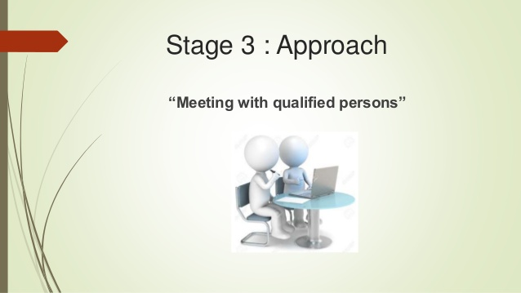

Slide 13
Approach(Analysis, Evaluation and Qualification of the Requirements, Identification of the Solution)
During this stage, you go on to meet the clients identified during the Prospecting stage. This meeting can happen either Virtually using phone & video calls or Physically by meeting in person.
In this stage, the sales person tries to identify the client's requirements, analyse them, perform lead qualification and based on that, tries to present a solution from their offerings. This happens over several days with multiple meetings each for Need Identification, Sales Presentations, etc

Slide 14
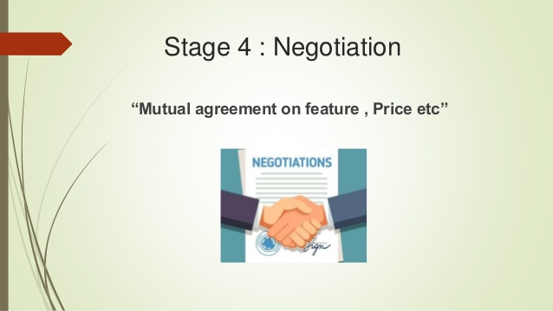

Slide 15
Stage 4:Negotiate
This is one of the most crucial stage of the sales cycle since this can either make or break sales deal. This stage would decide whether the client would buy from you or not. This stage involves negotiation with the clients on the pricing aspect of the deal and its associated terms & conditions. During this stage, you should demonstrate the value of your product to be more than what the customer is going to pay. This is usually done using many techniques like "Balance Sheet Comparison method" for comparing the pricing with respect to your competitor; "TCO" method, wherein you tend to explain the Total Cost of Ownership of your product over a given time period to the client and explain how it would benefit more than the cost he would pay at present.

Slide 16
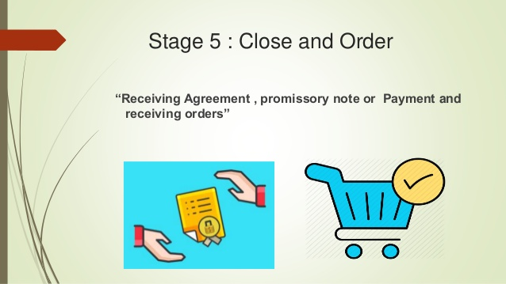

Slide 17
Stage 5: Close & Order(Finalising the order& account follow up)
At the closing point of sales cycle, the Client would agree to the terms & conditions of the deal or contract. The Deal would be considered to be "Close", when the customer would sign on the contract and would complete all the necessary formalities for issuing a purchase order to you.
Order is the last stage of the sales cycle, wherein the Client would issue the purchase order and Order fulfilment is done. Once a Purchase Order (PO) is issued, the salesperson has to hand over the PO to the concerned Operations Department or Fulfilment or Delivery Team which would carry it forward. The client's responsibility is transferred to the Delivery Team. This marks the end of the sales cycle for that particular deal.

Slide 18
