Slide 1
Closing a Sale- Top 7 Techniques
Prof : Sharlot Bency

Slide 2
Learning Objectives
To evaluate the various techniques of closing a sales call.
To apply the techniques in various sales closing scenarios.

Slide 3
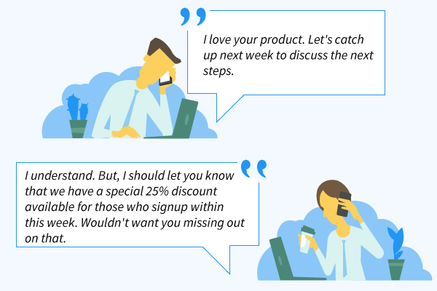

1.Now or Never closes
This is where salespeople make an offer that includes a special benefit that prompts immediate purchase. For example:
“This is the last one at this price.”
"We’ve got a 20% discount just for customers who sign up today.”
“If you commit to buy now, I can fast track you to the front of the implementation queue.”
This technique works because it creates a sense of urgency and can help overcome inertia when a prospect wants to buy -- but for some reason isn't pulling the trigger. Of course, you should always establish value before offering a discount or promotion.
Also called “Urgency Close’

Slide 4
2.
SUMMARY CLOSE
Salespeople who use this closing technique reiterate the items the customer is hopefully purchasing (stressing the value and benefits) in an effort to get the prospect to sign. For example:
“So we have a term policy of sum assured of 1 CR with a Critical Illness Rider with a premium payment term of 20 years and an annual premium of Rs 15000.The Mutual fund that we agreed upon is a maximizer fund with 100 % equity investment with a monthly mode of payment of Rs 25,000 for 10 years.In addition to this a Mediclaim with a Family Floater of Rs 8 lakhs has been agreed upon for a period of 5 years carrying an annual premium of Rs 10,000.
When would be a good time to collect the supporting documents ?”
By summarizing previously agreed-upon points into one impressive package, you're helping prospects visualize what they're truly getting out of the deal

Slide 5
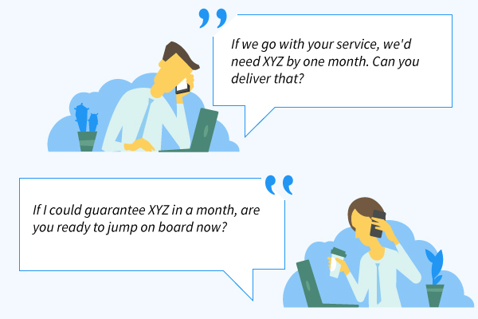
3.SHARP ANGLE CLOSE
Prospects often ask for price reductions or add-ons because they know they have the upper hand -- and they also know you expect it. If you have approval from your sales manager to do so, try the sharp angle close technique to catch these prospects by surprise.
When they ask, "Could you add on a few extra hours of onboarding at a discounted rate?" reply, "Sure. But if I do that for you, will you sign the contract today?" It's likely they won't be expecting this response -- first, because you agreed to their request, and second, because you've proposed closing today.

Slide 6

4.QUESTION CLOSE
In this tactic the concept is to ask your lead probing questions that can make them actually to explain why something does or doesn’t work for them .
Ask them why they can’t proceed with a certain investment plan or why a certain feature wont solve their problem.
Why this Works? These questions give you a far better opportunity to explain why your product meets their needs.
When it works best: When your lead seems perpetually on the fence, but isn't really explaining why they aren't interested.
When not to use it: When the prospect has clearly stated reasons for why aspects of your product doesn't work for them.
For example: “In your opinion, does what I am offering solve your problem?”
“Is there any reason why we can't proceed with the investment?"

Slide 7
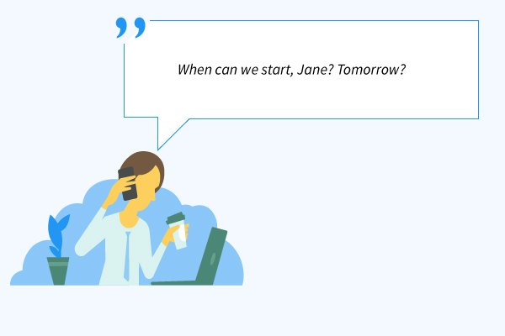
5. ASSUMPTIVE CLOSES
A popular closing technique, the Assumptive close is where the salesperson assumes that the deal has been made. Sales reps use this technique when the prospect has checked most of the boxes in each step of the sales process but has not yet confirmed the deal.
What's important here is to closely monitor your prospect's interest, engagement, and objections throughout.
After a call or meeting, ask, "Did this presentation align with your expectations?" If you've just provided them with new information about your product or service, ask, "Does this sound like something that would be valuable to your company? Does this meet a specific need or pain point?"

Slide 8
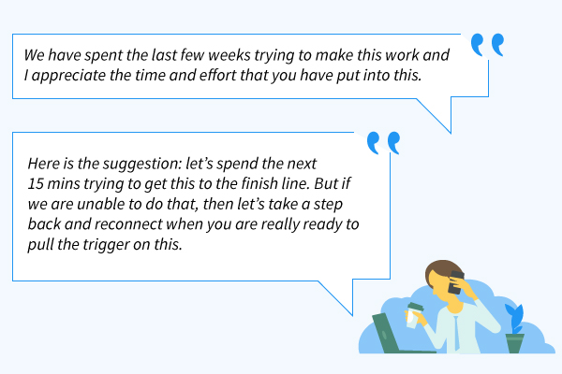
6.Take Away Closes
If you have observed kids, you've likely noticed if you take a candy away from them -- they'll want it more than ever. Use this similar psychological practice on your prospects.
Threaten to take away the candy and you’ll see how well they behave.
If they're balking on price, remove a feature or service and present the discounted offer to them. It's likely, they'll be thinking about the part you removed rather than the discounted price.
Using the Take Away closing technique, you can offer to withdraw the whole deal from the prospect in order to push them to accept the offer. This technique can be used for prospects who happen to be a time-sink and take up a lot of your time – with little to show by way of progress.

Slide 9
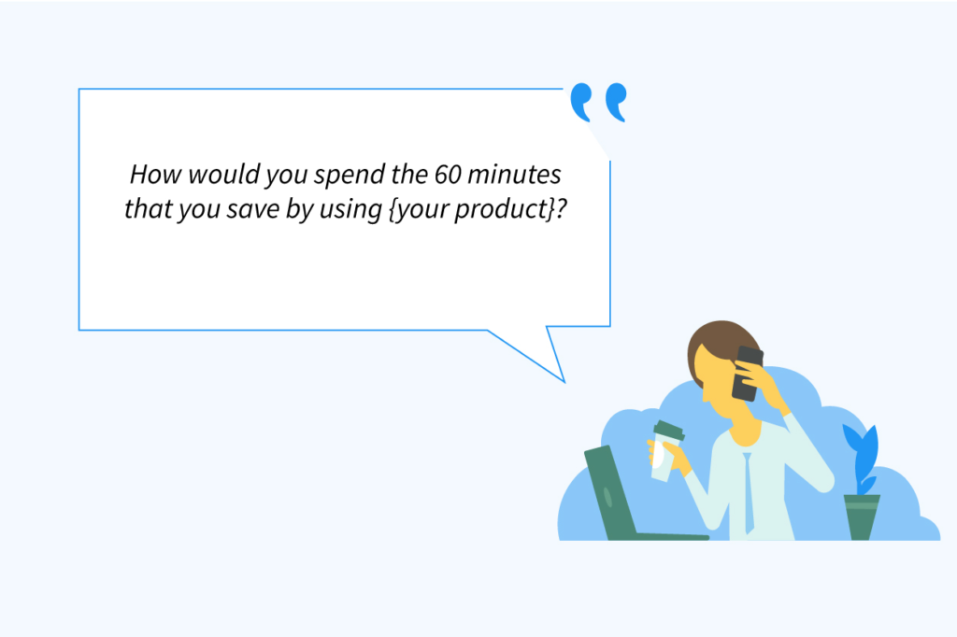
7.The Ownership Close
Have you come across one of those car salesmen who make a sales pitch, talking as though you already own the vehicle – Asking questions like, if your garage needs a rework or how frequently you plan to go on a road trip etc.
Classic Ownership close; where the seller firmly places the idea of the buyer owning the product.
Using this technique, you paint a picture of the prospect’s business will change for the better; being a hypothesis, this strategy works best when backed up by facts that show how their key metrics will have improved once they purchase your product – Tell compelling stories of terms goals achieved, competitions crushed etc. that will make the prospects to immediately jump in and start using your product.
By repeatedly stating the benefits that they will enjoy, you create a mental closure that your product will improve their business, thus making it easy for you to finalize a deal.
Eg-Would you like to add a Critical Illness Rider and a Premium Waiver Rider to the policy?
What mode of premium payment would you prefer?

