Slide 1
BPR
Process value chain,
process measurement

Slide 2
Process View
Input Output
Raw materials, components, Info products,services
PROCESS

Slide 3
Process view of an organisation
Processes are aligned horizontally with the objective of achieving the organisational objectives through the single point control of all the activities which culminate in the realisation of an objective
Processes can be strategic, tactical or operational
Strategic Processes Include –Strategic Business Planning, Succession Planning, Technology Planning etc
Tactical planning includes capacity expansion, make or buy, resource planning decisions, new product dev
Operational planning includes processes: cash planning to expenditure control
- customer acquisition and retention
-order to cash
-procure to pay
-plan to produce
-hire to retire -business continuity planning and control
-operational risk assessment and mitigation

Slide 4
Business –Value Chain?
One of the best known models of business is the ‘Value Chain’ framework developed by Harvard Business School professor Michael Porter who referred to processes as chains. Porter defined two types of activities in which the firm engage in : primary activities and support activities.
Primary activities are those activities through which a company ‘adds value’ to its input for their customers who are prepared to pay for its output .

Slide 5
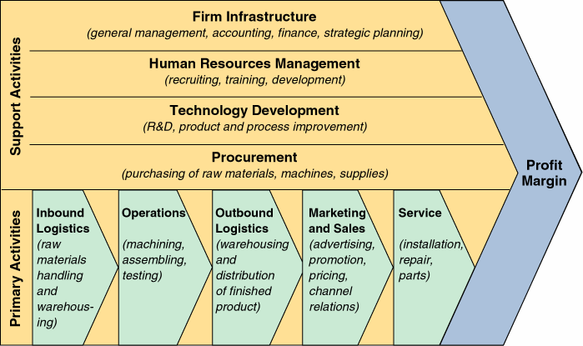
CORE BUSINESS PROCESSES (Porter Value Chain)
New Product Development

Slide 6
Classification of Business Processes
Core processes which have direct interface with external customer
Supportive processes which support core processes and have internal customers
Outsourced processes which could be sub contracted or outsourced
Collaborative processes which span across companies which collaborate to achieve a joint objective

Slide 7
Characteristics of Core Processes
Essential contributors to competitive advantage of firm
Related to core competence
Corporate strategy of firm depends on core processes
Generally not outsourced
Core processes include Customer acquisition and retention ,product development, operations, logistics etc

Slide 8
Characteristics of supportive processes
Important processes but are not generally in direct interface with external customers
Do not directly contribute to corporate revenues
Their functioning enhances the effectiveness and efficiency of core processes
Could be outsourced
Supportive processes include Finance, HR Admin, IT etc

Slide 9
Outsourced Processes
Practice of getting non core processes performed by 3rd party eg Call Centres.
Benefits of outsourcing include:
- Cost saving thru reduction of overheads - Preparation of a lean org thru abolishment of non value added activities - Elimination of monotonous jobs in the org as they are not its core competencies and can be better done with companies equipped with domain skills eg CISF
- Operational risk factors related to capacities competencies and operational continuity to be assessed

Slide 10
Collaborative Processes
Process of multiple companies coming together to serve the same company
Virtual corporation which is seen by customer as one
One seamless set of processes between multiple companies (may be even competitors-coopetition) which span across various companies to ensure delivery of value to customer - NTPC, L&T, BHEL bag order in Algeria, - Compaq, Microsoft, Oracle, SAP, CISCO form virtual organization to offer Enterprise Solutions

Slide 11
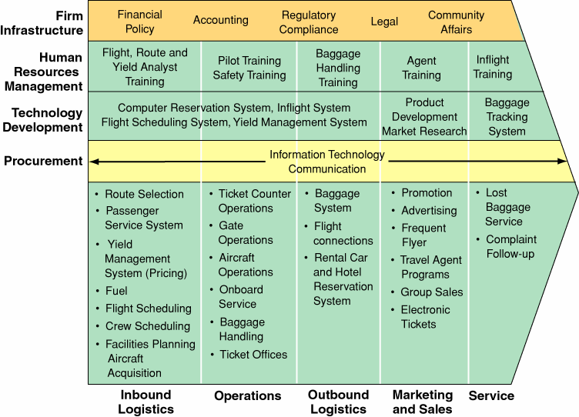
Core business processes (Porter Value Chain) – Air Line Company
New Product Development

Slide 12
Business process - performance measures
Process : inputs, outputs, net work of activities, resources(Capital, labour)
Flow units : unit of output
Key process measures :
Internal measures-operational : process flow time,: Total time needed to transform one flow unit from input to output.
Process flow rate/Throughput time: number of flow units that flow thru a specific point/stage in the process per unit of time.
Inventory , Process quality
Inventory : storage of finished units of product or service
Buffer : flow units of product or service
Activity : transformation process
Resources : Capital, labour
Cycle Time : total flow time.
Financial measures(value for money to customer) : revenue, cost, profit , - turns, ROI, ROA, cash flow.
External measures (customer expectations): response time, product cost, variety
Process competencies(transformation) : process flow time, process flexibility,
process quality : process accuracy, conformance to design specs, process reliability & sustainability.

Slide 13
Process measurement
Little’s Law: Inventory equals throughput times average flow time.
Average inventory : (I) =Throughput (R) x Average Flow Time(T)
Or
I = R x T
Average Flow Time(T) = Average Inventory(I)/ Throughput(R)
T = I/R

Slide 14
Process measurement -Examples-Exercises
Application of Little’s Law: Examples
Material Flow : A bakery processes an average of 500 Kgs of bread per week. Typical inventory of raw material for bread is 250 Kgs. Here the process is bakery and the flow rate is a kilogram of raw material for bread. Calculate average flow time.
Customer flow: An eatery on a national highway serves an average of 50 customers per day. A typical day at the eatery is about 10 hours. At any time there are an average of 15 customers at the eatery. These customers are eating their food/drinks or waiting to order or waiting for their order to arrive. Find out the total time spent by the customer in the eatery.
Job flow : A branch office of an insurance company processes 1000 claims per year. Average processing time is 2 weeks. The insurance office works for 50 weeks in a year. The process is a branch of insurance company and the flow unit is an insurance claim. How many claims are being processed at ant time?
Cash flow: A cement plant processes Rs 400 crores of cement per year. The cost of processing cement is Rs 200 crores per year. The average inventory is Rs 100 crores. The process is cement plant and flow unit is a cost rupee. The value of inventory includes both raw materials and processing cost. Calculate the flow rate of a rupee.
Service flow: A financial service organization receives on an average 160 enquiries per day about its products and services. It takes 30 minutes to process each enquiry. Management wants all enquiries to be answered on the same day.. Assume 8 hours of work per day. Assume that each enquiry requires one person to handle it. How many people are needed to process the enquiries ?

Slide 15
Capacity-Cycle time Analysis
What kind of capacity?
How much capacity?
When the capacity needed?
Cycle time analysis along with Rework, Multiple paths and Parallel activities..
Rework/rejection affects output..results in further processing, rework and cycle time and capacity..
Cycle time(CT) = (1+r) x T where T= sum of activity times including inspection, r= rejection %
Multiple paths: fast track and normal track. Assume a process follows multiple paths after a decision point into fast track and normal track.
Average cycle time across all paths is given as : CT is cycle time..
CT = p(1) x T(1) + p(2) x T(2)…where p- is probability that a process follows a normal or fast track..T is activity time..
Parallel activities : Cycle time efficiency = Process time/Cycle time(CT)
Process Time = theoretical cycle time.
^

Slide 16
Cycle time analysis
Example: (page no-71-text book) A medical insurance company processes an average of 1200 claims per year. On an average, at any time 60 claims are pending at various stages of claim processing(waiting for additional information from the customer, in-transit from branch office to the head-office, waiting for approval). Assume that the company works for 50 weeks in a year. Find out the number of weeks taken for processing a claim.
Answer: average flow-rate or throughput rate = ^ = 1200/50 = 24 claims per week.
Work-in –process= 60 claims.
By Littles law :
Average WIP/inventory(I) = Flow-rate/throughput ® X average flow-time(T)/cycle time
Therefore Time taken for processing a claim: Cycle time = WIP/^ = 60/24 = 2.5 weeks ..which is rather high..
Suppose the company wants to reduce the cycle time..as per Little’s law, either WIP must be reduced or flow rate should be increased. Suppose after a BPR exercise, the company is able to reduce the WIP by half . This can be achieved by reducing unplanned delays such as waiting for more info from customer, transit time..
Thus the cycle time for the redesigned process can be calculated as
CT = WIP/^ = 30/24= 1.25 weeks.

