Slide 1



PGDM-OM&SCM- 2021-23
Business Process Mgmt(BPR/BPM)
Introduction

Slide 2
Course Faculty -1
Prof B.V.R. Murty,
MTech (IIT, Madras). Consultant Kharghar, Navi Mumbai.
Over 20 years as Core Faculty in the area of Operations Management, 7 years as Deputy Director- ITM Global Leadership Centre offering 3 focused PGDM programmes with
Specialization in International Business, Retail Management and HR.
Over 27 years industrial experience with leading organizations – L&T, DRDO (Defense –GOI) in the area of product development, operations, maintenance and projects. Actively associated with consultancy projects.
Presented and published 45 research papers in National and international conferences.
Organized 2 International Conferences on Quality Management (2007 and 2009) in association with NCQM.
Active Rotarian and associated with QCFI, NCQM, BMA, IIMM, IIIE and Social/cultural organisations (ISKON).

Slide 3
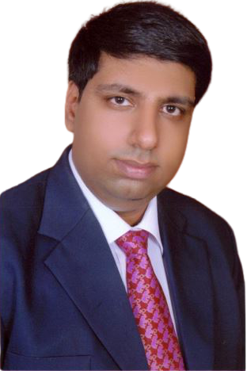
Course Faculty-2
ITM Alumni - PGDM -2004-06.
Abhinav Sabharwal RPA & AGILE Trainer @ School of RPA
with 13 years of overall experience in various domains like Supply Chain Management, Transport Management, Ware- House Management, CRM & ERP implementation, Banking domain for RPA (Robotic Process Automation) project.
Well versed with various SDLC methodologies like Waterfall, Agile & V model of software development.
Domain knowledge and experience – SCM, IT, Business Analyst
Worked in companies such as Capgemini, Melstar Technologies, Future Logistics, Blue-chip Consultants..

Slide 4
Recent events..
Toyota to cut global production by 40% ?
GM to recall Chevrolet Bolt cars ? $1 billion loss
Maruti Suzuki reported 40% drop in sales in H1
Govt. to relook at reopening international flights/travel?
Many countries have put 6 African countries in red list?
Alpha, Beta, Gama, Delta…Omicron?
What is the common issue/process in the above …?
What are Global challenges today?
Discuss…
Geo-political , Afghanistan, Global warming, Shipping delays, High crude prices, LPG, Petrol, Diesel, High inflation, Labour shortage, Super Power rivalry, any other..?

Slide 5
How Indian companies have responded..
Over 100 crores vaccinated, 50% fully vaccinated
India became self sufficient in PPE within 3 months
India supplies vaccines,critical medicines to many countries
Amul Launches 33 New products in the last one year and maintains supplies.
Biocon, Cipla, Zydus are launching cure for Covid 19 shortly
IIT Delhi has developed a low cost testing kit for Covid 19.
IIT Bhubaneswar has developed an app for monitoring health and helping migrant labour(to get jobs) in collaboration with Govt,s app Arogya.
DRDO has developed a testing kit for quick results
Many more examples..?
Reliance has garnered Rs 150,000 crores from leading technology companies and inventors in the last financial year…Name of investors?

Slide 6
Vodafone report on Covid readiness by Organizations- 2nd August 2020
Resilient and Future Ready
*Positive attitude to change* : They embrace change and are excited by the future.
*Open to new technology* : They acknowledge the power of technology to solve business challenges.
*Clear steps towards business transformation* : They have a roadmap in place for how technology can transform their business.
*Detailed strategy* : They have a wider business strategy for the future that is documented, specific, funded and measured.
*Up-to-date with trends and uncertainties* : They have clearly identified the forces shaping their business and refer to key thought leaders to help.
*Adaptable* : They can react quickly to new trends or challenges and are quicker to market than competitors.

Slide 7
BPM/BPR-Business Process Reengineering
Why study ? Consulting –big opportunity.
Lucrative opportunities, high growth and versatile experience.
Application/implementation during IIP
Essential in consulting/Logistics/IT/BFSI/…
Regular recruiters at ITM.. Accenture, MSX International, Deloitte, DHL.GEP (Business Analyst), DTDC, Scaler Academy, KD practice(Mgmt Consulting), Learning Mate, Reliance Jio, TCS, A&A consulting, Ugam Solutions, Savior Consulting, Consulting Connoisseurs, IRQS.
Skills, competencies…Analytical skills, communication skills, inter-personal skills, Business process analysis, Process flowcharts, business/sector specific knowledge, group behaviour, negotiation skills, creative ideas…

Slide 8
Business Process Reengineering
What is a business organization?
Objectives/purpose of Business?
Who are the stake holders?

Slide 9
What is a Business Process?
Business Process Management
Business process Analysis
Business process design
Business process mapping (As –Is)
Business process reengineering
Change management (To-Be)
Business process transformation
Business process improvement
Standardize and sustain.

Slide 10
Objectives of Business Organizations
Create wealth among stakeholders
Stay and grow in business thru best practices and innovation
Identify and satisfy customers
Competitive advantage over competition
Create employment opportunities
Motivate employees thru total employee involvement and empowerment
Maintain safety and adhere to regulations and law
Serve local community

Slide 11
Types of Business Organizations
Proprietary
Cooperative
Private sector-Pvt Ltd and Public Ltd
Public sector
Joint sector
Multi national companies with right of liaison only
Multinational companies with right of trading
Multi national companies with joint venture with Indian companies
MNC with wholly owned enterprise

Slide 12
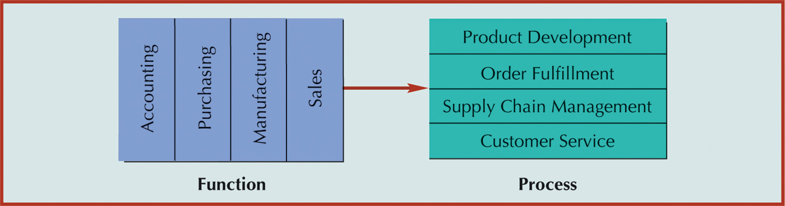
fig_06_09
Function vs Business Process

Slide 13
Functional view of an organization
Traditional org consists of vertically aligned functions
Each function has people with functional skills and objectives of function are specific to the operations of the function including targets and budget
Targets are a part of the org target
Lack of coordination or synergy with preceding or succeeding functions
Functions include Marketing, R&D, Sales, Finance, Manufacturing, Human Resources etc
Functions include sub functions for example mfg has sub functions such as purchasing, inventory, quality, etc
Sub functions can be further divided into activities and Tasks
Example of subdivision of function into sub-function includes categorizing mfg into mfg planning, inventory, purchase, mfg exec and control and qlty control
Activities are a set of tasks performed in a function to achieve a certain objective
Activities in sub function inventory include stock control, adjustment, purchase requisition, receipt, inspection, reject, binning, lot tracking, expiry control, issues, returns

Slide 14
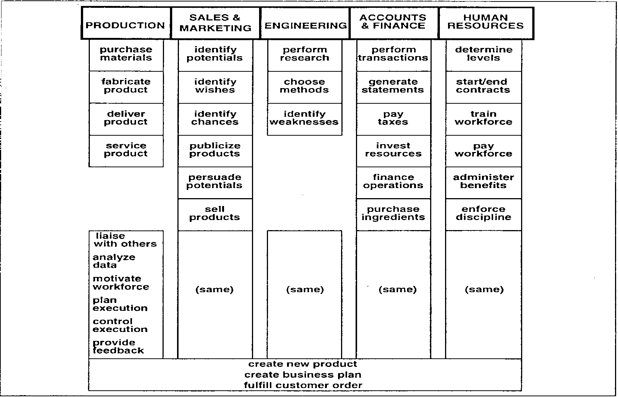
Functions- hierarchy

Slide 15
Disadvantage of functional View
Fragmentation of responsibility in executing a complete business cycle eg order fulfilment as well as different measures for what denotes completion of responsibility of function eg order booking by sales, completion of mfg by prodn, dispatch by logistics.
But for finance sale is complete only when money is realised
No one entity is in charge of the outcome of the entire cycle of activities starting from acceptance of order to realization of money
Individual functions may have separate goals ,priorities and budgets leading to lack of focus

Slide 16
What is a Business Process?
Business Process
Set of logically related tasks
Defined business outcome
Internal or external customers
Cross organisational boundaries

Slide 17
BUSINESS PROCESS
A Business Process consists of a set of inter-related Activities/Tasks intended to transform one or more inputs (based on customer’s requirement trigger) into one or more of outputs that represents solution from (internal or external) Customers’ point of view.

Slide 18
BUSINESS PROCESS ……..
The process starts with customer need or request and ends when the need is satisfied in terms of key business improvement(kbp)
Objective of key business improvement are…
-making process efficient :minimising the resources used
-making process effective : producing the desired results
-making process adaptable : being able to adapt to changing customer and business needs.
Parameters of excellence are : quality, cost, delivery, safety and morale

Slide 19
Video- 3 minutes -
1.1 Business Process – How and Why?

Slide 20
CHARACTERISTICS OF WELL MANAGED PROCESS
PROCESS OWNERSHIP AND RESPONSIBILITIES
WELL DEFINED PROCESS SCOPE AND BOUNDARIES
WELL DOCUMENTED PROCESS PROCEDURES
WELL DEFINED MEASUREMENT AND FEEDBACK CONTROL CLOSE TO POINT WHERE ACTIVITY IS PERFORMED AND IMPACT ON PERFORMANCE
PREDICTION AND CONTROL OF CHANGES IN BEHAVIOUR
CUSTOMER RELATED TARGETS AND MEASURES
FORMALISED CHANGE PROCEDURES
ELIMINATION OF PROCESS RISKS THROUGH RISK CONTROL PROCEDURES AND ROOT CAUSE ANALYSIS OF NON CONFORMITIES

Slide 21
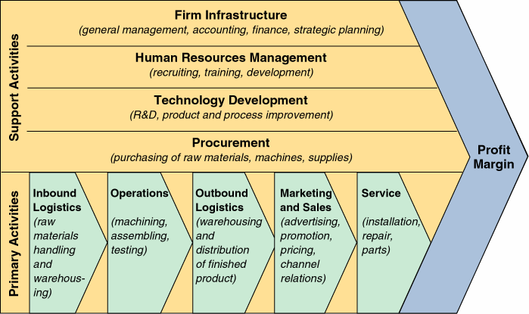
CORE BUSINESS PROCESSES (Porter Value Chain)
New Product Development

Slide 22
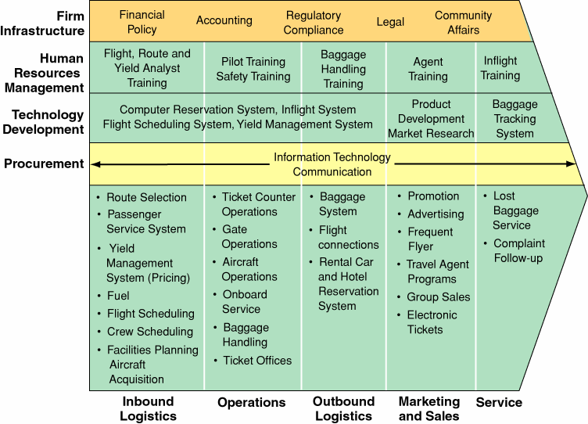
CORE BUSINESS PROCESSES (Porter Value Chain)
New Product Development

Slide 23
Business Process - Terminology
Business Process: A continuous and regular action or succession of actions, taking place or carried on in a definite manner and leading to the accomplishment of some result; a continuous operation or series of operations.
BPR emphasises a process view which cuts across the functional hierarchies to reach the customer.
Process Map: intended to represent a process in such a way that it is easier to read and understand . Process map provides a focal point for discussion about the way people work and will help create common understanding of work patterns. Process maps give clearer explanation of a process than words. The process of mapping spurs teams and individuals into improvement-visibility of wasteful or plain silly process steps, makes people want to change them.
Simple Flow chart symbols:
Flow
Start/End
Decision point
Task/Activity

Slide 24
Business Process - Terminology
Controls : company policy, legal.
Inputs: Outputs:
Materials, info.. Product, info…
Mechanisms : people,
Systems,
Process

Slide 25
Transformation Process?
Operations
Management
Feedback
for control
Transformation:
Network of activities
Inputs
Outputs
Man, Machine, Material, Information,
Skills, etc.
Goods /
Services

Slide 26
Transformation Processes-Types
Input
Transformation
Output
Physical Manufacturing
Locational Transport/storage
Exchange Retail
Physiological Healthcare
Psychological Entertainment
Informational Communications

Slide 27
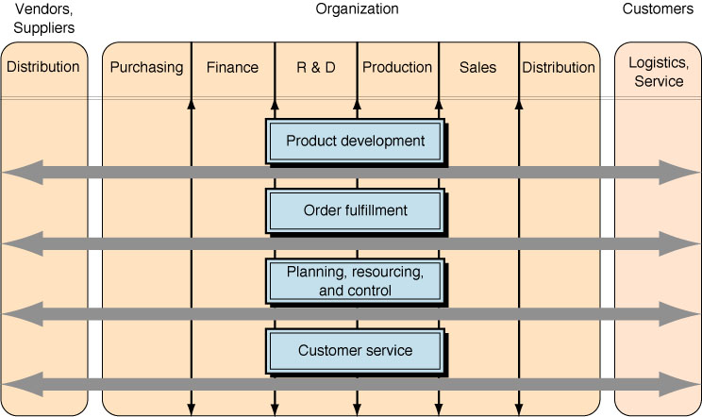
Business Processes Across Functional Areas

Slide 28
Business Process subdivisions
Processes
Sub processes
Activities
Tasks

Slide 29
Business Process Hierarchy
Process Level :
Sub-Process Level :
Purchasing-
Task Level :
Purchasing
Order
Processing
Shipping
Vendor
Management
Inventory
Management
Specify
Requirement
Issue
RFQ
Select
Vendor
Release
P.O.
Receive
Material
Issue
Payment
Verify
Need
Justify
Request
Obtain Cost
Estimate
Verify
Budget
Prepare
P.O. Form
Obtain P.O.
Approval

Slide 30
Business processes-examples
Order (Customer) to cash(Sales/Marketing)
Billing(Sales)
Purchasing(Purchasing dept)
Shipping(Logistics –inbound/out bound))
Inventory Management(Purchasing dept)
Warranty & Claim Processing(Sales)
Accounts payable(Sales/Finance)
Accounts receivable(Sales/Finance)
Vendor Approval process(Purchase dept)
Credit approval Process(Sales)
Human Resource planning…..(HR dept)
Customer service(Customer complaints/CSI/Customer engagement)
After sales service(Spares/repairs)
Quality Management(inspection/QA/Compliance/Standards)

Slide 31
Order Processing - Sub-Processes – Order to Cash
Sub - process order entry -order acceptance -order production scheduling -rough cut capacity planning
Sub - process material reqmt planning -bill of material –purchase requisitioning
Sub - process purchasing -tendering –purchase order on supplier
Sub - process receipt -material receipt –inspection binning/rejection
Sub - process invoicing- approval of supplier receipt and invoice thru 3 way match-preparation of bill and forwarding to accounts for passing
Sub - process inventory - material binning –inventory mgt –issues –returns – reorder mgt –purchase requisition
Sub - process mfg planning execution and control -production planning –work order initiation -requisition and consumption of materials -mfg execution control – eqpt mgt incl maintenance -productivity and quality control
Sub - process goods dispatch and receivables -packing of goods -invoicing –logistics –delivery - follow up of accounts receivables –payment receipt -closing of account

Slide 32
Why BPR ?
Organisation is divided into specialised functions e.g. sales, operations, finance,engineering etc,
Management focus has traditionally been on the functional hierarchy
Breakdown of tasks and specialisation in each, leading to
- Barriers in procedures and information flow
- Whole view of business process fragmented beyond recognition by any manager
- Lack of holistic view
And also.. Unnecessary process steps(non-value added)
Duplicated tasks and data ..examples?
Time consuming, error prone manual procedures

Slide 33
Why reengineering ?
Driving force behind reengineering is 3 C's:
CUSTOMER : Fast changing consumer habits and expectations
COMPETITION : Domestic and global,,
CHANGE : Business, social, political and economics

Slide 34
History of BPR?
BPR Components already existed…
  Improving business processes – TQM, Six Sigma
  Greenfield design – organisation design
  IT enabled – systems analysis
  Introduced as a new idea by Michael Hammer and James Champy in 1990 in a book titled “ Reengineering the Corporation” stating that radical redesign and rethinking in an organisation will reduce cost and improve service quality.
Current Limitations…
  TQM methodology is narrow & designed bottom-up
  Greenfield design too broad in scope
  Systems analysis projects constrained to current structure
BPR overcame limitations by using ‘business process’ as design unit

Slide 35
BPR - Evolution
  Initially, attention was given to a complete restructuring of organizations. Examples…Centralised to SBU(L&T)
  Later, the concept was changed due to failures of BPR projects and the emergence of Web-based applications.
  Today, BPR can focus on anything from the complete restructuring of an organization to the redesigning of individual processes.
  Major objective of BPR = Information Integration.

Slide 36
Business Process Reengineering
Definition
Business Process Reengineering is defined as the fundamental rethinking and radical redesign of business processes to achieve dramatic improvements in critical, contemporary measures of performance such as cost, quality, service, and speed.
Business process reengineering is focused on reengineering business processes.
Notes:
3

Slide 37
Key Words in Reengineering Definition
Fundamental
  Why do we do what we do?
  Ignore what is and concentrate on what should be…GST
Radical
  Business reinvention vs. business improvement …PGDM I Connect
Notes:
4

Slide 38
Key Words in Reengineering Definition (Continued)
Dramatic
  Reengineering should be brought in “when a need exits for heavy blasting.”
    Companies in deep trouble.
    Companies that see trouble coming.
    Companies that are in peak condition.
Business Process
  a collection of activities that takes one or more kinds of inputs and creates an output that is of value to a customer.
Notes:
5

Slide 39
Video- 3 minutes -
1.2 BPR - Intro

Slide 40
So What is BPR?
BPR is an important philosophy. It aims to achieve huge improvements in performance by redesigning the processes through which an organization operates, maximizing their value-added content and minimizing everything else. This approach can be applied at an individual process level or to the whole organization.
Drivers for BPR; Cost, Quality, Delivery reliability, product features, product support and service.
Focus areas : process focus, radical change, & radical improvement.
Phases : Rethink, Redesign and Retool.

Slide 41
BPR PHILOSOPHY
BREAK ESTABLISHED TRADITIONS
(Functional Silos; ‘Clean-slate’ Approach, Mgt. Practices)
TOP-DOWN APPROACH
(Re-look at ‘PROCESSES’, and not at
‘SUB-PROCESSES’ & ‘TASKS’)
EXPLOIT ‘IT’ & ‘INNOVATION’

Slide 42
OTHER NAMES SIMILAR TO BPR
PROCESS REENGINEERING
BUSINESS PROCESS REDESIGN
BUSINESS TRANSFORMATION
BUSINESS RINVENTING

Slide 43
Example :
Receiving the order, entering into the computer, checking the customer credit, picking the goods out of stock, packing, loading into the truck and so on. None of these activities is of any value or interest to the customer. Customer is only interested in the end result of these tasks ie, Deliver Goods/Service.
How do we reengineer the process to minimise time and speedy delivery ?

Slide 44
Video- 5 minutes -
1.3 Business Process Reengineering?

Slide 45
BPR- basics
The basics of BPR include
1) A process orientation
2) A horizontal focus across boundaries(rather than a vertical, functional approach within an organisation)
3) A customer perspective
4) Bench marking performance measures
5) Building organisational capabilities and competencies
6) Empowerment of inviduals in the organisation
7) Improvement through application of information technology.

Slide 46
BPR basics(continued)
Value chain analysis enables identifying essential activities.
Each activity has both a physical and an information component. For example, in the past application of technology has usually focused on the physical component of the activity,for example robotics in manufacturing.
Now systems analysts can approach the value chain as a means of identifying areas, which can apply technology for greater business benefit in the value chain.
Structured approach is essential
-what needs to be done, when it should be done,how it should be done and how it should it be controlled
Refer to slide – 1.2 …value concept..

Slide 47
BPR Terminology(continued)
Lead Times: how long is the process, how long does it take to complete each step and in between each step.
Dependences: should be clear, i.e where a task depends on the output of another.
Who is performing each task?
Problem areas: should be shown- those tasks that are difficult, dirty or dangerous and those which frequently experience problems.
Value addition: whether a step “adds value” or merely adds cost.
It is necessary to identify “levels” of processes by indicating each process step being broken down into more detail on another chart.

Slide 48
The Enabling Role of IT
Old Rule | Intervening Technology | New Rule
Information appears in only one place at one time. | Shared databases, client/server architecture, Internet, intranets | Information appears simultaneously wherever needed.
Only an expert can perform complex work. | Expert systems, neural computing | Novices can perform complex work.
Business must be either centralized or distributed. | Telecommunication and networks: client/server, intranet | Business can be both centralized and distributed.
Only managers make decisions. | Decision support systems, enterprise support systems, expert systems | Decision making is part of everyone’s job.

Slide 49
Business Process Reengineering Involves..
Examining how and why we add less value than competition
Continuous appraisal of customer requirements and tradeoffs they make between price functionality quality service
Eliminating unnecessary activities reducing delays in processes and improving task efficiencies
Increasing flexibility of processes and task force
Increased involvement of customers and suppliers
Empowered staff with greater responsibility
Outsourcing non core activities which consume mgt time money and energy(GE..Citi Bank)
Reengineering could involve improving parts of a process which is below par performance, redesign of end to end process, redefinition of business –Vision, Mission, Values, Strategies

