Slide 1
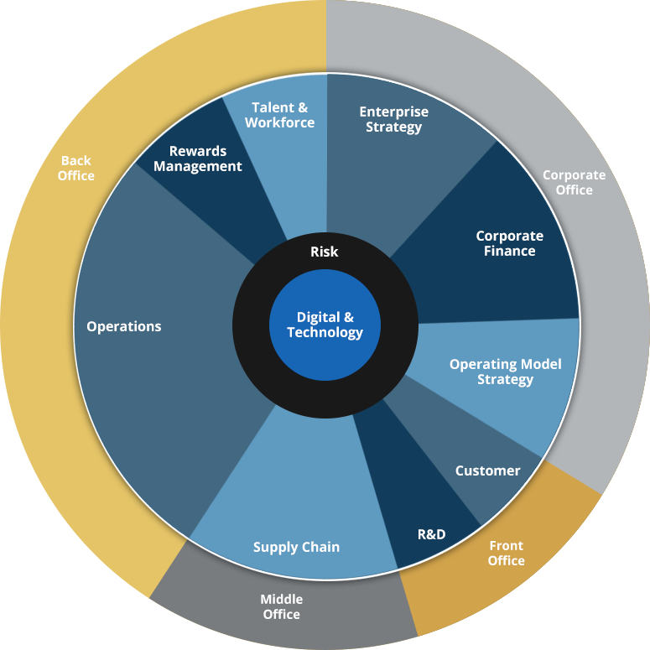
Consulting Industry -Composition
Share of various services

Slide 2
Consulting Services -Classification
Area-wise consulting services :
Enterprise Strategy : Business Strategy and Planning, Portfolio & Capital Strategy, Strategic Risk, Cybersecurity,
Corporate Finance :Transactions: Acquisitions, Transactions: Divestitures, Joint Ventures & Alliances, Balance Sheet Strategy & Investor Communications
Operating Model Strategy : Services , Organization, Corporate Services
Customer : Branding & Marketing, Pricing, Commercial Execution, Customer Service
Supply Chain : Supply Chain Planning, Capital Projects, Production Strategy, Production Operations, Asset Management, Logistics, Sourcing Strategy
Operations : Procurement Operations, Service Operations, Finance, IT, HR
Rewards Management: Benefits, Compensation
Talent & Workforce : Workforce Management, Communications & Change, Talent & Leadership

