Slide 1
BUSINESS PROCESS RISK MANAGEMENT

Slide 2
PROCESS RISK MGT
Risk is possibility of desired results not achieved
For business decisions risk is events that have strong effects on overall performance
Performance monitoring systems have early warning systems for risks or bottlenecks
Risks categorized as financial(liquidity, profitability) or by origin (recession, market changes, natural calamities, pandemic) or by position in value chain

Slide 3
RISK MANAGEMENT
Risk has grave effects on target systems of company
Number of factors subject to risk
Important to correlate risks associated with each other
Monitoring systems needed to ensure that developments that threaten the operations of a company be recognized in advance and preemptive action taken

Slide 4
RISK MANAGEMENT
Risk has to be analyzed with regard to the likelihood and potential harmful effects
Categorize risk according to problem categories such as bankruptcy, loss of profits
Management of financial risk includes bad debt, inventory obsolescence, spoilage,etc
Management of operating risk includes order backlog,cancellation,labour unrest,force majeure etc

Slide 5
PHASES/ACTIVITIES OF RISK MGT
Risk identification SBU wise and category wise
Risk analysis and assessment through control by taking measures for avoidance and reduction of risk by quantification of risk effects on key figures
Risk handling by avoidance measures and observing risk situations after measures
Risk control through continuous monitoring of early risk indications ,recording effects on key figures, goals, strategies
Simulation of effects and adjustment of risk measures.

Slide 6
MEASURES FOR RISK HANDLING
TYPE OF MEASURES
-RISK AVOIDNCE
-AVD HIGH RSK AREA
-RISK REDUCTION
-CREDIT CHECKS
-RISK SHARE
-BACKGROUND -RISK OFFSET
-HIGH MARK UPS
-RISK LIMITATION

Slide 7
FUNCTIONAL AREAWISE RISK
R & D - Late replacement of old products
SALES - Sales decline, price crash
PROCUREMENT - Supplier problems
PRODUCTION - Below expectation output
SHIPPING - Incorrect, late deliveries
CUST.SERVICE – Warranty issues, recalls
FINANCIALS – Share value decline, liquidity risk
PERSONNEL – Severance cost, low productivity

Slide 8
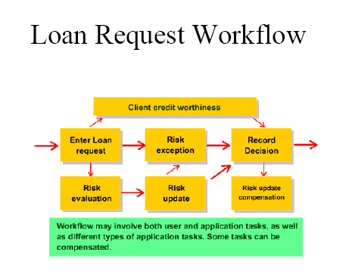
Loan Request workflow

