Slide 1
Process Models
CMMI –Process Improvement Model
BPM vs BPeM, BI
BPM Methodologies

Slide 2
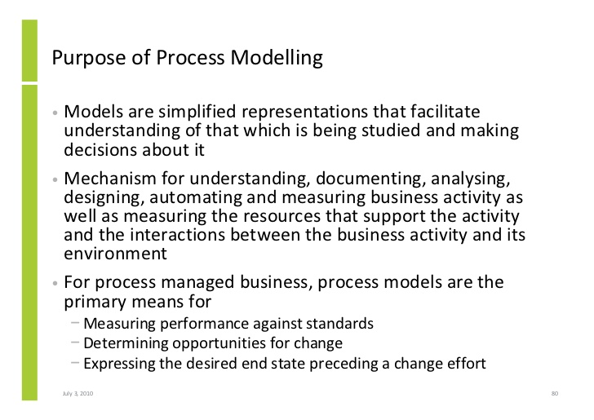

Slide 3
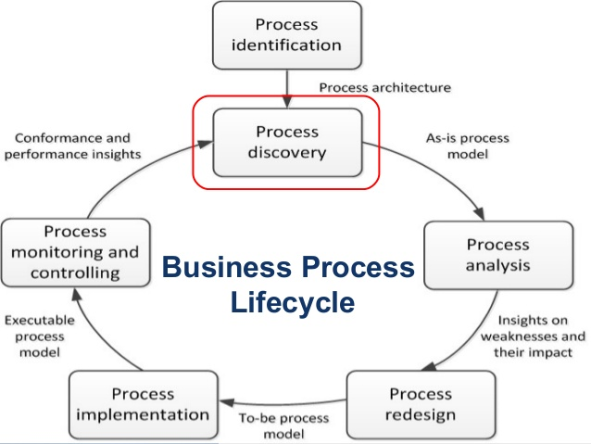

Slide 4
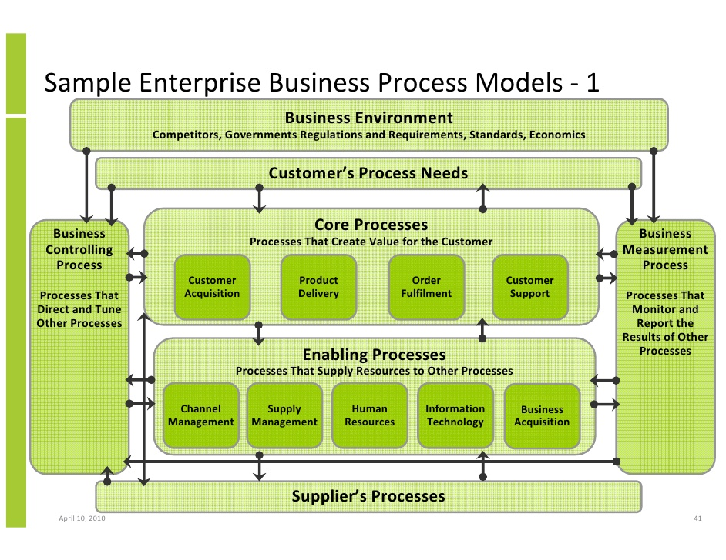

Slide 5
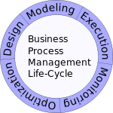
BPM Life Cycle

Slide 6
What is CMMI?
CMMI (Capability Maturity Model Integration) is a proven industry framework to improve product quality and development efficiency for both hardware and software
  Sponsored by US Department of Defence in cooperation with Carnegie Mellon University and the Software Engineering Institute (SEI)
  Many companies have been involved in CMMI definition such as Motorola and Ericsson
  CMMI has been established as a model to improve business results
CMMI, staged, uses 5 levels to describe the maturity of the organization, same as predecessor CMM
  Vastly improved version of the CMM
  Emphasis on business needs, integration and institutionalization

Slide 7
CMMI Staged Representation - 5 Maturity Levels
Level 5
Process performance continually improved through incremental and innovative technological improvements.
Optimizing
Level 4
Quantitatively
Managed
Processes are controlled using statistical and other quantitative techniques.
Process Maturity
Level 3
Defined
Processes are well characterized and understood. Processes, standards, procedures, tools, etc. are defined at the organizational (Organization X ) level. Proactive.
Level 2
Managed
Processes are planned, documented, performed, monitored, and controlled at the project level. Often reactive.
Level 1
Initial
Processes are unpredictable, poorly controlled, reactive.

Slide 8
How can CMMI help?
CMMI provides a way to focus and manage hardware and software development from product inception through deployment and maintenance, product life cycle.
  ISO/TL9000 are still required. CMMI interfaces well with them. CMMI and TL are complementary - both are needed since they address different aspects. TL 9000 is a quality management system built on ISO 9001 and the eight quality principles but designed specifically for the communications industry.
    ISO/TL9000 is a process compliance standard
    CMMI is a process improvement model
Behavioral changes are needed at both management and staff levels. Examples:
  Increased personal accountability
  Tighter links between Product Management, Development, SCN, etc.
Initially a lot of investment required – but, if properly managed, we will be more efficient and productive while turning out products with consistently higher quality.

Slide 9
Example
For the Requirements Management Process Area:
An example of Goal (required):
“Manage Requirements”
An example of Practice to support the Goal (required):
“Maintain bi-directional traceability of requirements”
Examples (suggested, but not required) of typical Work Prcedures might be
Requirement's traceability matrix or
Requirements tracking system

Slide 10
Maturity Level 1
Maturity Level 1 deals with performed processes.
Processes are unpredictable, poorly controlled, reactive.
The process performance may not be stable and may not meet specific objectives such as quality, cost, and schedule, but useful work can be done.

Slide 11
Maturity Level 2
Managed at the Project Level
Maturity Level 2 deals with managed processes.
A managed process is a performed process that is also:
  Planned and executed in accordance with policy
  Employs skilled people
  Adequate resources are available
  Controlled outputs are produced
  Stakeholders are involved
  The process is reviewed and evaluated for adherence to requirements
Processes are planned, documented, performed, monitored, and controlled at the project level. Often reactive.
The managed process comes closer to achieving the specific objectives such as quality, cost, and schedule.

Slide 12
Maturity Level 3
Defined at the Organization Level
Maturity Level 3 deals with defined processes.
A defined process is a managed process that:
  Well defined, understood, deployed and executed across the entire organization. Proactive.
  Processes, standards, procedures, tools, etc. are defined at the organizational (Organization X ) level. Project or local tailoring is allowed, however it must be based on the organization’s set of standard processes and defined per the organization’s tailoring guidelines.
Major portions of the organization cannot “opt out.”

Slide 13
CMMI Resources
Software Engineering Institute's CMMI website:
  http://www.sei.cmu.edu/cmmi/

Slide 14
BPM and BPeM
Business Process Management is a holistic management concept to improve a company's performance and profitability, which has an impact on everybody within a company. However, a holistic BPM approach is always a combination of BPM methods and applications and BPM technology.
Business Process Management (BPM) and Business Performance Management (BPeM) carry the same acronym but are inter-related.
Business Performance Management is not the Same as Business Process Management. Many Managers struggle with performance management versus process management. The two are very connected but also very different. You have to get the process right to better focus your time, energy and efforts on what really matters – performance.

Slide 15
BPeM and BI
Business Performance Management(BPeM) is a measuring tool to assess the performance in real time.
BI(Business Intelligence) is a set of processes, architectures, and technologies that convert raw data into meaningful information that drives profitable business actions. It is a suite of software and services to transform data into actionable intelligence and knowledge.
BI is a crucial element of BPeM.
Prof Sathyamurthy Sir will discuss BI in more detail

Slide 16
Business Performance Management (BPeM) Overview
Business Performance Management (BPeM) is…
A real-time system that alerts managers to potential opportunities, impending problems, and threats, and then empowers them to react through models and collaboration.
Also called, corporate performance management (CPM by Gartner Group), enterprise performance management (EPM by Oracle), strategic enterprise management (SEM by SAP)

Slide 17
Business Performance Management (BPeM) Overview
BPM refers to the business processes, methodologies, metrics, and technologies used by enterprises to measure, monitor, and manage business performance.
BPM encompasses three key components
  A set of integrated, closed-loop management and analytic processes, supported by technology
  Tools for businesses to define strategic goals and then measure/manage performance against them
  Methods and tools for monitoring key performance indicators (KPIs), linked to organizational strategy

Slide 18
Business Performance Management(BPeM)
Business Performance Management (BPeM)
links strategy to execution
  Strategize: Where Do We Want to Go?
  Plan: How Do We Get There?
  Monitor: How Are We Doing?
  Act /Adjust: What Do We Need to Do Differently?
Question for the class?
Describe some of the best practices in planning and management reporting?

Slide 19
Performance Measurement
Key performance indicator (KPI)
Outcome KPI’s vs. Driver KPI’s
(lagging indicators (leading indicators
e.g., revenues) e.g., sales leads)
Operational areas covered by driver KPI’s
  Customer performance
  Service performance
  Sales operations
  Sales plan/forecast

Slide 20
BPM Methodologies
1. Balanced scorecard (BSC) - A performance measurement and management methodology that helps translate an organization’s financials, customer, internal process, and learning and growth objectives and targets into a set of actionable initiatives
2. Six Sigma - A performance management methodology aimed at reducing the
number of defects in a business process to as close to zero defects per million
opportunities (DPMO) as possible
  The DMAIC performance model
  A closed-loop business improvement model that encompasses the steps of defining, measuring, analyzing, improving, and controlling a process
  Lean Six Sigma - Lean manufacturing / lean production
  3. Performance Dashboards.

Slide 21
BPeM versus BI
BI(Business Intelligence) is a set of processes, architectures, and technologies that convert raw data into meaningful information that drives profitable business actions. It is a suite of software and services to transform data into actionable intelligence and knowledge.
BPeM is an outgrowth of BI and incorporates many of its technologies, applications, and techniques.
The same companies market and sell them.
  BI has evolved so that many of the original differences between the two no longer exist (e.g., BI used to be focused on departmental rather than enterprise-wide projects).
  BI is a crucial element of BPeM.
BPeM = BI + Planning (a unified solution)

Slide 22
BPM Application Service Providers
Leading BPM Application Suits/Vendors
  SAP Business Objects Enterprise Performance Management
  Oracle Hyperion Performance Management
  IBM Cognos BI and Financial Performance Management
  Micro strategy, Microsoft

Slide 23
Performance Dashboards
Dashboards and scorecards both provide visual displays of important information that is consolidated and arranged on a single screen so that information can be digested at a single glance and easily explored

Slide 24
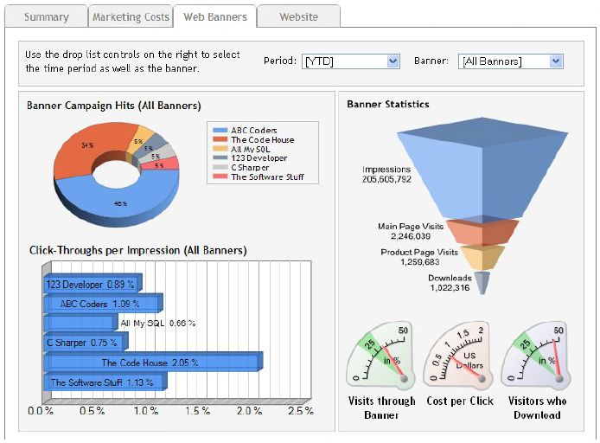
Performance Dashboards

Slide 25
Performance Dashboards
What to look for in a dashboard
  Use of visual components (e.g., charts, performance bars, spark lines, gauges, meters, stoplights) to highlight, at a glance, the data and exceptions that require action
  Transparent to the user, meaning that it requires minimal training and is extremely easy to use
  Combines data from a variety of systems into a single, summarized, unified view of the business
  Enables drill-down or drill-through to underlying data sources or reports
  Presents a dynamic, real-world view with timely data updates
  Requires little, if any, customized coding to implement, deploy, and maintain

Slide 26
Top Domestic BPM Companies
Top domestic BPM companies and their services include:
Genpact Ltd. – finance and accounting, human resources, procurement, legal, media, and IT infrastructure.
Tata Consultancy Services Ltd. – finance and accounting, customer management, analytics, human resources, procurement, IT, cloud, and engineering.
Wipro BPO – human resources, procurement, order management, knowledge processing, finance and accounting, technical and research/analytical services, and customer relationship management.
Infosys BPO – IT platforms, customer relationship management, finance and accounting, human resources, legal processing, sales, and procurement services.
Aegis Ltd. – a branch of Mumbai-based Essar Group; finance and accounting, human resources, spend management, customer relationship management, and engineering.
WNS Global Services (P) Ltd. – customer relationship management, finance and accounting, legal, procurement, analytics, risk management, and transformation services

Slide 27
Top Foreign BPM Companies
Top Foreign BPM companies and their services include:
Serco Global Services (U.K.) – contact center services, back office, finance and accounting, knowledge services, and counseling.
EXL Services (New York) – collections, transaction processing, finance and accounting, customer relationship management, and legal processing.
Convergys (Ohio) – customer service, technical support, back office, outbound, sales, collections, relationship management, analytics, service channels, home agent, and customer interaction technology.
Accenture (Ireland) – procurement or human resources across strategy, digital, technology, .and operations platforms.
Concentrix (California) – analytics, quality assurance and analytics, computer telephony integration, CCSI, knowledge management, and collections.
Sutherland Global Services (New York) – business transformation, knowledge services, front office, services, back office services, and technology-enabled services

