Slide 1

Business Process Outsourcing

Slide 2



Course Objectives
Explain What is Business Process Outsourcing (BPO)
Explain the Need for Business Process Outsourcing (BPO)
Describe the Drivers of the BPO Phenomenon
Explain the Elements to Consider to Outsource a Business Process
Describe the Factors to Consider for Selecting BPO Partner
Explain How to Thrive in Competitive BPO Market
Describe the Effect of BPO on the Workforce
Describe the Effect of Domestic Politics on BPO
Explain What is meant by Reverse Outsourcing
List the Performance Criteria of a BPO Business
Explain the Steps for Measuring Performance of BPO Business
Explain the Benefits of BPO to the Target Countries
Explain the Disadvantages of the BPO Phenomenon
Explain Relevance of Time Management in BPO Management
List the Tips for Efficient BPO Management

Slide 3



Introduction
Leo Trucker is the founder and CEO of Magnacom Electronics Inc., a leading manufacturer of laptops, desktops, tablets etc.

Slide 4


Introduction
Magnacom has a vast database of customers spread throughout the Unites States.

Slide 5


Introduction
As a part it’s after sales service, the company provides customer care service through a few internal sales employees who take care of the customer care also.

Slide 6

Introduction
Magnacom started receiving emails and calls to their office number complaining that their customer service numbers are always busy and so the customers are unable to reach the customer service desk.

Slide 7

Introduction
Management at Magnacom decided that in order to handle the large volumes of calls, they would now need to set-up a proper and dedicated facility center which would serve as the customer service desk.

Slide 8

Introduction
However, the main challenge that Leo and the Management feel that they are facing is the huge amounts of costs and the expertise that would be required to run such as customer service center.

Slide 9

Introduction
Management at Magnacom contemplate on the various options available to them. Vice President of Operations suggests that they should think about ‘outsourcing’ the customer service part of business operations.

Slide 10

Introduction
Everyone thinks that it would be a good idea to ‘outsource’ the customer service part of their business operations.

Slide 11


Introduction
‘Business Process Outsourcing’ or BPO means to contract out the back office operations and get them conducted from an outside supplier.
Let us learn about ‘Business Process Outsourcing’ in detail.

Slide 12

What is Business Process Outsourcing (BPO)?
In recent years, the term Business Process Outsourcing or BPO has gained prominence and the trend of outsourcing back office operations to countries such as China, India and Philippines along with other countries in Asia has taken center stage.
In recent years, there has been a growth in BPO with more western firms outsourcing to the Asian and other countries.

Slide 13
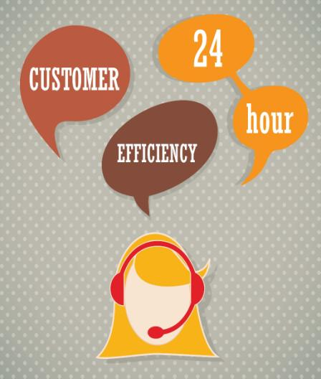
Why Business Process Outsourcing (BPO)?
Another factor for the advent of BPO is that the BPO employees in China, Philippines, India and other Asian countries are proficient in English and with some training can be taught to talk in an American accent or a British Accent.

Slide 14

BPO and the Global Economy
In recent years, the BPO phenomenon has accompanied the increasing globalization of the world economy and has spawned a shift in the way the United States and Europe view the developing countries of the East.
For instance, the increasing movement of companies wishing to outsource their back office work to India and Philippines has meant that the people in the West have a favorable impression of the work ethic and professionalism of the Asian countries.

Slide 15
Drivers of the BPO Phenomenon
The following are the key drivers of the BPO Phenomenon:
Globalization
Economics
Geopolitics
Demographics
Let us look at each in detail.

Slide 16


Role of Selecting the Right Partner in BPO
A business must use an effective outsourcing plan for the selection of companies to achieve outsourcing objectives.

Slide 17
Stage of Business Life Cycle
The various factors to consider for selecting your BPO Partner are:
1
Nature of Process
Selecting the right BPO Partner for outsourcing your business process largely depends upon the stage of the process in business life cycle.
    Initially, you can start by outsourcing processes that are at a lower level in your business life cycle before moving onto outsourcing high value processes.
2
Type of Market
3
Stage of Business Life Cycle
3
Stage of Business Life Cycle
4
Budget
5
Partial vs. Complete
Let us look at each in detail.

Slide 18


How to Thrive in Competitive BPO Market?
Today’s BPO market is full of cutting edge competition. With the advent of technology, there are new BPO services being launched every day. Hence, what may be the latest feature of your BPO’s service offering may become an obsolete feature the next day. So, it is critical that you should learn how to not only survive but also thrive in a highly competitive BPO market.

Slide 19

Increase in Profit Margins
Increase in Profit Margins
Increase in Profit Margins:
  Finally, in these recessionary times, any cost savings is welcome and BPO offers the recession hit companies in the West a fool proof way of increasing their profitability and margins.

Slide 20

Effect of BPO on the Workforce
Let us now understand the effect that the BPO sector has had on the lifestyles of the workforce and the effect that working in such an industry has had on their professional lives.
With the advent of the BPO sector in countries in Asia, numerous young men and women were exposed to the high life with fat pay checks and humungous perks that included the best of what was available.

Slide 21

Effect of Global Financial Crisis on BPO Sector
Many companies that have suffered because of the ongoing global economic crisis and have not received assistance from the government have decided to curtail the outsourcing budgets whereas others who have been bailed out by the government have decided to increase outsourcing as a means of cutting costs.

Slide 22

What is meant by Reverse Outsourcing?
  ‘Reverse Outsourcing’ is the latest trend in outsourcing. Gone past are the days when outsourcing meant a steady stream of jobs being shipped to India and other Asian countries. Now the trend is for such Indian companies to create jobs in the West.
  This phenomenon which is gathering pace in recent times is known as ‘Reverse Outsourcing’ or the trend of Indian IT and BPO companies opening offices in the US and Europe to employ locals there.

Slide 23

BPO Partner Management
In recent times, there has been a marked movement towards outsourcing positions within the businesses to BPO partners who would supply resources for the required jobs.
These positions and roles are deemed to be those that can be performed by external resources.
The BPO partners step in to do the job that has been outsourced.
The phenomenon of using BPO partners for regular positions is becoming popular and it is common to see many of these temporary workers doing the work that would have otherwise been done by full time employees of the business.

Slide 24


ManagementStudyGuide.com
This is a DEMO Course On – Business Process Outsourcing.
The Complete PPT consists of 184 Slides.
Become a Member and Get Access to Complete Powerpoint Presentations for more than 150 Subjects.
What You Get:
View All Courses Online.
Download Power-point Presentation for Each Course.
Do the Knowledge Checks for Each Course.

