Slide 1


Service level agreement
Abhinav Sabharwal visiting faculty @ ITM

Slide 2
What we will cover in this Presentation
INTRODUCTION TO SLA
WHY ARE SLAS IMPORTANT
EVOLUTION OF SLA
WHO NEEDS SLA
KEY COMPONENTS OF AN SLA
TYPES OF SLAS
VALIDATING SLA LEVELS
INDEMNIFICATION CLAUSES IN SLA
SLA PERFORMANCE METRICS
PENALTIES
SLA METRICS
EARN BACKS
WHEN TO REVISE AN SLA

Slide 3
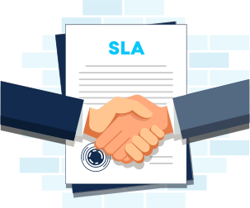
Service level agreements
A service-level agreement (SLA) sets the expectations between the service provider and the customer and describes the products or services to be delivered, the single point of contact for end-user problems, and the metrics by which the effectiveness of the process is monitored and approved.
Understanding not only what you are having an outsourcer do for you, but the level of service you are getting, is vital. Imagine hiring someone to provide all of your meals and they thought you only wanted one small meal a day. You'd probably be disappointed, not to mention hungry. Service levels are designed to ensure the services the client gets will meet their expectations

Slide 4
Why are SLAs important
Service providers need SLAs to help them manage customer expectations and define the severity levels and circumstances under which they are not liable for outages or performance issues. Customers can also benefit from SLAs because the contract describes the performance characteristics of the service -- which can be compared with other vendors' SLAs -- and sets forth the means for redressing service issues.
The SLA is typically one of two foundational agreements that service providers have with their customers. Many service providers establish a master service agreement to establish the general terms and conditions in which they will work with customers.

Slide 5
Evolution of sla
When IT outsourcing emerged in the late 1980s, SLAs evolved as a mechanism to govern such relationships. Service-level agreements set the expectations for a service provider's performance and established penalties for missing the targets and, in some cases, bonuses for exceeding them. Because outsourcing projects were frequently customized for a particular customer, outsourcing SLAs were often drafted to govern a specific project
As managed services and cloud computing; services become more prevalent, SLAs evolve to address the new approaches. Shared services, rather than customized resources, characterize the newer contracting methods, so service-level commitments are frequently used to produce broad agreements that are intended to cover all of a service provider's customers.

Slide 6
Who needs a service-level agreement
SLAs are thought to have originated with network service providers but are now widely used in a range of IT-related fields. Some examples of industries that establish SLAs include IT service providers and managed service providers, as well as cloud computing and internet service providers.
Corporate IT organizations, particularly those who have embraced IT service management, enter SLAs with their in-house customers -- users in other departments within the enterprise. An IT department creates an SLA so that its services can be measured, justified and perhaps compared with those of outsourcing vendors.

Slide 7
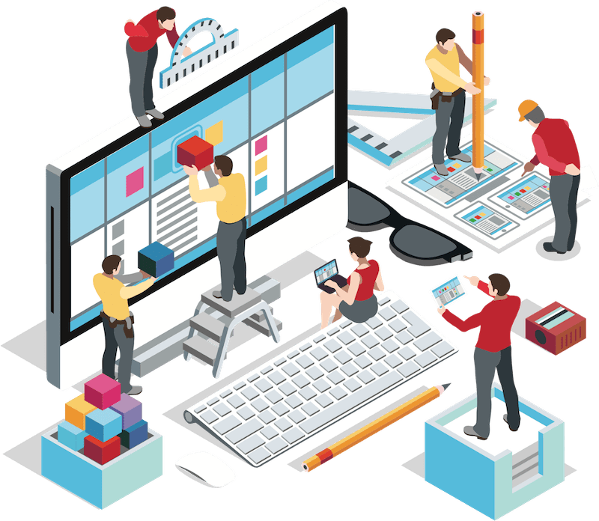
Key components of an SLA
Agreement overview. This first section sets forth the basics of the agreement, including the parties involved, the start date and a general introduction of the services provided.
Description of services. The SLA needs detailed descriptions of every service offered, under all possible circumstances, with the turnaround times included. Service definitions should include how the services are delivered, whether maintenance service is offered, what the hours of operation are, where dependencies exist, an outline of the processes and a list of all technology and applications used.
Exclusions. Specific services that are not offered should also be clearly defined to avoid confusion and eliminate room for assumptions from other parties.
Service performance. Performance measurement metrics and performance levels are defined. The client and service provider should agree on a list of all the metrics they will use to measure the service levels of the provider.
Redressing. Compensation or payment should be defined if a provider cannot properly fulfill their SLA.
Stakeholders. Clearly defines the parties involved in the agreement and establishes their responsibilities.

Slide 8
Key components of an SLA
Security. All security measures that will be taken by the service provider are defined. Typically, this includes the drafting and consensus on antipoaching, IT security and nondisclosure agreements.
Risk management and disaster recovery. Risk management processes and a disaster recovery plan are established and clearly communicated.
Service tracking and reporting. This section defines the reporting structure, tracking intervals and stakeholders involved in the agreement.
Periodic review and change processes. The SLA and all established key performance indicators (KPIs) should be regularly reviewed. This process is defined as well as the appropriate process for making changes.
Termination process. The SLA should define the circumstances under which the agreement can be terminated or will expire. The notice period from either side should also be established.
Signatures. Finally, all stakeholders and authorized participants from both parties must sign the document to show their approval of every detail and process

Slide 9

types of SLAs
There are three basic types of SLAs: customer, internal and multilevel service-level agreements.
A customer service-level agreement is between a service provider and its external customers. It is sometimes called an external service agreement.
An internal SLA is between an organization and its internal customer -- this could be another organization, department or site.
A multilevel SLA will divide the agreement into various levels that are specific to a series of customers using the service. For example, a software as a service (SaaS) provider might offer basic services and support to all customers using a product, but they could also offer different price ranges when buying the product that dictates different service levels. These different levels of service will be layered into the multilevel SLA.

Slide 10
customer-based SLA
In a customer-based SLA, the customer and service provider come to a negotiated agreement on the services that will be provided. For example, a company may negotiate with the IT service provider that manages its accounts payable system to define their specific relationship and expectations in detail.
A customer service-level agreement includes:
exact details of the service expected by the customer;
provisions of the service availability;
standards for each level of service;
each party's responsibilities;
escalation procedures; and
terms for cancellation.

Slide 11
Internal SLA
An internal SLA is between an organization and its internal customer -- this could be another organization, department or site.
That means that although a company could have an SLA open with each of its customers, it might also have a separate SLA between its marketing and sales departments.
For instance, a company's sales department has nearly $10,000 worth of sales every month, with each sale worth $500. If the sales team's average closing rate is 20%, then sales knows that marketing must deliver at least 100 qualified leads every month.
So, the head of the organization's marketing department can work with the head of the sales department on an SLA that stipulates that the marketing department will deliver 100 qualified leads to the sales director by a specific date every month.
This service-level agreement could stipulate that it will include four weekly status reports every month sent from marketing to sales to ensure the leads the sales team is getting are enabling them to hit their monthly sales goal.

Slide 12
Multilevel SLAs
A multilevel SLA will divide the agreement into various levels that are specific to a series of customers using the service. For example, a software as a service (SaaS) provider might offer basic services and support to all customers using a product, but they could also offer different price ranges when buying the product that dictates different service levels. These different levels of service will be layered into the multilevel SLA.
Example of an SLA is an internet service provider service-level agreement. This SLA will include an speed which is provided to customer but also how much data customer can consume in given month

Slide 13

validating SLA levels
Verifying the provider's service delivery levels is necessary to the enforcement of a service-level agreement. If the SLA is not being properly fulfilled, then the client may be able to claim the compensation agreed upon in the contract.
Most service providers make their service-level statistics available through an online portal. This allows customers to track whether the proper service level is being maintained. If they find it is not, the portal also allows clients to see if they're eligible for compensation.
These systems and processes are frequently controlled by specialized third-party companies. If this is the case, then it is necessary for the third party also to be included in the SLA negotiations.
Tools that automate the capturing and displaying of service-level performance data are also available.

Slide 14

indemnification clauses
An indemnification is a contractual obligation made by one party -- the indemnitor -- to redress the damages, losses and liabilities experienced by another party -- the indemnitee -- or by a third party. Within an SLA, an indemnification clause will require the service provider to acknowledge that the customer is not responsible for any costs incurred through violations of contract warranties. The indemnification clause will also require the service provider to pay the customer for any litigation costs from third parties that resulted from the contract breach.

Slide 15
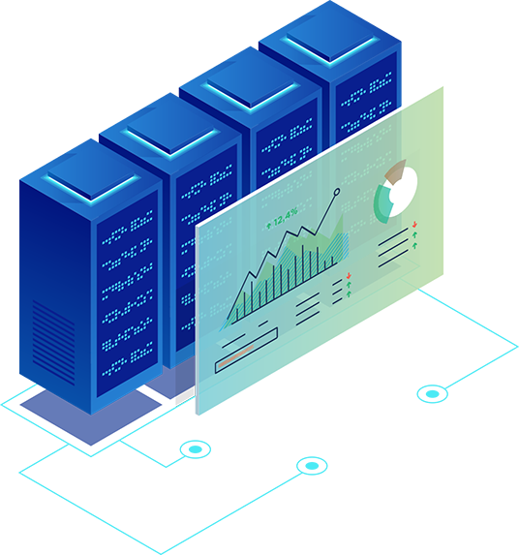
SLA performance metrics
SLAs include metrics to measure the service provider's performance. Because it can be challenging to select metrics that are fair to the customer and the service provider, it's important that the metrics are within the control of the service provider. If the service provider is unable to control whether a metric performs as specified, it's not fair to hold the vendor accountable for that metric.
And it should be easy to accurately collect the data for the metrics -- capturing the data automatically would be best. In addition, the SLA should specify a reasonable baseline for the metrics, which can be refined when more data is available on each metric.
SLAs establish customer expectations regarding the service provider's performance and quality in several ways.

Slide 16
SLA metrics
When choosing which performance metrics to include in the SLA, a company should consider the following factors.
The measurements should motivate the right behavior. When defining the metrics, both parties should remember that the metrics' goal is to motivate the appropriate behavior on behalf of the service provider and the customer.
The metrics should only reflect factors that are within the service provider's reasonable control. The measurements should also be easy to collect. Furthermore, both parties should resist choosing excessive amounts of metrics or measurements that produce large amounts of data. However, including too few metrics can also be a problem, as missing one could make it look like the contract has been breached.

Slide 17

Penalties
Service-level agreements include agreed-upon penalties in the event a service provider doesn't meet the agreed-upon service levels. These remedies could be fee reductions or service credits against the fees incurred by the customer, as well as termination of the contract for repeated failures.
Customers can enforce these service credits when service providers miss agreed-upon performance standards. Typically, the customer and the service provider agree to put a certain percentage of the monthly fees at risk. The service credits are taken from those at-risk fees when the vendor misses the SLAs.

Slide 18

Earn backs
An earn back is a provision that may be included in the SLA that allows providers to regain service-level credits if they perform at or above the standard service level for a certain amount of time. Earn backs are a response to the standardization and popularity of service-level credits.
Service-level credits, or, simply, service credits, should be the sole and exclusive remedy available to customers to compensate for service-level failures. A service credit deducts an amount of money from the total amount to be paid under the contract if the service provider fails to meet service delivery and performance standards.
If both parties agree to include earn backs in the SLA, then the process should be defined carefully at the beginning of the negotiation and integrated into the service-level

Slide 19
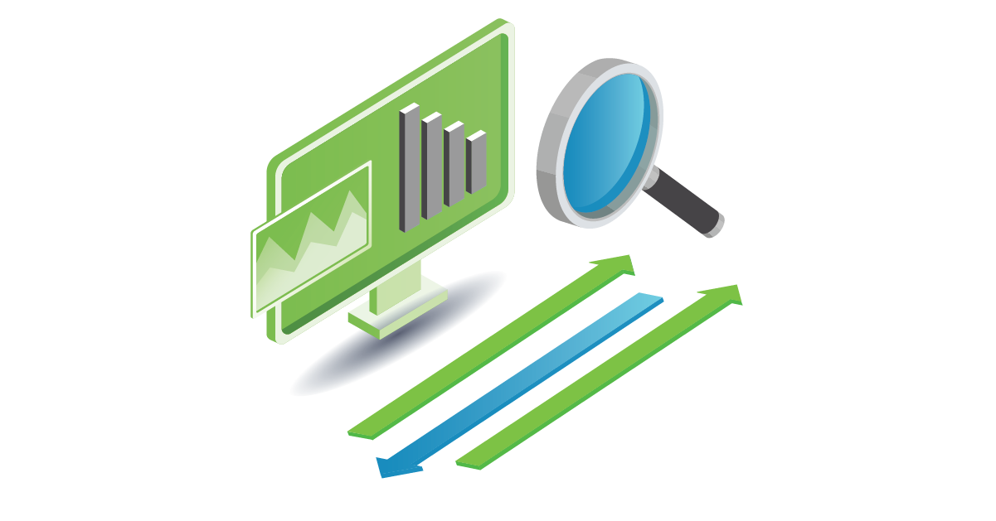
When to revise an SLA
A service-level agreement isn't a static document. Rather, an SLA should be updated and reviewed regularly with new information. Most companies revise their SLAs either annually or bi-annually. However, the faster an organization grows, the more often it should review and revise its SLAs.
Knowing when and when not to make changes in an SLA is a key part of managing the client/service provider relationship. The two parties should meet on a set schedule to revisit their SLA and ensure it's still meeting the requirements of both parties.

Slide 20
When to revise an SLA
A service-level agreement isn't a static document. Rather, an SLA should be updated and reviewed regularly with new information. Most companies revise their SLAs either annually or bi-annually. However, the faster an organization grows, the more often it should review and revise its SLAs.
Knowing when and when not to make changes in an SLA is a key part of managing the client/service provider relationship. The two parties should meet on a set schedule to revisit their SLA and ensure it's still meeting the requirements of both parties.

