Slide 1


BPO service models
Abhinav Sabharwal visiting faculty @ ITM

Slide 2
What we will cover in this Presentation
INTRODUCTION TO BPO MODELS
BUILD-OPERATE-TRANSFER
VARIATIONS OF B-O-T MODEL
STAGES OF THE BOT MODEL
PROS & CONS OF BUILT-OPERATE-TRANSFER
SOFTWARE DEVELOPMENT OUTSOURCING MODELS
SHARED SERVICES
GBS

Slide 3
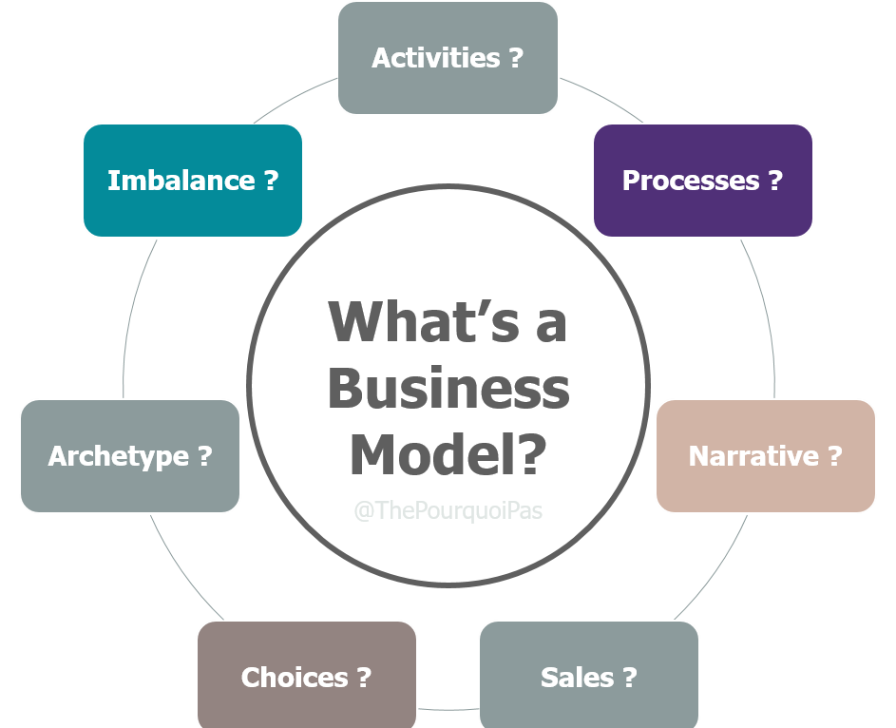
BPO Business MODEL
There are different types of BPO Business Models today we will look at 5 of them
The Philippines Department of Trade and Industry (DTI) defines BPO as the “delegation of service-type business processed to a third-party service provider.” The industry is generally divided into the following sectors: Contact centers, back office services, data transcription, animation, software development

Slide 4

Build-Operate-Transfer
Build-Operate-Transfer is an arrangement found in the outsourcing industry and across other sectors in a technical sense, is a type of concession arrangement wherein ‘Entity A’ delegates the right to build and operate a particular project ‘Entity B’ within a certain period.
This timeframe allows Entity B to recuperate their investment and profits while Entity A gets a more established business after the turnover.
The BOT setup is typical for government projects such as infrastructure. A common example would be the construction of expressways where the government gives the right to build and operate the expressway in favor of a private business.
In return, the private entity shall finance the project and enjoy the revenues they can derive within the contract frame. After the given period, the private entity shall be obliged to transfer the ownership back to the government.

Slide 5
How Build-Operate-Transfer contracts work
A private business is granted a concession by a government to finance, develop, and run a project under a build-operate-transfer (BOT) contract.
Once the corporation has recouped its investment, the government assumes management of the project and runs it for a set amount of time.
In general, BOT contractors are organizations founded for a specific project and only for that reason.
A single offtake purchaser often provides all of a contractor’s revenue during the project period, when the project is being

Slide 6
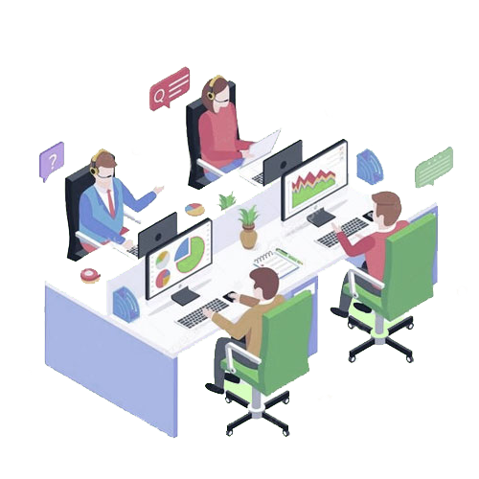
Build-Operate-Transfer in outsourcing
A Build-Operate-Transfer arrangement enables entities with limited capital and financing to implement their projects with the help of another entity who is willing to start the project.
This type of outsourcing gives way to a broader range of resources and talent, which could contribute to a better and well-thought-out project – read our full BOT article for more information.
A BOT arrangement can take on many forms, but in its simplest and most common form, it is the mutual understanding that a BPO will help build a team and operations for a client and that one day, the client might take that team out on their own and incorporate, or become a ‘captive’.
Outsource Accelerator can help set up your BOT arrangement with the outsourcing supplier to ensure that the best terms and prices are provided for your business.

Slide 7
How does Build-Operate-Transfer (BOT) work?
In general, the BOT model helps businesses contribute to the economy of a country by putting up infrastructures for the government to attract foreign investors.
With this model, different infrastructures such as roads, government offices, and public institutions are built and maintained for public and business use.
However, BOT doesn’t just exist in private and public partnerships. It also gained popularity in outsourcing as a way to expand

Slide 8
Variations of B-O-T MODEL
Build-own-operate-transfer (BOOT): A company owns and operates the facility to recover the investment costs while gaining margin profit on the project. This method usually involves large infrastructure projects done through private funding.
Build-own-operate (BOO): Here, a private organization builds, owns, and operates a part of a facility with encouragement from the government. In return, the organization receives financial incentives such as tax-exempt status. This mostly applies to BPO companies in different countries.

Slide 9
Variations of B-O-T MODEL
Build-lease-transfer (BLT):Upon completion of a project, the company sets a joint venture agreement with the public sector for the ownership of the facility. Then they will lease it back for a minimum of 10 years to operate as a business. This is usually common in healthcare facilities and institutions
Build-lease-operate-transfer (BLOT):Lastly, in this method, the private organization builds and operates a facility in a publicly leased land for a limited time. Once the lease duration is due, the organization transfers back the leased land to the public institution that owns it.

Slide 10
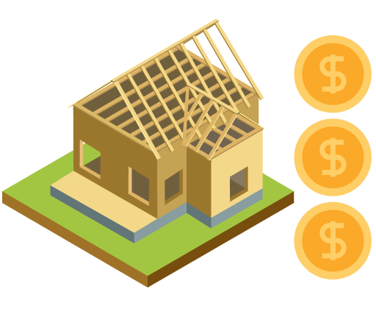
Stages of the BOT model in outsourcing
BUILD STAGE: During the “build” stage, the third party provides the required documents for renting or leasing an office space. This includes the set up of internet, electricity, and network for the team. Also, they will include the equipment needed such as desktops, phones, and office supplies.
Then, the outsourcing provider starts hiring the employees needed. Here, they will provide human resource management services such as training, onboarding, documentary compliance, and payroll.

Slide 11
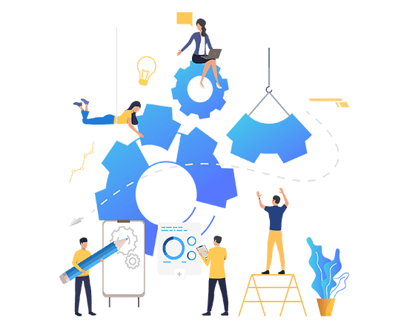
Stages of the BOT model in outsourcing
OPRATE STAGE: The “operate” stage is where the management of the entire operation starts. The project develops along with the leased staff and the office.
Outsourcing provider takes care of managing the progress according to the metrics and indicators provided by the company. Employees also get to improve their skills and knowledge with continuous training and onboarding of tools and services used in their operations.
The company handles the operation for a certain period. Usually, the process takes at least three to five years, depending on their agreed term. After that, when the client is ready, the entire operation, along with the facilities and manpower, is transferred to them.

Slide 12

Stages of the BOT model in outsourcing
TRANSFER STAGE: Lastly, for the “transfer” stage, the company takes over the operation. Here, the outsourcing partner turns the team, processes, metrics, and office over to the company. They may still rely on their outsourcing partner for support under a new engagement model or fully take over the operations.

Slide 13

Pros of Built-Operate-Transfer
Short setup time: Companies save up time and effort in building their team on their own. As a result, they can focus more on building up strategies to make their business grow.
Shared knowledge and resources: Companies can learn from their service provider on setting up a team. They even share the resources used during building and operation.
Access to a larger talent pool: Hiring an offshore service provider allows them to access a large talent pool of employees. With this, they can have a wider insight into how a task is done.
Low building and operation risk: With BOT, they won’t have to worry about the documentary requirements they need in building and operating an offshore team. Their service provider will do it for them.

Slide 14
Cons of Build-Operate-Transfer
Long-term employee retention: Upon transfer, employees now require long-term retention to the company. This setup is not ideal when a role has a specific demand and they decide to scale down.
Operational retention risks: When a team transfers, companies should comply with a long process of documentation. This consumes time, effort, and expertise since they deal with legalities.
Higher transfer rates: Some service providers charge a higher rate for BOT. With this, companies should make sure to plan their offshore operations and how they would handle it.
Cultural differences: Lastly, companies and their offshore teams might experience culture shock since they come from different countries and cultures. To prevent this, companies should get to know their teams and teach their culture to better understand each other.

Slide 15
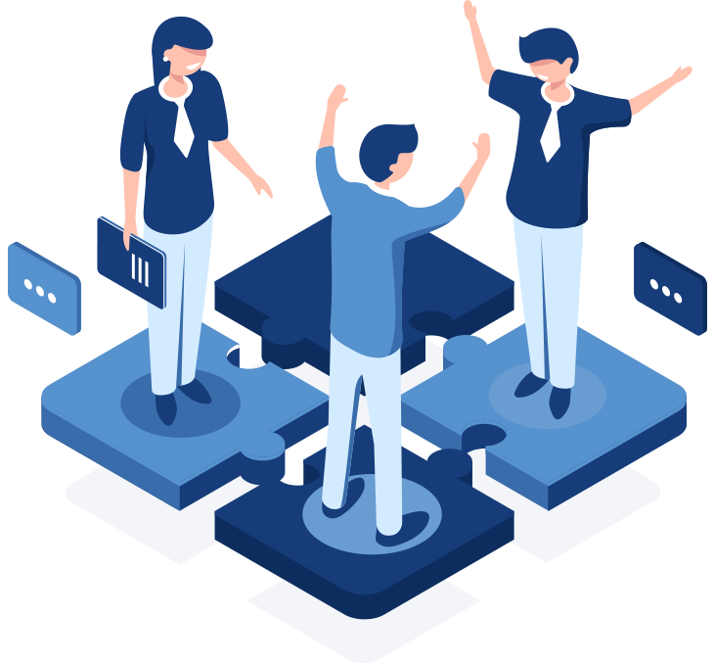
Common outsourced services suited for BOT
Most tasks that can be outsourced can be relevant for BOT. However, not all of these work effectively. Some are better outsourced differently. The most common services applied through BOT include:
SELF-MANAGED SERVICES :Typically offshore operations that are self-managed (i.e. the day-to-day operations are managed by the client), are the ideal candidate for eventual BOT. If the client is managing most, or all, of the day-to-day operations, then there is little difference in moving to an entirely self-managed environment. Though, it is easy to overlook all of the activity that goes on in maintaining a facility and ensuring employee compliance.
CUSTOMER SERVICE: This is one of the most common services that can be outsourced either through BOT or BPO. Most companies, to help their customer service team handle their customers better, hire them through BOT. This is to have more hands-on training and supervision to improve their services.

Slide 16
Common outsourced services suited for BOT
IT NETWORK: IT outsourcing through BOT has become popular for tech companies in the West. This includes setting up a cloud network for employees of organizations for a better workflow. Companies often outsource their IT network management to countries like the Philippines and Poland to save on costs and assure better security.
SOFTWARE DEVELOPMENT. After being built by an offshore team, software and system management are turned over to its clients for handling and distribution. With this, some companies retain the team to do software and system maintenance since they are already involved in the project.
WEB DEVELOPMENT: Same with software, website management is usually turned over to the client after setting up. One of the reasons service providers transfer the team to the client is to help them better with maintaining and improving the security of their websites and databases.

Slide 17
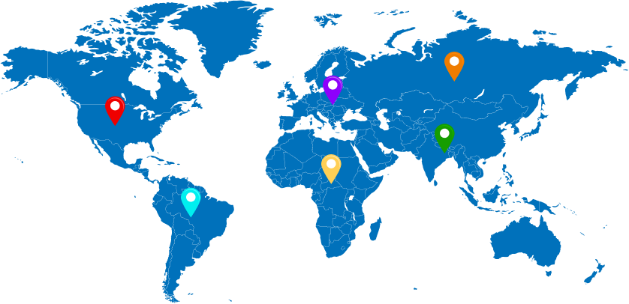
Software development outsourcing models
ONSHORE/ONSITE MODEL = NEAR BUT EXPENSIVE
Fundamentally, onshore/onsite software development model is an outsourcing option that is the nearest to your place.
In general, onshore/onsite software development model is working with outsourcing companies that are located in your area.
The advantages of onshore software development model are that you can work with native teams and have no problem with communication. However, the cost is a huge
Disadvantage for this option, a US developer cost you at least about 5000USD/ month. However, high cost does not always guarantee an adequate result. Offshore and near shore development model cost much less and may bring you the same or even better result

Slide 18
Software development outsourcing models
OFFSHORE/OFFSITE = INEXPENSIVE, FLEXIBILITY BUT DIFFICULT TO WORK VIRTUALLY
Offshore/offsite software development model is outsourcing teams from abroad, far from your place.
The core advantage of this model is the reasonable expense.
The disadvantages of this model are the lack of direct communication, the culture and time-zone difference. However, today’s technology can help direct meeting through Skype or Zoom and solve all the problems through lots of solutions.
It’s important to make sure the project architecture quality is high and the standard of the result is right because there are a lot of cases where offshore model locates in a country that the standard is low.

Slide 19
Software development outsourcing models
Nearshore model = affordable, near and frequent visit
Nearshore software development model is an outsourcing team from neighbour countries.
For example, you live and work in the EU and you have a team in the US, or you live in Canada and have a team in the US or Mexico, vice versa.
Nearshore outsourcing saves some cost over onshore and adds benefits of more frequent site visits than offshore.
However, it’s not really the best choice because you actually just choose the average cost option, a medium choice, it feels safe but so so.

Slide 20
Software development outsourcing models
HYBRID/DUAL MODEL = SUPER FLEXIBLE AND COVER ALL THE DISADVANTAGES.
Hybrid/Dual software development model is the mixing of 2 or 3 of the models above, depends on the condition of the projects, they may have all kind of teams: onshore/onsite, offshore/offsite or nearshore/nearsite to provide whatever customer wants.
This flexible model can cover all the disadvantages and also give you more than you expected. Hybrid model brings our clients the highest quality software with all the benefits of a global cost structure.

Slide 21
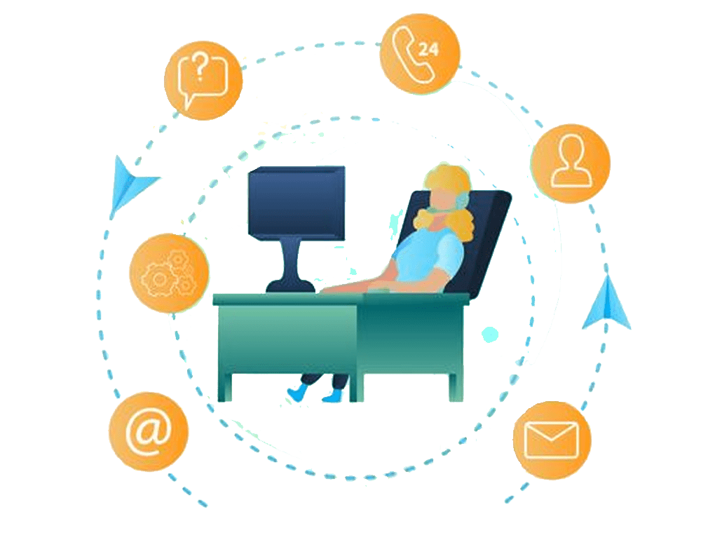
Shared Services
There is a lot of confusion in the marketplace surrounding outsourcing, offshoring and shared services.
Journalists (particularly in election years) often use the word outsourcing when describing the perceived dangers of shifting jobs to low cost countries.
Clearly they are describing the practice of offshoring, but end up declaring outsourcing as a new and dangerous trend.
Outsourcing has been around for centuries, in fact, Pope Julius II outsourced the painting of the Sistine Chapel ceiling to Michelangelo in 1508.

Slide 22
Shared Services
There is similar confusion surrounding outsourcing and shared services.
There are many similarities between outsourcing and shared services.
Outsourcing is the act of contracting with a third party to perform some service. Over the last fifteen years, outsourcing for businesses has grown from traditional outsourcing of facilities management (janitorial services, security, cafeterias) to outsourcing more administrative support functions like Information Technology, Finance and Accounting and yes, Human Resources.

Slide 23
Shared Services
In the late 1980s, the term "Shared Services" was coined by a US multinational and defined as the following:
Shared Services is the delivery of those functions or processes that can be delivered to the corporation from a "shared" delivery model.
This ‘sharing’ not only leverages the delivery of services across business units, but also represents a ‘sharing’ of accountabilities and responsibilities between the shared services organisation and it’s customers.
What’s interesting about this definition is the lack of the notion of "ownership" anywhere in the definition.
It refers to delivery of services to a corporation from a shared delivery model which could just as easily be a third party external to the corporation as an internal organisation

Slide 24
Shared Services
All of these success factors applicable in outsourcing are equally important to an internal shared services organisation.
The main difference between outsourcing and shared services is that often a shared services organisation will not execute a legal contract between themselves and their customers as they have the same parent company.
Another similarity between outsourcing and shared services is that rarely does either organisation take over all of the processes for a given function.
For example, a company outsourcing their Human Resources may have payroll, workforce administration, and recruiting in scope
The company is retaining compensation administration, benefits administration, HR strategy, labour relations, etc. Sometimes these "retained organisations" are organised themselves as a shared service centre, other times the company will retain these processes in various business units

Slide 25
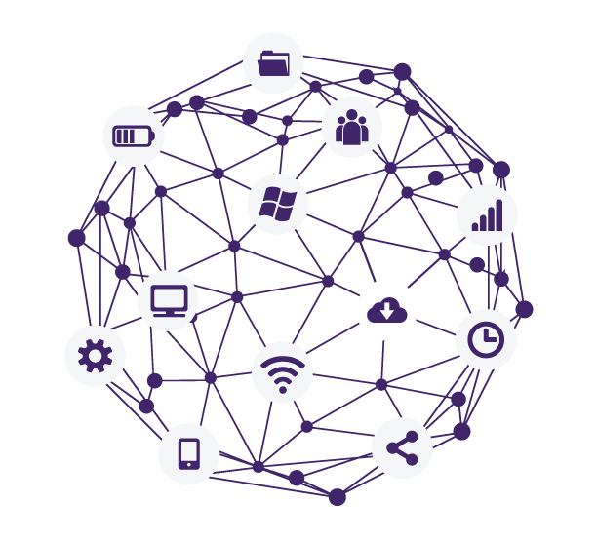
Global Business Services (GBS)
I define GBS as "controlling the delivery of business support functions to the core business through multiple service delivery models on a truly global basis." There are several key words and concepts in this definition that we will explore
Controlling the delivery" is the first key concept. GBS is not about being an organisation that delivers all functions, but to operate at peak efficacy for the enterprise, the GBS orgainsation needs to control the delivery of the functions placed in scope.
The GBS organization can be the umbrella for several functions and have multiple service delivery models in place in various geographies.

Slide 26
Global Business Services (GBS)
Taking HR services as an example, the GBS organisation may elect to have the more transactional processes in Human Resources delivered across the world in a standardised, outsourced model.
They may then elect to have additional HR processes delivered through business partnership models whereby regional or country based HR professionals sit with the business leaders and provide service and advice.
And lastly, they may develop regional shared service centres to deliver those aspects of HR that have been deemed unsuitable for outsourcing and/or business partnership

Slide 27
Global Business Services (GBS)
Just as shared services and outsourcing leverage the management expertise across multiple processes and in the case of outsourcing, multiple clients, GBS can leverage management expertise across all support functions within the enterprise.
This results in economies of scale for expensive talent and more importantly frees up the management team of a business unit to focus on their core competency.
As the number of delivery model alternatives expands, the enterprise is best served by a small team of experts to constantly shift the portfolio of delivery models to take advantage of market dynamics and ensure the portfolio is optimised.
This is very difficult to do in a decentralised, fragmented environment

Slide 28
Global Business Services (GBS)
The last concept is that of multiple delivery models on a truly global basis. We have already touched upon the notion of multiple delivery models for different processes or even geographies.
The truly global concept is often misunderstood. A company operating in every region of the world and 150+ countries is not necessarily global.
Being global entails having global process owners who ensure the key processes around the world are all done in a standardised manner where possible.

Slide 29
Global Business Services (GBS)
Being global means having the ability to shift work and/or employees around the world in the event of a natural disaster or market turbulence.
Being global means having visibility into the key metrics and performance measures in every region of the world.
Being global ensures that best practices developed in one country or region are quickly leveraged in every other region around the world.

